Slide 1
Person Centred Planning
October 2017
Chris Atherton
Senior Educational Psychologist

Slide 2
Visible Learning
John Hattie: “effect sizes” are the best way of answering the question ‘what has the greatest influence on student learning?‘
An effect-size of 1.0 is typically associated with:
Advancing learners' achievement by one year, or improving the rate of learning by 50%
A two grade leap in GCSE, e.g. from a C to an A grade
An effect size of 1.0 is clearly enormous!
(It is defined as an increase of one standard deviation)

Slide 3
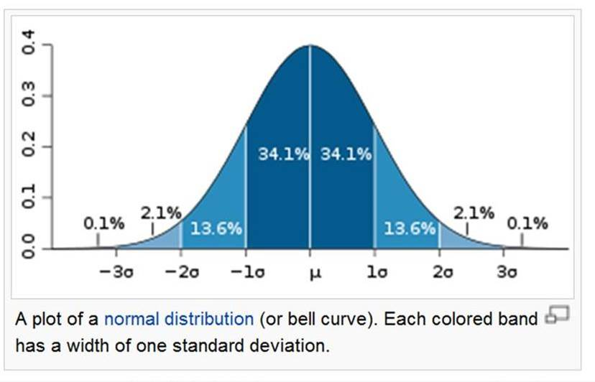
Normal Distribution

Slide 4
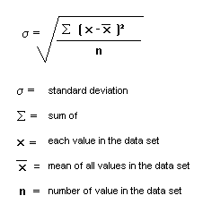
Calculating the Standard Deviation

Slide 5
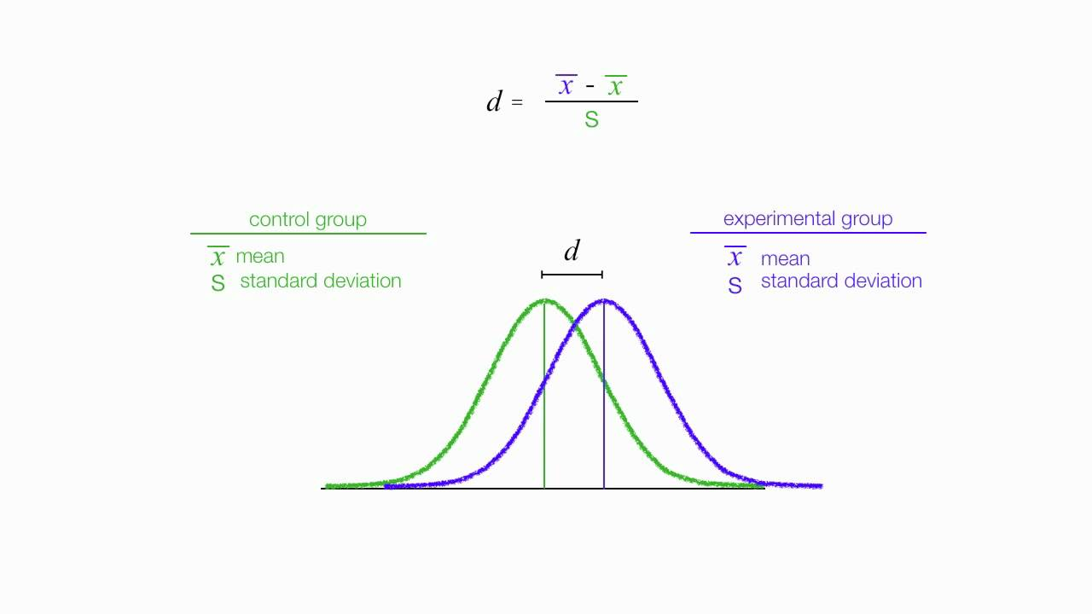
What is an effect size?

Slide 6
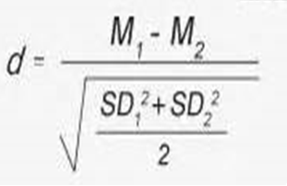
Calculating the Effect Size

Slide 7
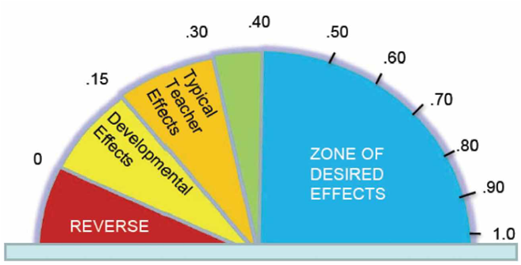
Zone of Desired Effects

Slide 8
Visible Learning
An effect size of 0.5 is equivalent to a one grade leap at GCSE
An effect size of 1.0 is equivalent to a two grade leap at GCSE
Number of effects is the number of effect sizes from well designed studies that have been averaged to produce the average effect size.
An effect size above 0.4 is above average for educational research

Slide 9
Table of Effect Sizes
Influence | Effect Size | Source of Influence
Feedback | 1.13 | Teacher
Student's prior cognitive ability | 1.04 | Student
Instructional quality | 1.00 | Teacher
Direct instruction | .82 | Teacher
Acceleration | .72 | Student
Remediation/feedback | .65 | Teacher
Student's disposition to learn | .61 | Student
Class environment | .56 | Teacher
Challenge of Goals | .52 | Teacher
Peer tutoring | .50 | Teacher
Mastery learning | .50 | Teacher
Homework | .43 | Teacher
Teacher Style | .42 | Teacher
Questioning | .41 | Teacher

Slide 10
Pupil – Teacher Alliance
Pupils and teachers share ownership of the learning process:
  joint formulation of clear, achievable learning goals
  teacher provides feedback on process (not just outcome) to highlight effort and strategies
  learner and teacher experience successful learning through the interaction and sharing of ideas
Notes:
The pupil teacher alliance is also particularly important in the process of dynamic learning because it generates an ethos whereby both parties take ownership of the learning process.
The essential features of this alliance are: ……..

Slide 11
Person Centred Planning
Highly individualised
Focus on strengths, interests and needs
Look beyond a ‘medical model’
People are more than their ‘diagnoses’
Take a holistic view
Focus on achievements, goals and dreams

Slide 12
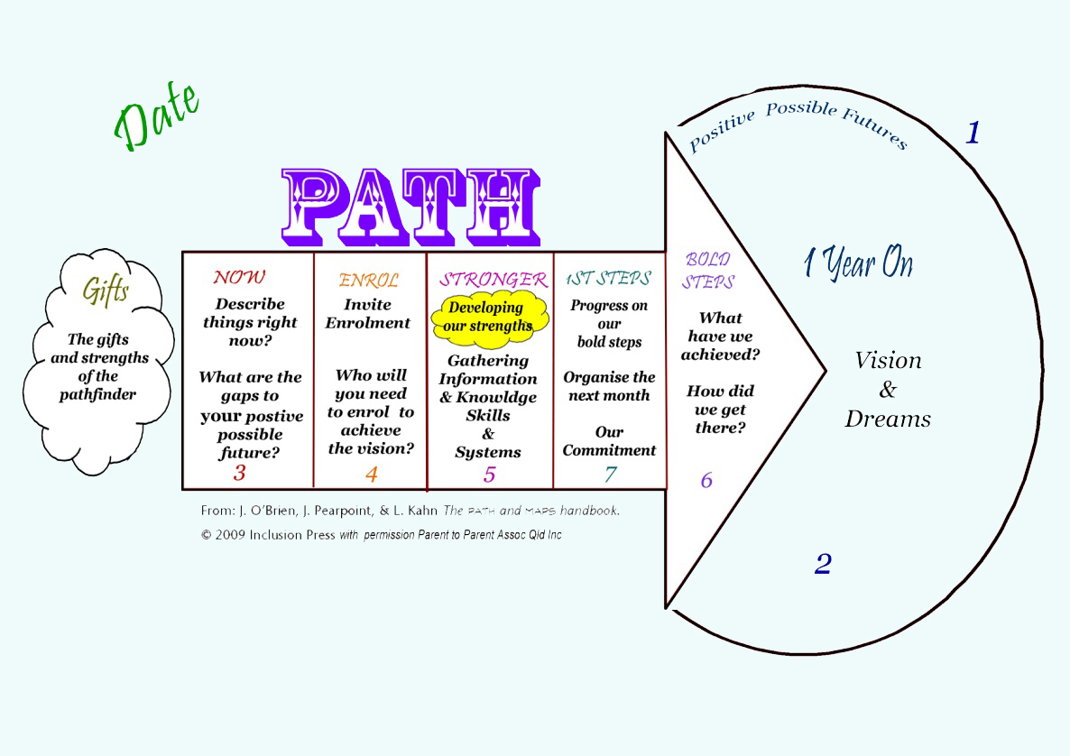
Person Centred Pathway

