Slide 1
ASD Advisors Meeting
29th April 2016
Annie McGauley
Chris Atherton

Slide 2
Hi Annie,
CC can come to the CCC for the PLA on 11th of May at 1.30pm.
If you can confirm ASAP we can remove TBC from the diary and henceforth stop with the acronyms.
Chris.

Slide 3
I can meet at that time
Annie

Slide 4
http://www.bbc.co.uk/news/entertainment-arts-35856814

Slide 5
http://www.bing.com/videos/search?q=stand+by+me+oasis&adlt=strict&qpvt=stand+by+me+oasis&view=detail&mid=175EE70F780D5D0DCEE9175EE70F780D5D0DCEE9&FORM=VRDGAR

Slide 6
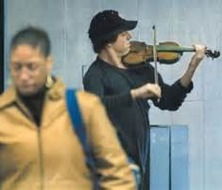
What do you see?
https://www.youtube.com/watch?v=51Rd4tp6wpg

Slide 7
What is this?

Slide 8

What is This?

Slide 9
Damian Hirst

Slide 10
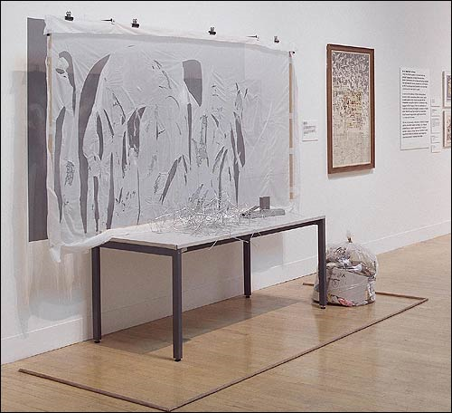
Gustav Metzger
Tate Gallery

Slide 11

Joshua Bell
Washington DC Union Station
$32.17
43 minutes
1 person recognised him out of 1097 passers by.
Usually sells out theatres with an average seat price of $100.

Slide 12
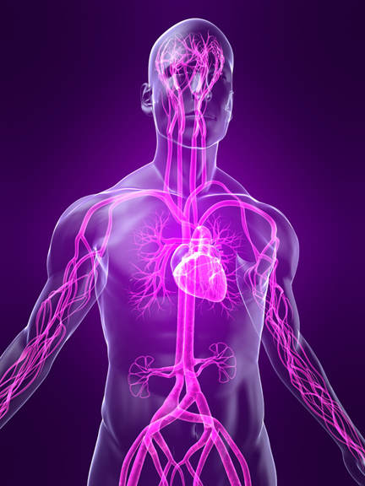
Sensory Integration
Exploring the Seven Senses in Autism
Chris Atherton
East Renfrewshire Psychological Service

Slide 13
Perception
Often brings us to think of cognition:
  Theory of Mind
  Weak Central Coherence
  Executive Dysfunction
What about pre-cognitive / sub-cognitive influences?
Autism affects perceptual experience first and foremost…

Slide 14
The Senses (Shore, 2004)
Sight
Eyes
Hearing
Ears
Touch
Skin
Smell
Nose
Taste
Mouth
Vestibular
Proprioceptive
Inner Ear
Muscles and Joints

Slide 15
Other ‘Senses’
Our sensory experience and nervous system also allows us to interpret information relating to:
  Pain
  Temperature
We also develop a sense of the passage of time.

Slide 16
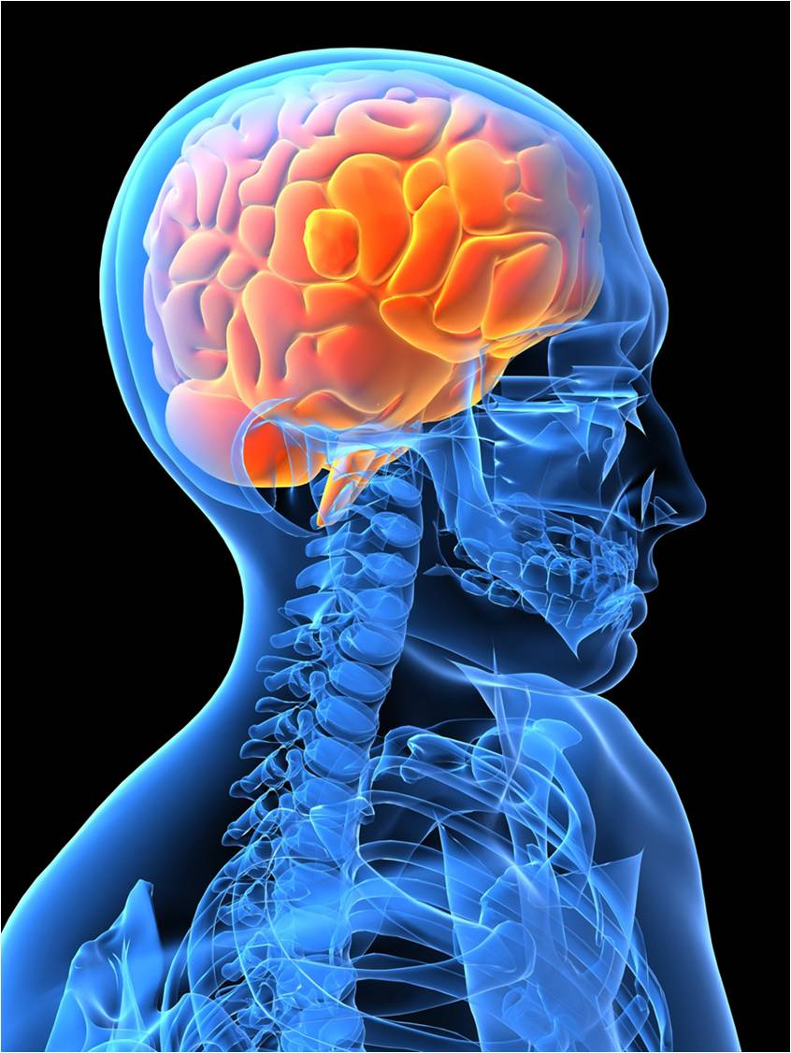
Sensory
Integration
Notes:
Sensory integration difficulty, sensory sensitivity, sensory dysfunction

Slide 17
Autistic Individuals
Autistic individuals can experience senses differently in a way that affects:
  Their experience of the present
  Their developing experience and understanding of the world in which they live.

Slide 18
Differences in Sensory Processing
Hypo and hyper sensitivity
Sensory overload
Gestalt perception
Fragmented perception
Delayed perception
Distorted perception
Sensory shutdowns
Compensation

Slide 19
Sensory Intensity
Hypersensitivity – senses are working too well, being averse to sensory stimuli
  Look for rocking, swinging, hitting ears, pressing eyes, twisting, flapping and spinning behaviours.
Hyposensitivity – senses not working well enough, being drawn towards a sensory stimuli
  Look for banging of objects / doors, seeking out noises, preference for deep sensory pressure, self injurious behaviour.

Slide 20
ASD and Sensory Sensitivity
Hypersensitive
Hyposensitive
Channel is too open
Desire to avoid or shut out the sense
Distraction / repulsion
Repel away from
Over sensitive
Can be experienced as painful or anxiety provoking
Channel is too closed
Desire to seek out the sense
Distraction / attraction
Drawn towards
Under sensitive
Can be experienced as pleasurable, and / or stimulating

Slide 21
Sight (NAS)
Situated in the retina of the eye and activated by light, our sight helps us to define objects, people, colours, contrast and spatial boundaries. People with an ASD may experience the following differences.
Hypo (under-sensitive)
Objects appear quite dark, or lose some of their features.
Central vision is blurred but peripheral vision quite sharp.
A central object is magnified but things on the periphery are blurred.
Poor depth perception – problems with throwing and catching; clumsiness.
Hyper (over-sensitive)
Distorted vision: objects and bright lights can appear to jump around.
Images may fragment.
Easier and more pleasurable to focus on a detail rather than the whole object.

Slide 22
Sound
This is the most commonly recognised form of sensory impairment. Hearing impairments can affect someone's ability to communicate and possibly also their balance. People with an ASD may experience the following differences.
Hypo
May only hear sounds in one ear, the other ear having only partial hearing or none at all.
May not acknowledge particular sounds.
Might enjoy crowded, noisy places or bang doors and objects.
Hyper
Noise can be magnified and sounds become distorted and muddled.
Particularly sensitive to sound and can, for example hear conversations in the distance.
Inability to cut out sounds – notably background noise, which often leads to difficulties concentrating.

Slide 23
Touch
Touch is important for social development. It helps us to assess the environment we are in (is an object hot or cold?) and react accordingly. It also allows us to feel pain. People with an ASD may experience the following differences.
Hypo
Holds others tightly - needs to do so before there is a sensation of having applied any pressure.
Has a high pain threshold.
May self-harm.
Enjoys heavy objects (eg, weighted blankets) on top of them.
Hyper
Touch can be painful and uncomfortable; people may not like to be touched and this can affect their relationships with others.
Dislikes having anything on hands or feet.
Difficulties brushing and washing hair because head is sensitive.
Only likes certain types of clothing or textures.

Slide 24
Taste
Chemical receptors in the tongue tell us about different tastes - sweet, sour, spicy and so on. People with an ASD may experience the following differences.
Hypo
Likes very spicy foods.
Eats everything - soil, grass, Play-dough. This is known as pica.
Hyper
Finds some flavours and foods too strong and overpowering because of very sensitive taste buds. Has a restricted diet.
Certain textures cause discomfort; some children will only eat smooth foods like mashed potatoes or ice-cream.

Slide 25
Smell
Chemical receptors in the nose tell us about smells in our immediate environment. Smell is the first sense we rely upon. People with an ASD may experience the following differences.
Hypo
Some people have no sense of smell and fail to notice extreme odours (this can include their own body odour).
Some people may lick things to get a better sense of what they are.
Hyper
Smells can be intense and overpowering. This can cause toileting problems.
Dislikes people with distinctive perfumes, shampoos, etc.

Slide 26
Vestibular
Situated in the inner ear, our vestibular system helps us maintain our balance and posture, and understand where and how fast our bodies are moving. People with an ASD may experience the following differences.
Hypo
A need to rock, swing or spin to get some sensory input.
Hyper
Difficulties with activities like sport, where we need to control our movements.
Difficulties stopping quickly or during an activity.
Car sickness.
Difficulties with activities where the head is not upright or feet are off the ground.

Slide 27
Proprioception
Situated in the muscles and joints, our body awareness system tells us where our bodies are in space, and how different body parts are moving. People with an ASD may experience the following differences.
Hypo
Stands too close to others, because they cannot measure their proximity to other people and judge personal space.
Hard to navigate rooms and avoid obstructions.
May bump into people.
Hyper
Difficulties with fine motor skills: manipulating small objects like buttons or shoe laces.
Moves whole body to look at something.

Slide 28
Sensory overload
Sensory overload happens when there is too much information coming in at once and this is overwhelming. It can be very difficult to cope with. The brain might not be able to filter out anything irrelevant such as background noise, wallpaper, the feel of clothes on skin or people moving around.

Slide 29
Gestalt perception
This is the inability to filter foreground and background information, so everything is perceived as a ‘whole’ rather than a combination of different items. This can happen in any of the senses – someone who experiences visual gestalt has difficulty focusing on a single detail of a scene and finds it almost impossible to separate it from the whole picture.

Slide 30
Fragmented perception
When too much information needs to be processed at the same time, people with autism may not be able to break down the whole picture into meaningful units. We might process some parts of a whole, for example parts of a scene or a sentence.

Slide 31
Delayed perception
Sometimes it may take longer to process information that’s coming in. This makes it hard to understand and learn new things. Concentration becomes more important and distractions need to be minimised.

Slide 32
Distorted perception
Sometimes senses get distorted, which means they may change or misrepresent what can truly be seen, heard, touched, tasted or smelt.
Distorted perception is reported to become worse in the state of information overload. When senses are distorted, a person might have difficulty with:
  Space expanding or decreasing
  Changes in shapes and sizes
  Associating the location, form and texture of objects
  Fears of heights, stairs and escalators
  Double vision
  Seeing everything in two dimensions only
  Poor awareness of own body
  Unable to distinguish between some sounds.

Slide 33
Sensory shutdowns
Shutdowns happen when someone can’t deal with all the information coming in – for example if they are experiencing a sensory overload. All or some of the senses are being overloaded and the person is unable to cope. Often we manage by shutting down one or some of our sensory systems – to block out the stimuli coming in and enable our other senses to function better.

Slide 34
Compensation
Because of sensory sensitivities/fragmented or distorted perception or delayed processing, a person may compensate through other more reliable senses to build a better understanding of their environment.

Slide 35
Because someone will mention this at some point!
Synaesthesia
‘Synaesthesia is a rare condition which some people with an ASD experience. A sensory experience goes in through one system and out through another. So a person might hear a sound but experience it as a colour. In other words, they will 'hear' the colour blue.’
(NAS Website)

