Slide 1
ASD Advisors Forum
28th October 2016
Chris Atherton
Annie McGauley
Gordon Laird

Slide 3
NO LUNCH?!!?
What happened?
‘The budget for lunch disappeared!’
What are you feeling?
‘Totes raging and a little bit hungry already’
Who was affected?
‘The ASD advisors I suppose but mostly just me.’
How can we make it better?
‘I could get a £3 Subway meal deal with a nice coffee to counterbalance the probably dodgy GM salad.’

Slide 4
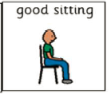
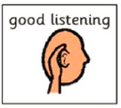
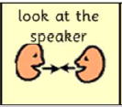
When I speak I would like to see…

Slide 5
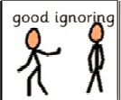
And when Annie speaks….

Slide 6
Quiz
(No cheating)
Theories & Research:
ASD , Girls & Extreme Male Brain
~ Morning Break ~
Assessment:
Wellbeing Assessment & Case Studies
Interventions:
Class Dojo
~ Lunch Break ~
Perspectives:
A Young Person’s View of Inclusive Supports (Q + A)
An Overview of Williamwood Communication Support Service
Transitions:
What do we currently do? How can we improve?
~ Home ~

Slide 7
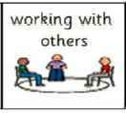
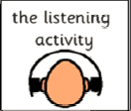
First Then

Slide 8
Quiz

Slide 9
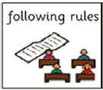
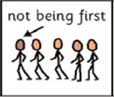
Quiz

Slide 10
Quiz
What is the triad of impairment?
What are the seven senses?
What is the difference between hypo and hyper sensitivity?
What is context blindness?
What is theory of mind?

Slide 11
ASD, Girls and Extreme Male Brain Theory

Slide 12
https://www.youtube.com/watch?v=VzWorS8CdBM

Slide 13


PRESENTATION
Relies on other children (usually girls)
Girls are more able to follow social actions
Girls are often more aware of and feel a need to interact socially.
Many have one special friend.
• 1:1 relationships
Prefer to play with younger children or less able peer
Notes:
Relies on other children (usually girls) to guide and speak for them.
Girls are more able to follow social actions by delayed imitation
Gravitate towards older girls, who tend to mother them and act as a form of social “protection”
Girls are often more aware of and feel a need to interact socially.
They are often led rather than initiating social contact.
= Can socialise, just not for as long.
Have difficulties making or keeping friends
1:1 relationships but are uncomfortable and anxious in large groups
may be socially immature and prefer to play with much younger children who are not challenging and would allow the child with ASD to dominate play. May “adopt” a less able peer, so they are open to being dominated by the child with ASD.

Slide 14
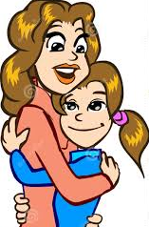


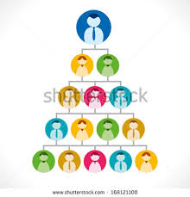

Dependent on their mother (or other primary carer)
= regard as their best friend and confidante
Rich and elaborate fantasy world with imaginary
friends
Passionate interests - quality and intensity
Conversation is restricted to her topics of interest.
Social communication hierarchy can be
problematic
Do not 'do social chit chat'
Notes:
May be unnecessarily dependent on their mother (or other primary carer) whom they regard as their best friend and confidante in a social world which they find challenging and frightening.
Many have a very rich and elaborate fantasy world with imaginary friends, escape into fiction, and some live in another world with, for example, fairies and witches.
"passionate" and limited interests that are very specific and restricted -even if they are age appropriate and are very often similar .
Therefore are not seen as unusual but it is the quality and intensity of these interests.
Eg fascinated by a TV show or pop star and collect facts about the characters or actors, but know little or nothing about the plot or genre of the show or their music.
Conversation is restricted to her topics of interest. She may share her areas of specific and restricted fascination, but have no interest in hearing another person's response.
The idea of a social hierarchy and how one communicates with people of different status can be problematic and get girls into trouble with teachers.
Girls on the spectrum do not 'do social chit chat' or make
'meaningless' comments.

Slide 15

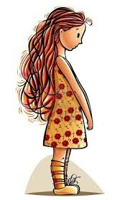
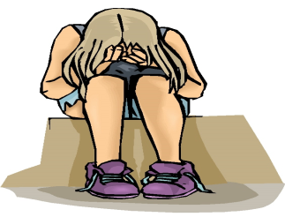
Low frustration level / age-inappropriate "meltdowns."
Depression, anxiety, or moodiness - come to the attention of health professionals
Facial expressions tend to not match their moods.
Anorexia nervosa has been called “female Asperger’s” because around 1/5 of girls who present with anorexia have traits:
Quiet or shy - unusually passive.
High emotional empathy - overwhelmed by feeling others emotions
Appear to be develop fairly typically but social communication increasingly difficult in teen years
Notes:
low frustration level, and finds it difficult to moderate her feelings, having age-inappropriate "meltdowns."
experiences an unusual degree of depression, anxiety, or moodiness.
More likely to come to the attention of health professionals due to difficulties with anxiety, depression, eating disorders, behavioural problems and/or social skills challenges.
Girls facial expressions tend to not match their moods. They may say that are fine, but on the inside they are unhappy, anxious or both.
Anorexia nervosa has been called “female Asperger’s” because around 1/5 of girls who present with anorexia have traits:
around 20 -30% of anorexic patients are perfectionists and demonstrate rigid modes of thinking and behaviour.
Anorexia offers girls with ASD what they perceive to be a positive outcome because lack of nutrition prevents menstruation and physical development.
Described as "quiet" or "shy" in school and other challenging social situations. unusually passive.
Have high emotional empathy - highly sensitive to the emotions of others ‘referred emotion’
When overwhelmed by feeling others emotions they are unable to process or ‘read ‘the subtle social signals
= Learn to accept and trust your intuition. Learning a variety of interventions to help manage or cope with high empathy is important.
Appear to be developing fairly typically as a young girl, but finds social communication to be increasingly difficult as she enters her teen years when social expectations become more complex and demanding

Slide 16


Dale Yaull-Smith (2008) - ‘social exhaustion’ from the enormous energy it takes pretending to fit in.
Repetitive questioning
An inability to “move on” - not throwing away old toys/clothes and difficulties with change.
Trying to please – want to be accepted – wanting others to like them
Perfectionist – never gain a sense of satisfaction
Notes:
Dale Yaull-Smith (2008) discusses the ‘social exhaustion’ from the enormous energy it takes pretending to fit in.
= solitude to recharge their batteries to regain energy.
Can engage in repetitive questioning well beyond the age that those who are not on the spectrum would normally do.
An inability to “move on” - not being happy to throw away old toys or clothes and difficulties with change.
Trying to please – want to be accepted – wanting others to like them
Perfectionist – never gain a sense of satisfaction as haven’t got 100%
= social story on making mistakes. Setting goal and marking at achieving 8 / 10

Slide 17
Next Steps….
Much wider perspective
Parents may perceive their daughter as being non-specifically “odd”, but without being able to pinpoint the cause
Likely that the number of girls with autism will appear to rise in the next few years
The question of whether those girls were always there, however, may remain open.
Notes:
It is important to take a much wider perspective regarding the social, communication and imagination dimensions
in addition to the special interests and rigidity of behaviour.
parents may perceive their daughter as being non-specifically “odd”, but without being able to pinpoint the cause
It seems very likely that the number of girls with autism will appear to rise in the next few years
The question of whether those girls were always there, however, may remain open.

Slide 18
Amy Farrah Fowler
https://www.youtube.com/watch?v=8g9OszJFIzg

Slide 19
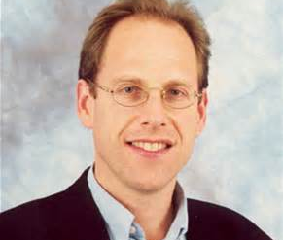
Simon Baron-Cohen
‘Autism can be considered as an extreme of the normal male brain’

Slide 20
Extreme Male Brain Theory
Sex differences in cognition traditionally studied in terms of verbal and spatial ability.
Baron-Cohen –human systemising and empathising are a neglected area in the research.
The male brain – significantly stronger in systemising
The female brain – significantly stronger in empathising

Slide 21
Empathising
The drive to identify another person’s emotions and thoughts, and to respond to these with an appropriate emotion.
Evidence suggests (on average) females do this spontaneously more than males.

Slide 22
Systemising
The drive to analyse the variables in a system, to derive the underlying rules that govern the behaviour of a system. Systemising also refers to the drive to construct systems. Systemising allows you to predict the behaviour of a system, and to control it.
Evidence suggest (on average) males do this spontaneously more than males.

Slide 23
Systemising
‘If–then’ (correlation) rules.
Brain focuses on details or parameters - observing how this varies.
Treats a feature as a variable that can be manipulated
Notes the effect(s) of this one input elsewhere in the system (i.e. the output).
‘If I do x, then y happens’.
Systemising therefore needs an exact eye for detail.

Slide 24
Six Types of Systems
At least six types of system that a human being can analyse or construct:
Technical systems: a computer, a musical instrument, a hammer, etc.
Natural systems: a tide, a weather front, a plant, etc.
Abstract systems: mathematics, a computer program, syntax, etc.
Social systems: a political election, a legal system, a business, etc.
Organisable systems: a taxonomy, a collection, a library, etc.
Motoric systems: a sports technique, a performance, a technique for playing a musical instrument, etc.

Slide 25
Systemising
Works for phenomena that are indeed ultimately lawful, finite and deterministic.
Of almost no use when it comes to predicting moment-by moment changes in a person’s behaviour.

Slide 26
Empathising
Attribution of mental states to others, and an appropriate affective response to the other’s affective state.
It covers not only what is sometimes called ‘theory of mind’ or mentalising but also what is implied by the English words ‘empathy’ and ‘sympathy’.
Although systemising and empathising are in one way similar – they are both processes that allow us to make sense of events and make reliable predictions – they are in other respects almost the opposite of each other.
Empathising involves an imaginative leap in the dark, in the absence of much data.

Slide 27
5 Brain Types
Empathising is more developed E>S (The Female Brain)
Systemising is more developed S>E (The Male Brain)
Both are equally developed E=S (The Balanced Brain)
Systemising is extremely more developed S>>E
Empathising is extremely more developed E>>S????
Notes:
Baron-Cohen postulates the existence of 5. Empathising is extremely more developed E>>S.
Not clarified by research to date.

Slide 28
The central claim is only that more males than females have a brain of Type S, and more females than males have a brain of Type E.

Slide 29
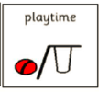
First Then

Slide 30


Slide 31
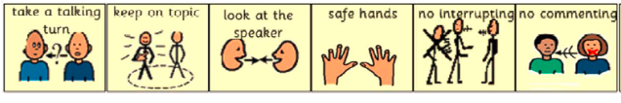
Remember!

Slide 32
Evidence of a Female Brain
Baron-Cohen, S. (2002) The Extreme Male Brain Theory of Autism. Trends in Cognitive Science 6(6). Elsevier Science.
Sharing and turn-taking.
Rough and tumble play or ‘rough housing’.
Responding empathically to the distress of other people.
Using a ‘theory of mind’.
Sensitivity to facial expressions.
Questionnaires measuring empathy.
Values in relationships.
Disorders of empathy
Notes:
Sharing and turn-taking. On average, girls show more concern for fairness, whereas boys share less.
Rough and tumble play or ‘rough housing’. Boys show more ‘rough housing’ (wrestling, mock fighting, etc) than girls do. Although there is a playful component, it can hurt or be intrusive, so it needs lower empathising to carry it out.
Responding empathically to the distress of other people. Girls from 1 year old show greater concern through more sad looks, sympathetic vocalizations and comforting. More women than men also report frequently sharing the emotional distress of their friends. Women also show more comforting, even of strangers, than men do.
Using a ‘theory of mind’. By 3 years of age, little girls are already ahead of boys in their ability to infer what people might be thinking or intending
Sensitivity to facial expressions. Women are better at decoding non-verbal communication, picking up subtle nuances from tone of voice or facial expression, or judging a person’s character.
Questionnaires measuring empathy. Many of these find that women score higher than men.
Values in relationships. More women value the development of altruistic, reciprocal relationships, which by definition require empathising. In contrast, more men value power, politics, and competition. Girls are more likely to endorse cooperative items on a questionnaire and to rate the establishment of intimacy as more important than the establishment of dominance. Boys are more likely than girls to endorse competitive items and to rate social status as more important than intimacy.
Disorders of empathy. Disorders such as psychopathic personality disorder and conduct disorder are far more common among males.

Slide 33
Evidence of a Female Brain
Baron-Cohen, S. (2002) The Extreme Male Brain Theory of Autism. Trends in Cognitive Science 6(6). Elsevier Science.
Aggression
Murder
Establishing a ‘dominance hierarchy’
Language style
Talk about emotions
Parenting style
Face preference and eye contact
Better language ability in general
Notes:
Aggression. Even expressed at normal levels, aggression can only occur with reduced empathising. Here again, there is a clear sex difference. Males tend to show far more ‘direct’ aggression (pushing, hitting, punching, etc.) whereas females tend to show more ‘indirect’ (or ‘relational’, covert) aggression (gossip, exclusion, bitchy remarks, etc.). Direct aggression might require an even lower level of empathy than indirect aggression. And indirect aggression needs better mindreading skills than does direct aggression, because its impact is strategic.
Murder. This is the ultimate example of lack of empathy. Daly and Wilson analysed homicide records dating back over 700 years, from a range of different societies. They found that ‘male-on-male’ homicide was 30–40 times more frequent than ‘female-on-female’ homicide.
Establishing a ‘dominance hierarchy’. Males are quicker to establish hierarchies of dominance. This partly reflects their lower empathising skills, because often a hierarchy is established by one person pushing others around, to become the leader.
Language style. Girls’ speech is more cooperative, reciprocal and collaborative. In concrete terms, this is also reflected in girls being able to keep a conversational exchange with a partner going for longer. When girls disagree, they are more likely to express their different opinion sensitively, in the form of a question, rather than an assertion. Boys’ talk is more ‘single-voiced discourse’ (the speaker presents their own perspective alone). The female speech style is more ‘double voiced discourse’ (girls spend more time negotiating with the other person, trying to take the other person’s wishes into account).
Talk about emotions. Women’s conversation involves much more talk about feelings, whereas men’s conversation with each other tends to be more object- or activity-focused.
Parenting style. Fathers are less likely than mothers to hold their infant in a face-to-face position. Mothers are more likely to follow through the child’s choice of topic in play, whereas fathers are more likely to impose their own topic. And mothers fine-tune their speech more often to match what the child can understand.
Face preference and eye contact. From birth, females look longer at faces, and particularly at people’s eyes, and males are more likely to look at inanimate objects.
Females have also been shown to have better language ability in general than males. It seems likely that good empathising would promote language development and vice versa, so these might not be independent.

Slide 34
That plus women are always right….

Slide 35
Evidence of a Male Brain
Toy preferences
Adult occupational choices
Maths, physics, and engineering
Constructional abilities
The Water-Level Task
The Rod and Frame test
Good attention to relevant detail
The Mental Rotation test
Notes:
Toy preferences. Boys are more interested than girls in toy vehicles, weapons, building blocks and mechanical toys, all of which are open to being ‘systemised’.
Adult occupational choices. Some occupations are almost entirely male. These include metalworking, weapon making, manufacturing of musical instruments, or the construction industries, such as boat building. The focus of these occupations is on constructing systems.
Maths, physics, and engineering. These all require high systemising, and are largely male dominated disciplines. The Scholastic Aptitude Math Test (SAT-M) is the maths part of the test administered nationally to college applicants in the USA. Males on average score 50 points higher than females on this test. Taking only those people scoring above 700, the sex ratio is 13:1 (men to women).
Constructional abilities. If you ask people to put together a 3-D mechanical apparatus in an assembly task, on average men score higher. Boys are also better at constructing block buildings from 2-D blueprints. Lego bricks can be combined and recombined into an infinite number of systems. Boys show more interest in playing with Lego. Boys as young as 3 yrs are also faster at copying 3-D models of outsized Lego pieces, and older boys, from the age of 9, are better at imagining what a 3-D object will look like if it is laid out flat. They are also better at constructing a 3-D structure from just an aerial and frontal view in a picture.
The Water-Level task. Originally devised by Swiss child psychologist Jean Piaget, this task is to show someone an empty bottle, tipped at an angle, and then ask them to show the water level when it is, say, half full. Women more often draw the water level aligned with the tilt of the bottle, and not horizontal, as it should be.
The Rod and Frame test. If a person’s judgement of vertical is influenced by the tilt of the frame, they are said to be ‘field dependent’: their judgement is easily swayed by extraneous input in the surrounding context. If they are not influenced by the tilt of the frame, they are said to be ‘field independent’. Most studies show that females are more field dependent – that is, women are relatively more distracted by contextual cues, rather than considering each variable within the system separately. They are more likely than men to say(erroneously) that the rod is upright if it is aligned with its frame.
Good attention to relevant detail. This is a general feature of systemizing. It is not the only factor, but it is a necessary part of it. Attention to relevant detail is superior in males. A measure of this is the Embedded Figures Task: on average, males are quicker and more accurate in locating the target embedded within the larger, complex pattern. Males, on average, are also better at detecting a particular feature (static or moving)
The Mental Rotation test. Here again, males are quicker and more accurate. This test involves systemising because you have to treat each feature in a display as a variable that can be transformed (e.g. rotated) and predict how it will appear (the ‘output’).

Slide 36
Evidence of a Male Brain
Map reading
Motoric systems
Organisable systems
The Systemising Quotient
Mechanics
Notes:
Map reading. Reading maps is another everyday test of systemising, because it is necessary to take features from 3-D input and predict how they will appear when represented in 2-D. Boys perform at a higher level than girls. Men can also learn a route in fewer trials, just from looking at a map, correctly recalling more details about direction and distance. This suggests they are treating features in the map as variables that can be transformed into 3-D. If you ask school children to make a map of an area that they have visited only once, boys’ maps have a more accurate layout of the features in the environment than girls’ maps. More of the girls’ maps make serious errors in the location of important landmarks. The boys tend to emphasise routes or roads, whereas the girls tend to emphasise specific landmarks (the corner shop, etc.). These two strategies – using directional cues versus landmark cues – have been widely studied. The directional strategy is an instance of taking understanding space as a geometric system and the focus on roads or routes is an instance of considering space in terms of another system, in this case a transport system.
Motoric systems. If you ask people to throw or catch moving objects (target directed tasks) such as playing darts or intercepting balls flung from a launcher, males tend to be better. Equally, if you ask men to judge which of two moving objects is travelling faster, men are on average more accurate.
Organisable systems. People in the Aguaruna tribe (northern Peru) were asked to classify a hundred or more examples of local specimens together into related species [34]. Men’s classification systems had more sub-categories (i.e. they introduced greater differentiation) and more consistency between each other than those of the women. The criteria that the Aguaruna men used to decide which animals belonged together more closely resembled the taxonomic criteria used by western (mostly male) biologists. Classification and organisation involves systemising because categories are predictive. The more fine-grained the categories, the better the system of prediction will be.
The Systemising Quotient. This questionnaire has been tested among adults in the general population. It has 40 items asking about the subject’s level of interest in a range of different systems that exist in the environment (including technical, abstract, and natural systems). Males score higher than females on this measure.
Mechanics. The Physical Prediction Questionnaire (PPQ) is based on an established method for selecting applicants for engineering. The task involves predicting which direction levers will move when an internal mechanism (of cog wheels and pulleys) of one type or another is involved. Men score significantly higher on this test than women.

Slide 37
Autism and the Extreme Male Brain
There is evidence of structural and functional differences in regions of the brain (such as the amygdala being abnormal in size, and this structure not responding to cues of emotional expression)
Converging evidence points to:
  Impaired empathising
  Superior systemising

Slide 38
Impaired Empathising
Mind Reading
The Empathy Quotient
The ‘Reading the Mind Eyes’ Test
The Complex Facial Expressions Test
Eye Contact
Language Development
Pragmatics
The Faux Pas Test
The Friendship Questionnaire
Notes:
Impaired empathising
Mindreading. Girls are better than boys on standard ‘theory of mind’ tests, and children with autism or AS
are even worse than normal boys [7]. They have specific delays and difficulties in the development of
‘mindreading’ (i.e. in making sense of and predicting another’s feelings, thoughts and behaviour).
Autism has been referred to as a condition of ‘mindblindness’ [3].
The Empathy Quotient (EQ). On this questionnaire, females score higher than males, and people with AS
or high-functioning autism score even lower than males (S. Baron-Cohen and S. Wheelwright,
unpublished data).
The ‘Reading the Mind in the Eyes’ test. In this test of discriminating emotions from expressions in the eyes,
females score higher than males, but people with AS score even lower than males [43].
The Complex Facial Expressions test. Females score higher than males, but people with AS score even
lower than males [44].
Eye contact. Females make more eye contact than do males, and people with autism or AS make less eye
contact than males [45,46].
Language development. Girls develop vocabulary faster than boys, and children with autism are even
slower than males to develop vocabulary [47].
Pragmatics. Females tend to be superior to males in terms of chatting and the pragmatics of conversation,
and it is precisely this aspect of language which people with AS find most difficult [48].
The Faux Pas test. Females are better than males at judging what would be socially insensitive or
potentially hurtful and offensive, and people with autism or AS have even lower scores on tests of this
than males do [49].
The Friendship Questionnaire (FQ). This assesses empathic styles of relationships. Women score higher
on the FQ than males, and adults with AS score even lower than normal males (S. Baron-Cohen and
S. Wheelwright, unpublished data).

Slide 39
Superior Systemising
Islets of ability
Attention to detail
Preference for rule based, structural, factual information
Tests of intuitive physics
Toy preference
Collecting
Obsessions with closed systems
The systemising quotient
Notes:
Superior systemising
Islets of ability. Some people with autism spectrum disorders have ‘islets of ability’, or special abilities to a
high degree, in mathematical calculation, calendrical calculation, syntax acquisition, music, or memory for
railway timetable information [50]. In the high functioning cases this can lead to considerable
achievement in mathematics, chess, mechanical knowledge, and other factual, scientific, technical or
rule-based subjects. All of these are highly systemisable domains. Most of them are also domains
where males in the general population have a greater natural interest.
Attention to detail. Autism also leads to extra fine attention to detail. For example, on the Embedded
Figures Task (EFT) males score higher than females, and people with AS or high-functioning autism score
even higher than males. The EFT is not a systemising test per se, but it is a measure of detailed local
perception, which is a prerequisite for systemising [51]. On visual search tasks, males have better
attention to detail than do females, and people with autism or AS have even faster, more accurate visual
search [52].
Preference for rule-based, structured, factual information. People with autism are strongly drawn
to structured, factual and rule-based information. A male bias for this kind of information is also found
in the general population. Tests of intuitive physics. Males score higher than females on such tests, and people with AS score
higher than males [53].
Toy preference. Boys like constructional and vehicle toys more than girls do, and clinical reports
suggest that children with autism or AS have this as a very strong toy preference.
Collecting. Boys engage in more collecting or organising of items than girls do, and the diagnosis of
autism identifies this to an even greater extent.
Obsessions with closed systems. Most individuals with autism are naturally drawn to predictable things,
such as computers. Unlike people, computers follow strict laws, and are closed systems – all the variables
are well-defined within the system, are knowable, predictable and, in principle, controllable. Other
individuals with autism might not make computers their target of understanding, but latch on to
different, equally closed, systems such as bird migration or train spotting [54].
The Systemising Quotient. Males score higher on this questionnaire, and people with autism and AS score
even higher than normal males (S. Baron-Cohen and J. Reichler, unpublished data).

Slide 40
Biological and Familial
The Autism Spectrum Quotient
Sexually Dimorphic Somatic Markers
Early Puberty
Familiality of Talent
Notes:
The Autism Spectrum Quotient (AQ). Males in the general population score higher on the AQ than do
females, and people with AS or high-functioning autism score highest of all [55].
Sexually dimorphic somatic markers. On measures of finger-length ratio, males tend to have a longer ring
finger than their second finger, and people with autism or AS show this trait in a magnified form [56].
Early puberty. Males with autism have been reported to show precocious puberty, correlating with
increased levels of testosterone [57].
Familiality of talent. Fathers and grandfathers (on both sides of the family) of autistic individuals are overrepresented
in occupations such as engineering, which require good systemising but in which a mild
impairment in empathising (as has also been documented) would not necessarily be an impediment
to success [58]. There is a higher rate of autism in the families of those talented in fields such as maths,
physics and engineering, as compared with those talented in the humanities [59]. These two findings
suggest that the extreme male cognitive style is in part inherited.

Slide 41
Mrs Hofstadter
https://www.youtube.com/watch?v=nRoxCqCd77E

Slide 42
Mrs Hofstadter
https://www.youtube.com/watch?v=iHROHQNjMXE
https://www.youtube.com/watch?v=zcWr8WIYIO8
Notes:
Baron Cohen Observes:
People with autism and AS have their greatest difficulties in the playground, in friendship, in intimate relationships, and at work, where the situation is unstructured, unpredictable, and where social sensitivity is needed.
The more able individuals report that they struggle to work out a huge set of rules of how to behave in each and every situation, attempting to develop a mental ‘manual’ for social interaction of ‘if–then’ rules. It is as though they are trying to systemise social behaviour when the natural approach to socialising should be via Empathising.

Slide 43
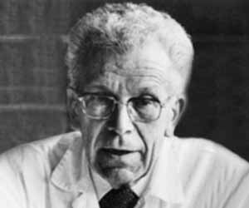
‘The autistic personality is an extreme variant of male intelligence. Even within the normal variation, we find typical sex differences in intelligence… In the autistic individual, the male pattern is exaggerated to the extreme’

Slide 44
Assessment

Slide 45
Wellbeing Assessment
Girl X is in P1 (no diagnosis)
Quite able in many respects
Quite artistic and creative, strong visual memory
Appears to cope with morning transition into school
Evidence of some sensory needs (noise)
Struggles with elements of social interaction, including interpersonal space.
High tendency to try and control her environment (likes to use the word ‘No’ a lot.)

Slide 46
Wellbeing Assessment
Finds it difficult to sit or participate in a group situation.
Struggles when not picked to respond by the teacher and when she is not first in a line.
Struggles to use emotional language to talk about her feelings – what went wrong etc.
Extreme reactions to situations when things don’t go her way / according to plan – no obvious / consistent triggers (wailing, crying, lying on the floor, occasional lashing out)
Needs to be escorted from class up to five or six times per day when she is having a ‘melt down’ – taken to PT office to sit and calm down. Usually returns after 10-15 minutes.
There are two class teachers and PSA support is available.

Slide 47
What are Girl X’s Wellbeing Needs?

Slide 48
Intervention

Slide 49
Outcomes are maximized when interventions are matched to individual characteristics and begun as early as possible.
Autism Spectrum Disorders: Guide to Evidence Based Interventions (2012) Missouri Autism Guidelines Initiative

Slide 50
Evidence based practice
Scientific research
Includes professional expertise
Includes consideration of individual characteristics

Slide 51
Best Available Research
Individual Characteristics
Professional Expertise
EVIDENCE
BASED
PRACTICE

Slide 52
Perspectives

Slide 53
Transitions

Slide 54
Transitions
Moving from one place to another
Transitions are not easy for people with autism.
Tells us that ‘it is time to move on’ and pre-supposes that one is ready, willing and equipped to do so.
Autism however says ‘I have to stay here because ‘here’ is all I know’ and
assumes that anything outside of ‘here’ is chaotic, unpredictable and unpleasant.
Fortunately however, with the understanding of how difficult change can be for those on the spectrum comes the possibility to create greater order, predictability and clarity within transition situations. (Wendy Lawson)

Slide 55
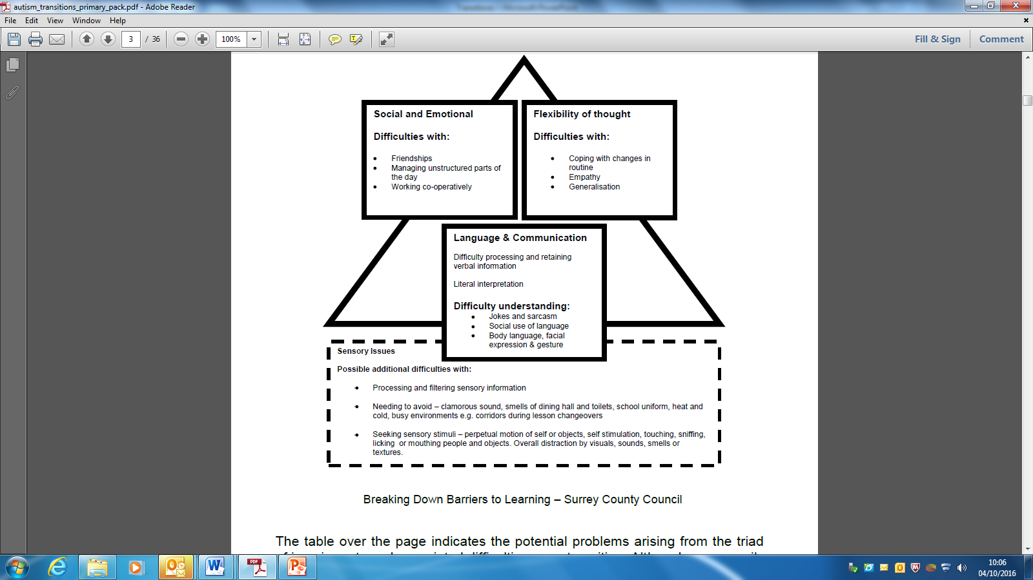

Slide 56
GETTING READY FOR SECONDARY SCHOOL
You will be thinking about your new school
You may be worried
Please answer the questions by circling the number that best shows how you feel.
1 means you are not worried at all. 4 means you are very, very worried
………………………………………………………will help you fill out this form
Getting lost 1 2 3 4
Being bullied 1 2 3 4
Making Friends 1 2 3 4
Getting detentions or consequences 1 2 3 4
Having lots of different teachers 1 2 3 4
Finding class work too difficult 1 2 3 4
Homework 1 2 3 4
Doing PE 1 2 3 4
Changing and showering 1 2 3 4
Being late for school 1 2 3 4
Being late for lessons 1 2 3 4
Having your money stolen 1 2 3 4
Having other property stolen 1 2 3 4
Break time / Lunchtime 1 2 3 4
Doing tests and exams 1 2 3 4
Forgetting books or equipment 1 2 3 4
Getting ill 1 2 3 4

Slide 57
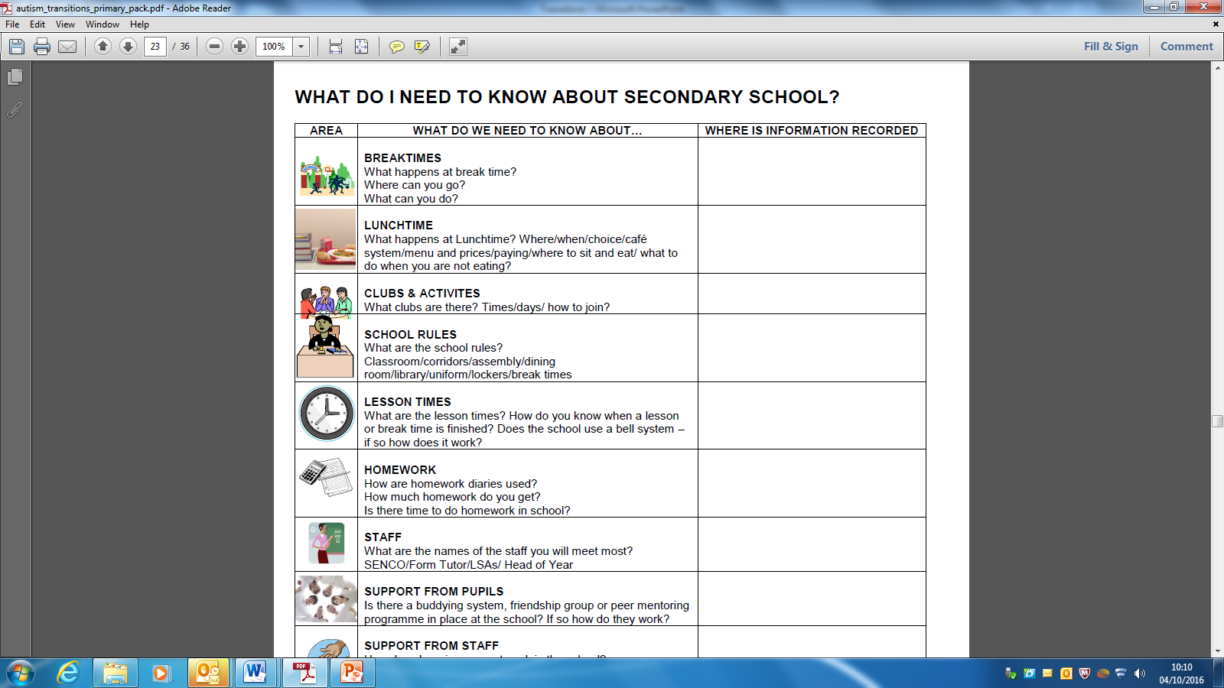
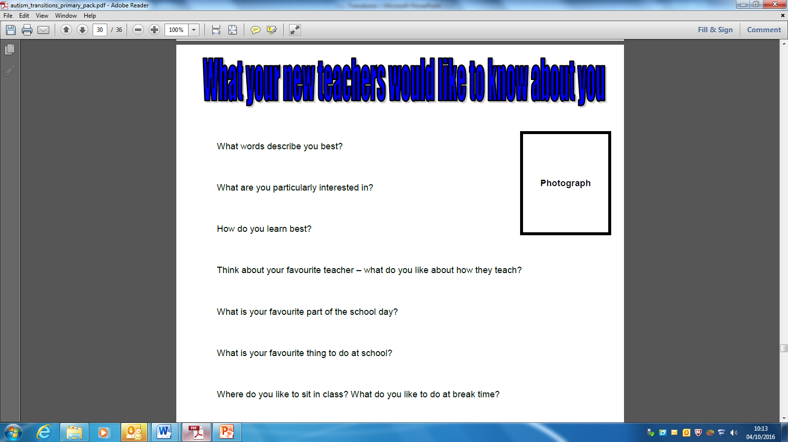

Slide 58
Preparing for transitions at the end of the school year - What do you currently do?
Preparing for transitions from nursery to Primary and Primary to Secondary and Secondary to world of work/further study - What do you currently do?

Slide 59
Transition – CCC to CSS
Feb – April CSS staff member visits pupil at CCC/ Primary.
Identified pupil visits CSS
P7 pupils spend 3 am/ pm in CSS
2 day S1 Transition days
Review Meetings

Slide 60
Transition – CCC to CSS
Challenges
Resources – Staff, Time
Trans year to year (s2 –s3)
Timetabling issues
Q: What are the main challenges we face?

Slide 61
Transition – CCC to CSS
Future plans inc. school to FE
Extended transition between CCC and CSS (Oct)
Drama Workshops – Social Skills
Reciprocal staff observations
Smoother transition between S1/2 to S3 – Phased transitions, meeting mainstream teachers in advance when possible
Securing placements for senior pupils to access FE link courses with appropriate support

Slide 62
Transition – CCC to CSS
SWOT Analysis
Strengths
Weaknesses
Opportunities
Threats

Slide 63
Supporting Transitions
26th October 2016
Alina Spence
Outreach Support
Communication Support Service
Williamwood High School

Slide 64
Outreach Transitions Support
Primary to secondary transitions
In collaboration with primary outreach
Group with various needs
In primaries followed by visits to high schools
In-school transitions
Annual transitions (Moving On)
Rotational transitions (New timetables, classrooms, teachers)
Post-school transitions
Application process for college/university
Interview skills
Visits to campuses
Independent travel

Slide 65
P7 to S1 Transition:
Gathering Information
Close liaison with primary, secondary schools, CCC, CCC outreach
Attend transition reviews, JSTs
Attend ASN cluster meetings
Gather information from (P6 and) early P7
Attend parents information evenings in primary and secondary schools
Views of parents considered

Slide 66
P7 to S1 Transition:
Planning and assessment
Information gathered used to plan individual support for Outreach pupils
Other suitable pupils identified to join groups (ASD, communication difficulties, vulnerable or anxious)
Support based on needs of Outreach pupils
Liaison with Support for Learning teachers
Transition plan produced

Slide 67
P7 to S1 Transition:
Format
Individual support?
Group support?
In primary school?
In secondary school?
Both?
Suitable times identified between primary and secondary schools
Additional visits arranged (with or without parents)?
Second adult identified as additional teacher?

Slide 68
Mearns Castle Timeline
October Cluster ASN transition meeting
            Collected names of outreach pupils
            Other suitable pupils identified
            (ASD/social communication/vulnerable/anxious)
            Dates agreed
January Primary based support in cluster schools
March MCHS Outreach ASD Transition Group
April MCHS ASN Transition Group
May ‘Fast Day’
June Induction Days
August Settling-in support (1:1 or group)

Slide 69
P7 to S1 Plan (show outline and daily plan)
Visits to high schools – finding their way around, meeting key people
Change and loss
Differences/similarities between primary and secondary school
Friendships
Different teachers/teaching styles/expectations
School rules
Subjects

Slide 70
P7 to S1 Plan (ctd.)
Timetable
Organisation
Breaks and lunchtimes
Clubs
Dealing with problems inc bullying
Reflection on primary school – memories
Saying goodbye to primary school
Production of Pupil Passport
Talking through worries and questions
Role-playing situations

Slide 71
‘Fast Day’
‘Fast Day’ | Period 1 | Period 2 9:35-10:25 | Break 10:25-10:40 | Period 3 10:40-11:30 | Period 4 11:30-11:55 | ‘Hometime’ 11:55-12:20 | Lunch 12:20-1:05 | Period 5 1:05-1:30
Tuesday | Getting Organised Base | Home Economics CfE Mrs Ross 111 | Base | Geography CfE Miss Spence 302 | ICT CfE Mrs Mair 118 | Base | Base Atrium Canteen | Evaluation Miss Spence Base
Practise skills learned over group meetings
Go over plan first
Independence - maps
Lessons - expectations
Do homework – using planner, organisation
Positive feedback from pupils, parents, schools

Slide 72
P7 to S1 transition:
Ongoing High School Support
Pupils supported through transition from P7 to S1
Regular meetings with Outreach Support teacher if appropriate to support specific identified targets
1:1 or group work
Observation in classes and unstructured times
Liaison with class teachers and Support for Learning/Behaviour Support
Attendance at Settling-in Meetings/reviews (Oct/Nov)

Slide 73
In-school Transitions:
Annual and termly transitions
Necessity and intensity determined by needs of individual pupils
Moving from year to year
Changes to timetable (rotational subjects)
  Preparation in advance (before summer break/changes)
  Ideally have copy of new timetable
  Ideally meet teachers and know where classrooms are
  Expectations for next step in school (e.g. S3/4/5/6)
  Timeline of year (topics, assessments etc.)

Slide 74
Post-school transitions:
Support in school
Pupils identified by SfL staff and/or parents
Work Experience
Interview skills
Barclays Life Skills
My World of Work
Skills and personal qualities
Expectations in employment / further education
Independence

Slide 75
Post-school transitions:
College/University
Familiarisation with chosen establishment/course
  Website/prospectus
  Course outline
  Course timeline
Supported transition visits
  Supported/Independent travel
  Meeting key people (Support department, Advisers)
  Visiting faculty/lecture theatres/library/canteen etc
  Lunch visit

Slide 76
Mainstream Outreach
P7 – S1
Post school trans
Year to year

Slide 77
Trans
What improvements can we make?

Slide 78
Communication Support Service Williamwood High School
Established in 2013
Vision Statement
To provide pupils with communication support needs with a safe, inclusive and rewarding education in the positive environment of a mainstream school.
In line with the principles of GIRFEC we endeavour to nurture and inspire pupils to achieve their full potential.
We shall work with parents, carers and other partners to achieve the best outcomes for our pupils.

Slide 79
Aims
To provide inspiring experiences to support pupils’ development of essential and transferable skills for learning, life and work.
To support and develop core literacy skills.
To support and develop core numeracy skills.
To support emotional and physical well being through the development of social and communication skills.
To stimulate and engage pupils within a nurturing classroom environment.

Slide 80
Pupil Profiles
August 2013 | 3 F/T placements
September 2016 | 19 F/T placements 1 phased transition placement
19 pupils with ASD diagnosis
1 pupil with additional language and communication needs
Overlapping behavioural, developmental, psychological and physiological conditions.
Pupils from a variety of demographical areas in East Renfrewshire

Slide 81
Staffing
Principal Teacher of Learning Support
3 Full Time Teachers
4 PSA’s

Slide 82
Referral Process
Referrals are made by case educational psychologists
Case Discussed at ECG
Placements offered and transition process begins from:
CCC
Pupil’s catchment primary
Pupil’s catchment Secondary

Slide 83
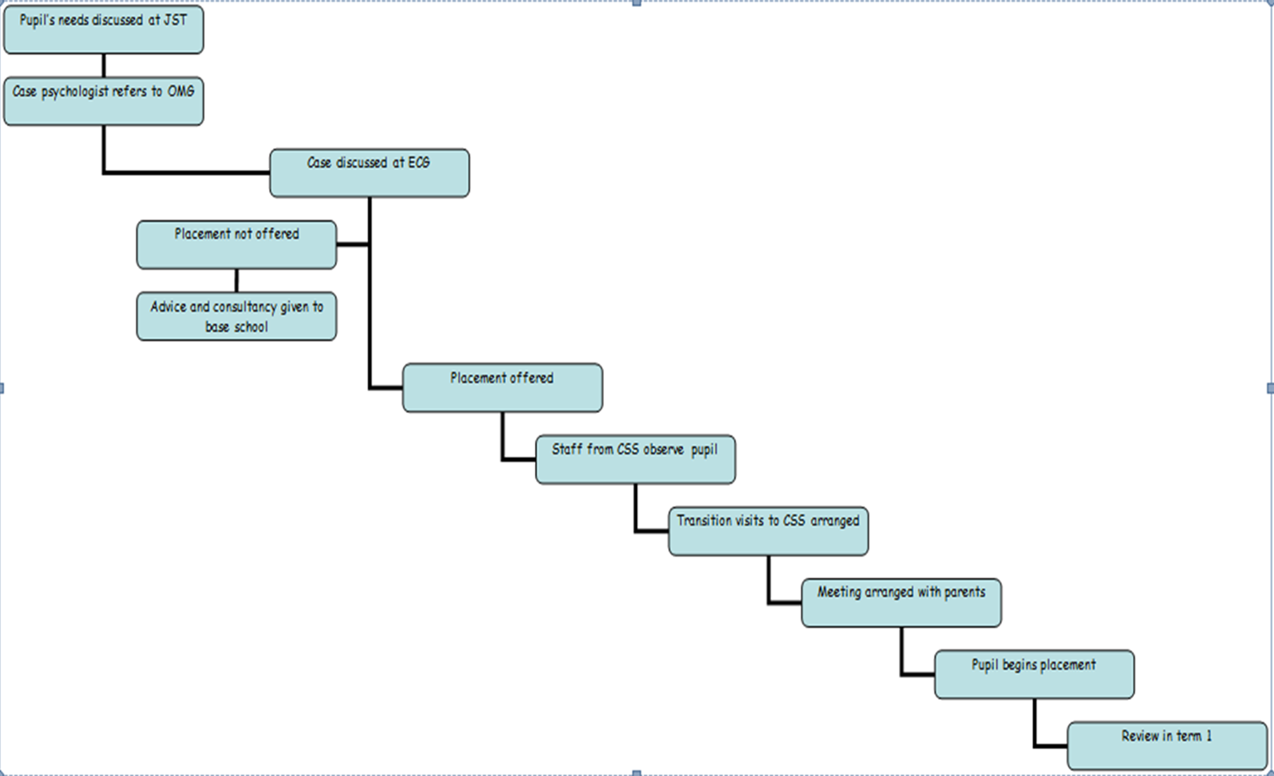
Referral Process

Slide 84
Contexts of support and curriculum
Bass classes (Small Group)
Mainstream – discrete classes with mainstream teacher
- inclusion within mainstream classes
Curriculum & Assessment
BGE S1/2
CfE – Health and Wellbeing; Literacy; Numeracy E’s and O’s & SELF framework
BGE S3
CfE – Health and Wellbeing; Discreet subject National 2 – 3
S4-6
National Qualification Learning outcomes andUASP’s

Slide 85
Curriculum & Assessment
National 2-6
(H &WB)
CfE: H & WB
CfE: H & WB
(E/O – SELF)
Literacy
(Early to Third Level)
Numeracy
(Early to Third Level)
National 2 - 4
FE Link Courses
S4 - 6
S3
S1/2
Broad General Education

Slide 86
S1/ 2 Curriculum
Day/Period | 1 | 2 | 3 | 4 | 5 | 6 | 7
Monday | Art Miss Cook A & D 3 | Science Miss McBride Sc 12 | Maths Ms MacDonald CSS | English Ms MacDonald CSS | Community Ms MacDonald CSS
Tuesday | Active Start Ms MacDonald CSS | PE | Maths Ms MacDonald CSS | English Ms MacDonald CSS | FTT (F& TT1) | Social Skills Ms MacDonald CSS | Life Skills Ms MacDonald CSS
Wednesday | PE | English Ms MacDonald CSS | ICT Mr Smith ICT 5 | Maths Ms MacDonald CSS | Social Skills Ms MacDonald CSS | Life Skills Ms MacDonald CSS
Thursday | Active Start Ms MacDonald CSS | English Ms MacDonald CSS | Maths Ms MacDonald CSS | Social Skills Mr Moffat PS 1 | S1/2 Art CSS | S1/2 Soc Sub Ms Smith | Life Skills Ms MacDonald CSS
Friday | FTT (CSS Kitchen) | Science Miss McBride Sc 12 | Maths Ms MacDonald CSS | ICT Mr Smith ICT 5 | English Ms MacDonald CSS | Golden Time CSS

Slide 87
S1/2 Visual Timetable

Slide 88
S1/2 Health and Wellbeing
Active Start
Community
Life Skills
Social Skills
Dynamic Youth Award

Slide 89
S4 Timetable example
Day/Period | 1 | 2 | 3 | 4 | 5 | 6 | 7
Monday | Maths Mr MacAllister | Music Ms Parker Music | Per Develop Mr Laird CSS | Per Develop Mr Laird CSS | Biology Ms McBride Sc12 | English Ms Burns PS6 | Computing Ms Moir ICT 9
Tuesday | PE | Drama Mr Laird CSS | Per Develop Mr Laird CSS | Per Develop Mr Laird CSS | Maths Mr McAllister G3 | Mr Laird Scot Stu CSS | Biology Ms McBride Sc12
Wednesday | Drama Mr Laird CSS | PE | Mod Lang Ms Pierre CSS | English Ms Burns PS6 | English Ms Burns PS6 | Computing Ms Moir ICT 9
Thursday | Per Develop Mr Laird CSS | Per Develop Mr Laird CSS | English Ms Burns PS6 | Computing Ms Moir ICT 9 | Mr Laird Scot Stu CSS | Maths Mr McAllister G3 | Biology Ms McBride Sc12
Friday | Maths Mr McAllister G3 | Mr Laird Scot Stu CSS | English Ms Burns PS6 | S4 Social Skills Mrs McKinlay | PE | Drama Mr Laird CSS

Slide 90
S3-6 Health and Wellbeing
Social Skills
Dealing with Emotions
Social Stories
Life Skills
Sexual Health, Relationships and Parenthood
Personal safety
SQA Personal Development Award
Practical Abilities – Project
Group social communication
Self and Work
Self and Community
PD Award: Interpersonal, Teamwork and Task Management Skills

Slide 91
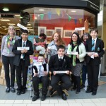
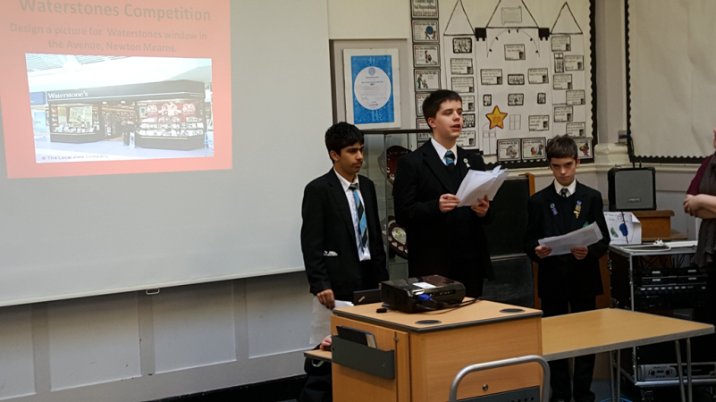

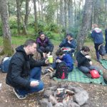
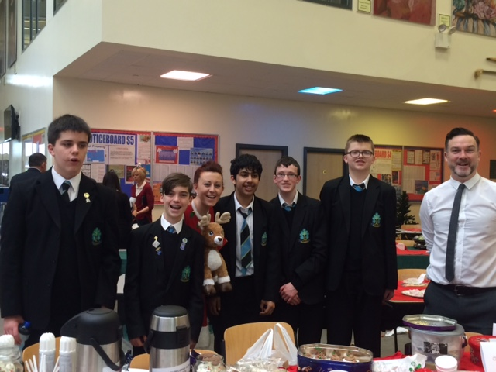
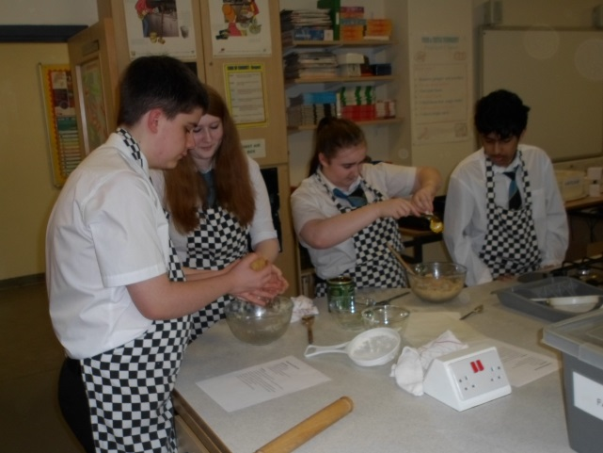
Achievements
David Walliams Competition
BBC Comedy Classroom
Winter Fair
Comrie Croft

Slide 92
Parental Communication
Daily Diary – S1/2
Quarterly Review meetings
Wellbeing plans (STINTS)
Annual parental Questionnaires
Informal communication – open door

Slide 93
Communication Support Service
Q & A?

Slide 94

Cormac O’Hara S4 CSS
All about me:
I am:
A Williamwood High School S4 pupil
a runner – Scottish Champion!!
A big brother to 2 siblings
A member of an inclusion football club
determined, focussed and sporty.

Slide 95
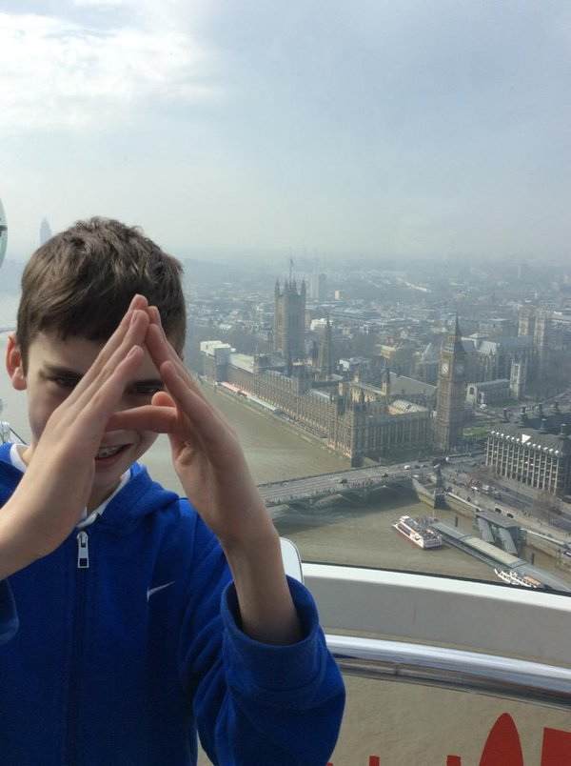
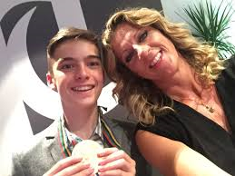
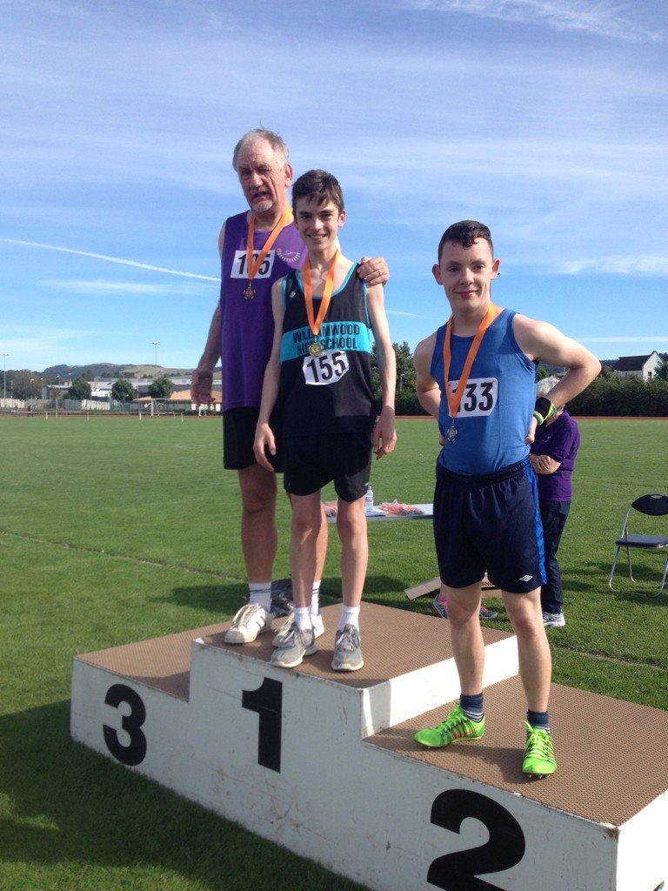
Cormac O’Hara S4 CSS
Why I attend the Communication Support Service

Slide 96
My journey S1- S4
Included
Inclusion in mainstream classes
Friendship groups
Personal Development Projects
Representing the school at sporting events
Recognition of my achievements

Slide 97
My journey S1- S4
Confidence
Social Communication and relationships
Getting to know my peers
More confident to ask for help
Less shy due to compassionate and respectful environment

Slide 98
My journey S1- S4
Dealing with emotions
Understanding my emotions
Support from Notre Dame, Mrs.Brotherhood, Staff at CSS
How to cope with my emotions
Strategies to use to help my anxiety and stress

Slide 99
My journey S1- S4
Learning
I have had opportunities to increase my skills and understanding in PE, Art & Design, Biology and English
People give me chances, point me in the right direction, independence and support
Challenge offered in mainstream classes
‘Safety net’ and support in the base

Slide 100
My journey S1- S4
Q & A?

