Slide 1
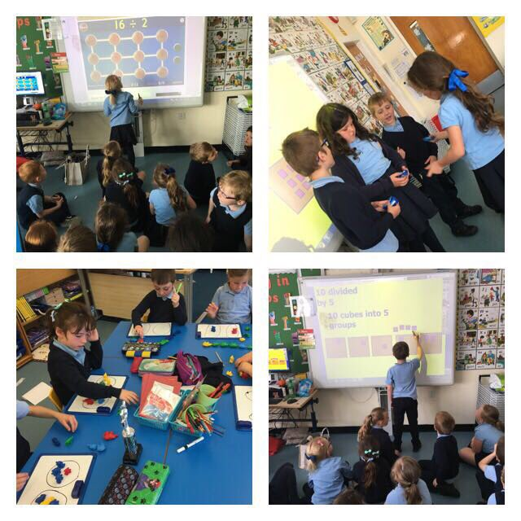
Workshop for Parents and Carers
24th August 2017
Notes:
Good Evening and welcome to our curricular evening on Big Maths.
This evening you will be finding out about a new approach that Our Lady of the Missions have introduced to help improve mental agility.

Slide 2
Aim of Big Maths
To support the raising of attainment in mathematics and numeracy across all stages.
Notes:
The aim of Big Maths is to get children numerate as they journey through school.
The approach builds on basic numeracy skills and follows a natural sequence of progression. Children would be working on specific progress drives and are assessed on these allowing the teacher to intervene and plug gaps where necessary, and to prevent future gaps from developing as children make their way through their primary education.

Slide 3
Confidence
To face the challenges of the 21st century, each young person needs to have confidence in using mathematical skills.
Notes:
Times have changed, we live in a digital world where children are not required to have the same memory for numbers.
Who can remember learning important telephone numbers or having your change counted out to you in a shop.
This doesn't happen anymore and there isn't that same expectation for our children to hold numbers in their head.
We want our children to be confident in their numeracy ability without relying on calculators or phones to help them.

Slide 4
Numbers in Society
Football match
Planning a holiday
Supermarket shopping
Mobile phone tariffs
Sales
Pocket money
Bills
Time

Slide 5
What is Big Maths?
It is a daily programme of mental maths with a strong emphasis on learned facts and developing the mental agility to do something with these facts.
Notes:
What is the Big Maths approach all about?
Read slide

Slide 6
CLIC
Four core skills lie at the heart of numeracy.
The acquisition of these basic skills allow children to use and apply their knowledge in all areas of Mathematics.
This process is known as CLIC …
Counting
Learn Its
It’s Nothing New
Calculations
Notes:
Read Slide

Slide 7
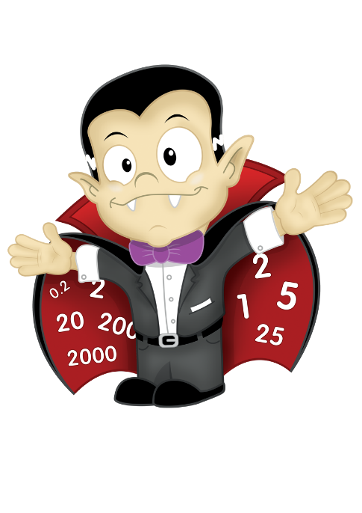
Counting
Children learn to count and to count on.
Count round the room from 0 in 1s
When one person claps, count backwards
On the next clap, count forwards
Make this harder – count in 2s, 5s, 10s, 4s
Try this at home
Count Fourways
Notes:
Could do this with your group depending on your numbers.
If not possible you can explain the counting that you do with your class

Slide 8
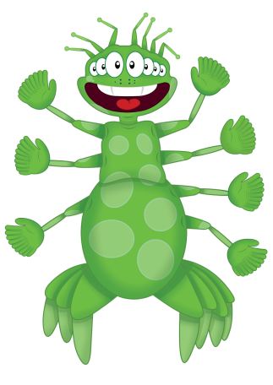
Learn Its
A ‘Learn It’ is a number fact that is learnt so well that it can be recalled instantly,
e.g. 4 + 3 = 7
They are number facts that we need again and again in all areas of numeracy
There are 72 number facts pupils should know by the end of Primary 7
Notes:
Read Slide.
It is important that children learn these number facts.
To learn 72 facts seems like a lot but this has been broken down to roughly 10 number facts per stage. This should be manageable for all children to do.
Once a child has learned these number facts then they can apply them in different contexts and also focus on the learning of Mathematical processes.

Slide 9
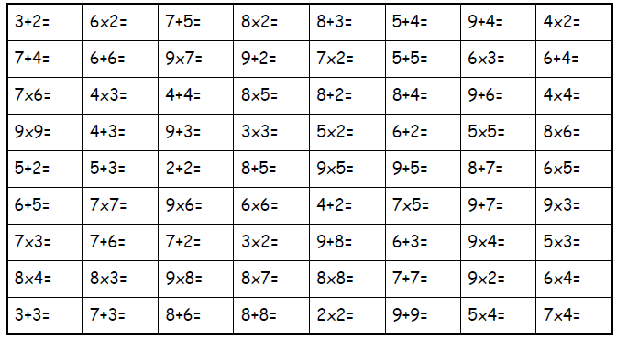
Learn Its – 72 total recall facts
Notes:
Here are the 72 recall facts.

Slide 10
It’s Nothing New
Pim is an alien from the planet CLIC.
He is used to support the principle that it is irrelevant what the ‘thing’ is when applying knowledge.
Therefore, if we know that 3+4=7, then 3 things + 4 things must be 7 things. There is no need to count, we can just ‘learn it’.
Notes:
The Big Maths approach uses Characters and songs to help make Maths fun for children.
Read slide.

Slide 11
It’s Nothing New
There is no new maths involved when we add
multiples of ten together.
30 + 40 = 70
3 tens and 4 tens = 7 tens
So its nothing new that…
3 things and 4 things = 7 things
3 + 4 = 7
Notes:
Further example of nothing new.
Some children will always say that they find maths challenging or difficult but once you learn the answer it never changes.
Through the Big Maths approach children can clearly see this process.

Slide 12
Jigsaw Numbers
Jigsaw numbers are just number bonds.
They total a special number in our number system,
e.g. 10, 100 or 1000.
I know the missing decimal piece
I know the missing piece to 1000
I know the missing piece to 100
I know the missing piece to the next multiple of 10
I know the missing piece to 10
Notes:
Jigsaw numbers allow our children to make connections with numbers.
Read slide

Slide 13
Jigsaw Numbers
Notes:
An example of Jigsaw numbers

Slide 14
Multiplying by multiples of 10
Notes:
Smile Multiplication is the Big Maths name for multiplying by multiples of 10.
It is a critical building block for multiplication.
It is so called because of the smiley face that the children draw as they first apply the skills of multiplying by multiples of 10.
There are three fool-proof steps to follow:
Remember to do the tables bit
Remember to count the zeros in the question
Remember to put the zeros on your answer.

Slide 15
Switchers/ Fact Families
What is a switcher?
3 + 4 = 7
So what is 4 + 3 = ?
What is a fact family?
3 x 4 = 12
4 x 3 = 12
12 ÷ 3 = 4
12 ÷ 4 = 3
Notes:
Whenever there is a new approach there is new language to learn.
Switcher is a term we use for swopping the numbers round. If you know what 3+4 is then you know what 4+3 is.
If you have an activity home and children are talking about switchers that is what they mean not a complicated mathematical process.
We talk about fact families with children understanding that if they know what the multiplication family is then they can use those numbers to create a division calculation.

Slide 16
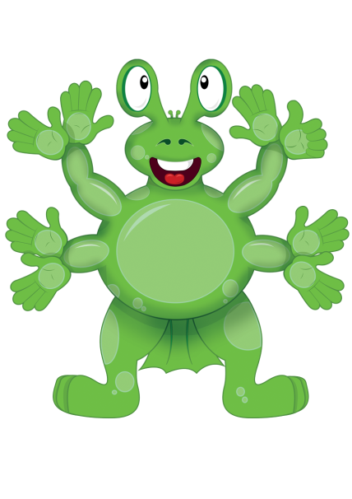
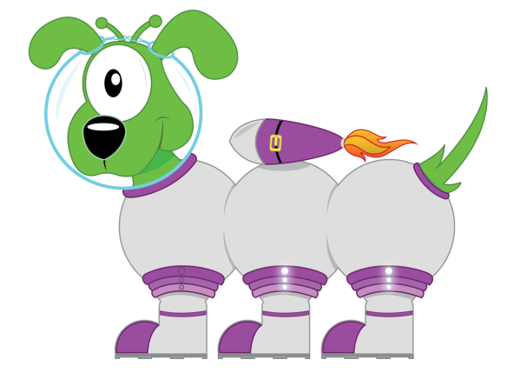
Big Maths Characters
Notes:
Here are other characters that your child will meet on their Big Maths journey.
Mully, Pim the Alien, Pom, Squiggleworth and Count Fourways.
Each character is used to support mathematical learning.
It engages children and makes maths a little less frightening!

Slide 17
Meet Squiggleworth!
Squiggleworth, the Place Value Pet!
What is that squiggle worth?
3
6
7
300
60
7
Notes:
Read Slide

Slide 18
Where’s Mully?
Meet Mully Multiple! He likes to explore and to hide behind the biggest multiple of a number he can find.
‘Where’s Mully?’ significantly enhances the pupils’ knowledge of multiples and how known multiples can be added to find new multiples.
At the same time, pupils are actually becoming proficient at division!
Notes:
Read slide

Slide 19
Pom’s Words
Pom is an alien. He lives with Pim on the planet CLIC.
Pom has several features that help children learn 4 key mathematical words: multiple, factor, square and prime.
Notes:
Read slide

Slide 20
Beat That!
Time for a test…. ☺
Notes:
Each Friday the children will be assessed on their learn its.
They will get a timed test. They have to answer as many questions they can in that given time.
They will receive a score and they have to try and beat their own score each week. Improving their accuracy and pace of answering questions.
It is now time for you to Beat that!!!
Your challenge will begin......

Slide 21
What Can I Do to Help My Child?
Talk to your child about their experiences, e.g. a trip to the shops – how many numbers?
Fun maths tasks e.g. Dividing chocolate bars
Help with recipes/ TV guides/ newspapers/ magazines
Have fun with numbers (websites)
Number puzzles e.g. Sudoku
Notes:
There are many ways that you can support your child in numeracy here are some ideas.

Slide 22
Websites to support numeracy
Education City
Topmarks
Sumdog
Parentzone website
Cool Maths Games
Math Playground
Notes:
I have included an example of websites that your child can access to practice their numeracy skills at home.

