Slide 1


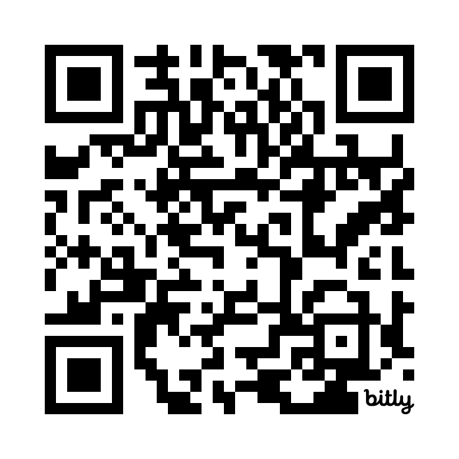

Porridge Pledge 2025
Ndombo School
Mary’s Meals
Every £19.50 raised feeds 1 child for a year.
This is enough for a nutrient enriched porridge which provides key nourishment for each child.
Help us to feed the world’s most vulnerable children.
This is your opportunity to show solidarity with our friends in Ndombo School, Malawi.
The week beginning the 24th March will see the start of our second
Porridge Pledge.
S4-6 pupils and staff have been encouraged to sign up to eating plain porridge and rice for 5 days. S1-3 pupils can do so for any 24 hour period during that week
We hope to raise money through sponsorship from family and friends.
Donate at St Ninian's High School - Fundraising - Mary's Meals

