Slide 1
European Day of Languages 2021
French Challenge

Slide 2
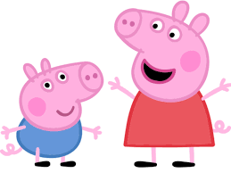
Get your ticket!
Disney challenge
French blind test Disney
Peppa pig in French
French crepes
Sport in French

Slide 3
Disney songs challenge
Have a look at the booklet called “Disney songs booklet”
You will find:
-a matching up exercise with titles of Disney films in French & English
-an emoji exercise: guess the title of the film with the emojis
Enjoy 🎤
ACTIVITY
0000001

Slide 4
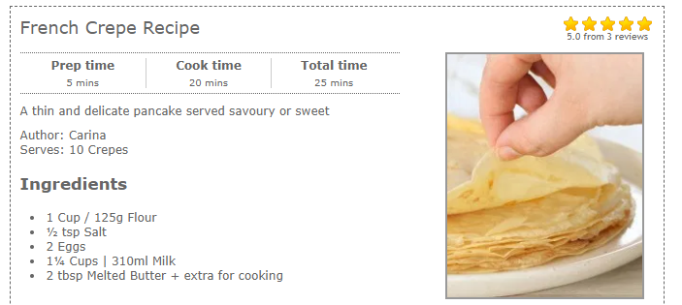
French crepes
If you want to make crepes with an adult, click on this link to see the recipe and a video :
https://recipesbycarina.com/french-crepe-recipe/
ACTIVITY
0000002

Slide 5
French blind test - Disney
Can you recognise these Disney songs in French?
Click on this link:
https://www.youtube.com/watch?v=Vrp9OVDUB-E
2. You are going to hear 40 songs:
=>1 point if you guess the name of the Disney film in English
=> 1 point if you guess the name of the song in English
ACTIVITY
0000003

Slide 6
Peppa pig in French
Watch Peppa pig in French with English subtitles:
=> Peppa pig au supermarché (Peppa pig at the supermarket)
https://www.youtube.com/watch?v=bF6b4lOlCv8
=> Mer, soleil et neige (Sea, sun and snow)
https://www.youtube.com/watch?v=--N-tHiq_Co
ACTIVITY
0000005

Slide 7
Sport in French
Gym lesson in French:
https://www.youtube.com/watch?v=Yt0wuk_bOXI
2) Yoga with the names of French pets:
https://www.youtube.com/watch?v=a2Bt3Ruk9Lg
3) Learn body parts in French:
https://www.youtube.com/watch?v=aUMNUKlpJVk
ACTIVITY
0000006

