Slide 4
Challenge: use a language (or languages) other than English to show your ideas, hopes or even advice for our world.
Topics can include: climate change, helping the environment, how we treat one another, equality, etc.
Format: Any – a poem, an essay, a song, a cartoon.
Length: no minimum or maximum number of words.
Judging categories: S1-3 and S4-6. Individual or group entries are welcome.
Entries will be judged on language use, content and creativity.
Closing date: Monday 25 October 2021.
https://scilt.org.uk/LearningforSustainability/Wordsfortheworld/tabid/8489/Default.aspx

Slide 5
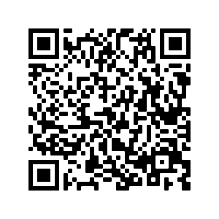
https://scilt.org.uk/LearningforSustainability/Wordsfortheworld/tabid/8489/Default.aspx

