Slide 1
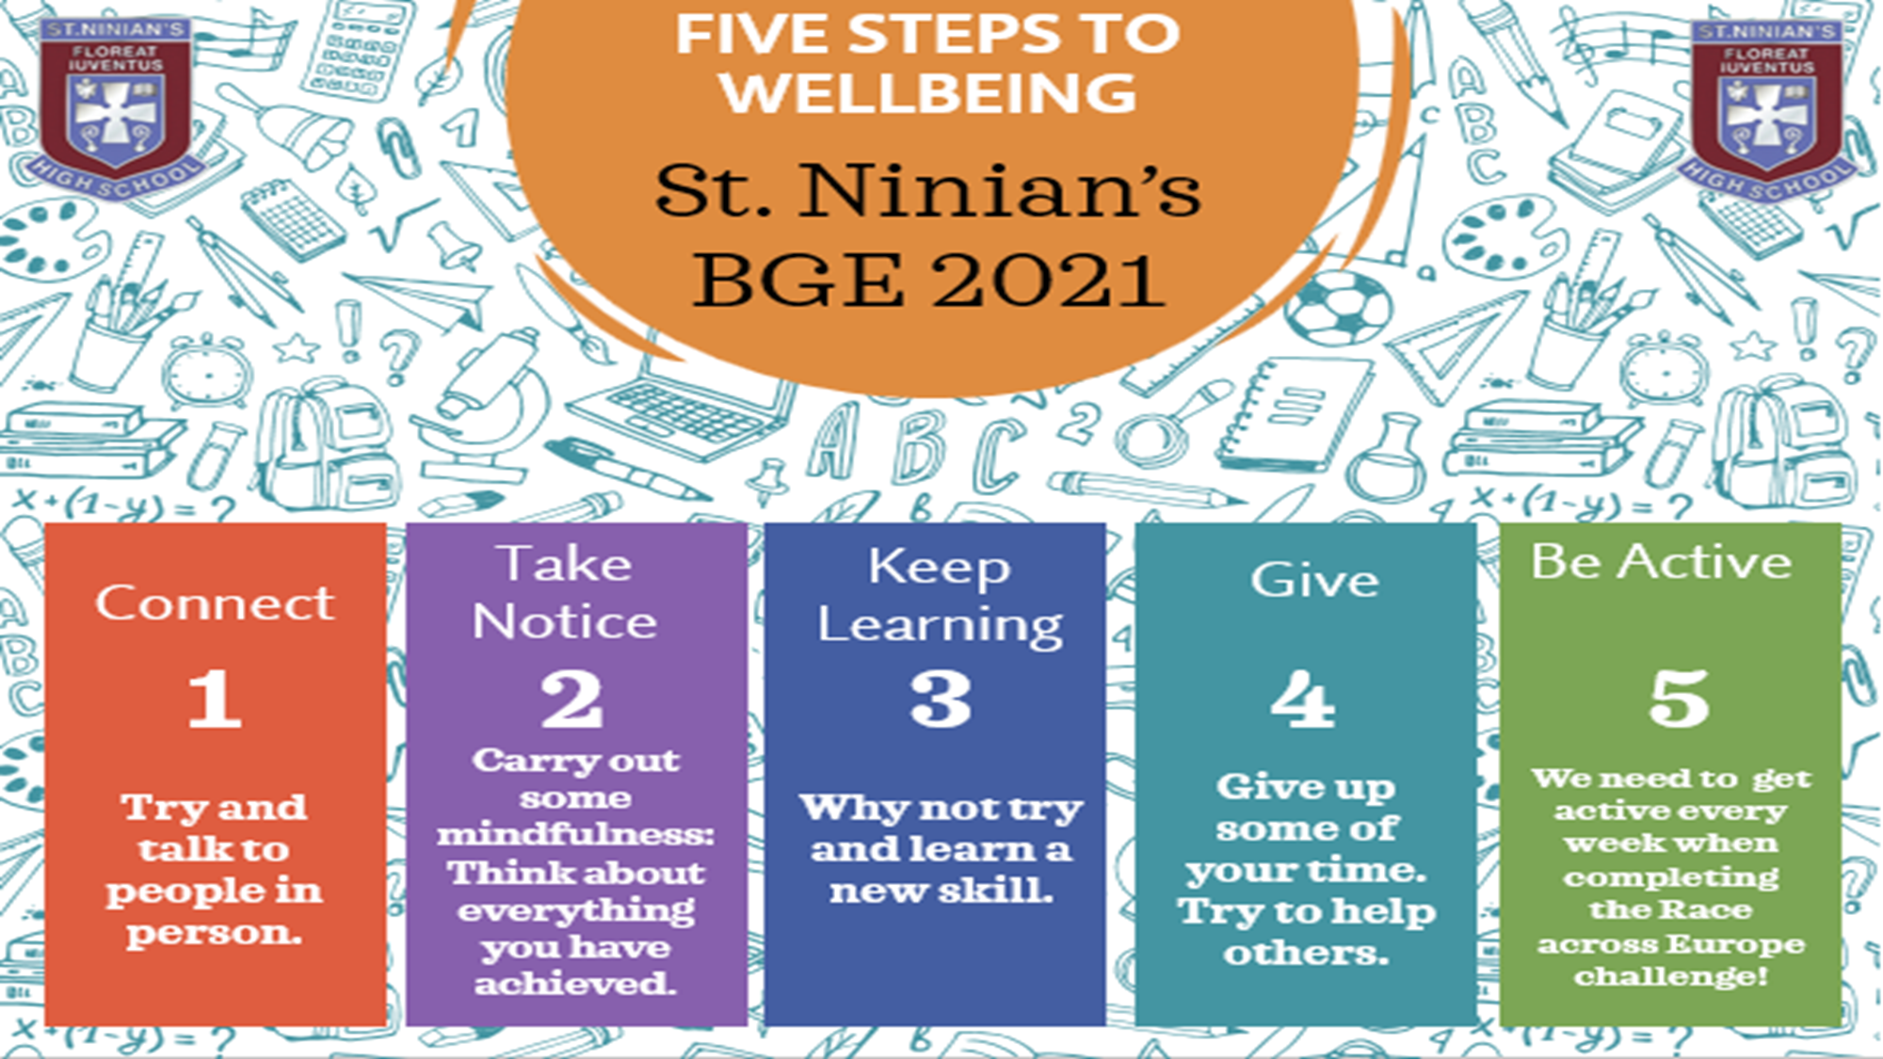

Slide 2
Step 4 – Give
This week we are going to have a look at the fourth step in our Saint Ninian’s Five Steps to Wellbeing, Give.
We will consider the following questions:
What does it mean to Give?
How can we Give?
What strategies can I use to Give?

Slide 3
What does it mean to Give?
Giving is the act of freely parting with something and offering it to someone or something beyond ourselves- a stranger, friend, family member, a charitable organisation, our local community or our wider community.
Research has found a link between doing good things and an increase in positive wellbeing.
Sometimes we think of wellbeing in terms of what we have: Our comfort, our income, our home, our car, our job. But evidence shows that what we do and the way we think actually have a far more meaningful impact on mental health and wellbeing.

Slide 4
How can we Give?
There are a number of different ways that we can ‘Give’:
It can involve parting with material things like money and gifts, or immaterial things like our time, skills, knowledge, enthusiasm, passion and kindness.
In practice, giving can look like a number of things – it could mean supporting a friend with a problem, donating clothes or unused items to a charity, volunteering your time for a cause you care about, or simply making an effort to make more time for the people that you care about.
Making someone laugh is the most fun way of giving and one of the very best gifts you can offer someone.

Slide 5
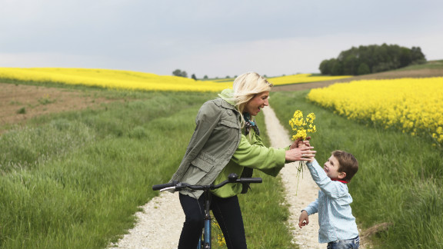
What strategies can I use to Give?
There are a number of different strategies that we can use to help us ‘Give’.
You can use the next slide to help you introduce ‘Giving’ into your daily life. You should aim to complete 3 actions from this tree each day for one full week.
Our ‘Giving Tree’ is a fantastic way for you to introduce simple but effective changes into your daily life!
Good luck introducing our 4th Step to Wellbeing into your day to day life ☺

Slide 6
GIVE STRATEGIES
To carry out our Giving challenge please complete 3 examples of Giving from our ‘Giving tree’ each day.
Smile and say Hi to a passerby.
Make a donation to a charity: This could be time or money.
Make someone a tea or coffee
Ask someone how their day is going.
Hold a door open for someone.
Do a chore. Something big or small.
Stop to help someone that needs help.
Offer to do the dishes at home
Say thank you to someone that’s helped you.
Make a small gift for a friend.
Help someone with work.
Give your full attention to a friend: Listen to them without looking a phone.
Give someone a compliment.

