Slide 1
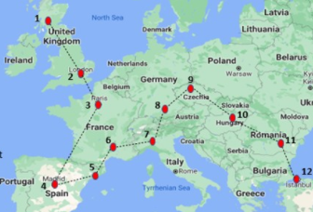
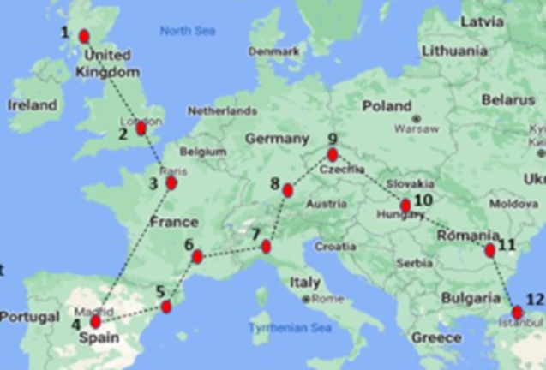
Race across Europe
This is the updated totals for our ‘Be Active’ challenge. So far first year are marginally in the lead, approximately 25km outside Budapest. Second year are around 160km away from arriving in Budapest, aiming to quickly close the gap. Finally S3/S4 are close to arriving into Madrid, almost finishing the longest check point stretch.
S1 Total
5,521.80 km
S2 Total
5,329.52 km
S3+S4 Total
2,005.19 km

