Slide 2
Week 2 – Take Notice
This week we are going to have a look at the second step in our Saint Ninian’s five steps to wellbeing, Take Notice.
We will consider the following questions:
What does Take Notice mean?
How can we Take Notice?
What strategies can I use to Take Notice?

Slide 3
What does Take Notice mean?
Taking Notice means actively bringing our mind’s attention and interest to the world around us and ourselves; what is going on externally to us and what is happening within us.
Taking notice means being present in the moment; observing what’s beautiful or unusual in the world.
It means being aware of our thoughts and feelings as they arise, without getting lost in them.
It means savouring the moment whether you’re being active, connecting with a friend, learning a new skill, or giving to others.

Slide 4
How can we Take Notice?
Be observant, look for something beautiful or remark on something unusual.
Savour the moment, whether you are on a bus or in a taxi, eating lunch or talking to friends.
Be aware of the world around you and what you are feeling.
Reflecting on your experiences will help you appreciate what matters to you.

Slide 5
What strategies can I use to Take Notice?
Life can be so busy, taking a moment to engage with everything around you and taking the time to reflect is really important.
When trying to take notice you could try:
Mindfulness and meditation
A gratitude journal – taking a moment before you sleep each night to write down what you are grateful for that day
Having a ‘clear the clutter’ day
Taking notice of how those around you are feeling or acting
Take a different route when completing a journey you regularly do

Slide 6
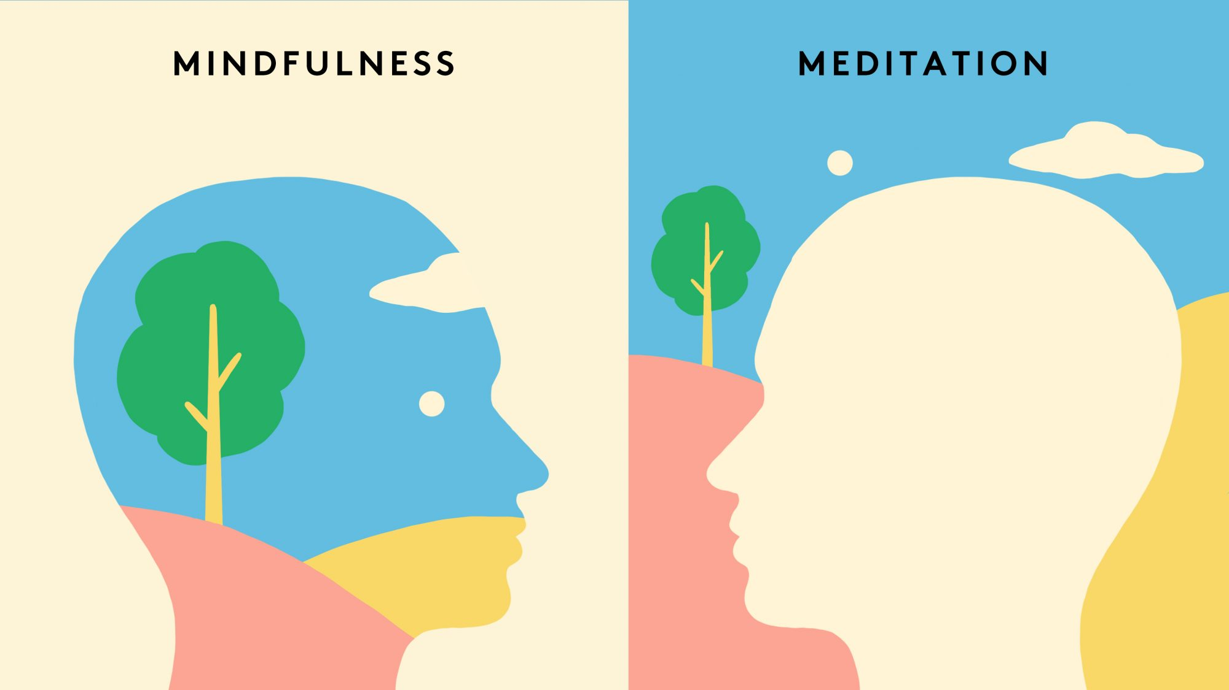
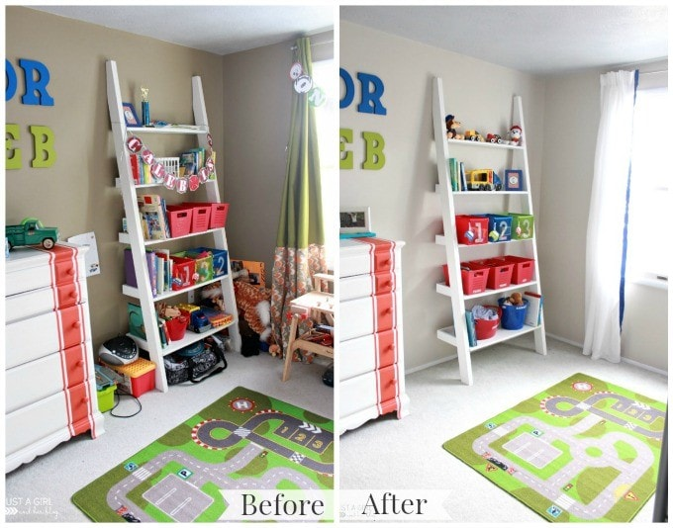
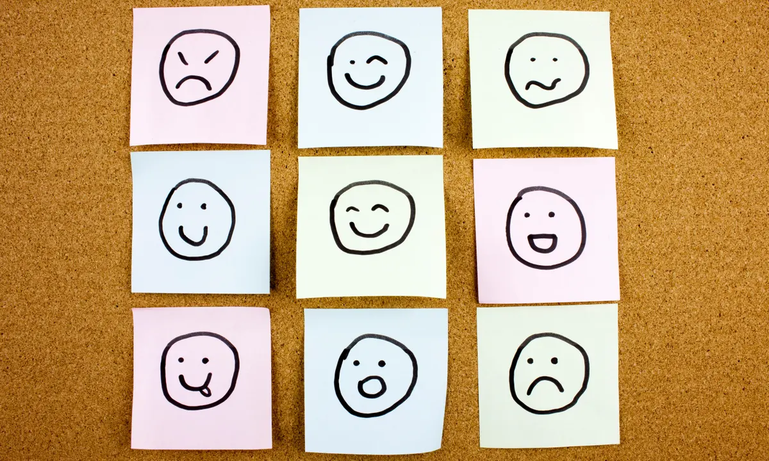
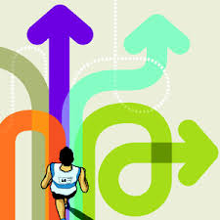
What strategies can I use to Take Notice?

Slide 7
Race across Europe – Be Active Challenge
Your work over this past week has been fantastic, accumulating kilometres that are going to be added to the BGE total for our ‘Race across Europe’.
Each week you are trying to cover as many kilometres as possible by Walking, Running or Cycling.
Remember to fill in the attached document to let your teacher know how many kilometres you manged to cover.
Keep up to date with the PE department Twitter so you can see our progress across Europe ☺

