Slide 1
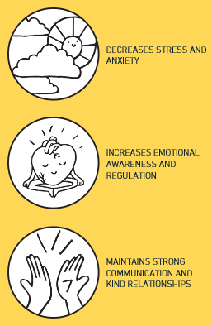
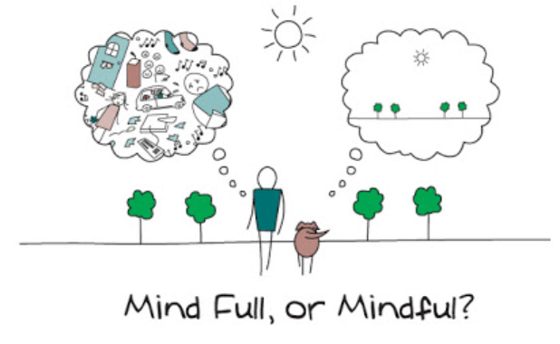
Positive Mental Health – a pupil guide
Try to follow a routine and create your own workspace
Try to log in to your google classrooms at the same time you would attend each subject.
Remember weekends will continue as normal and ensure indoor treats and fun activities are still planned.
Although it's tempting to head to your sofa with a laptop, try to set up a work area helps you stay focused. If you can, try to set aside a specific area or space where you can work. If you don't have a desk, use a table or worktop.
Practice mindfulness
Use websites to facilitate mindfulness and positive changes. The my life/ ‘stop, breathe and think’ allows for a simple ‘check in’ and then generates personalised guided exercises, guided journaling and other helpful support to navigate challenges with resiliency and calm.
My Life/Stop, breathe and think has proven to achieve the following outcomes:
Download the app by following this link: https:/my.life
In addition, look on the positive mental health page for posts on how to practice daily tasks in a mindful way around the house or in the garden.
https://blogs.glowscotland.org.uk/er/snhspositivementalhealth/
Look for positive messages
This is a difficult time and we all cope with stressful times in a variety of different ways. Although it can be helpful to keep up-to-date with official guidance and information surrounding Covid-19, try to limit the exposure you all have; this can increase worry.
Instead, look for positive and accurate on-line messages and supports, for example
https://www.actionforhappiness.org/ provides helpful calendars and clear positive advice.
Connect with others
Whilst communication can feel really different during this time – remember to connect with your family and friends. Zoom calls, facetime. Try to pick up the phone for a real conversation rather than relying on email or instant messaging all day.
Remember fresh air
Remember to get out for a walk – fresh air helps to clear your mind and focus. Also it gives you a break away from the computer gets you in a clear headspace for the tasks ahead!

