Slide 1
Athletics 2020

Slide 2
S1/S2 Athletics
1a1/2a1 - Germany
1a2/2a2 - Spain
1a3/2a3 - Holland
1a4/2a4 - France
1a5/2a5 - Portugal
1a6/2a6 - Italy
1a7/2a7 - England
1a8/2a8 - Ireland
1a9/2a9 - Wales
1a10/2a10 - Scotland
2a11 - USA

Slide 3
What events are we going to cover during the block?
100m
200m
400m
800m
Relays
Shot putt
Poster event
(Further information during today’s lesson)

Slide 4
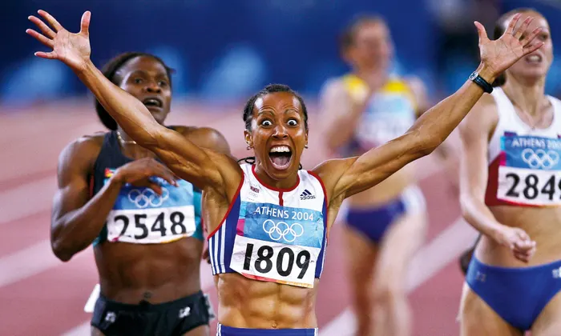
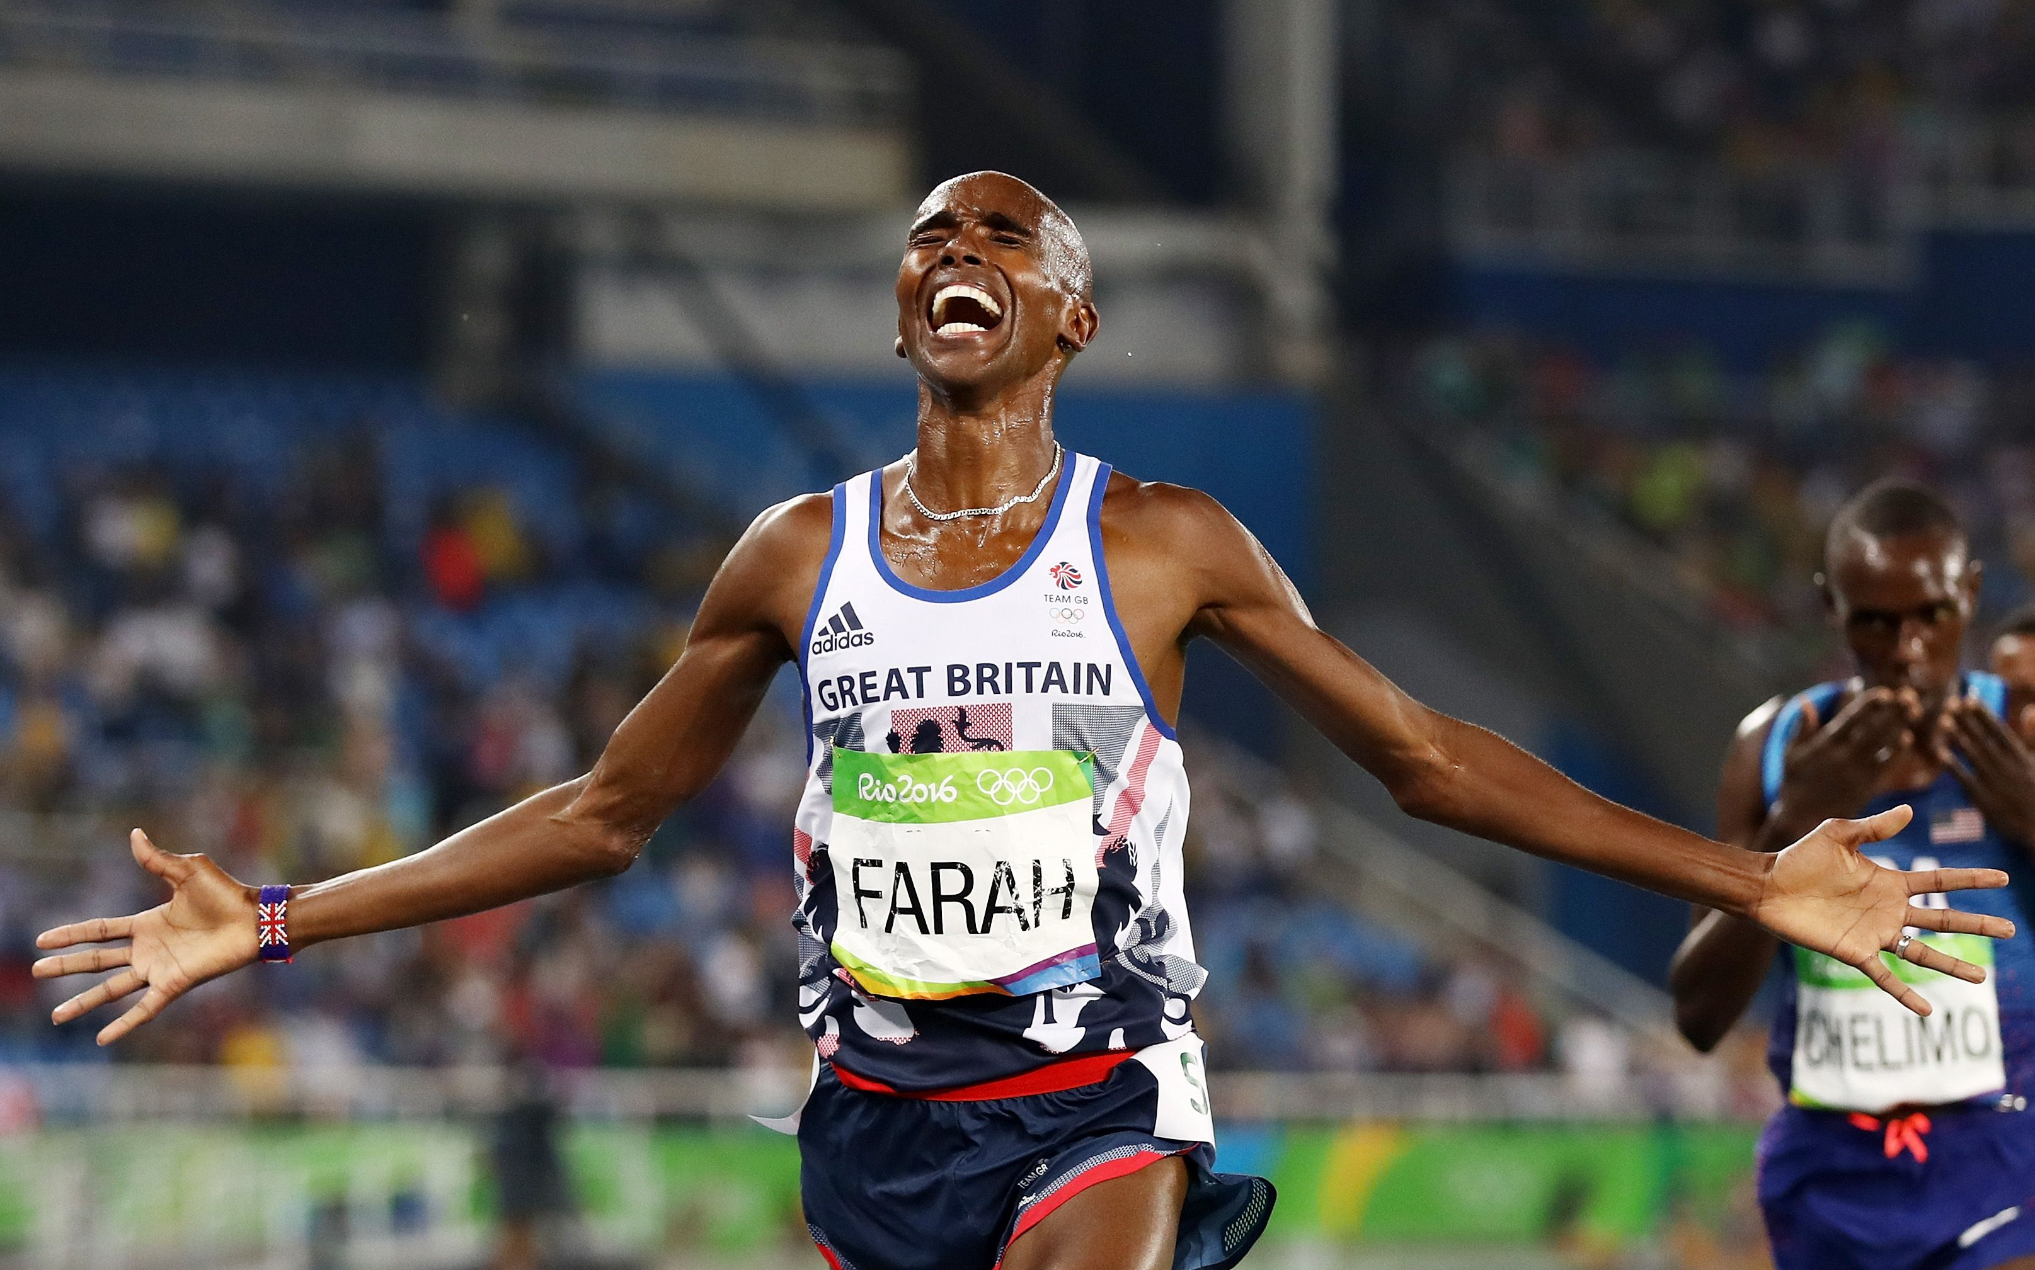
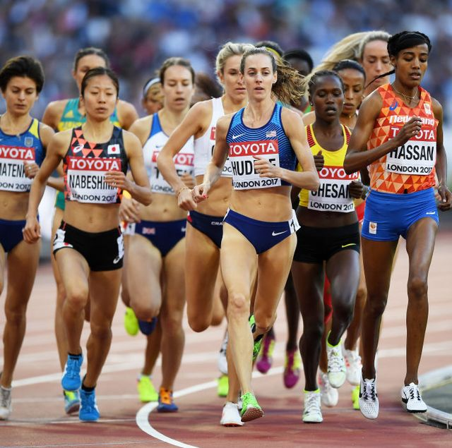
Athletics 2020
As part of our PE classes we will be completing a block of Athletics. To make this more interesting the Saint Ninians PE department have come up with a class competition.
Each Alpha has been assigned a country that they are going to represent for the duration of our Athletics block e.g. 1a1/2a1 Germany.
We will record your classes time/scores for each event and generate an alpha average for each individual event.
For example: Scores will be taken from both 1a1 and 2a1 for 100m, the scores will then be added together and divided by the number of participants. This will generate an average for the alpha for the medals chart.
Each event will count towards our medals chart.

Slide 5
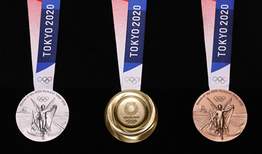
Medals table
For each event we will have a Gold, Silver and Bronze medal up for grabs.
Gold Medal = 5 points
Silver Medal = 3 points
Bronze Medal = 1 point
The alpha top of the leader board after all events are complete will receive 200 class of the year points, 2nd will receive 100 points and 3rd will receive 50 points. (Class of the year goes to Blackpool!)

Slide 6
What do we need from you guys?
When carrying out each activity make sure that you give 100 percent!!
You giving 100 percent could be the difference between your class gaining a 5 points or no points from that event.
Encourage everyone in the class to do well during all lessons. Your encouragement will be a huge part of the success of your alpha.

Slide 7
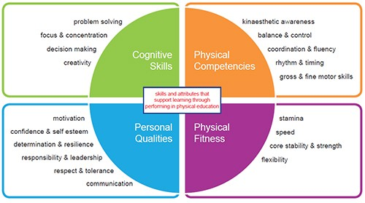
Research task
You will be split up into small groups of three or four.
Each group will design a poster based on the country assigned
to their alpha.
Information that could be included the poster:
1) The country’s records for each event e.g. Jamaica 100m – Usain Bolt 9.58 seconds
2) Famous athletes from the country (Athletics specific)
3) Trying to link the SALs into some of the events e.g. Shot Put – Core stability and Strength
4) Any fun facts about the country related to athletics or general knowledge

Slide 8
Poster entries
Making posters – You will be given some time in class to complete your posters, however you can also work on them at home.
Make each of you poster’s as interesting as possible and ADD PLENTY OF COLOUR !
Remember there are medals available for the 3 best alpha entrants for our competition.
When completed all posters should be handed to your class teacher by Friday the 11th of December.

