Slide 1
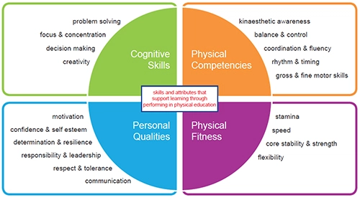
Physical Education Anti-Bullying week 2020
As part of the Anti-Bullying week 2020, S1-S3 pupils will learning about Respect and Tolerance.
Pupils will consider the different impact that Respect and Tolerance can have on both sporting performance and their daily life.

Slide 2
Physical Education Anti-Bullying week 2020
Learning intention: Develop knowledge of Respect and Tolerance
Success criteria: 1) I can give examples of how to show respect and
tolerance in sport.
2) I can demonstrate both respect and
tolerance in sport.

Slide 3
Physical Education Anti-Bullying week 2020
Plenary question ideas:
By demonstrating respect and tolerance in a game, how will this benefit your team?
What negative effects can be displayed with poor respect and tolerance?
Homework task:
Pupils should be asked to come prepared to next lesson with a definition of how Respect and Tolerance in sport can be transferred into their daily life in school and outside of school.

