Slide 1
Primary 7
The John Muir Award

Slide 2
What is the John Muir award?
It is an environmental award focused on wild places.
It helps people connect with nature, enjoy and care for wild places.
It encourages awareness, understanding and personal responsibility for the environment.

Slide 3
The 4 elements
Discover
Explore
Conserve
Share

Slide 4
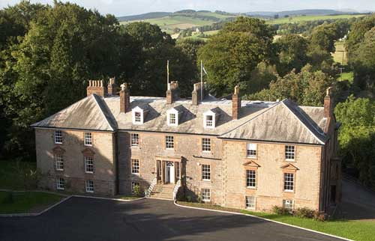
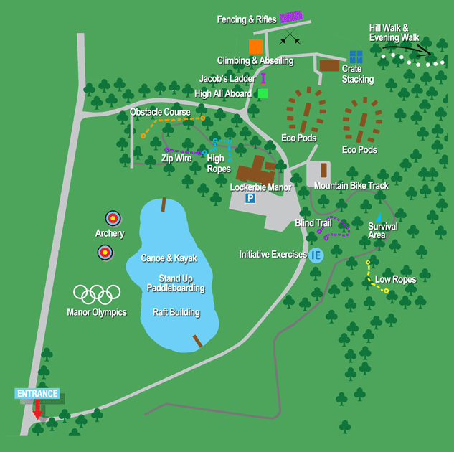
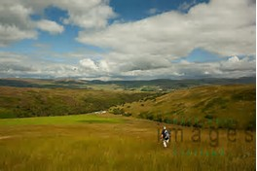
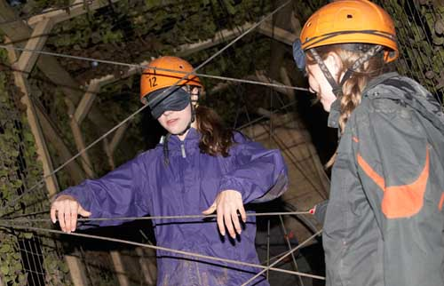
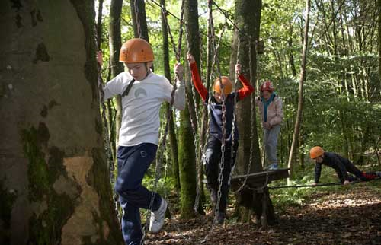
Discover
Lockerbie manor
School grounds

Slide 5
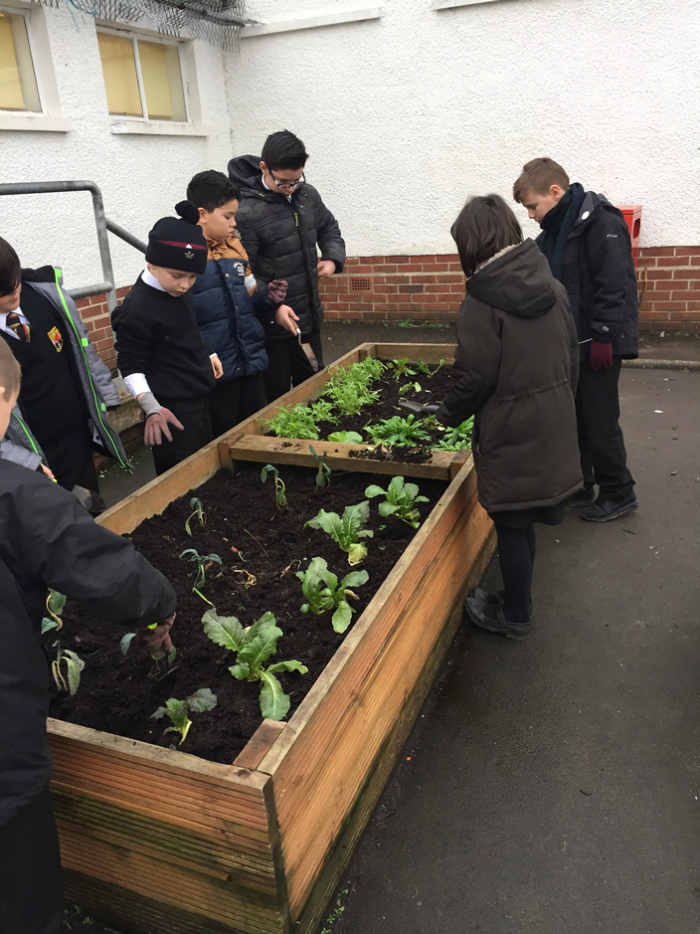
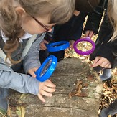
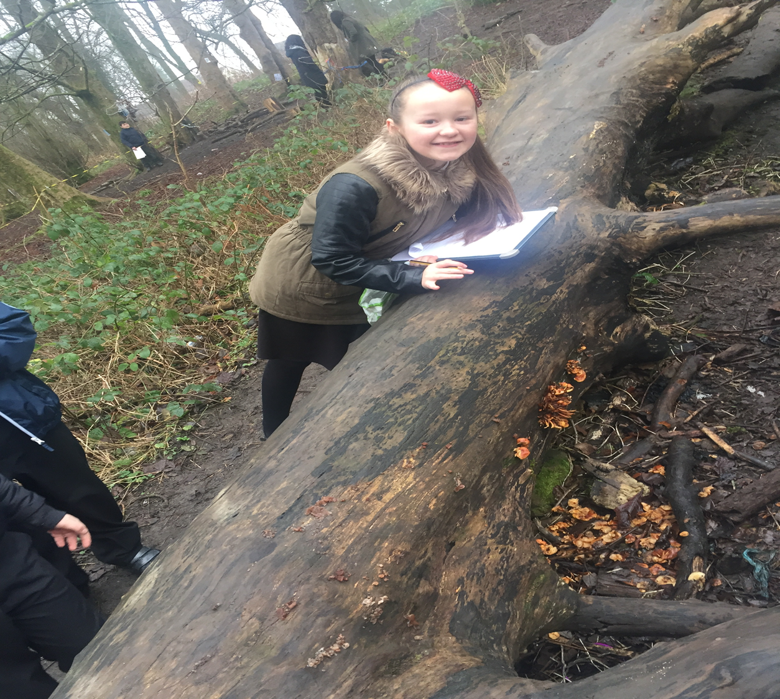
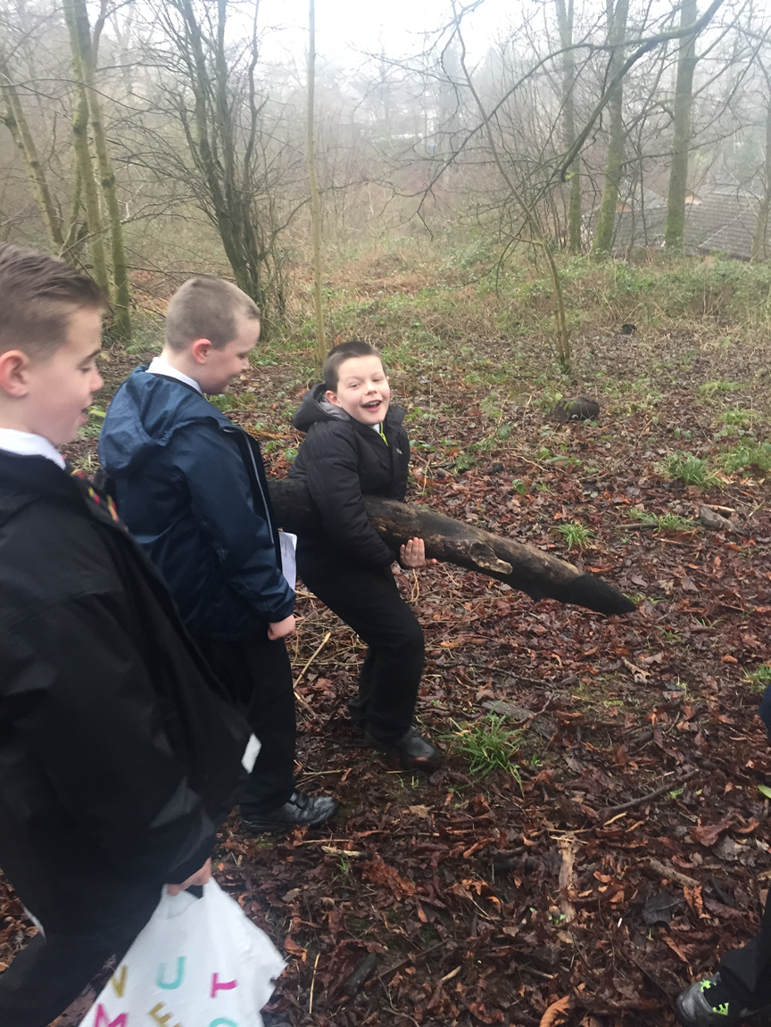
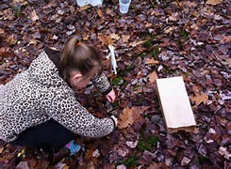

Slide 6
Explore
Lockerbie Manor
School grounds

Slide 7
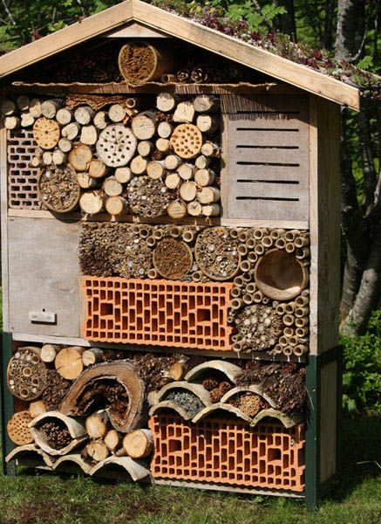
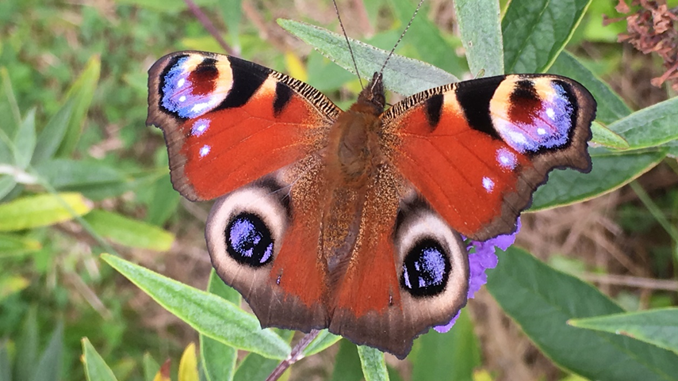
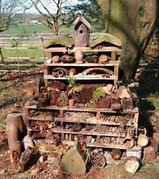
Conserve
Lockerbie manor
School grounds

Slide 8
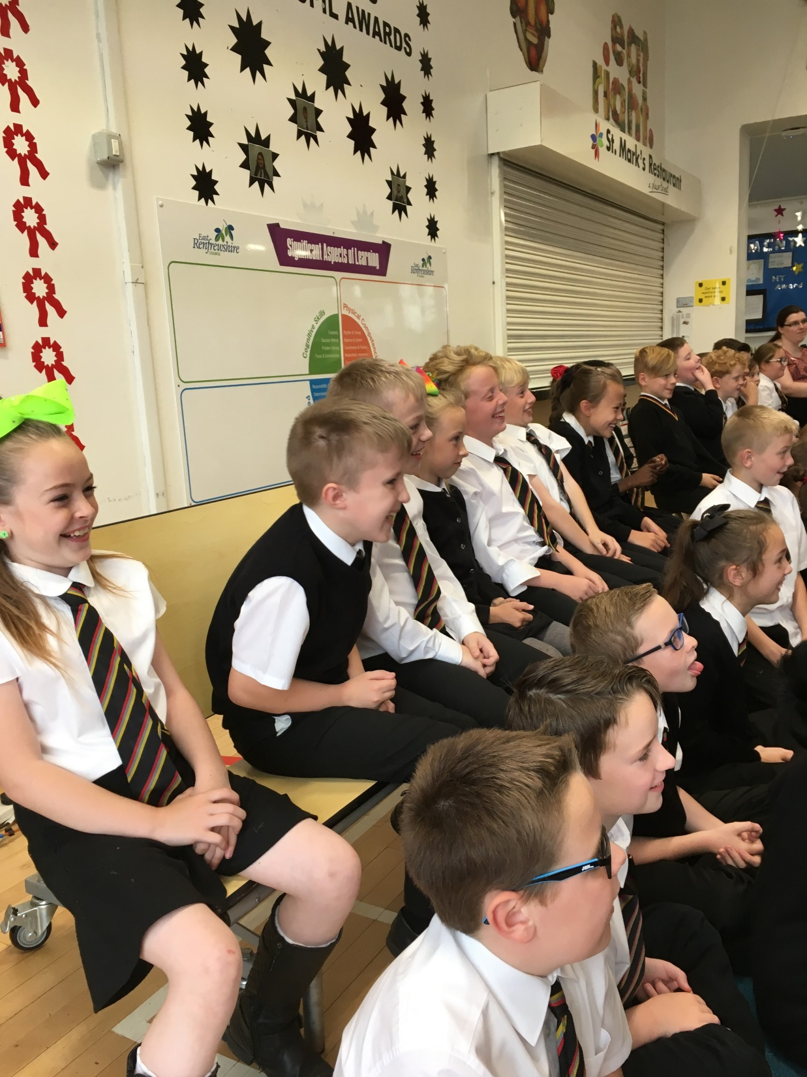
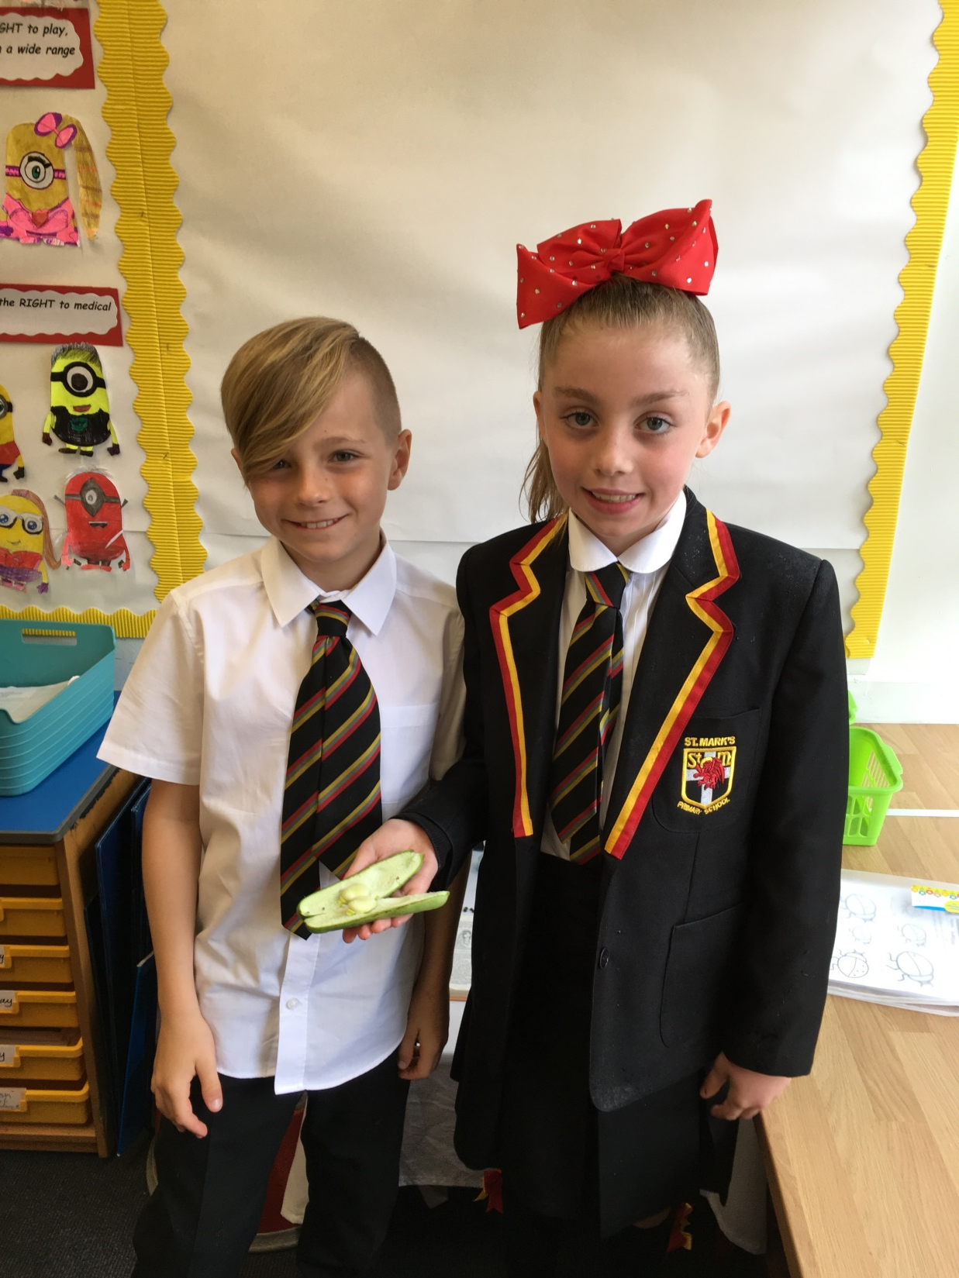
Share
Lockerbie manor
School grounds

Slide 9
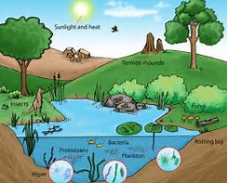
Ecosystem
An ecosystem includes all of the living things in a given area, interacting with each other, and also with their non-living environments.

Slide 10
Habitats
A habitat is a place where something lives.
There are many different types of habitats:
hot or cold
big or small
on land or in water

Slide 11
