Slide 1
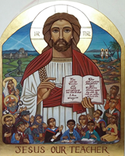
Catholic Schools: Good for Scotland The Centenary of the 1918 Education Act (Scotland) We will be hosting the Icon of Jesus Our Teacher, Tuesday 4th September. Fr. Joe will lead pupils in prayer. Parents and carers are very welcome to spend reflective time with the Icon 3.00pm-3.30pm. A Power Point outlining the history of Scottish Catholic Education will be running for your information.

