Slide 1
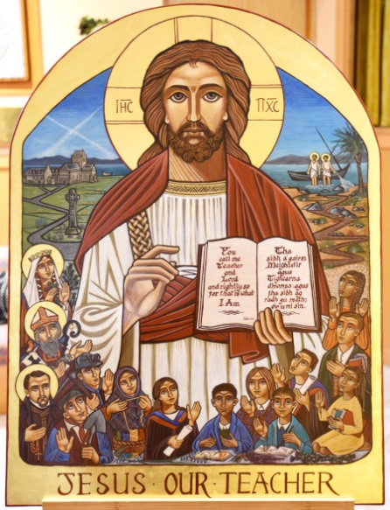
CATHOLIC EDUCATION PRAYER Jesus our Teacher, in your love for us, help us to develop our own talents so that we may become like you and lead lives of goodness. Bless all learners and all teachers. May our Catholic schools continue to serve our families, our communities and our country. Help us, through our learning, to believe in you and to celebrate the life of your Church. Help us to grow in holiness as we grow in friendship with you and try to become saints. We make this prayer in the name of Jesus, our Lord. Amen

