Slide 1
Fairtrade 2015 We are here to talk to you about Fairtrade. LI: By the end of this presentation you will be able to -name some Fairtrade products -Recognise the fairtrade logo -Say how you can help Fairtrade by Fairtrade Committee
P1-3

Slide 2
Have you ever seen the Fairtrade Logo?
You can find the Fairtrade logo on kit kats, maltesers, tea, coffee, bananas, sugar and lots more. Have a look next time you are in Asda or Tesco for the Logo on some of these products.

Slide 3
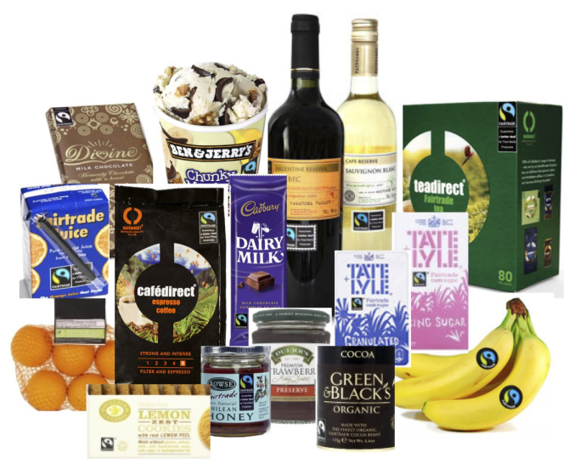
What Fairtrade Products can you see in this picture?
Can anyone spot the Fairtrade Logo?

Slide 4
This is the Fairtrade Logo What do you think it looks like? Why do you think it is green and blue?

Slide 5
http://schools.fairtrade.org.uk/sites/default/files/Full%20MP4%20of%20finished%20movie%20extracted%20from%20Youtube.mp4 What does it mean if you buy something with the Fairtrade LOGO on it? What does it mean for people in the world?

Slide 6
How you can help
Now that you recognise the fairtrade logo you can look for it when at the shops.
Whenever you are helping your mummy or daddy with the shopping you can ask them to buy Fairtrade whenever you see this logo.

Slide 7
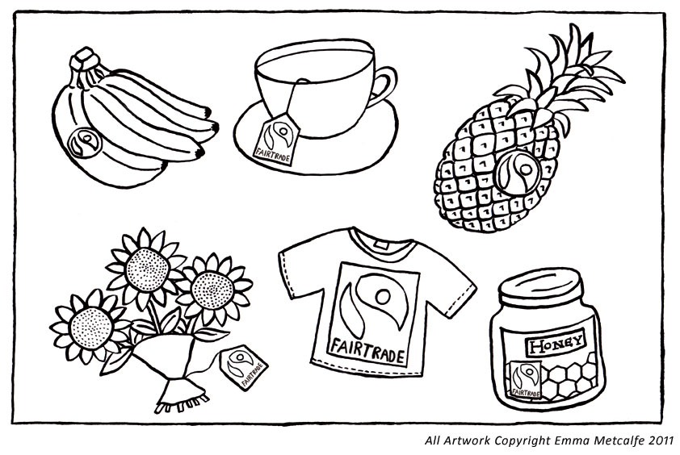
Competition Time
We would like p1-3 to take part in our colouring Competition.
One winner will be selected from each class and will receive a special prize.

