Slide 1
Learning for Sustainability
International Migrants Day 18 December

Slide 2
Pope Francis said migrants are not numbers, “but persons with feelings that need ongoing protection” adding that “particular concern must be shown for migrant children and their families.”“ EVERYONE HAS A DUTY TO DO GOOD.” POPE FRANCIS

Slide 3
By the end of the lesson, I will be able to:
Understand what migration and immigration mean
Identify reasons why people would want to go to a different country
Discuss the challenges some people may face when they come to live in a different country

Slide 4
STARTER
SHARE
PAIR
THINK
Consider:
What is migration?
What is immigration?
Why do you think people would want to live in another country?

Slide 5
(Im)migration
Copy the following definition in to your jotter:
What does migration mean?
movement from one part of something to another e.g. a country
What does immigration mean?
the action of coming to live permanently in a foreign country

Slide 6
Immigration
Activity:
Make a list of different possible reasons for immigration
e.g. the search for a better standard of living
SHARE
PAIR
THINK

Slide 7
Immigration
What are the reasons people want to leave their country of birth? Some examples below:
Fear of imprisonment
Fear for own safety or of family members
Civil conflict / War
Natural disasters
Poverty / starvation
Search of a better quality of life
To find employment
To be reunited with family
Retirement
Climate

Slide 8
Immigration
SHARE
PAIR
THINK
Consider:
What preconceived ideas do people have regarding immigration?
e.g. they take all of the jobs and increase unemployment

Slide 9
Immigration
SHARE
PAIR
THINK
Perceived consequences:
Jobs / increase in unemployment
Housing
Health care
Education
Crime / violence
Racism

Slide 10
Immigration
Some people may not appreciate the risks immigrants can take to get to another country. Watch the clip(s) below and share your thoughts at the end.
IMMIGRATION 1
IMMIGRATION 2
IMMIGRATION 3

Slide 11
Immigration
Activity:
How did you feel when you were watching the clip?
Were your feelings the same after having watched?
SHARE
PAIR
THINK

Slide 12
Immigration statistics
As of 2015, the number of international migrants has reached 244 million worldwide
As of 2015, the number of international migrants has reached 244 million worldwide
One third of the world's international migrants are living in just 20 countries
The largest number of international migrants live in America with 19% of the world's total
UK has 9 million immigrants
In 2015, the number of international migrants below the
age of 20 reached 37 million

Slide 13
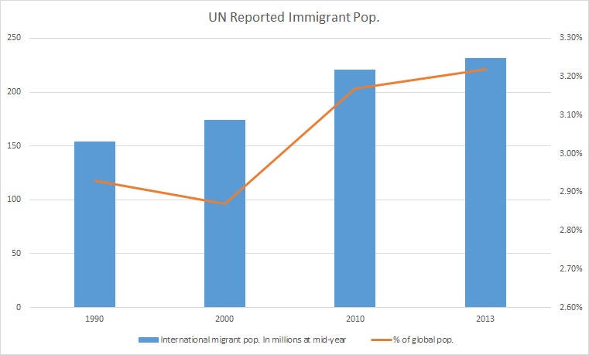
Immigration statistics

Slide 14
Immigration
Consider:
What hopes you would have if you were going to emigrate to a different country
How you would feel if you and/or your family were not welcomed in a new country
SHARE
PAIR
THINK

Slide 15
Immigration
Consider:
What do you think most people in Britain think about immigration? Why?
Do you think it is necessary to change other people’s viewpoint? If so, how and why?
SHARE
PAIR
THINK

Slide 16
I am now able to:
Understand what immigration is
Identify specific reasons for immigration
Understand and respect that people do not have the same opinions on immigration

