Slide 1
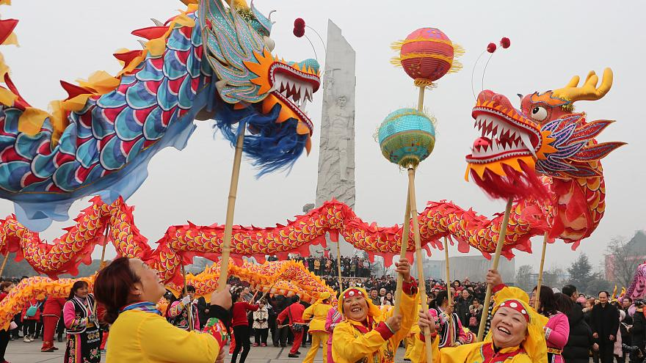
Learning for Sustainability
Chinese New Year
5th of February 2019

Slide 2
Chinese New Year 2019
IT CELBRATES THE BEGINNING OF THE NEW YEAR AND ALLOWS FAMILY AND FRIENDS TO COME TOGETHER

Slide 3
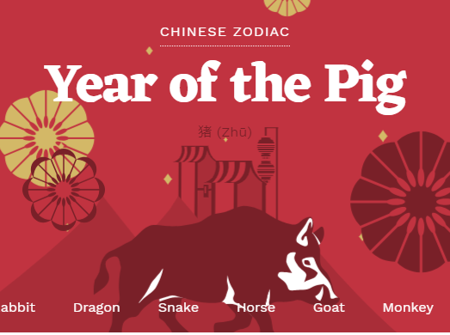
Chinese New Year 2019

Slide 4
Chinese New Year 2019
Year of the Pig
The Pig is the twelfth of all zodiac animals
In Chinese culture, pigs are the symbol of wealth.
Their chubby faces and big ears are signs of fortune as well.

Slide 5
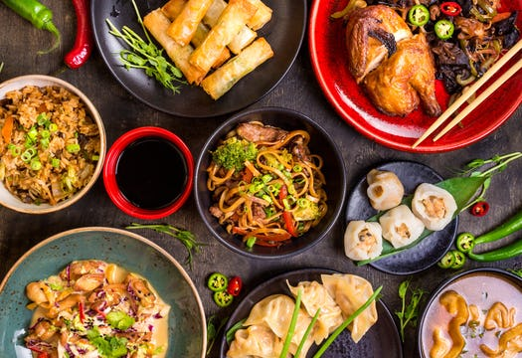
Chinese New Year 2019
Chinese New Year Dishes
What to eat during New Year Celebrations
FAMILY GATHERINGS AND MEALS TOGETHER ARE VERY IMPORTANT AT THIS TIME!

Slide 6
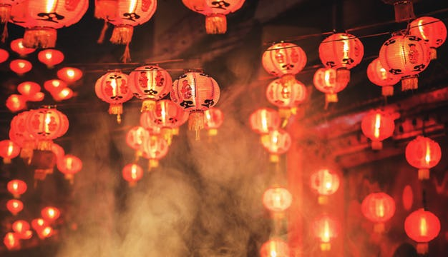
Chinese New Year 2019
Things you did not know about Chinese New Year:
Chinese New Year is also known as the Spring Festival
There's no set date for Chinese New Year
It is a day for praying to gods
FACTS ABOUT CHINESE NEW YEAR

Slide 7
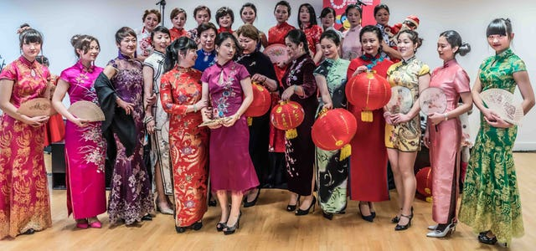
Chinese New Year 2019
Chinese New Year Clothes
WHAT TO WEAR DURING CHINESE NEW YEAR

Slide 8
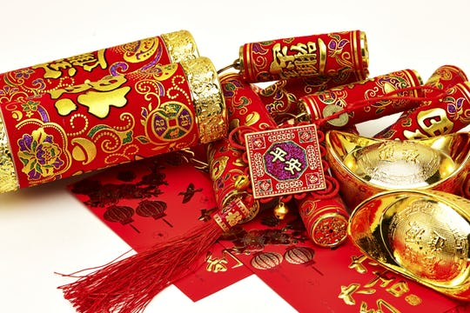
Chinese New Year 2019
Chinese New Year Decorations
WHAT THEY MEAN AND WHERE THEY CAME FROM

Slide 9
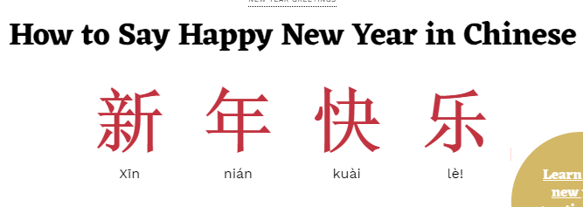
Chinese New Year 2019

Slide 10
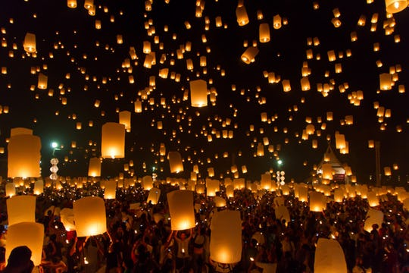
Chinese New Year 2019
Lantern Festival – the climax of the celebrations
The Chinese New Year holiday comes to its climax with the Yuan Xiao (元宵节—yuán xiāo jié), or Lantern Festival.
Began over 2000 years ago, the festival has developed many meanings. It celebrates family reunions and society. It features ancient spiritual traditions. Some also call this the “true” Chinese Valentine’s Day.
The many activities include moon gazing, lighting lanterns, riddles, lion dances and eating rice balls. According to the lunar calendar, the festival takes place on January 15.

