Slide 1
St. Luke’s High School
S1 Information Evening
Reporting on Progress and Achievement

Slide 2
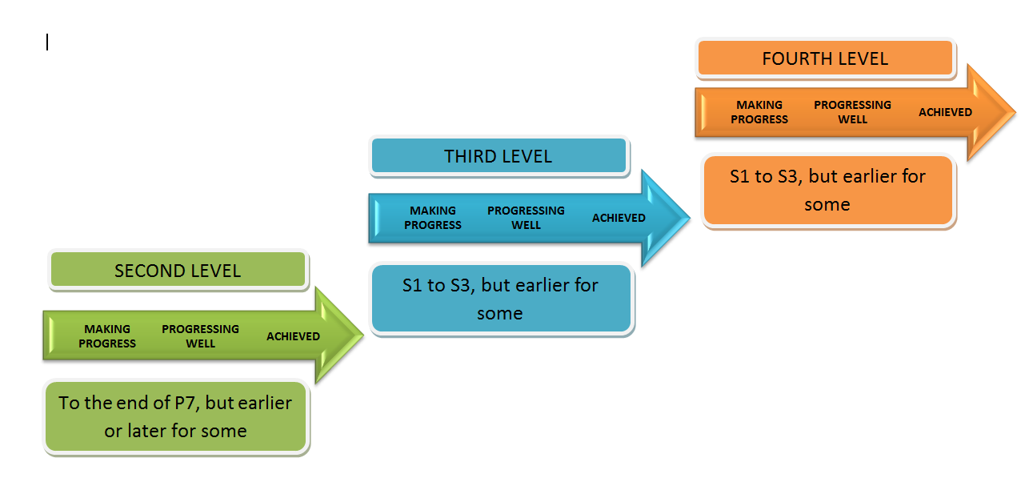
Curriculum for Excellence
LEVELS

Slide 3
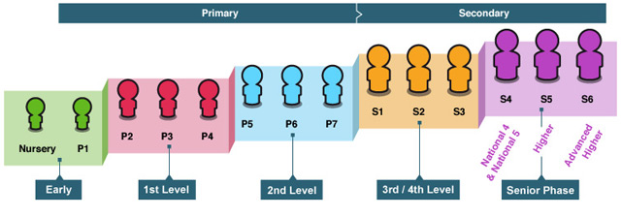

Slide 4
Curricular Areas
Expressive Arts
Health and Wellbeing
Languages
Mathematics
RERC
Sciences
Social Studies
Technologies

Slide 5
Assessment
Effective assessment involves a wide range of evidence which will be made up of things that learners ....
say
WRITE
SAY
write
do
MAKE
DO

Slide 6
Curriculum for Excellence Assessment Record

Slide 7
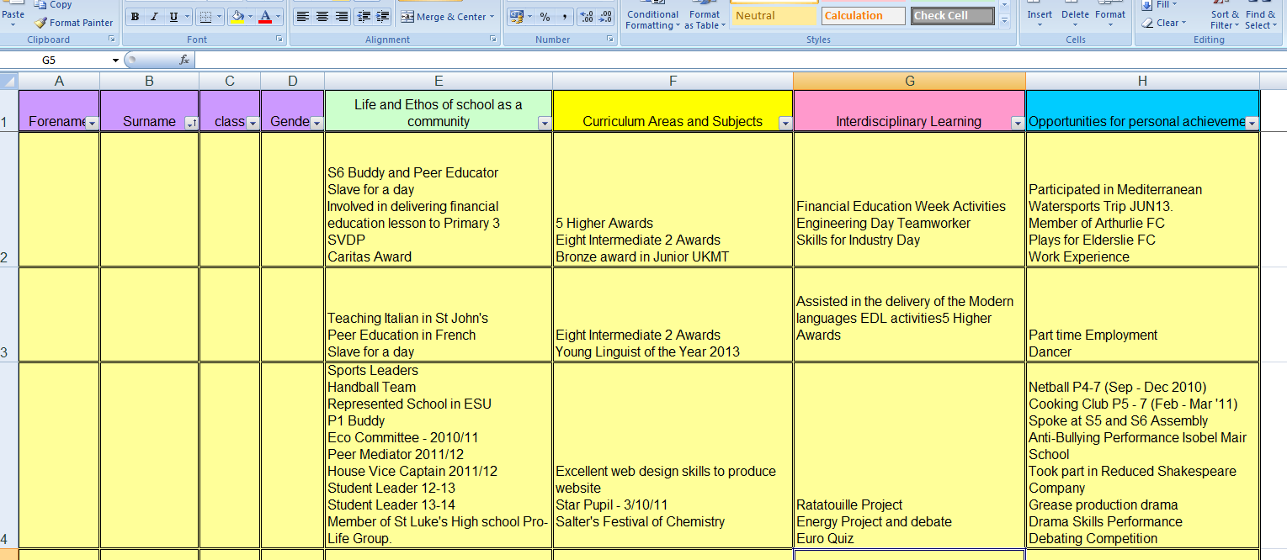
Achievement Spreadsheet
https://getinvolved.eastrenfrewshire.gov.uk/education/pupil-achievements

Slide 8
Profiling
Summary information on progress and
achievement across all curricular areas
and in literacy, numeracy and
health and wellbeing.
A learners’ statement detailing
latest, best and most relevant
achievements in and out of school.

Slide 9
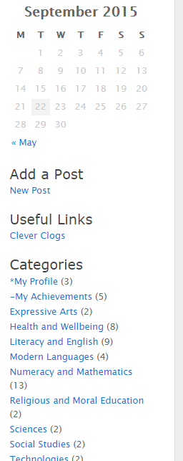

Slide 10
Reporting on Progress – S1
Interim Tracking Report – November 2015
Interim Tracking Report – January 2016
Full Report – May 2016
Parents’ Evening – 17 May 2016

Slide 11
Language of Reporting
ACHIEVED
Has achieved breadth, challenge and application in
their learning across almost all of the experiences and outcomes for the level.
PROGRESSING WELL
Has achieved breadth, challenge and application in
their learning across many of the experiences and outcomes for The level.
MAKING PROGRESS
Has started to engage in the work of the new level.

Slide 13
Interim Tracking Reports
Level/progress within level
Home Learning
Effort
Behaviour
Full Reports
As above but with full written comments on:
Progress/achievements
Strengths
Development needs/next steps
How can you help?
Parents’ Evening
Format

Slide 14
S1 Assessment, Moderation, Profiling and Reporting Calendar 2015/16
September | wc 07 |  | S1 Settling in Interviews
November | wc 16 |  | Tracking Grades and Target Setting discussion with S1 pupils
November | wc 30 |  | Tracking Reports issued to S1 and Target Setting discussion- PSHE
December | wc 14 |  | S1- e-portfolio update -PSHE
January | wc 11 |  | Tracking Grades and Target Setting discussion with S1 pupils
January | wc 25 |  | Tracking Reports issued to S1 and Target Setting discussion - PSHE
February | wc 08 |  | S1 e-portfolio update - PSHE
May | wc 09 |  | Full Reports issued to parents/carers of First Year and Target Setting discussion - PSHE
May | wc 09 |  | Full Reports and Target Setting discussion with S1 pupils
May | 17 |  | Parents' evening for First Year
May | 17 |  | RARA Celebration S1-2
May | wc 23 |  | S1 e-portfolio update - PSHE

Slide 15
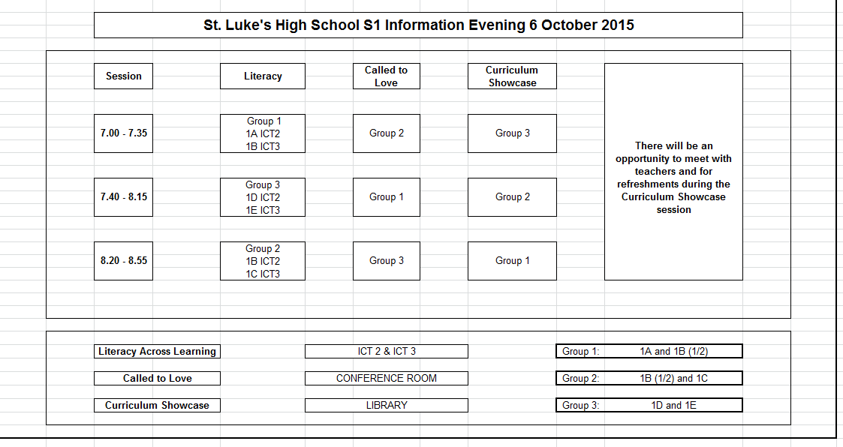
Format of this Evening

Slide 17
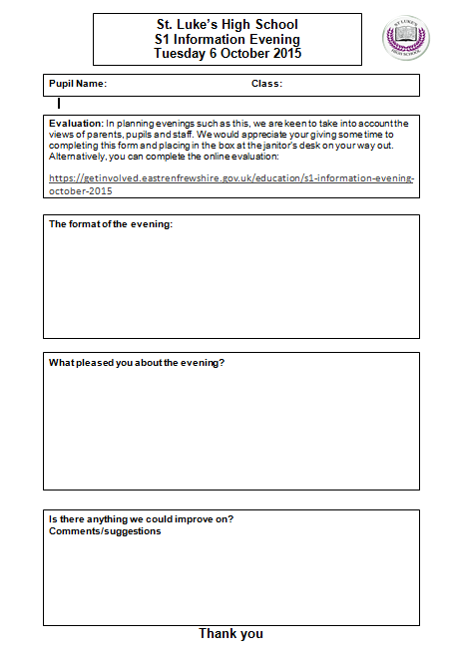
Evaluation
https://getinvolved.eastrenfrewshire.gov.uk/education/s1-information-evening-october-2015

