Slide 1

Budget Panel: Education
Session 1
Monday 14th November, 7pm, Barrhead High School

Slide 2
Introductions
Eddy Graham, IBP Strategy & Research
Mark Ratter, Director of Education
Mary Docherty, Education Resources Senior Manager
Julie Breslin, Strategy & Partnerships Manager

Slide 3
Consultation proposals set out for a number of Departments and functions:
Education;
Environment;
Business Operations & Partnerships;
Support Services;
East Renfrewshire Culture & Leisure
The Budget Panels (including this one which covers Education) are intended to supplement the wider consultation, allowing groups of stakeholders to provide the most informed input possible to these discussions over two sessions.

Slide 4
Tonight
Over the two planned Budget Panel meetings we will provide an overview of the Council’s budget position and discuss potential savings within Education, as well as other options to meet the identified funding gap, including in relation to Council Tax and charging for services.
Overview of how the Council budget is set
Challenges facing the Council generally
The budget consultation and use of the Budget Simulator
Specific issues and challenges for Education
Identification of issues to be investigated at second Budget Panel meeting

Slide 5
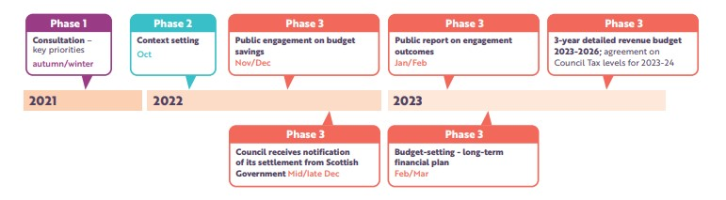
Budget Road Map

Slide 6
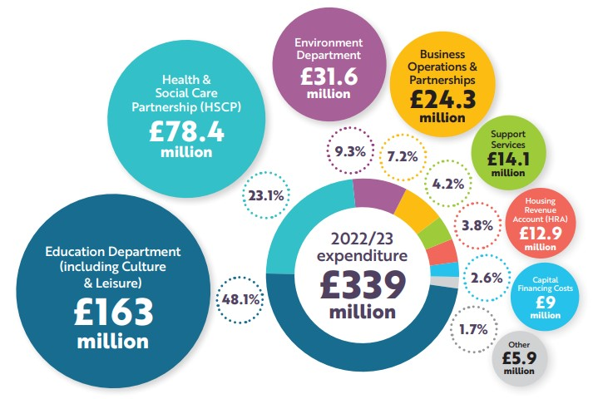
What we spend on services

Slide 7
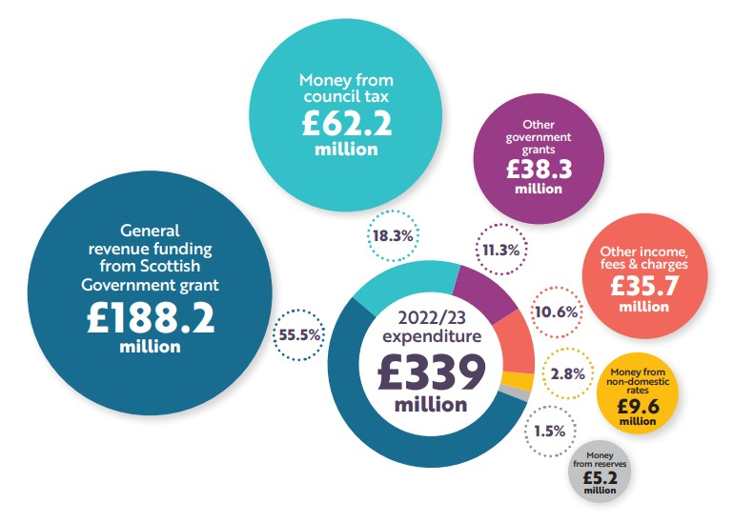
Where our funding comes from

Slide 8
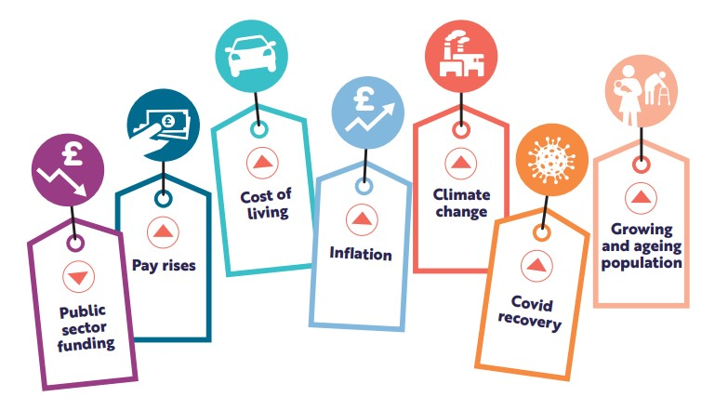
Cost Pressures

Slide 9
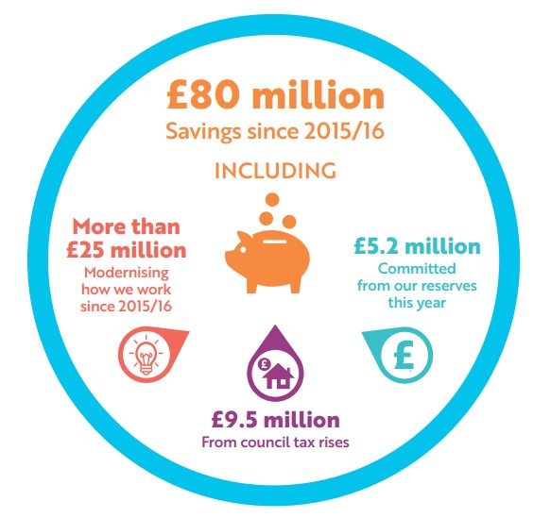
How we have met past challenges

Slide 10
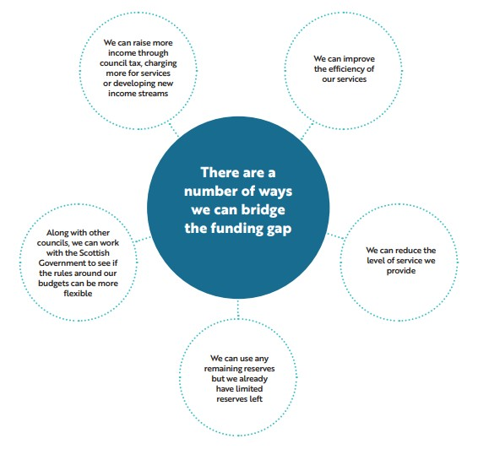
Estimated Savings Needed 2023-2026 and Options to Meet These
£30m

Slide 11
Impact of Council Tax Rises
The projections in the previous slide assume a 3% increase in Council Tax.
Each 1% increase over and above this would generate c.£600,000 per year, which would reduce the need for savings or income generation elsewhere
£1% = £600,000

Slide 12
The Budget Consultation and Budget Simulator
A series of briefings have been produced for members of the public and people are invited to complete an online survey about the budget. Full details are at the link below.
The Budget Simulator gives people further insight into the budget setting process and might help you to think about priorities and options for the budget generally, including proposals in the specific service areas and revenue raising options.
It can be accessed at:
https://eastrenfrewshire.prioritysimulator.com/
We have provided tablets tonight for you to have an initial look (or you can use your phone)
https://getinvolved.eastrenfrewshire.gov.uk/corporate-community-services/east-renfrewshire-council-budget-2022/

Slide 13
What are your impressions, about the issues and challenges facing the Council having had an opportunity to use the Budget Simulator?

Slide 14
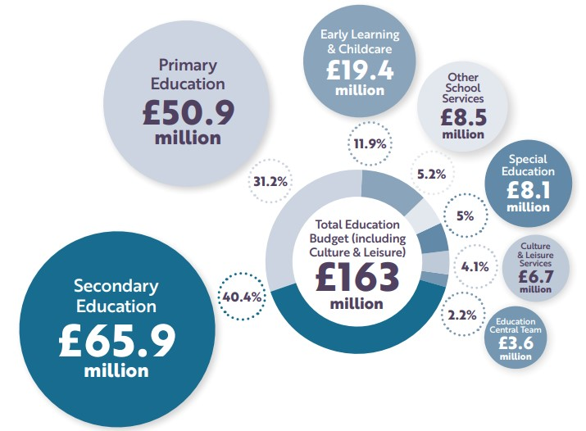
Education Budget 2022-23

Slide 15
Currently Identified Options
Option | Potential Savings
Savings or additional income generation - Education | £19.9m
Savings or additional income generation - Environment | £8.4m
Savings or additional income generation – Business Operations & Partnerships | £2.1m
Savings or additional income generation – Support Services | £3m
Savings or additional income generation – East Renfrewshire Culture and Leisure | £2m
Plus
Council Tax and / or other income generation options
Use of reserves

Slide 16


Education - Overview
TOTAL SAVINGS - £19.9m
Savings proposals in five broad areas:
  Reduction in Devolved School Management budgets involving teachers
  Reduction in Devolved School Management budgets involving other staff groups & budgets
  Reduction in centrally-Based Education staff
  Reductions in centrally-based budgets
  Income generation: school meal price increase

Slide 17
Education – Reductions in Devolved School Management budgets involving teachers
TOTAL SAVINGS - £13.6m
Proposals – Could reduce funding for:
  Lowest 20% pupils
  Pupil Support Teachers and support for equity
  Covid recovery staff
  Reduce absence cover funding
  Smaller classes in English and maths in secondary
  Management structures and staffing in ELC and management structures in Primary/Secondary schools
  Pupil week in primary – Change to 22.5 hours

Slide 18
Education – Reductions in Devolved School Management budgets involving other staff groups and budgets
TOTAL SAVINGS - £1.4m
Proposals – Could reduce funding for:
  Pupil Support Assistants
  School based business support staff
  Some trips, activities/clubs in special sector
  Support for Quality budget and Classroom Supplies
Proposals – Could remove funding for:
  School Librarians, Multi-media technicians and Bilingual Support Workers
  Easter school and outdoor education

Slide 19
Education – Reductions in centrally-based Education Staff
TOTAL SAVINGS - £2.5m
Proposals – Could reduce funding for:
  Quality Improvement Team and ELT
  Educational Psychology
  Adult Learning and Early Intervention
  Cleaning, catering and janitorial services
  Business and budget support

Slide 20
Education – Reductions in centrally-based budgets and income generation
TOTAL SAVINGS - £676k
Proposals – Could reduce funding for:
  Hospital tuition
  Speech and Language Therapists
  Campus Police Officers
  Junior Conservatoire
  Early Years – align eligibility with legislation
Income Generation – school meal price increase £116k

Slide 21
Education - Further Savings
TOTAL SAVINGS - £1.5m
Proposals – extremely challenging but could include:
  Seeking further efficiencies e.g. property costs
  Further cuts to central education budgets
  Further cuts to Devolved School Management budgets

Slide 22
Key themes to explore in the second Budget Panel meeting?
Your reaction to the savings proposals
Reaction to revenue increasing options
What this says about the principles that should be applied to decision making about closing the funding gap.
Ways of mitigating or reducing the impact of proposed changes?
Alternative ideas to achieve savings and bridge the budget gap.
Other issues you would like to discuss?

