Slide 1
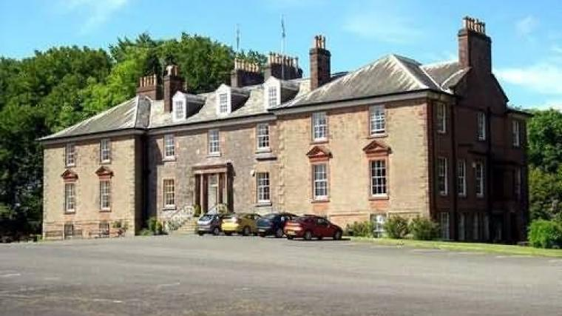
Lockerbie Manor
Monday 25th March-
Thursday 28th March 2024
Parent Information Session

Slide 2




Why go on a Residential Trip?
RESILIENCE
FRIENDSHIPS
CONFIDENCE
TEAM-WORK
ACHIEVEMENT
FUN!

Slide 3
Lockerbie Manor
Lockerbie Manor in Dumfries and Galloway is set amidst 78 acres of tranquil woodland and fields inhabited with an abundance of natural wildlife. The centre is superbly located in South West Scotland with easy access from the M74 motorway.
https://www.manoradventure.com/lockerbie-manor.php

Slide 4

Health and Safety
Approved centre status
AALA licence
Regularly inspected by Health and Safety Executive
Conforms to all Governing Body Guidelines
Each outdoor pursuit risk assessed
Pursuits, equipment and instructors continually monitored and assessed
Notes:
Adventure activities licensing ensures that activity providers follow good safety management practices.
These should allow young people to experience exciting and stimulating activities outdoors without being exposed to avoidable risks or injury

Slide 5
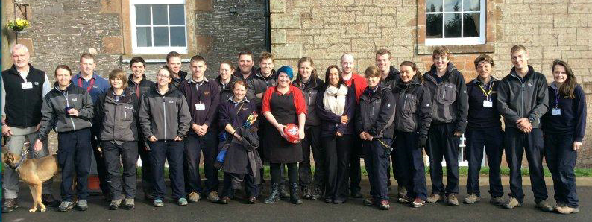
Instructors
Rigorous recruitment and training programme
NGB qualifications
First aid trained
Fire Marshall trained
Emergency procedures in place
Notes:
National Governing Body

Slide 6
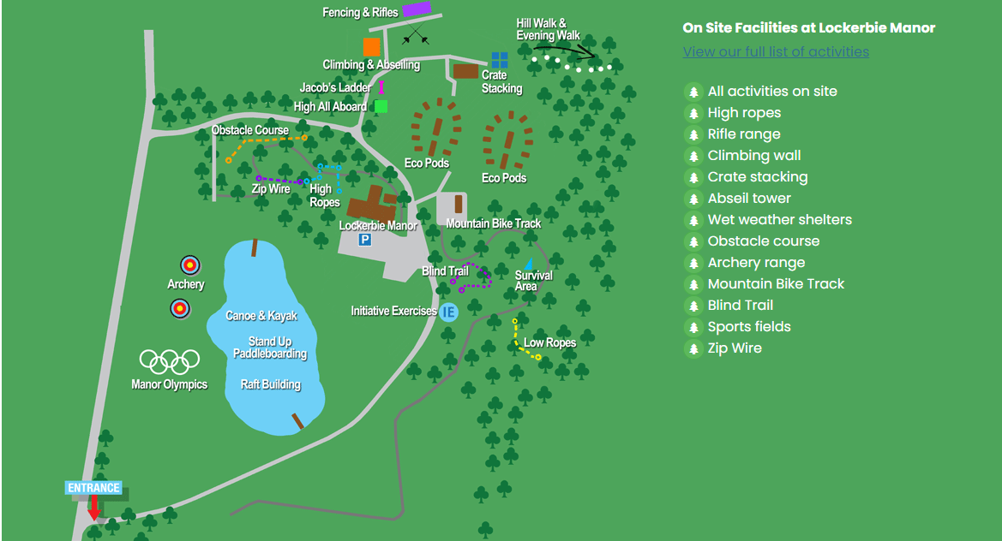
On Site

Slide 7
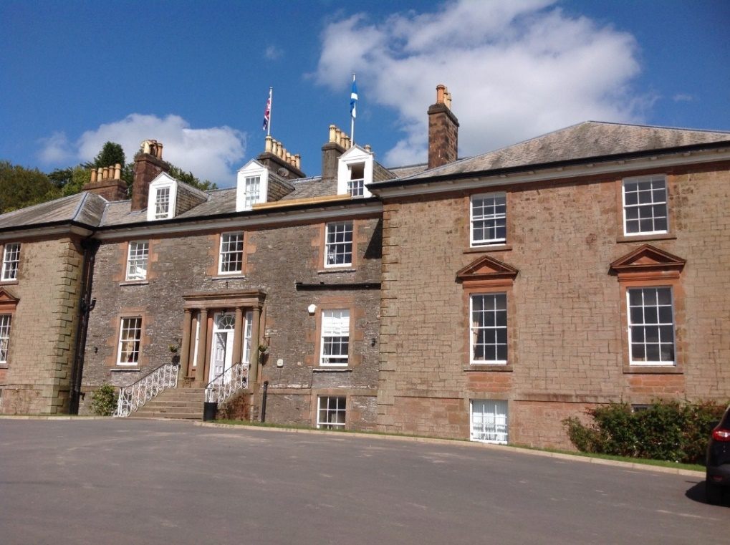
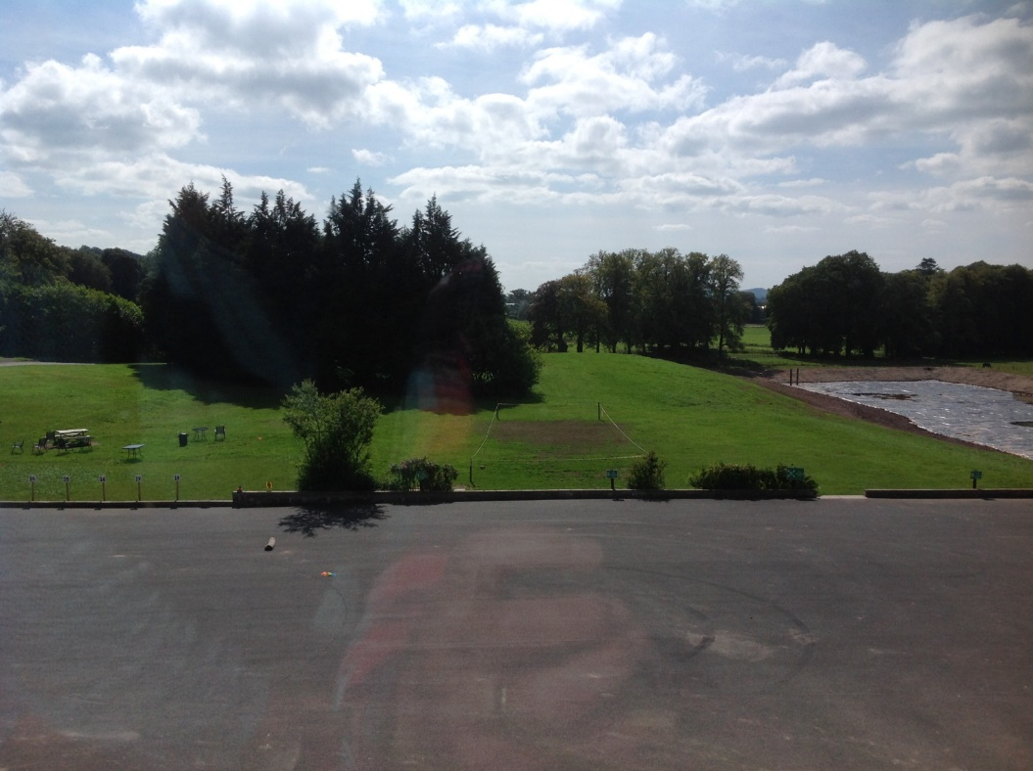
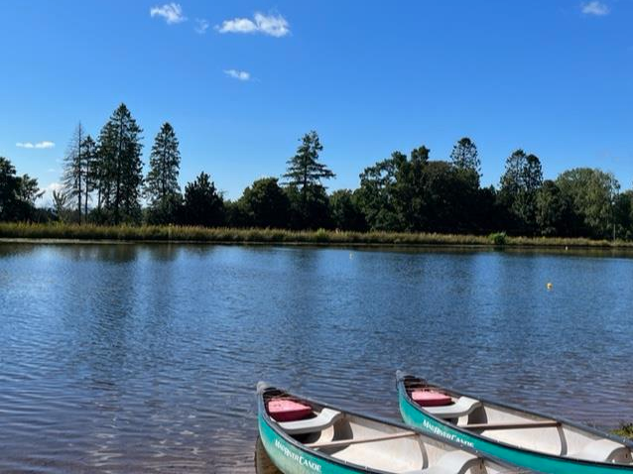
THE VENUE

Slide 8
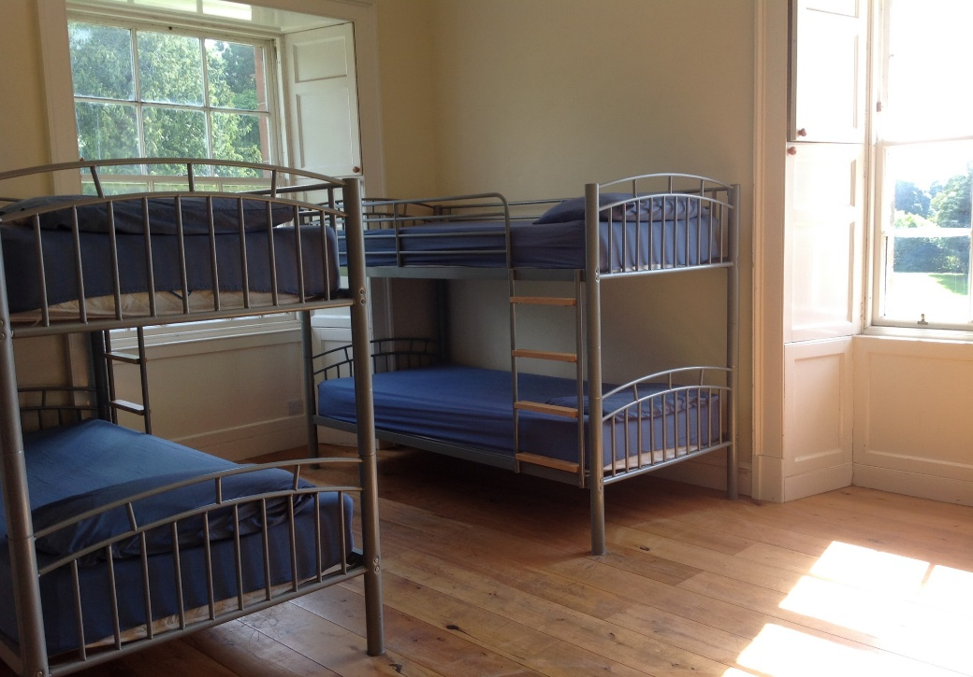
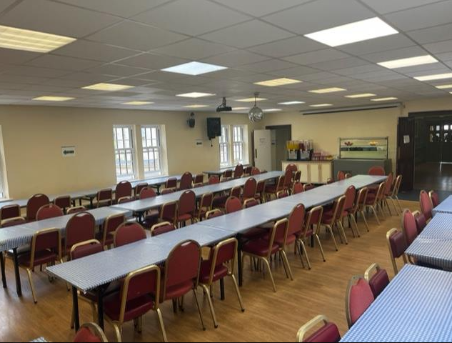
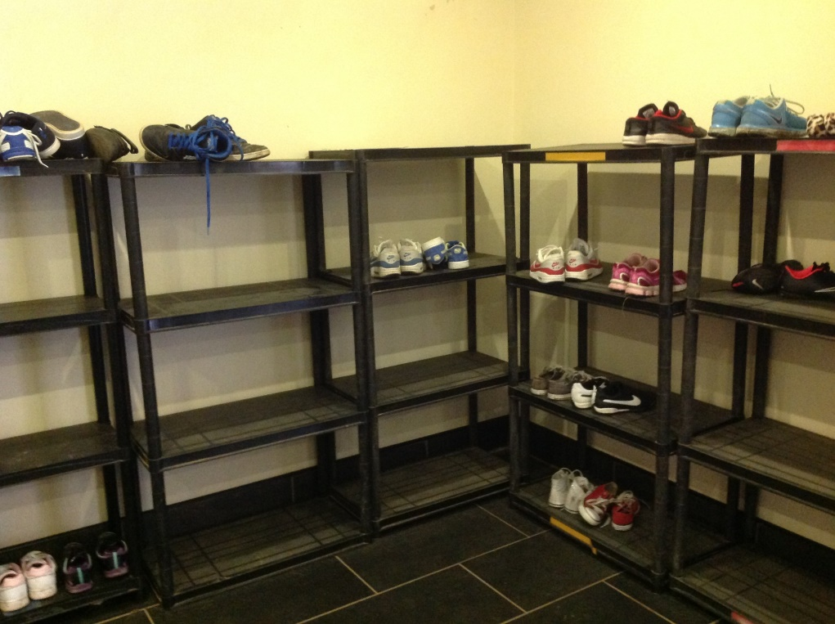
THE VENUE

Slide 9

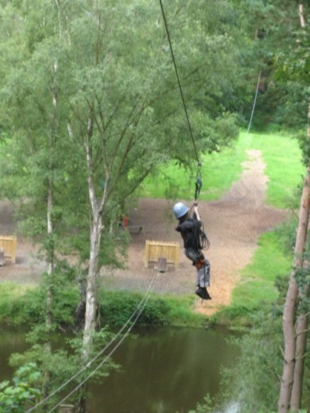

Example Activities
Canoe/Kayak
Hill Walk
Zip Wire
Fencing
Camp Craft
Manor Olympics (fun and games for teams)
Climbing
Scavenger Hunt (small group activity - collect fun items)
Volleyball
Abseiling
Low Ropes (a series of cabled and rope events)
Stand up Paddle Boarding (very wet!)
Canoeing
Kayaking
Survival Skills (5 basic elements : shelter, warmth, drink, food, rescue)
Mountain Biking
Blind Trail (experience life without one of the senses)
Obstacle Course
Wide Games (plan tactics and learn skills)
Orienteering
Team Games

Slide 10
Activity Groups and Dorms
Activity groups will be split across the cluster
Children will only be in dorms with children from St John’s
Children will be asked for 3 names to be part of their dorm (they are guaranteed 1).
We use the friendship selection to help us to allocate the children to the activity groups too so they may be with a friend on activities if not in the same dorm
Dorms are organised nearer the time once we have final numbers and a breakdown of the room sizes from the Manor

Slide 11


A typical day
07.00 - Rise & Shine
07.30 - Breakfast starts
09.00 – 10.30 - Outdoor Pursuit Session 1
10.30 – 10.50 - Break Time
10.50 – 12.20 - Outdoor Pursuit Session 2
12.20 – 13.40 - Lunch Time
13.40 – 15.10 - Outdoor Pursuit Session 3
15.10 – 15.30 - Break Time
15.30 – 17.00 - Outdoor Pursuit Session 4
17.15 – 19.00 - Evening Meal / Free time
19.00 – 20.30 - Outdoor Pursuit Session 5
21:00 - Bedtime

Slide 12


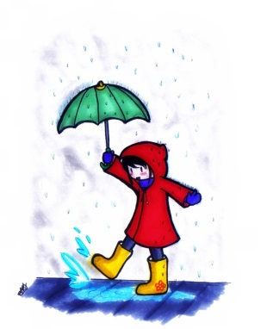
Kitlist
Please label all clothing
4 woolly jumpers or heavy sweatshirts
8-10 warm t-shirts (include 2 or 3 long sleeve tops)
5 pairs of old jogging/tracksuit bottoms. No jeans allowed for activities
Underwear (lots of spares)
Old trainers that can get wet x2
Waterproof jacket
Waterproof trousers
Pyjamas
Indoor Shoes
Do not buy new clothes or send expensive clothes

Slide 13
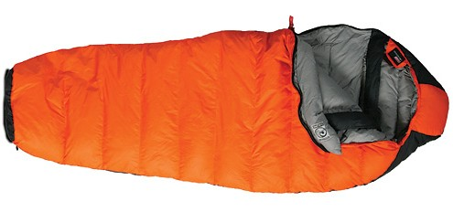

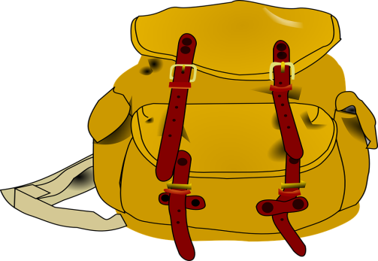
Other Essentials
Sleeping bag and pillow
A plastic drink bottle
Wash Bag and Toiletries (no aerosols, roll on deodorant)
Large plastic bag for dirty clothes
Towel x 2
Sun cream
Insect repellent

Slide 14

Optional Extras
Some sweets for night time – no nuts or traces of nuts
(Please avoid sending too many sweets)
Books, playing cards and other quiet activities
Camera – disposable one
Torch

Slide 15


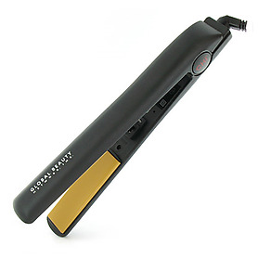
What not to pack
Electronics such as:
  ipads
  Phones
  Tablets
  Games Consoles
  Hair Dryers
  Straighteners
Chewing gum
Football strips/tops
Wellies
Jewellery

Slide 16

Food
All children will be provided with breakfast, lunch and dinner
A few options will be available
Dietary requirements/allergies will be catered for

Slide 17
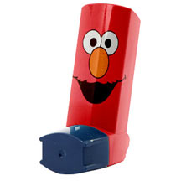

Medication
Any medication that is kept in school will be taken by the teachers to Lockerbie Manor
Parents please ensure you sign Medicine Consent form prior to departure (this will include permission for calpol to be administered if required)
Any medication that is administered will be recorded by 2 members of staff
Children to make sure they are responsible for anything they may need on the bus i.e. inhaler
If possible a spare inhaler should be provided

Slide 18


Departure – 25th March
Arrive at school between 9am and 9:30am
Ensure your child’s name is clearly marked on the suitcase
Relaxed morning with class teacher in class
Break at normal time
Lunch in school
Bring packed lunch in a disposable bag
Departure time TBC, parents are welcome to come to the school in time for departure
No food allowed on the bus
Travel sickness – please provide medication

Slide 19

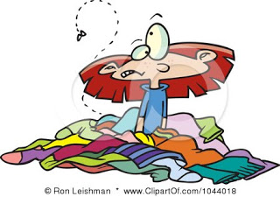
Return – Thursday 28th March
Should arrive back at school around 2.30pm
School will provide updates if any travel disruption etc.
Children should be collected and taken home at this time

Slide 20

Twitter
No Wi-Fi out with main building
Staff will take as many photographs as possible
Please be patient
You will be notified of any emergencies immediately
If you need to contact your child in the case of an emergency please call the school and they will contact school staff at Lockerbie. You can also contact Lockerbie Manor directly 01584 861333

Slide 21
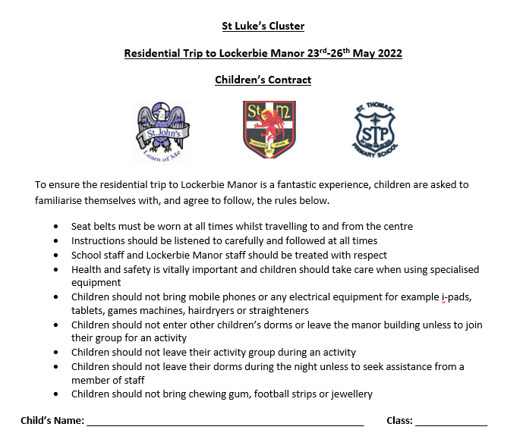

Slide 22
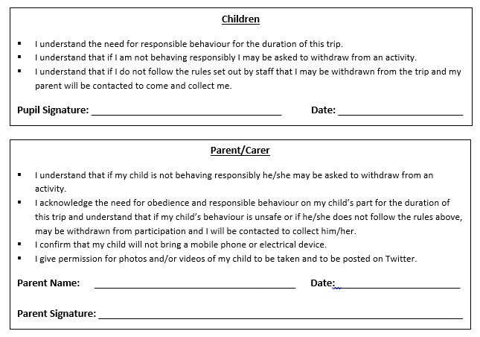

Slide 23

What Next?
£30 non-refundable deposit is due on Friday 29th September 2023
Instalments can be paid between then and Friday 1st March 2024 Current price is £300 but fundraising is likely to reduce this
A kit list will be sent to you separately
Please try to encourage your child to come to Lockerbie Manor
Please speak to us if you have any concerns prior to the trip
Don’t worry ☺

