Slide 1
Stellar Physics
CfE Advanced Higher Physics

Slide 2
Learning Intentions

Slide 3
Properties of Stars
In this topic we are going to examine:
temperature and colour of a star
spectral class
the power of a star
stellar luminosity
apparent brightness
symbols
useful units in astronomy.

Slide 4
Temperature and Colour
A star is a massive body of gas which emits light. The colour of a star is a good guide as to its approximate surface temperature. For example dull red stars are cool and bluish-white stars are very hot.
An ideal black body is an object that is both a perfect emitter and absorber of electromagnetic radiation. That is, a black body emits and absorbs all frequencies equally and perfectly. Stars are not ideal black bodies, but treating them as such is a good approximation.

Slide 5
Temperature and Colour
You may remember from Higher that the energy which a star emits is spread over a wide range of wavelengths. Astronomers can analyse a star’s intensity-wavelength graph and use the peak wavelength to determine the surface temperature with the equation:
$λ_{max}T=$3x10⁻³ (constant) -Wein’s law.
The shorter the wavelength of the peak wavelength, the higher the surface temperature of the star.

Slide 6
Temperature and Colour

Slide 7
Spectral Class
The relative strengths of particular absorption lines gives the spectral class of a star. O is the hottest and M is the coolest type. So the Sun is a fairly middle of the road G star, but the relationship between surface temperature and spectral class is neither linear nor logarithmic.

Slide 8
Spectral Class

Slide 9
Spectral Class
You can use a mnemonic to remember the order. The standard one is "Oh Be a Fine Girl/Guy, Kiss Me", but some may prefer "Oh Boy, An F Grade Kills Me".

Slide 10
Spectral Class
The hottest stars are also generally the biggest and brightest. These stars use up their supply of hydrogen very quickly and therefore have shorter lifetimes. All of the stellar properties (spectral type, luminosity, radius and temperature) depend on a star’s mass.
We will see that once a star evolves beyond its normal hydrogen fusing phase, its size and temperature will change, but the life cycle it will follow is also determined by its mass. So for a star, its mass is really important.

Slide 11
Spectral Class
Copy into notes jotter:
We assume that stars behave like black bodies – a black body emits and absorbs all frequencies equally and perfectly.

Slide 12
Power of a Star
Copy into notes jotter:
The power output of a radiating object depends on its temperature and surface area. This relationship is known as the Stefan-Boltzmann Law and is written as follows:
$$\frac{P}{A}=σT^{4}$$
P = Power (W)
σ= Stefan-Boltzmann constant $5.67x{10}^{−8}Wm^{−2}K^{−4}$
A = Area (m²)
T = Temperature (K)
On formula sheet as:
$$power per unit area=σT^{4}$$

Slide 13
Power of a Star
Copy into notes jotter:
This relationship means that a small increase in a star’s surface temperature results in a very large increase in its power output per unit area.
Hot objects cool faster than cooler objects. They have a bigger surface area, which means they can emit more energy per second than smaller objects.

Slide 14
Example 1
Vega has a surface temperature of 9602 K. Calculate the power per unit area for Vega.

Slide 15
Answer

Slide 16
Example 2
The power per unit area of Rigel is 8.30x10⁸Wm⁻². Find the surface temperature of Rigel.

Slide 17
Answer

Slide 18
Stellar Luminosity
The luminosity of a star is a measure of the total power the star emits from all wavelengths i.e. the total energy emitted per second.
We can therefore see from the Stefan-Boltzmann law that the luminosity can be expressed as:
$$L=σAT^{4}$$
On formula sheet as: $L=4πr^{2}σT^{4}$

Slide 19
Stellar Luminosity

Slide 20
Stellar Luminosity
Copy into notes jotter:
The luminosity of a star is a measure of the total power the star emits from all wavelengths i.e. the total energy emitted per second.
$$L=4πr^{2}σT^{4}$$
Where:
L = stellar luminosity (Watts, W)
σ= Stefan-Boltzmann constant $5.67x{10}^{−8}Wm^{−2}K^{−4}$
T= Temperature (Kelvin, K)
$4πr^{2}$ = Area of a sphere (m²)

Slide 21
Stellar Luminosity
Copy into notes jotter:
The luminosity of a star depends on both its radius and surface temperature. A star can be luminous because it is hot or large or both.
A star’s total luminosity takes account of all the wavelengths of radiation, such as infrared and microwaves, not just the visible range.

Slide 22
Stellar Luminosity
Copy into notes jotter:
Consider a star which has a radius double that of the Sun. Its surface area would be four times that of the Sun.
If this star and the Sun have the same surface temperature, then this star would have a luminosity four times that of the Sun.

Slide 23
Example 1
Betelgeuse has a surface temperature of 3500 K. The luminosity of Betelgeuse is 7.2 × 10³¹ W. Calculate the radius of Betelgeuse.

Slide 24
Answer

Slide 25
Example 2
Sirius is the brightest star in the night sky. Sirius has a luminosity of 9.9 × 10²⁷ W. The radius of Sirius is 1.2 ×10⁶ km. Calculate the surface temperature of Sirius.

Slide 26
Answer

Slide 27
Example
Arcturus has a surface temperature of 4300 K and a radius of 1.8 × 10¹⁰m. Another star has the same luminosity but a surface temperature of only 3600K. Determine its radius.

Slide 28
Answer

Slide 29
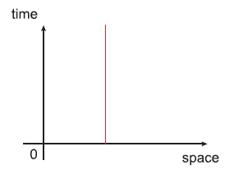
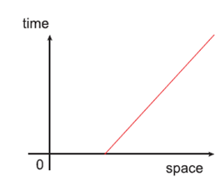
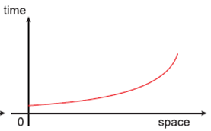
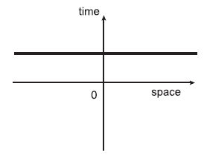
Lesson Starter
What do the following space time graph tell you about the object:
1.
2.
3.
4.

Slide 30
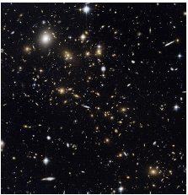
Apparent Brightness
If you look up at the night sky on a clear night, you will notice that the stars appear to have different levels of brightness. Some appear dimmer than others. Now this may be because they genuinely emit less visible light, but it may also be because they are further away.

Slide 31
Apparent Brightness
For example, consider two stars A and B. Star B emits more visible radiation per second than A. However, the two stars may appear equally bright to you an observer on Earth if star B is more distant than star A.
What you are judging with your eye is the apparent brightness of the stars.

Slide 32
Apparent Brightness

Slide 33
Apparent Brightness
Copy into notes jotter:
Apparent brightness is the amount of energy per second reaching a detector per unit area.
It depends upon the star’s luminosity and its distance from us. The exact relationship between apparent brightness and distance is called the inverse square law.

Slide 34
Apparent Brightness
As you move away from a star, the radiation spreads out to cover the surface of a progressively larger sphere. The area of a sphere is equal to$4πr^{2}$.
The star’s apparent brightness received by a detector will vary inversely as the square of the star’s distance from us. Doubling the distance from a star will quarter the apparent brightness. Tripling the distance will make the apparent brightness become one ninth of the previous value etc.

Slide 35
Apparent Brightness
The apparent brightness b of a star can be found using the equation:
$$b=\frac{L}{4πr^{2}}$$
L = luminosity of the star
r= distance from the star and observer (m).

Slide 36
Apparent Brightness
Copy into notes jotter:
The apparent brightness b of a star can be found using the equation:
$$b=\frac{L}{4πr^{2}}$$
In the luminosity equation, r stands for the radius of the star. In the apparent brightness equation, r stands for the distance from the star to observer.
L = luminosity of the star (W)
r= distance from the star and observer (m)
b = brightness (Wm⁻²)

Slide 37
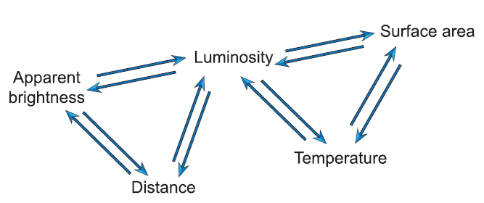
Summary of Properties
Copy into notes jotter:
Astronomers use a star’s apparent brightness and distance to find its luminosity. They can then use this and its temperature to determine its size. All of the properties we have met are interlinked as shown:

Slide 38
Example
Copy into notes jotter:
Pollux is a star with a radius of 5.6 × 10⁸ m. It is 3.2 × 10¹⁷ km from Earth and has a surface temperature of 4900 K. Find the apparent brightness of Pollux.

Slide 39
Answer
Copy into notes jotter:

Slide 40
Useful Units in Astronomy
You met the definition of a light year in the National 5 course. One light year is the distance that light travels in one year. Therefore, 1 light year can be found from:

Slide 41
Useful Units in Astronomy
Another useful unit for distance is the Astronomical Unit (AU).
The AU is the average distance between the Earth and the Sun, which is about 150 million kilometres.
Astronomical units are usually used to measure distances within our solar system and the value is stated on the AH data sheet as:
$$1AU=1.5x{10}^{11}m$$

Slide 42
Useful Units in Astronomy
The solar radius ($R_{⊙}$) is a unit of distance used to express the radius of a star in relation to the current radius of the Sun.
The data sheet states that 1 solar radius = $6.955x{10}^{8}m$.
The solar mass ($M_{⊙}$) is a unit of mass in astronomy that is used to express the mass of a star in relation to that of the Sun. i.e if the mass of a star is 4 solar masses then it is 4 x the mass of the sun.
The data sheet states that the mass of the sun = $2.0x{10}^{30}kg.$

Slide 43
Useful Units in Astronomy
Copy into notes jotter:
One light year = $9.47 x{10}^{15} m$
One Astronomical Unit (1 AU) = $1.5 x{10}^{11} m$
Solar radius ($R_{⊙}$) = $6.955x{10}^{8}m$.
Mass of sun = $2.0x{10}^{30}kg.$
All (except one light year) are on the data sheet.

Slide 44
Lesson Starter
Sirius is the brightest star in the night sky. Sirius has a luminosity of 9.9 × 10²⁷ W. The radius of Sirius is 1.2×10⁶ km. Calculate the surface temperature of Sirius.
Name the different types of classes of stars.
What class of star is our Sun?

Slide 45
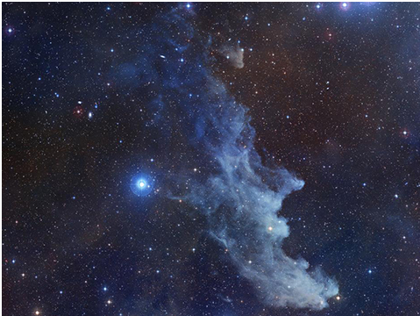
Star Formation
Stars are born in huge clouds of gas and dust called nebulae. These regions are extremely cold at temperatures of about 10 K to 20 K. Higher temperatures would cause the particles to have too much kinetic energy to stay together.

Slide 46
Star Formation
Gravitational forces pull the gas and dust into the centre. This accumulation of mass increases the gravitational attraction and results in even more hydrogen gas being pulled in. This leads to an increase in density.
The Ep of the gas is converted to heat, the temperature and pressure at the core also increases.
Hydrogen nuclei are positively charged and repel each other. Eventually the temperature of the core will become sufficiently large (bigger Ek) for the hydrogen nuclei overcome this and undergo fusion.

Slide 47
Star Formation

Slide 48
Star Formation
Copy into notes jotter:
Stars are formed in interstellar clouds (cold - about 10-20K).
When the gravitational forces overcome thermal pressure, it causes a molecular cloud to contract until the core becomes hot enough to sustain nuclear fusion.
This then provides a thermal pressure that balances the gravitational force.

Slide 49
Success Criteria

Slide 50
Learning Intentions

Slide 51
Hertzsprung-Russell diagrams
Astronomers Hertzsprung and Russell developed the technique of plotting luminosity against surface temperature.
Both the surface temperature and luminosity scales are logarithmic and that the surface temperature is in descending order.
For historical reasons, the lowest surface temperature stars are on the right hand side to match the spectral order OBAFGKM.

Slide 52
Hertzsprung-Russell diagrams

Slide 53
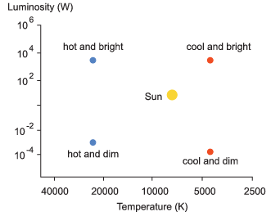
Hertzsprung-Russell diagrams
Hot bright stars are shown at the top left of the diagram and cool dim stars are shown at the bottom right.

Slide 54
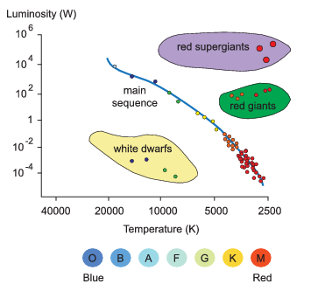
Hertzsprung-Russell diagrams
There are three distinct groups of stars: the main sequence, the white dwarfs and the red giants and supergiants.

Slide 55
Main Sequence
The long diagonal band of stars that runs from the top left to the bottom right is called the main sequence. Most of the stars fall on this curve.
About 90% of the stars in our region of the Milky Way belong to the main sequence. Main sequence stars are still in their long-lived stable phase where they are fusing hydrogen into helium in their cores.

Slide 56
Main Sequence
The mass of such a new star determines its luminosity and surface temperature. A high mass star has a larger inwards gravitational pull and therefore a higher core temperature.
The most massive main sequence stars are shown at the upper left. They have a high luminosity and are hot (blue). The least massive ones are shown at the lower right. They are less luminous and are cooler (yellow or red). Since the Sun is neither especially large nor small in mass when compared to the rest of the main sequence, it is neither especially hot, cold, bright or dim. This means that the Sun lies fairly close to the middle of the main sequence.

Slide 57
Red giants and red supergiants
Stars which have a lower surface temperature and a higher luminosity than the main sequence stars must also have larger radii.
These stars are called red giants and red supergiants. They are found in the top right corner of the H-R diagram. They are stars which have moved off the main sequence, having started to fuse heavier elements. Red supergiant stars are the brightest of all stars.

Slide 58
White dwarfs
Stars which have a higher surface temperature and a lower luminosity than the main sequence stars must also have smaller radii. These are the white dwarfs. They lie in the bottom left corner of the H-R diagram and are typically about the size of the Earth.
White dwarfs are faint hot stars at the end of their lives. All of their fusion reactions have stopped and they are just slowly cooling and dimming to ultimately form a black dwarf.

Slide 59
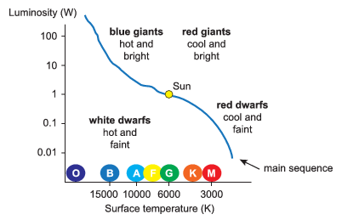
White Dwarfs
White dwarfs can actually be blue. They are just named this way since the vast majority are white.

Slide 60
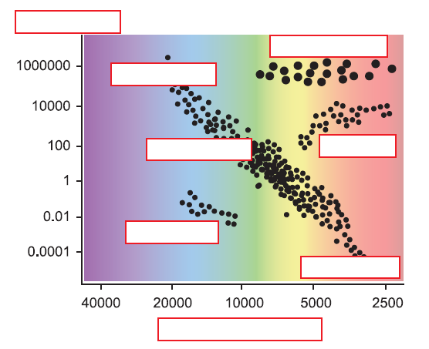
Example
Use the following labels to match the correct location on the H-R Diagram.

Slide 61
Hertzsprung Russel Diagrams
Copy into notes jotter:
H-R diagrams are a representation of the classification of stars.
All stars have a position in a HR diagram depending on its class.
There are three distinct groups of stars: the main sequence, the white dwarfs and the red giants and supergiants.
H-R diagrams are used to determine the stellar properties of stars and predict the colours of stars from their positions on H-R diagrams.
Fusion of hydrogen occurs in the core of stars in the main sequence of the H-R diagram.

Slide 62
Hertzsprung-Russell diagrams
Copy into notes jotter:

Slide 63
Success Criteria

Slide 64
Learning Intentions

Slide 65
Stellar evolution and life cycles on H-R diagrams
The mass of a star ranges in size from roughly 0.08 solar masses to 150 solar masses.
If an object has a mass less than 0.08 solar masses, then it would be unable to achieve a high enough core temperature to initiate fusion.
These "failed stars" are called brown dwarfs. A star cannot have a mass greater than 150 solar masses: the outwards force due to the thermal pressure from fusion would be so large in comparison to the inwards gravitational pull that the extra mass would be driven off into space.

Slide 66
Stellar evolution and life cycles on H-R diagrams
All main sequence stars will eventually evolve to become either red giants or red supergiants, but their eventual fate also depend on their mass.
Even though stars with a large mass have a lot of fuel, they use it up more quickly and therefore don’t spend as long on the main sequence.
Example, a star with a mass comparable to that of the Sun will spend about 10 billion years on the main sequence. A star that has a mass about 15 times the Sun will only belong to the main sequence for approximately 10 million years.

Slide 67
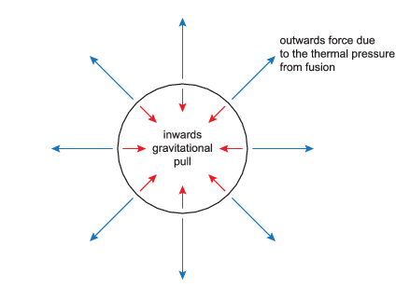
Stellar evolution and life cycles on H-R diagrams
During the stable stage whilst a star is still on the main sequence, the outwards force due to the thermal pressure produced from hydrogen fusion in the core balances the gravitational pull trying to compress it.

Slide 68
Stellar evolution and life cycles on H-R diagrams
The hydrogen in the core runs out and nuclear fusion stops.
The outward pressure is removed, so the core contracts and heats up.
The temperature is high enough for the core to fuse helium into carbon and oxygen.
This releases a huge amount of energy, which pushes the outer layers of the star outwards.
The outer layers expand and cool, the star leaves the main sequence and becomes either a red giant or a red supergiant, depending on its mass.

Slide 69
Death of a low or medium mass star
The core temperature of a low or medium mass star is not sufficiently high to allow the fusion of elements beyond helium.
Once all the helium has been converted into carbon and oxygen, the core once more contracts due to gravitational attraction.
The outer layers become more and more unstable as the core contracts. The star pulsates and ejects the outer layers into space as a planetary nebula.
This leaves behind a dense core-a white dwarf. Remember the white dwarfs lie below the main sequence as they have low luminosities. A white dwarf will then simply cool down and fade away, ultimately forming a black dwarf.

Slide 70
Death of a high mass star
Really massive stars become red supergiants, which can fuse progressively heavier elements all the way up to iron.
Once they are depleted, the core collapses in less than a second and a supernova explosion occurs. A supernova event can temporarily outshine a whole galaxy. It provides the energy needed to produce all the elements heavier than iron up to uranium.
Shock waves blow off the outer layers, leaving behind either a neutron star or a black hole.

Slide 71
The Life Cycle of a Star

Slide 72
Life cycles on H-R diagrams
The evolution of a star can be mapped out on a H-R diagram. The example shows the life cycle of a star of mass equal to that of the Sun. It starts on the main sequence and then moves diagonally up to the right to become a red giant, before eventually becoming a white dwarf.

Slide 73
Life cycle of a star
Copy into notes jotter:
For a main sequence star, the hydrogen fusion in the core supplies energy that balances out the outward thermal pressure and inward gravitational forces.
When hydrogen becomes depleted, nuclear fusion in the core stops, but the gas surrounding the core will still contain hydrogen.
Gravitational forces cause the core and the hydrogen gas shell to shrink.
In a star like the sun, the shell will become hot enough for hydrogen fusion to begin in the shell. This increases the pressure which pushes the surface of the star outwards, causing it to cool.
At this stage, the star will be in the giant or supergiant region of a H-R diagram.
For a star like the sun, its core will shrink and become hot enough to begin the fusion of Helium in the core.

Slide 74
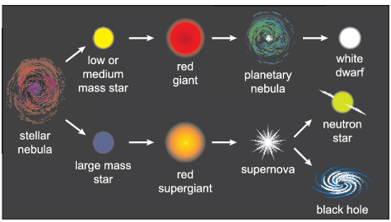
Life cycle of a star
Copy into notes jotter:
The mass of a star will determine its life time and its ultimate fate: a white dwarf, neutron star or black hole – every star will eventually become one of these.

Slide 75
Life cycles on H-R diagrams
The fate of our sun:
https://www.youtube.com/watch?v=PM9CQDlQI0A

Slide 76
Lesson Starter

Slide 77
Success Criteria

Slide 78
Learning Intentions

Slide 79
Stellar nucleosynthesis and fusion reactions
Stellar nucleosynthesis is the name of the process whereby a star carries out nuclear fusion to produce new elements heavier than hydrogen.
A star's mass determines what types of nucleosynthesis occur in its core. This is because heavier stars have a stronger gravitational pull in their cores, leading to higher core temperatures.
The smallest stars only convert hydrogen into helium by a process called the proton-proton chain. They can’t fuse heavier elements, since they are not sufficiently hot to overcome the repulsive forces between larger nuclei.

Slide 80
Stellar nucleosynthesis and fusion reactions
The proton-proton chain consists of three stages:
Two hydrogen nuclei (${}_{1}^{1}H$) undergo fusion to produce a deuterium nucleus (${}_{1}^{2}H$), a positron and a neutrino. The positron is annihilated by an electron to produce further energy in the form of gamma ray photons.

Slide 81
Stellar nucleosynthesis and fusion reactions
Stage 1:

Slide 82
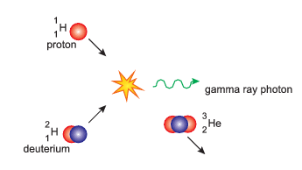
Stellar nucleosynthesis and fusion reactions
2. The deuterium nucleus (${}_{1}^{2}H$) then fuses with a proton to form a helium - 3 nucleus (${}_{2}^{3}{He}$) and a gamma ray photon.

Slide 83
Stellar nucleosynthesis and fusion reactions
Stage 2:

Slide 84
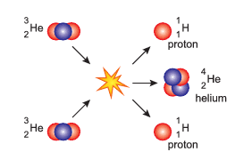
Stellar nucleosynthesis and fusion reactions
3. Two helium-3 nuclei (${}_{2}^{3}H$e) fuse to form a helium-4 nucleus (${}_{2}^{4}{He}$) and two free protons, which may cause further proton- proton chains.

Slide 85
Stellar nucleosynthesis and fusion reactions
Stage 3:

Slide 86
Stellar nucleosynthesis and fusion reactions
The net effect is to combine 4 protons to form one helium nucleus, with the energy released going into the particles and gamma ray photons produced at each step of the chain.

Slide 87
Stellar nucleosynthesis and fusion reactions summary

Slide 88
Stellar nucleosynthesis and fusion reactions
Copy into notes jotter:
The following is a very brief summary of the proton- proton chain:
A proton fuses with another proton to form deuterium – releases an electron, electron neutrino and energy.
Then deuterium fuses with a proton to form a helium - 3 nucleus – releases gamma radiation and energy.
Two helium - 3 nuclei then fuse to form a helium - 4 nucleus – releases two hydrogen isotopes and energy .
${}_{1}^{1}H+{}_{1}^{1}H$ → ${}_{1}^{2}H+ e^{+}+v_{e}+energy$
${}_{1}^{1}H+{}_{1}^{2}H$ → ${}_{2}^{3}H+ γ+ energy$
${}_{2}^{3}H+{}_{2}^{3}H$ → ${}_{2}^{4}H+2{}_{1}^{1}H+ energy$

Slide 89
Success Criteria

Slide 90
Lesson Starter
Write the three stages of Stellar nucleosynthesis for hydrogen.
Betelgeuse has a surface temperature of 3500 K. The luminosity of Betelgeuse is 7.2 × 10³¹ W. Calculate the radius of Betelgeuse.

Slide 91
Answer

Slide 92
Lesson Starter
Where would you find the sun on a H-R Diagram?
What path on the H-R diagram will our sun take?
Explain the life cycle of our sun and it’s eventual fate.

Slide 93
Quiz

Slide 94
Quiz

Slide 95
Quiz
large mass star

Slide 96
Lesson Starter
What equation defines the period of a satellite?
What equation defines the speed of a satellite?
What equation defines the potential energy of a material in space?

