Slide 1
Advanced Higher Physics
Graphical uncertainties
gradients
intercepts

Slide 2
Advanced Higher Physics
Parallelogram method
draw the axes and plot all points without using uncertainty bars

Slide 3
Advanced Higher Physics
calculate the centroid, or the midpoint, for both the x and y values
use the formula

Slide 4
Advanced Higher Physics
draw the line of best fit through the centroid with an approximately equal scatter of points on either side of the line
the best estimates of the gradient and the intercept of this line can be determined

Slide 5
Advanced Higher Physics
draw vertical lines through the largest and smallest x values

Slide 6
Advanced Higher Physics
draw two lines parallel to the line of best fit, one through the point most above the line of best fit and one through the point most below the line of best fit, this forms a parallelogram surrounding all of the points

Slide 7
Advanced Higher Physics
draw in the diagonals of the parallelogram
the gradients of these lines are used to calculate the uncertainty in the gradient Δm using

Slide 8
Advanced Higher Physics
the diagonals give two other intercepts, c_{high} and c_{low}
the uncertainty in the intercept Δc is then calculated using

Slide 9
Advanced Higher Physics
Example
use the following data points to practise the parallelogram method:
(2,1), (3,2), (4,1.6), (5, 2.4), (6,3), (7,4), (8,4), (9,5), (10,4.6), (11,6), (12,7)

Slide 10
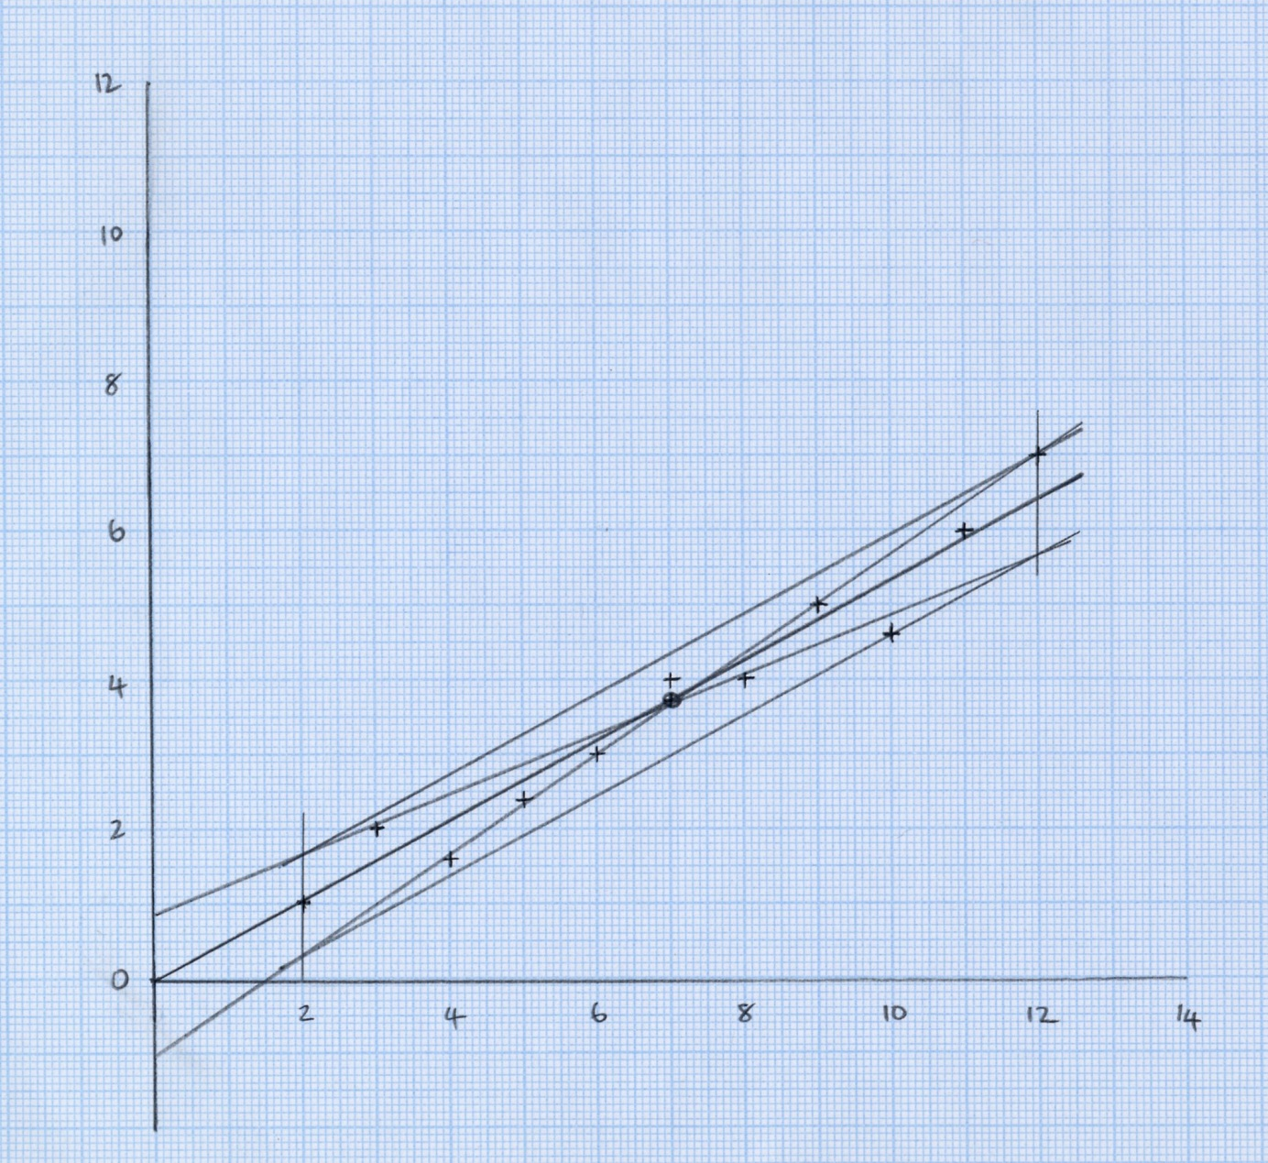
Advanced Higher Physics

Slide 11
Advanced Higher Physics
answers:

Slide 12
Advanced Higher Physics
Two thirds of uncertainty bars method
draw the axes and plot all points using uncertainty bars

Slide 13
Advanced Higher Physics
draw a line of best fit through about two thirds of the uncertainty bars with an approximately equal scatter of points on either side of the line

Slide 14
Advanced Higher Physics
draw two “worst” lines of best fit through about two thirds of the uncertainty bars

Slide 15
Advanced Higher Physics
calculate the uncertainty in the gradient using
giving the gradient value m ± Δm
m_{high}
m
m_{low}

Slide 16
Advanced Higher Physics
calculate the uncertainty in the intercept using
giving the gradient value c ± Δc
c_{high}
c
c_{low}

Slide 17
Advanced Higher Physics
Example
use the following data points to practise the parallelogram method, all points have a y uncertainty of ±0.5 and a negligible x uncertainty:
(2,1), (3,2), (4,1.6), (5, 2.4), (6,3), (7,4), (8,4), (9,5), (10,4.6), (11,6), (12,7)

Slide 18
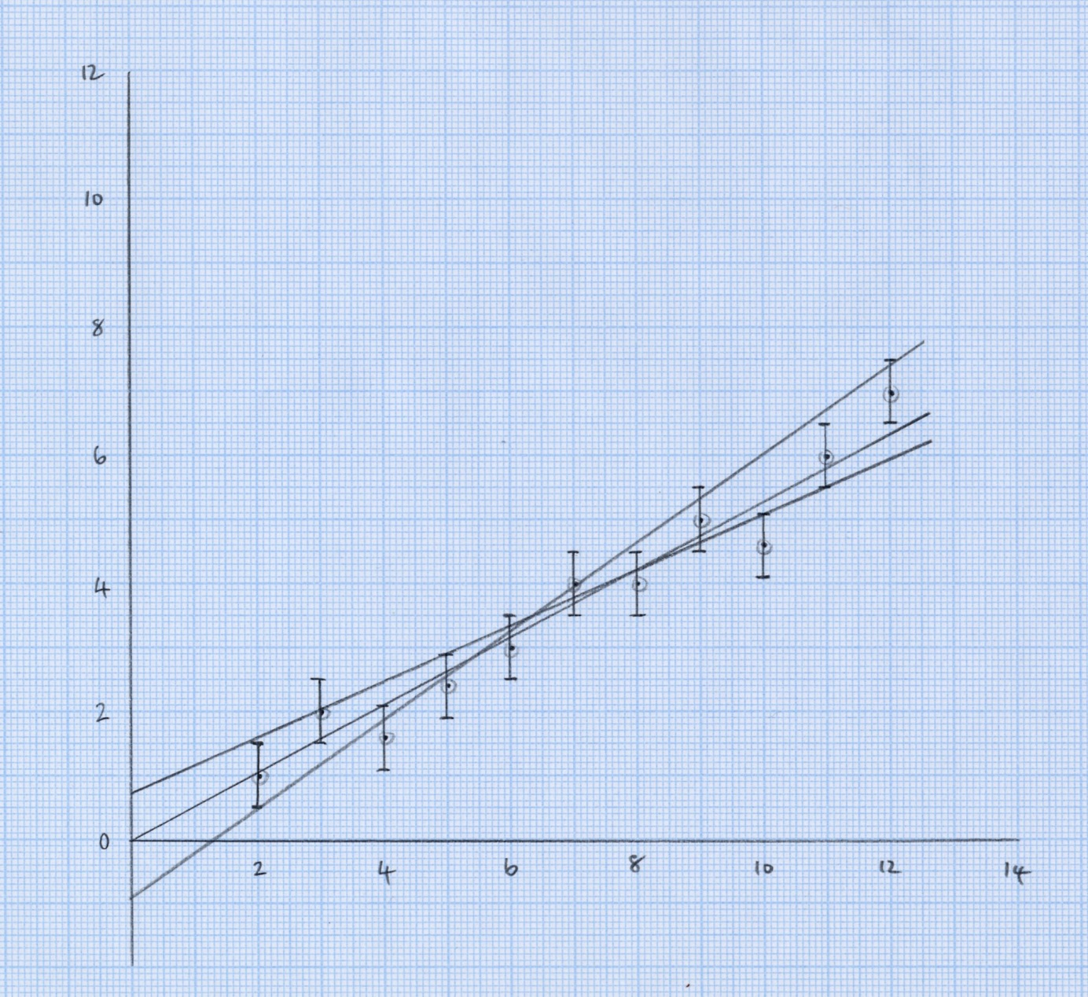
Advanced Higher Physics

Slide 19
Advanced Higher Physics
answers:

