Slide 1
Advanced Higher Physics
Data Analysis

Slide 2
Percentage Uncertainty
Single measurements may be quoted as ± measurement absolute uncertainty, for example 53.20 ± 0.05 cm. When measured quantities are combined (e.g. when the quantities are multiplied, divided or raised to a power) to obtain the final result of an experiment it is often more useful to quote measurement ± percentage uncertainty, where:
Always compare percentage uncertainties never absolute uncertainties

Slide 3
Percentage Uncertainty
A percentage uncertainty in an individual measured quantity can be regarded as insignificant if it is less than one third of any other percentage uncertainty.
Absolute uncertainty should always be rounded to one significant figure.

Slide 4
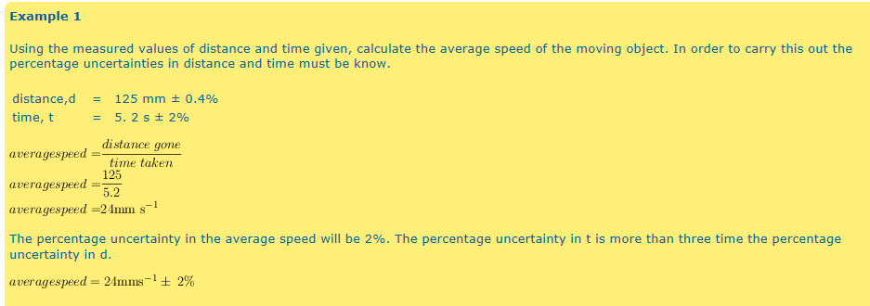
Example

Slide 5
Combining Uncertainties
Addition and subtraction
When two quantities P with absolute uncertainty ΔP, and Q with absolute uncertainty ΔQ, are added or subtracted to give a further quantity S, the absolute uncertainty in ΔS, is given by:

Slide 6
Combining Uncertainties
Multiplication and division
When two quantities P with absolute uncertainty ΔP, and Q with absolute uncertainty ΔQ, are multiplied or divided to give a further quantity S, the percentage uncertainty in S is given by:

Slide 7
Combining Uncertainties
Powers
When a quantity P is raised to a power n to give a further quantity Q, then
When measured quantities are combined it is usual to ignore any percentage uncertainty that is not significant; a percentage uncertainty in an individual measured quantity can be regarded as insignificant if it is less than one third of any other percentage uncertainty.

Slide 8
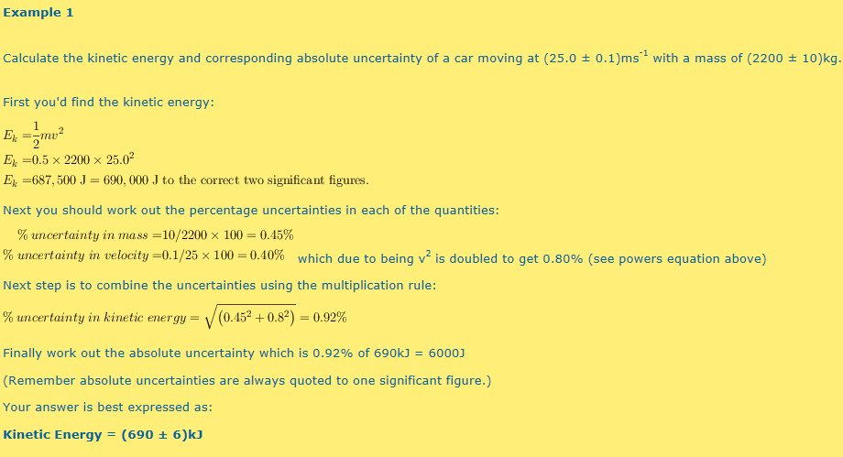
Example

Slide 9
Graphing
When graphing quantities that include uncertainties, note the following points.
Each individual point on the graph should include error bars, on one or both of the quantities being plotted, as appropriate.
The error bars on each point could indicate either the absolute uncertainty or the percentage uncertainty in the quantities being plotted, as appropriate.
The error bars are used to draw the best straight line or the best fit curve, as appropriate.

Slide 10
The Centroid Method
This can be used to estimate the uncertainty in the gradient and the uncertainty in the y-intercept of a straight-line graph.
Plot the points and error bars.
Calculate the centroid of the points. The x co-ordinate of the centroid is the mean of the values plotted on the x-axis and the y co-ordinate of the centroid is the mean of the values plotted on the y-axis.
Draw the best fitting straight line through the centroid.

Slide 11
The Centroid Method
Construct a parallelogram by drawing lines, which are parallel to this line, and which pass through the points furthest above and furthest below this line.
Calculate the gradients, m₁ and m₂, of the diagonals of the parallelogram. (These two diagonals represent the greatest and least values that the gradient could have.)
Calculate the uncertainty in the gradient, Δm using:

Slide 12
The Centroid Method
where n is the number of points (not including the centroid) plotted on the graph.
Read off the intercepts, c₁and ,c₂ on the y-axis, of the diagonals of the parallelogram.
Calculate the uncertainty in the intercept, Δc using:
Again, n is the number of points (not including the centroid) plotted on the graph.

Slide 13
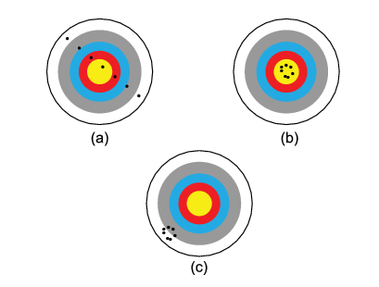
Accurate, precise or both?
For the following three pictures, would you say they are accurate, precise, both or neither?

Slide 14
Answer
Is netiher
Accurate and precise
Precise but inaccurate

