Slide 1
Special Relativity and Space time
CfE Advanced Higher Physics

Slide 2
Introduction
Einstein’s special theory of relativity only applies when an object is moving at a constant speed in a straight line. It does not let us consider what happens when something turns or changes speed. For this we need Einstein’s general theory of relativity.
In this topic we will compare the two theories and explore how general relativity the study of non-inertial frames of reference. allows us to more fully understand gravity. We will then turn our attention to the effect of mass on spacetime and the curious behaviour of black holes.

Slide 3
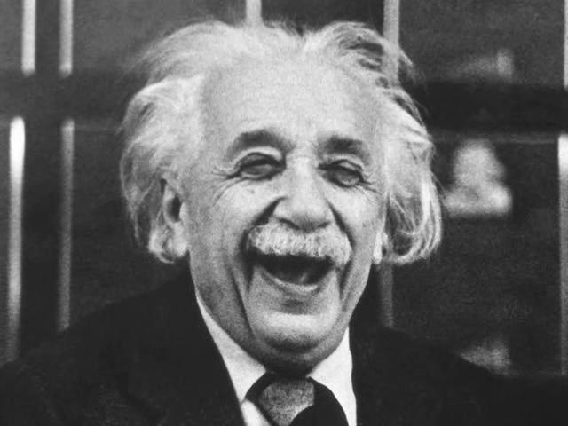
Comparison of General and Special Relativity
You studied special relativity at Higher. You may remember that in this theory Einstein made the following two points:
The speed of light is absolute. It is always the same for all observers irrespective of their relative velocities.
The laws of Physics are the same for all observers inside their frame of reference.

Slide 4
Comparison of General and Special Relativity
These observations lead to some conclusions that were confirmed by observation, such as time dilation and length contraction. However, the theory did not allow us to consider what happens when a frame of reference is accelerating.
Special relativity only considered inertial (stationary or constant velocity) frames of reference.
General relativity will allow us to study a non-inertial frame of reference a frame of reference that is accelerating.

Slide 5
Comparison of General and Special Relativity

Slide 6
The Equivalence Principle
Einstein said it would be impossible to distinguish between a spaceship at rest on the Earth and the other accelerating at 9.8 ms⁻² in deep space, far away from any astronomical bodies.

Slide 7
The Equivalence Principle
(a) At rest in the Earth's gravitational field. (b) In deep space accelerating upwards at 9.8 m s⁻².

Slide 8
The Equivalence Principle
A ball dropped in one spaceship would fall to the floor in the same way as in the other spaceship.
However, in the accelerating spaceship, it continues to accelerate upwards, so the floor of the spaceship will accelerate upwards to meet the ball. So, from the observer’s viewpoint, the ball appears to accelerate downwards towards the floor at 9.8 ms⁻².

Slide 9
The Equivalence Principle

Slide 10
The Equivalence Principle
Einstein realised that the force of gravity is just the acceleration that you feel as you move through spacetime.
Einstein’s equivalence principle states that gravity is equivalent to acceleration.

Slide 11
The Consequences – Bending Light
Consider a laser beam sent across a spaceship that is accelerating upwards. To an observer who watches the spaceship from the ground, the light moves in a straight line. However, the spaceship will move slightly upwards in the time it takes the light to travel across it.
Therefore the light will strike a point lower on the spaceship wall than it would if the spaceship did not move. This means that, to an observer inside the spaceship, the light actually appears to bend.

Slide 12
Bending Light
(a) View from the ground. (b) View inside the spaceship.

Slide 13
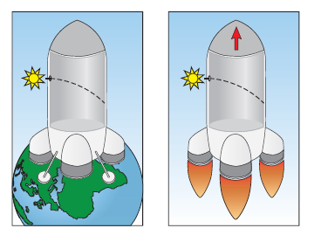
Bending Light
In the last section we explored the equivalence principle, so gravitational fields must also bend light. Since we are very familiar with light being bent by a lens, we call this effect gravitational lensing.

Slide 14
Gravitational time Dilation
Once more, consider a spaceship which is accelerating upwards. A source of light emits pulses at regular time intervals from the bottom of the spaceship. By the time a pulse reaches an observer at the top of the spaceship, the spaceship will have moved away from the position it occupied when the pulse was emitted.
Since the spaceship is accelerating, the distance each consecutive light pulse must travel to reach the observer will be increasing. That means the time for pulses to reach the observer will also be increasing. So the observer at the top of the spaceship will conclude that the clock at the bottom of the spaceship is running more slowly.

Slide 15
Gravitational time Dilation

Slide 16
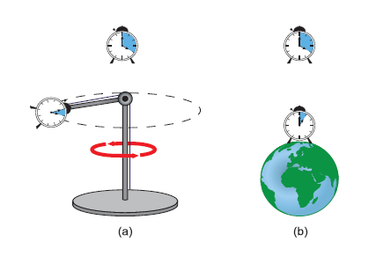
Gravitational time Dilation
A clock in a gravitational field runs more slowly than in the absence of a field. Time is slower in a g-field than in no g-field.
(a) Accelerating clock in a centrifuge. (b) Clock in a gravitational field - the lower the slower.

Slide 17
Gravitational Red Shift
Consider a source of light at the top of an accelerating spaceship. Due to the Doppler Effect, an observer at the bottom of the spaceship will observe a higher frequency than the source emitted.
The equivalence principle means that a beam of light travelling in the same direction as a gravitational field should shift towards the higher frequency blue end of the spectrum.
Any electromagnetic wave originating from a source that is in a gravitational field is reduced in frequency when observed in a region of a weaker gravitational field. We call this effect gravitational red shift.

Slide 18
Gravitational Red Shift

Slide 19
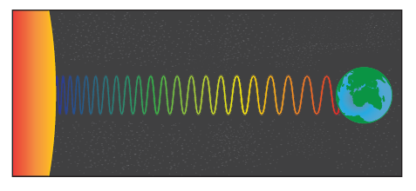
Gravitational Red Shift
This effect can also be explained in terms of the photons. If a photon moves towards the Earth, the photon’s energy increases as it travels to a position of smaller gravitational potential energy. Therefore, from E=hf, the photon’s frequency ought to increase.

Slide 20
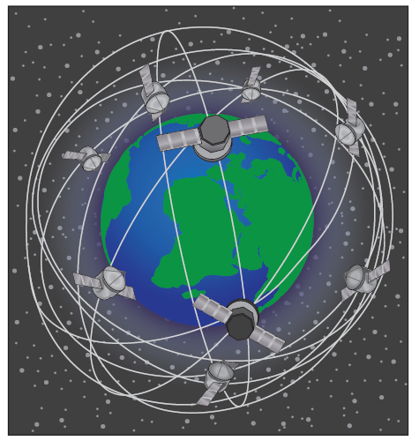
GPS
When Einstein first produced his general theory of relativity, its predictions were far removed from everyday experience and were therefore difficult to test experimentally. However, most people are nowadays accustomed to relying on the theory to keep their GPS (Global Positioning System) receivers working accurately.

Slide 21
GPS
Since the Earth’s gravitational field is weaker at altitude, a clock in a GPS satellite will run fast relative to a clock on the ground.
Adjustments need to be made to take this into account or the clocks will become out of sync within minutes.
Corrections also need to be made to allow for the special relativistic effect of time dilation brought about by the large velocity of the satellite.
Ignoring Einstein’s theories would result in a discrepancy of around 10 km per day. So within a week you would be confusing Edinburgh with Glasgow.

Slide 22
Spacetime Diagrams
Gravity is a property of both space and time. So, a spacetime system involves a x,y,z co-ordinate system.
Consider an event, E. Imagine light moving out from a source at E in an expanding spherical shell.
We’ll consider x and y, but ignore z. The light would look like an expanding circle.
Imagine snapshots are taken at regular intervals and stacked on top of each other so that the horizontal plane represents how far the light has moved and the vertical axis represents time. A cone shape would be formed.

Slide 23
Spacetime Diagrams

Slide 24
Spacetime Diagrams
We constructed this lightcone by choosing an event in spacetime and imagining all the possible paths that light could take in moving through this event.
Spacetime is filled with light cones; there is one for every event.

Slide 25
Spacetime Diagrams
Knowing the light cone structure of spacetime allows us to see which events can have an effect upon others. The top half of the light cone represents the future and it is the all events that have not yet happened that could be affected by E.
The bottom half is the past and it is all the events that could have contributed to E. A region outside the light cone would be inaccessible, since something would need to travel faster than light to reach it. Remember from special relativity that the speed of light is believed to be the greatest possible speed.

Slide 26
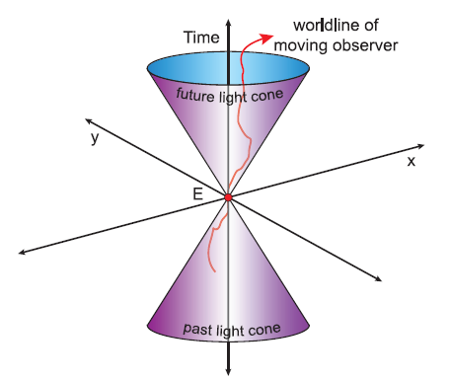
Spacetime Diagrams
The path of an object through spacetime is called a worldline. An example is shown in red below. Note that worldlines cannot go beyond the light cone, as to do so would require an object to travel at a speed greater than the speed of light.

Slide 27
Spacetime Diagrams
In reality, the light cone would actually be four-dimensional, 3 dimensions for space and one for time.
However, the concept is easier to visualise with the number of spatial dimensions reduced. The diagrams are most often simplified to show time and only one spatial dimension.

Slide 28
Lesson Starter
What is the equivalence principle?
What does a space-time diagram represent?
The moon orbits the Earth with a mean radius of 3.85×10⁸m. What is the gravitational field strength on the moon due to the Earth? M_{E} = 6.0x10²⁴ kg

Slide 29
Spacetime Diagrams

Slide 30
Spacetime Diagrams
The different regions of the spacetime diagram have the following significance:
The diagonal lines correspond to a speed equal to the speed of light in a vacuum, c.
The regions within the diagonals are where the speed is less than c.
The regions outside the diagonals cannot affect or be affected by the event at E, since messages cannot travel faster than c.
The present corresponds to where the time is zero.
The region below the x-axis is the past.

Slide 31
Worldlines
A particle’s spatial location at every instant in time is called a worldline.
Each point of a worldline is an event that can be labelled with the time and the spatial position of the object at that particular time. Note that unlike distance-time graphs, the spatial position will be displayed on the x-axis and the time on the y-axis.

Slide 32
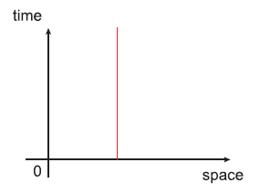
Worldlines
A stationary object’s position does not change with time and so its spacetime diagram would be as follows.

Slide 33
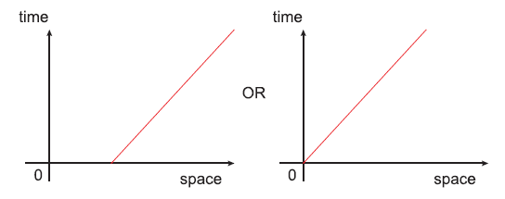
Worldlines
An object moving at constant speed could be shown by either of the following worldines.

Slide 34
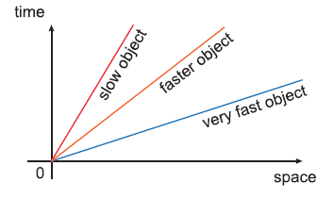
Worldlines
The greater the gradient of a worldline, the smaller the velocity.

Slide 35
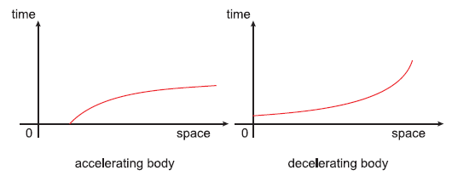
Worldlines
Accelerating objects are shown on spacetime diagrams as having world lines of changing gradient. So curved lines on spacetime diagrams correspond to non-inertial frames of reference i.e. accelerating frames of reference.

Slide 36
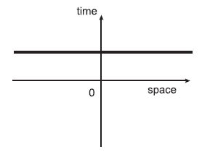
Worldlines
Simultaneous events are ones that occur at the same time. Therefore simultaneous events are shown as a flat line on a spacetime diagram, a line of constant time.

Slide 37
The curvature of Spacetime
We saw earlier that gravitational lensing is the process whereby a large mass can make light bend. In this situation, the light is still travelling in a straight line.
It is just that the mass has actually warped spacetime into being curved. Light always travels the shortest path between two points in spacetime and this path is called a geodesic path.

Slide 38
The curvature of Spacetime

Slide 39
The curvature of Spacetime
Matter tells spacetime how to curve, and curved spacetime tells matter how to move.

Slide 40
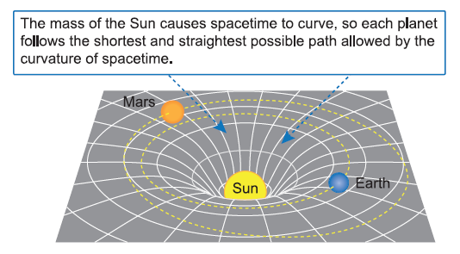
The curvature of Spacetime
The gravitational force of attraction between the Sun and a planet decreases with distance from the Sun. The closer to the Sun, the greater the degree of curvature in spacetime. The further from the Sun, the less the curvature in spacetime.

Slide 41
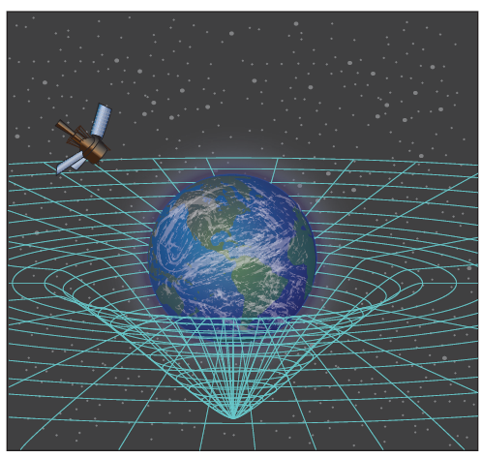
The curvature of Spacetime
Gravity Probe B was launched in 2004 to measure the curvature of spacetime. Tiny deviations in the orientation of spinning gyroscopes allowed astronomers to measure the amount by which the Earth warps the local spacetime in which it resides.

Slide 42
The orbit of Mercury
Einstein's general theory of relativity helps explain the motion of Mercury.
The mass of the Sun was creating a curvature in spacetime. The Sun was warping spacetime and Mercury was simply following the resulting curvature in the fabric of spacetime.

Slide 43
The orbit of Mercury

Slide 44
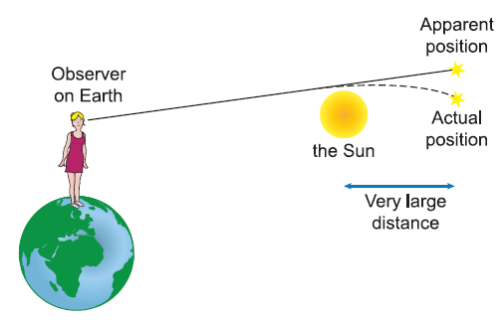
Observing Gravitational Lensing
General relativity predicts that an astronomical body with a very large mass ought to bend light. The astronomer Arthur Eddington was the first to provide evidence to confirm this. He made measurements to show that the gravitational field of the Sun deflects light from its straight path towards the Earth.

Slide 45
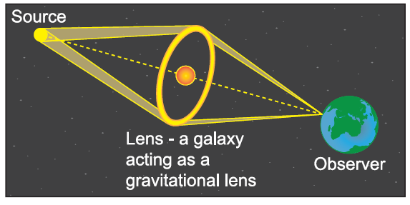
Observing Gravitational Lensing
An interesting example of this effect is known as an Einstein ring. If the light from a distant galaxy is made to bend by the gravitational field of another galaxy that is directly behind it, the light can be focused into a visible ring.

Slide 46
Gravitational Lensing
The gravitational field of a large object deflects light from its straight path.
An example of this effect is known as an Einstein ring.
If the light from a distant galaxy is made to bend by the gravitational field of another galaxy that is directly behind it, the light can be focused into a visible ring.

Slide 47
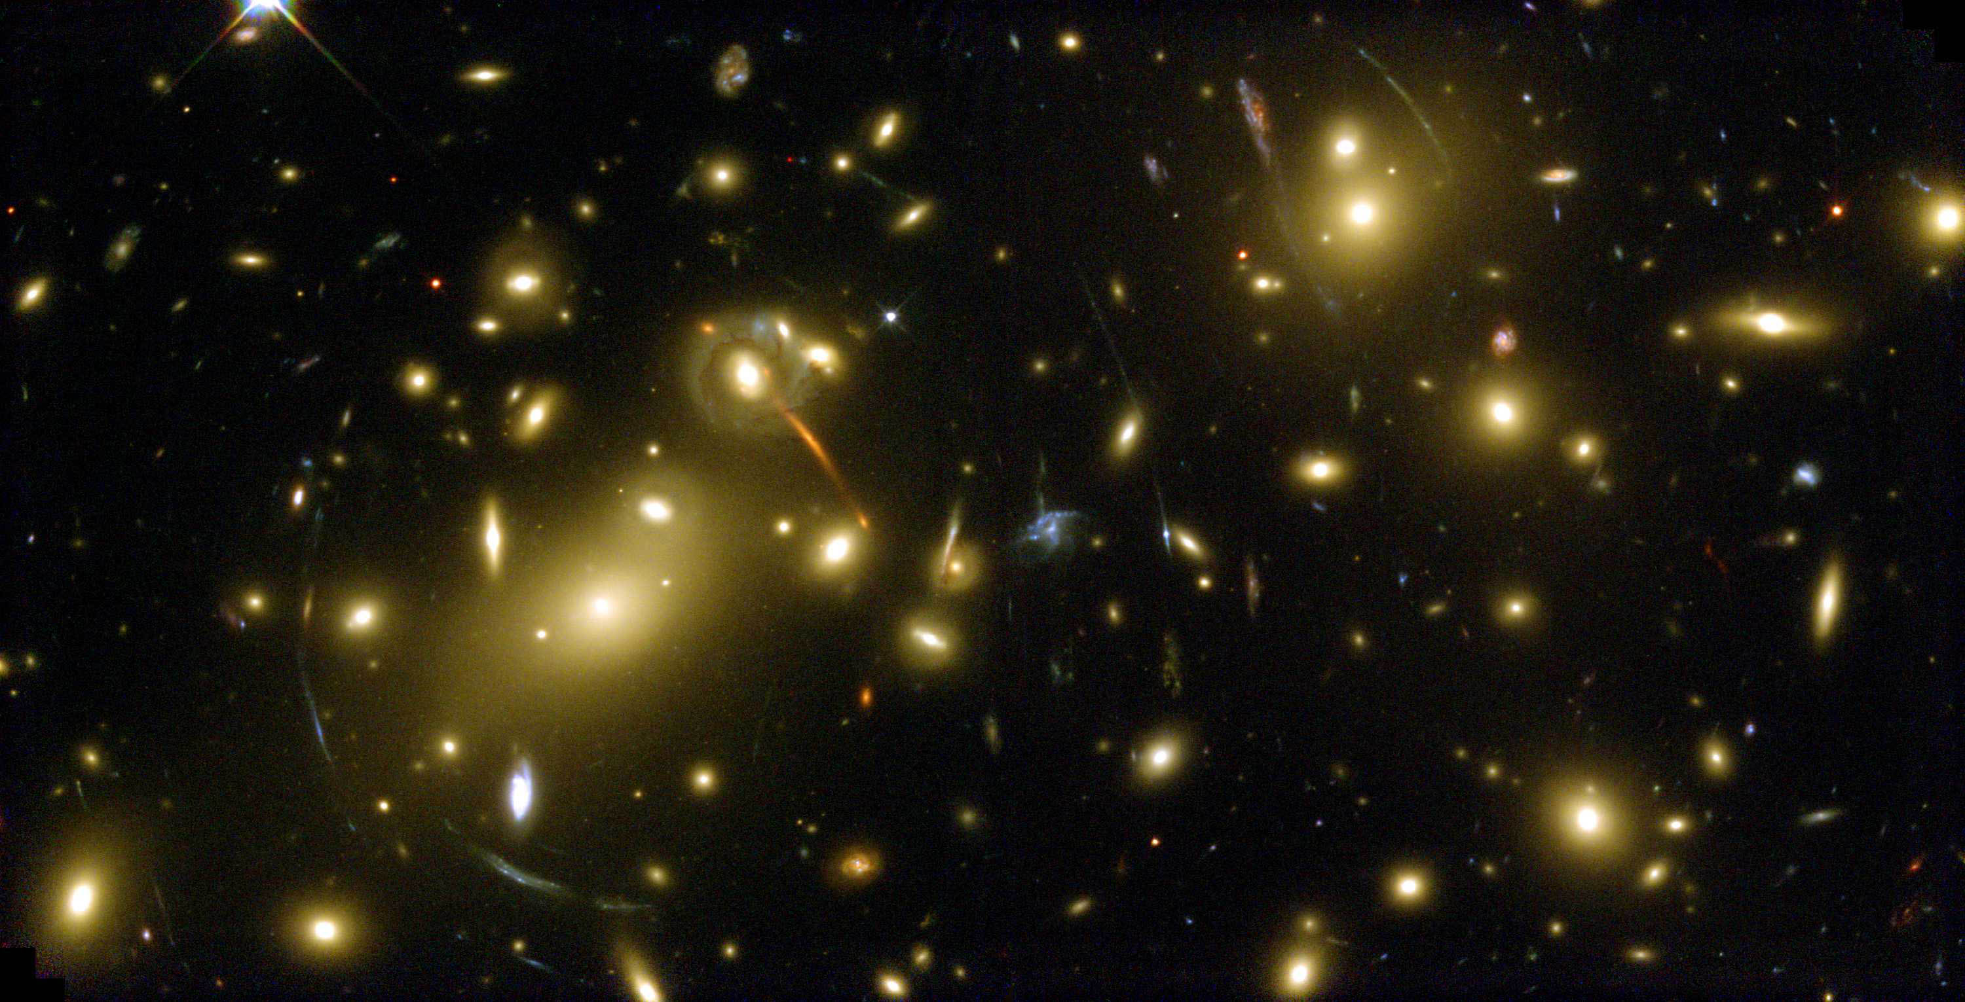

Slide 48
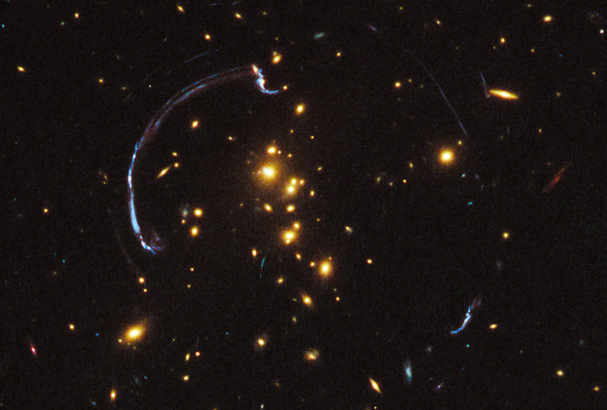

Slide 49
Mandatory Content

Slide 50
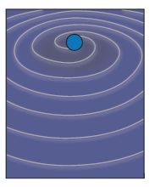
Gravitational waves - Ripples in spacetime
Einstein's general theory of relativity also predicts the existence of gravitational waves, which are ripples in spacetime generated during extremely violent astrophysical events, such as the collision of two black holes.

Slide 51
Gravitational waves - Ripples in spacetime
Gravitational waves are so weak that they are very hard to detect, but special interferometers such as LIGO (Laser Interferometer Gravitational Wave Observatory) use precisely calibrated laser beams to search for them.
A passing gravitational wave ought to slightly distort spacetime and cause a noticeable shift in the interference pattern created by the lasers.

Slide 52
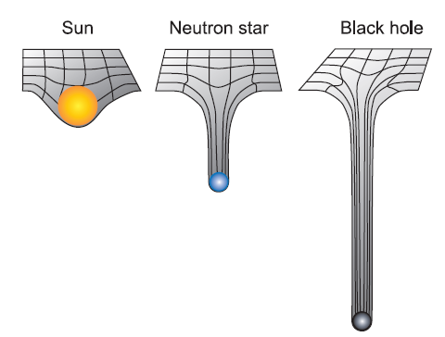
Black Holes
When a star of exceptionally large mass reaches the end of its life, gravitational compression will cause it to collapse to a very small radius, producing an incredibly dense body called a black hole.
Due to their extraordinary density, black holes exert extremely strong gravitational fields. Or rather, as general relativity would describe it, black holes severely distort spacetime.

Slide 53
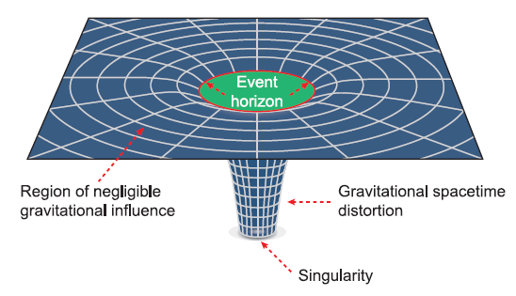
Black Holes
The spacetime around a black hole is stretched to a point of infinite density known as a singularity. This is a single point to which all mass would collapse.

Slide 54
Schwarzschild Radius
Up to a certain distance away, the gravitational field around a black hole is so high that nothing can escape, not even light i.e. the escape velocity is greater than the speed of light. A
Since nothing can travel faster than the speed of light, nothing can escape, not even photons. This means that a black hole’s name is certainly a very apt description. A black hole is effectively cut off from the rest of the Universe. However, a black hole’s presence can still be deduced by detecting the stream of X-rays produced as matter falls into it.

Slide 55
Black Holes

Slide 56
The Schwarzschild radius and the event horizon
The Schwarzschild radius is the distance from the centre of a black hole at which not even light can escape. At the Schwarzschild radius the escape velocity is equal to the speed of light.
The escape velocity for an object in a gravitational field can be found from:

Slide 57
The Schwarzschild radius and the event horizon
So, replacing v with the speed of light, c, gives the equation for the Schwarzschild radius:
Squaring both sides results in:
Rearranging for r_{Schwarzschild} gives:

Slide 58
The Schwarzschild radius and the event horizon
The Schwarzschild radius is also called the gravitational radius. It effectively forms a boundary called the event horizon.
No matter or radiation can escape from within the event horizon. It is possible to go from outside the event horizon to inside, but once you are over it, there is no going back!

Slide 59
Black holes
Black holes are extremely dense and exert extremely strong gravitational fields.
They severely distort spacetime.
The spacetime around a black hole is stretched to a point of infinite density known as a singularity.
The Schwarzschild (graviatational) radius is the distance from the centre of a black hole at which not even light can escape. It effectively forms a boundary called the event horizon. Time appears to be frozen at the event horizon.

Slide 60
Example 1
A star of mass 7.96 × 10³² kg collapses to form a black hole. Calculate the Schwarzschild radius.

Slide 61
Answer

Slide 62
Example 2
Calculate the mass of a black hole with a Schwarzschild radius of 1.76 × 10³ km.

Slide 63
Answer

Slide 64
Example 3
A black hole has a mass of 1.50 × 10³⁴ kg. Find the distance of the event horizon from its centre.

Slide 65
Answer

Slide 66
Example 4
Calculate the mass of a black hole with a Schwarzschild radius of 2.98 × 10²⁹ km.

Slide 67
Answer

Slide 68
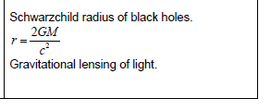
Mandatory Content

