Slide 1
Gravitation
CfE Advanced Higher Physics

Slide 2
Universal Law of Gravitation
Copy into notes jotter:
Newton's Law of Gravitation states that there is a force of attraction between any two objects in the universe.
The size of the force is proportional to the product of the masses of the two objects, and inversely proportional to the square of the distance between them. This law can be summed up in the equation:
$$F=\frac{Gm_{1}m_{2}}{r^{2}}$$
Where G = the gravitational constant 6.67x10⁻¹¹ m³ kg⁻¹ s⁻²
m₁ and m₂ are the masses of the two objects (kg) and r is the distance between the two masses (m).

Slide 3
Example
Copy into notes jotter:
Consider two point masses, each 2.00 kg, placed 1.20 m apart on a table top. Calculate the magnitude of the gravitational force between the two masses.

Slide 4
Answer
Copy into notes jotter:
$$F=\frac{Gm_{1}m_{2}}{r^{2}}$$
$$=\frac{6.67x{10}^{−11}x 2.0 x2.0}{{1.20}^{2}}$$
$$=1.85x{10}^{−10}N$$
The gravitational force between these two masses is only 1.85 × 10⁻¹⁰ N. This is an extremely small force, one which is not going to be noticeable in everyday life.

Slide 5
Example 2
Copy into notes jotter:
The Earth has a radius of 6.4 × 10⁶ m and a mass 6.0 × 10²⁴ kg. What is the gravitational force due to the Earth acting on a woman of mass 60.0 kg standing on the surface of the Earth?

Slide 6
Answer
Copy into notes jotter:
$$F=\frac{Gm_{1}m_{2}}{r^{2}}$$
$$=\frac{6.67x{10}^{−11}x 6.0x{10}^{24} x 60.0}{{(6.4x{10}^{6})}^{2}}$$
$$=590N$$
The gravitational force acting on the woman is 590 N, and this force is directed towards the centre of the Earth.
If you calculate the force due to gravity acting on the woman by another method, using , w-mg, you should also get the answer 590 N, when rounded to two significant figures.

Slide 7
Weight
Copy into notes jotter:
The weight of an object of mass can be defined as the gravitational force exerted on it by the Earth.
$$W=F_{grav}=\frac{GM_{E}m}{r_{E}^{2}}$$
The acceleration due to gravity, g, is found from Newton's second law of motion:
$$F=ma$$
$$∴W=mg$$
Subbing in F we get:
$$mg=\frac{GM_{E}m}{r_{E}^{2}}$$
$$∴g=\frac{GM_{E}}{r_{E}^{2}}$$

Slide 8
Weight
Copy into notes jotter:
The acceleration of an object due to gravity close to the Earth's surface does not depend on the mass of the object. In the absence of friction, all objects fall with the same acceleration.
In general, at a distance from the centre of a body of mass M, the value of g is given by:
$$g=\frac{GM}{r^{2}}$$
The weight of an object tells us the magnitude of the gravitational force acting upon it, so it is not a constant.

Slide 9
Mandatory Content

Slide 10
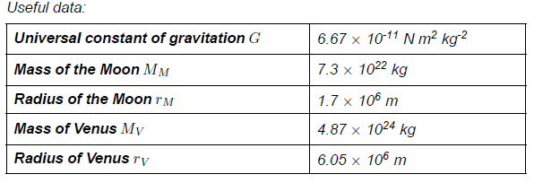
Quiz

Slide 11
Quiz

Slide 12
Lesson Starter
Compare the values of g on the surfaces of the Earth and the Moon.
M_{Earth}= 6.0 × 10²⁴ kg
r_{E}= 6.4 × 10⁶ m
M_{moon}= 7.3 × 10²² kg
r_{M}= 1.7 × 10⁶ m

Slide 13
Answer
Compare the values of g on the surfaces of the Earth ( M_{Earth}= 6.0 × 10²⁴ kg, r_{E}= 6.4 × 10⁶ m) and the Moon ( M_{moon}= 7.3 × 10²² kg, r_{M}= 1.7 × 10⁶ m).
Answer:

Slide 14
Gravitational Field Strength
Copy into notes jotter:
The gravitational field strength at a point in a gravitational field is equal to the force acting per unit mass placed at that point in the field. At a distance r from a point object of mass M, the gravitational field strength is given by
$$g=\frac{GM}{r^{2}}$$
Where g is measured in N kg⁻¹ or ms⁻², because a=g

Slide 15
Example
The Earth orbits the Sun with a mean radius of 1.5×10¹¹ m. What is the gravitational field strength on Earth due to the Sun, given that the mass of the Sun is 2.0×10³⁰ kg.

Slide 16
Answer
In the Sun's gravitational field, the field strength is given by:
So, $g=\frac{GM_{s}}{r^{2}}$
$$=\frac{6.67x{10}^{−11}x 2.0x{10}^{30}}{{\left(1.5x{10}^{11}\right)}^{2}}$$
$$=5.9x{10}^{−3}N kg^{−1}$$
$$g=\frac{GM_{s}}{r^{2}}$$

Slide 17
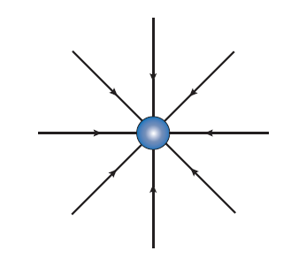
Field Lines
We can express the strength of a gravitational field of a point mass by using field lines:
This is an example of a conservative field. A field in which the work done in moving from one point to another in the field is independent of the path taken.

Slide 18
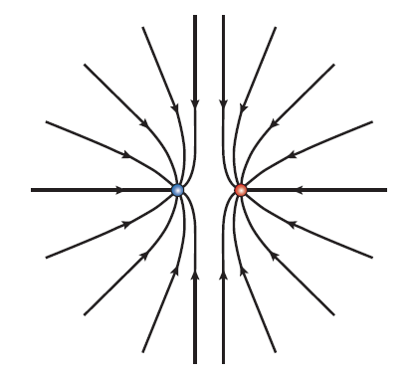
Gravitational Field
The gravitational field due to two identical point masses is drawn as:
To calculate the gravitational field strength at any point in the field due to two point masses or spheres, we take the vector sum of the two individual fields.

Slide 19
Example
The mean distance between the centre of the Earth and the centre of the Moon is 3.84 × 10⁸ m. At what distance from the centre of the Earth is the point where the total gravitational field strength due to the Earth and the Moon is zero?
M_{E} =6.0 × 10²⁴ kg
M_{M} = 7.3 × 10²²kg,

Slide 20
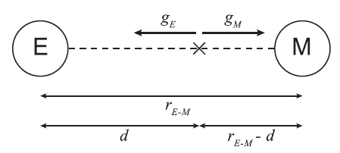
Answer
Draw a diagram:
At position X, the point where the total gravitational field strength is zero, the gravitational field strength g_{E} of the Earth is balanced by g_{M}, the gravitational field strength of the Moon. Position X is a distance from the centre of the Earth. To find the distance d, we must solve the equation g_{E}=g_{M}

Slide 21
Answer cont…
$$g_{E}=g_{M}$$
$$\frac{GM_{E}}{d^{2}}=\frac{GM_{M}}{{(r}_{E−M}−{d)}^{2}}$$
$$\frac{M_{E}}{d^{2}}=\frac{M_{M}}{{(r}_{E−M}−{d)}^{2}}$$
$$\frac{\sqrt{M_{E}}}{d}=\frac{\sqrt{{M }_{M}}}{{(r}_{E−M}−d)}$$

Slide 22
Answer cont…
$$\sqrt{M_{E}}{ x (r}_{E−M}−d)= \sqrt{M_{M}} x d$$
$$\sqrt{M_{E}}{ x r}_{E−M}=\left(\sqrt{M_{M}}+{\sqrt{M}}_{E}\right)x d$$
$$2.449x{10}^{12} x 3.84x{10}^{8}=d \left(2.702x{10}^{11}+2.449x{10}^{12}\right)$$
$$d=\frac{9.404x{10}^{20}}{2.719x{10}^{12}}$$
$$d=3.5x{10}^{8}m$$

Slide 23
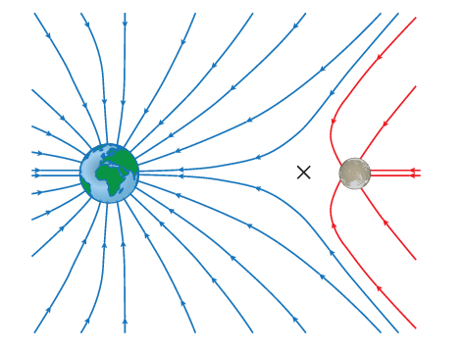
The Earth-Moon system
The gravitational field line pattern for a planet-moon system is:
The gravitational field lines meet the surface of the Earth and the Moon at 90 ° to their surface.
The point at which the gravitational field strength is zero has been labelled X.
This is closer to the Moon than the Earth because the Earth has a much larger mass.

Slide 24
Quiz

Slide 25
Quiz

Slide 26
Satellite Motion
Man-made satellites orbiting the Earth are used extensively by the telecommunications industry.
Other artificial satellites are used for applications such as meteorological observations. The Earth does have a natural satellite too, of course, namely the Moon.
In this section we will be studying the motion of satellites, investigating the relationship between orbit radius and orbit period.

Slide 27
Newton’s Canon
http://courses.scholar.hw.ac.uk/vle/scholar/session.controller?action=viewContent&contentGUID=08ceecc8-642c-f66c-e356-ed7da3401632
Imagine if we fire a cannonball horizontally from a cannon. Using the kinematic relationships, we can work out how far the cannonball travels before hitting the ground, and how long it spends in the air before reaching the ground.
If the cannonball has sufficient speed, and is fired from a very high point, the calculation becomes more complicated, since the Earth is not horizontal but curved. We must take the curvature of the Earth into account when we try to calculate where the cannonball lands.
Newton compared the theoretical cannonball to the orbit of the Moon.
Using the idea of the Moon "falling" around the Earth, he compared the rate at which the Moon was falling to the rate at which an object close to the Earth falls, and from this he was able to establish the inverse square law of gravitation.

Slide 28
Newton’s Canon
If a satellite is orbiting the Earth with a uniform speed, then there must be a constant centripetal force acting on it. We have seen that the only force acting on the satellite (mass M) is the gravitational force exerted on it by the Earth (mass M_{E}).
This force acts towards the centre of the Earth and is the centripetal force.

Slide 29
Speed of a Satellite
The speed of the satellite can be found by:
$\frac{GM_{E}m}{r^{2}}=\frac{mv^{2}}{r}$
$∴v^{2}=\frac{GM_{E}}{r}$
$∴v=\sqrt{\frac{GM_{E}}{r}}$

Slide 30
Newton’s Canon
The mass of the satellite does not affect the speed. It is this fact that leads to the effect of 'weightlessness' experienced by astronauts. An astronaut in a satellite can be considered to be a satellite himself, and will be orbiting at the same speed as the satellite.
Since there will be no force pushing the astronaut against the floor or the walls, the astronaut experiences an apparent weightlessness relative to the satellite.
Weightlessness occurs because the astronaut and the satellite are both 'falling' with the same acceleration.

Slide 31
Period of a satellite
The period T of an object performing circular motion with radius is related to the speed of the object by the equation:
$F=mrω^{2}=mr{\left(\frac{2π}{T}\right)}^{2}=\frac{mv^{2}}{r}$
so: $\frac{mv^{2}}{r}=mr{\left(\frac{2π}{T}\right)}^{2}$
$\frac{mv^{2}}{r}=mr\frac{4π^{2}}{T^{2}}$
$\frac{v^{2}T^{2}}{r^{2}}=$ $4π^{2}$
$v^{2}=\frac{4π^{2}r^{2}}{T^{2}}$
$v=\frac{2πr}{T}$

Slide 32
Period of a satellite
The period T of an object performing circular motion with radius is related to the speed of the object by the equation:
$$v=\frac{2πr}{T}$$
Does not depend on mass!!
NOT ON EQUATION SHEET!!

Slide 33
Period of a satellite
Using the following equations we can derive an expression for the period of a satellite orbiting the Earth:
$v=\frac{2πr}{T}$ and $v=\sqrt{\frac{GM_{E}}{r}}$
$$\sqrt{\frac{GM_{E}}{r}}=\frac{2πr}{T}$$
$$\frac{T}{2πr}=\sqrt{\frac{r}{GM_{E}}}$$
$$T=2π\sqrt{\frac{r^{3}}{GM_{E}}}$$
Does not depend on mass of satellite!!
NOT ON EQUATION SHEET!!

Slide 34
Example
A meteorological satellite orbits the Earth at an altitude of 2.50×10⁵ m above the Earth's surface. What is the speed and periodic time of the satellite? (The radius of the earth is 6.4x10⁶ m)

Slide 35
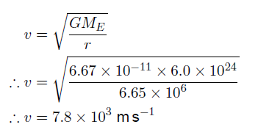
Answer
Before we can calculate the speed, we have to find the radius of the satellite's orbit, which is equal to the radius of the Earth plus the altitude of the satellite above the Earth's surface.
Now calculate the speed:

Slide 36
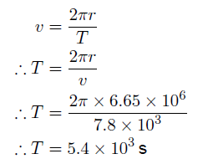
Answer cont…
We can now calculate the period:
The satellite orbits with a speed of 7.8 × 10³ m s⁻¹ and a period of 5400 s (90 minutes).

Slide 37
Orbital Speed of a Satellite
The total energy of a satellite in orbit around a planet is made up of kinetic energy due to its motion and potential energy due to its position in the gravitational field of the planet.
http://courses.scholar.hw.ac.uk/vle/scholar/session.controller?action=viewContent&contentGUID=08ceecc8-642c-f66c-e356-ed7da3401632

Slide 38
Geostationary Satellites
A geostationary satellite is a satellite that remains directly above the same point on the Earth's surface.
Communications satellites are all in geostationary orbits, so that a fixed receiver dish back on Earth can receive a signal. A geostationary satellite must be orbiting the Earth with the same angular velocity as the Earth's rotation about its axis. This orbit is sometimes referred to as a parking orbit.

Slide 39
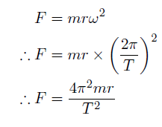
Geostationary Satellites
The angular velocity ω is equal to $\frac{2π}{T}$. A satellite of mass m in a geostationary orbit of radius r around the Earth requires a centripetal force given by the equation

Slide 40
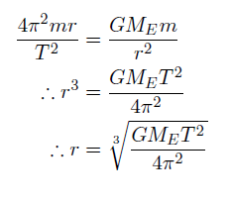
Geostationary Satellites
This centripetal force is provided by the gravitational force exerted by the Earth on the satellite, hence the centripetal force is equal to the gravitational force calculated using Newton's Law of Gravitation.

Slide 41
Kepler’s Laws
The three laws that govern the motion of planets were discovered by Johannes Kepler in the early 17th century. The laws were based on the astronomical observations of Tycho Brahe, and are known as Kepler's laws. These laws state that:
The planets move in elliptical orbits, with the Sun at one focus of the ellipse.
The line joining the Sun and a planet sweeps out equal areas in equal times.
For each planet, the square of the periodic time of its orbit is proportional to the cube of its mean distance from the Sun.

Slide 42
Kepler’s Laws

Slide 43
Quiz

Slide 44
Quiz

Slide 45
Quiz

Slide 46
Gravitational Potential and Potential Energy
If a mass is raised through a height, it gains potential energy. If the mass is then allowed to fall back down, this potential energy is converted to kinetic energy as it is accelerated downwards.
When an object moves through large distances in a gravitational field, we can no longer use this simple expression for the change in potential energy, as the value of the gravitational field strength is not constant.
The gravitational potential is used to describe how the potential energy of an object changes with its position in a gravitational field, and how much work is done in moving an object within the field.

Slide 47
Gravitational Potential and Potential Energy
The gravitational potential at a point in a gravitational field is the work done by external forces in moving a unit mass from infinity to that point.
We cannot use the simple expression work done = force × distance to calculate the work done against the gravitational force, as the gravitational force acting on the unit mass increases as it moves closer to m. Instead, we have to consider the small amount of work done in moving a unit mass a distance in the field. Integrating over the range from ∞ to r.

Slide 48
Gravitational Potential
Using Newton's law of gravitation for the force acting on the body
In this expression, the values of m₁ and m₂ are M and 1 kg

Slide 49
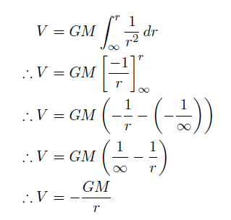
Gravitational Potential
Integrating we get:
Where V is gravitational potential and measured in Jkg⁻¹
Gravitational potential is negative, this is because the zero of gravitational potential is at an infinite distance from M. The potential becomes lower and lower the closer we get to M.

Slide 50
Gravitational Potential

Slide 51
Example
The planet Pluto orbits at a mean distance of 5.92 × 10¹² m from the Sun. What is the gravitational potential due to the Sun's gravitational field at this distance? (Mass of sun = 2.0x10³⁰kg)

Slide 52
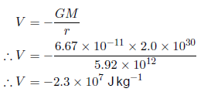
Answer
Here M represents the mass of the Sun, since we are calculating the potential due to the Sun's gravitational field. The mass of the Sun is 2.0 × 10³⁰ kg, so

Slide 53
Gravitational Potential Energy
$V=−\frac{GM}{r}$tells us the gravitational potential at a point in a gravitational field per unit mass. To find the gravitational potential energy of an object of mass m₂ placed at that point in the field around a mass m₁, we simply multiply by m₂.
We can now calculate the work done in moving an object in a gravitational field using this equation. The work done is equal to the change in potential energy of the object. When carrying out these calculations, it is important to take care to get the sign correct.

Slide 54
Example
A rocket ship, mass 4.00 × 10⁵ kg, is travelling away from the Moon. The ship's rockets are fired when the ship is at a distance of 3.00 × 10⁶ m from the centre of the Moon. How much work is done by the rockets in moving the ship to a distance 3.20×10⁶ m from the Moon's centre?
M_{M} = 7.3 ×10²² kg

Slide 55
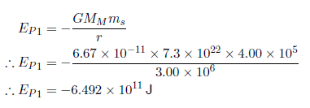
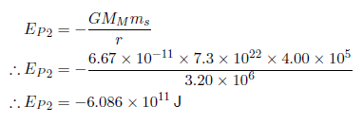
Answer
The rocket ship has an initial gravitational potential energy of:
The final value of the potential energy is:

Slide 56
Answer cont…
The change in potential energy is:
The potential energy of the rocket ship has increased by 4.1 × 10¹⁰ J, so the amount of work done by the rockets must also be equal to 4.1 ×10¹⁰ J.

Slide 57
Gravitational field
The gravitational field is a conservative field, which means that the work done in moving a mass between two points in the field is independent of the path taken. We do not need any details about the path taken between two locations.
(An example of doing non-conservative work would be the work done against friction in sliding a heavy mass between two points. Obviously we do less work if we slide the mass directly from one point to the other rather than taking a longer route.)

Slide 58
Mandatory Content

Slide 59
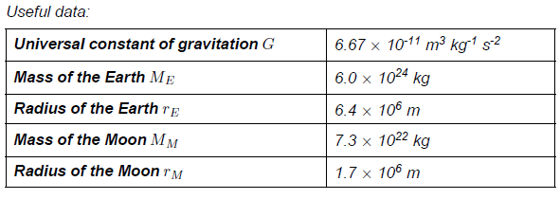
Quiz

Slide 60
Quiz

Slide 61
Quiz

Slide 62
Lesson Starter

Slide 63
Escape Velocity
To escape from the gravitational field, an object must have sufficient kinetic energy. We know that at an infinite distance from Earth, the potential energy of a body will be zero. We can also work out the (negative) potential energy of the body when placed at the Earth's surface. If the body has sufficient kinetic energy to raise its total energy above zero J, then it can escape from the gravitational field.
The gravitational potential energy of an object such as a rocket of mass m at a point on the Earth's surface can be calculated using:

Slide 64
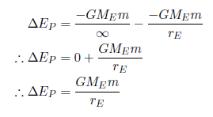
Escape Velocity
To escape the Earth's gravitational field, the work done by the rocket must equal the potential difference between infinity and the point on the Earth's surface.
The rocket must have an initial kinetic energy at least equal to this, so that its velocity does not drop to zero before it has escaped from the field.

Slide 65
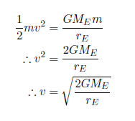
Escape Velocity
We can use the equation for kinetic energy to calculate the initial velocity of the rocket.
This velocity is the minimum velocity required.
YOU NEED TO KNOW THIS DERIVATION!!

Slide 66
Escape Velocity
The minimum velocity a mass must have that would allow it to escape the gravitational field of the planet or star.

Slide 67
Derivation of Escape Velocity Relationship
E_{P} at surface = - GMm
r
E_{P} at infinity = 0
E_{K} at surface = ½ mv²
E_{K} at infinity = 0
Total Energy at Surface = Total energy at infinity
-GMm + ½ mv² = 0
r
v² = 2GM
r
v(escape) = 2GM
r

Slide 68
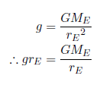
Escape Velocity
Now we will use the expression for the acceleration due to gravity , equivalent to the gravitational field strength at the Earth's surface, which is given by the equation:
Substituting this expression into the equation for the escape velocity gives us:
Where g is the gravitational field and r is the radius of the
planet you are trying to escape.

Slide 69
Escape Velocity
The escape velocity for a rocket fired from Earth is given by this equation. Putting in the values of = 9.8 m s⁻² and = 6.4 × 10⁶ m, the escape velocity has a value:

Slide 70
Escape Velocity
You should note that the escape velocity does not depend on the mass of the rocket - the escape velocity is the same for any object launched from the Earth's surface.
In general, the escape velocity from the gravitational field around a body of mass , starting from a point from the centre of the field, is given by the following equation:

Slide 71
Example
What is the escape velocity for a lunar probe taking off from the surface of the Moon? ( M_{M}= 7.3 × 10²² kg, r_{M}= 1.7 × 10⁶ m)

Slide 72
Answer
The escape velocity from the Moon's gravitational field is 2.4 × 10³ m s⁻¹, or 2.4 km s⁻¹.

Slide 73
Mandatory Content

Slide 74
Quiz

Slide 75
Quiz

