Slide 1
The Standard Model
Lesson 4:
Forces and Bosons

Slide 2
What are we learning today?
That Bosons are force mediating (carrying) particles.
How a PET scanner works.

Slide 3
What holds matter together?
We now have a better understanding of how matter is made up.
But what holds it together?
Why don’t the protons in the nucleus fly apart?
Why isn’t the electron attracted to the nucleus?
Because of forces!

Slide 4
There are four fundamental forces.
Strong
Weak
Electromagnetism
Gravity
Each force has an associated exchange particle. These are called BOSONS.

Slide 5
The Strong Force
This is a short range force that holds particles of the same charge together.
It holds quarks together to form hadrons.
It’s exchange particles are called gluons because they glue the quarks together.
The strong force between the quarks in individual protons is strong enough to overcome the force of repulsion between the protons in the nucleus.
It is an extremely short range force.

Slide 6
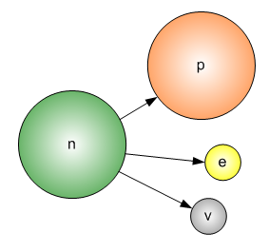
The Weak Force
This is involved in radioactive beta decay.
It’s exchange particles are W and Z bosons.
It is an extremely short range force.

Slide 7
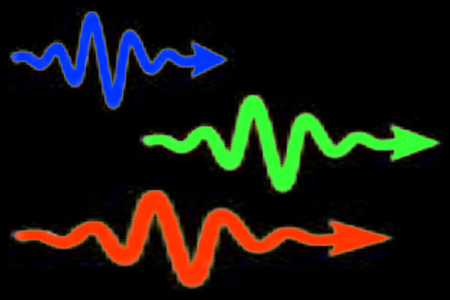
The Electromagnetic Force
This stops the electron from flying out of the atom.
It’s exchange particle is the photon.

Slide 8
The Gravitational Force
This is the weakest of the four fundamental forces.
It attracts particles that have mass and is responsible for holding matter together.
It’s exchange particle is the graviton. (n.b. the graviton has not yet been detected)
Gravity cannot be easily explained by the Standard Model.

Slide 9
Bosons - in summary
Four fundamental forces each with an associated boson (force mediating particle)
Strong force
mediating particle: gluon
holds particles together in nucleus
Weak force
mediating particle: W and Z bosons
involved in radioactive beta decay
EM force
mediating particle: photon
keeps electron in atom
Gravitational force
mediating particle: gravitons
weakest force that holds matter together

Slide 10
The four fundamental forces:
There are four fundamental forces between particles:
Gravitational force (for particles with mass, a.k.a., fermions) – mediating particle is the graviton .
Electromagnetic force (for particles with a charge) – mediating particle is the photon.
Strong nuclear force (for quarks) – mediating particle is the gluon.
Weak nuclear force (for electrons and neutrinos) – mediating particle are the W and Z bosons.
The graviton, photon, gluon and W and Z bosons are ALL BOSONS!

Slide 11
The four fundamental forces:
Gravitational force is a weak force holds matter together (attractive force).
Electromagnetic force stops electrons flying out the atom.
Strong nuclear force holds quarks together.
Weak nuclear force involved in radioactive beta decay – extremely short range.

Slide 12
Bosons
The strong nuclear force holds particles of the same charge together – holds quarks together to form hadrons.
In the nucleus the electromagnetic and strong nuclear forces are balanced.
The strong nuclear force acts to oppose the electromagnetic force.
https://www.youtube.com/watch?v=ehHoOYqAT_U

Slide 13
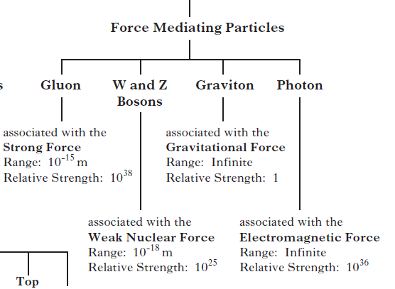
2012

Slide 14
Extension: Uses of Antimatter
Positron Emission Tomography (PET)
PET scanners use antimatter annihilation to build up 3D images of the functions of our body.

Slide 15
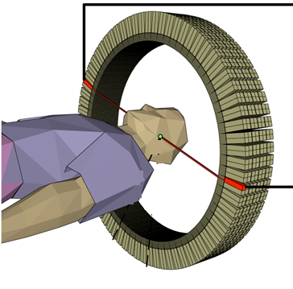
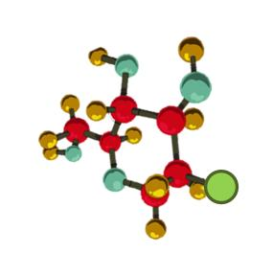
A radioactive tracer that emits positrons is attached to a compound such as glucose, oxygen or water and injected into the body.
Radioactive glucose
Notes:
Image IOP.

Slide 16
When this tracer emits a positron it will annihilate nearly instantaneously with an electron.
This produces a pair of gamma-ray photons of specific frequency moving in approximately opposite directions to each other.
Gamma ray
electron
positron
Gamma ray

Slide 17
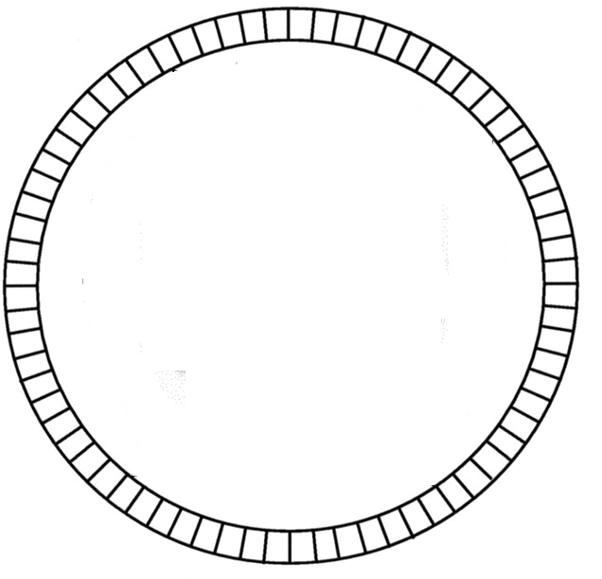
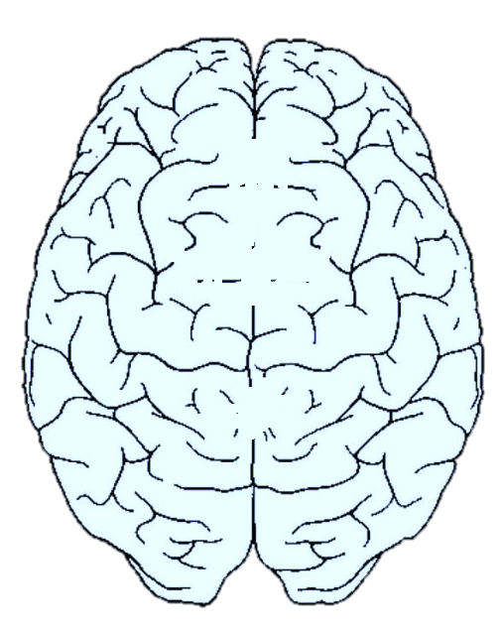
The gamma rays are detected by a ring of scintillators, each producing a burst of light that can be detected by a photodiode.
Complex computer analysis traces tens of thousands of possible events each second and the positions of the original emissions are calculated.

Slide 18
A 3D image can then be constructed.
CT and MRI are often used to obtain a more accurate picture.
The detecting equipment in PET scanners has much in common with particle detectors.
The latest developments in particle accelerators can be used to improve this field of medical physics.

Slide 19
PET Scanners
A tracer that emits positrons is injected into the body and will annihilate nearly instantaneously with an electron.
This produces a pair of gamma-ray photons of specific frequency moving in approximately opposite directions to each other.
The gamma rays are detected by a ring of scintillators, each producing a burst of light that can be detected by a photodiode.
With enough information, the computer can make up a 3D image.

