Slide 1
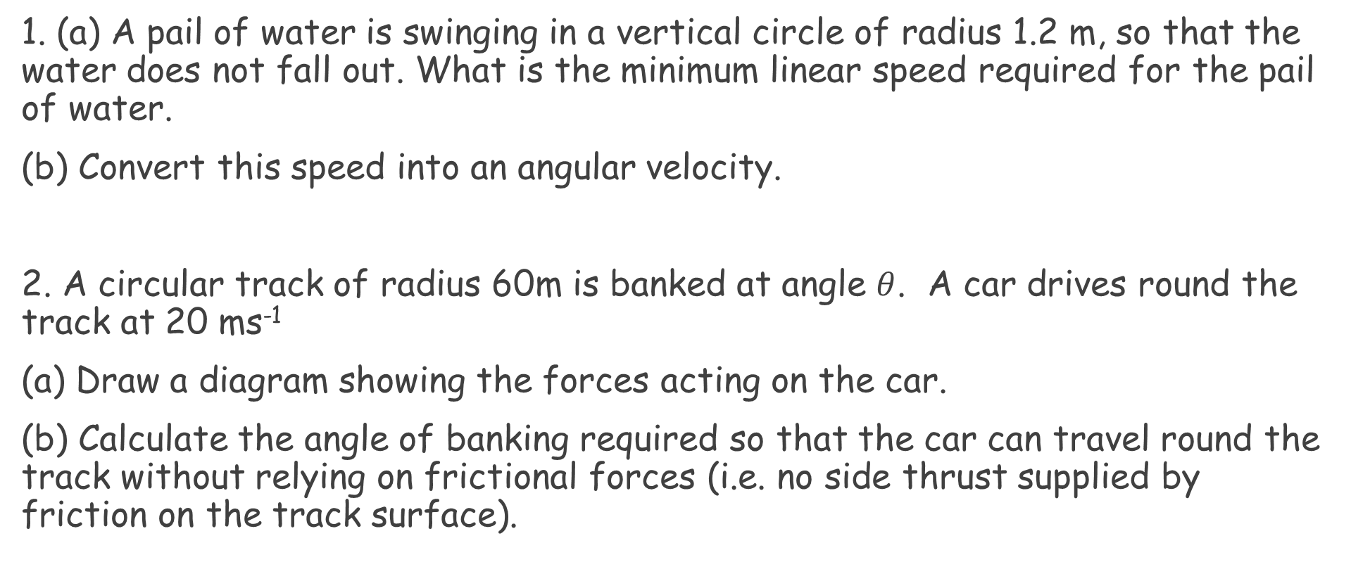
Lesson Starter
1. (a) A pail of water is swinging in a vertical circle of radius 1.2 m, so that the water does not fall out. What is the minimum linear speed required for the pail of water.
(b) Convert this speed into an angular velocity.
2. A circular track of radius 60m is banked at angle $θ$. A car drives round the track at 20 ms⁻¹
(a) Draw a diagram showing the forces acting on the car.
(b) Calculate the angle of banking required so that the car can travel round the track without relying on frictional forces (i.e. no side thrust supplied by friction on the track surface).

Slide 2
Angular Momentum
CfE Advanced Higher Physics

Slide 3
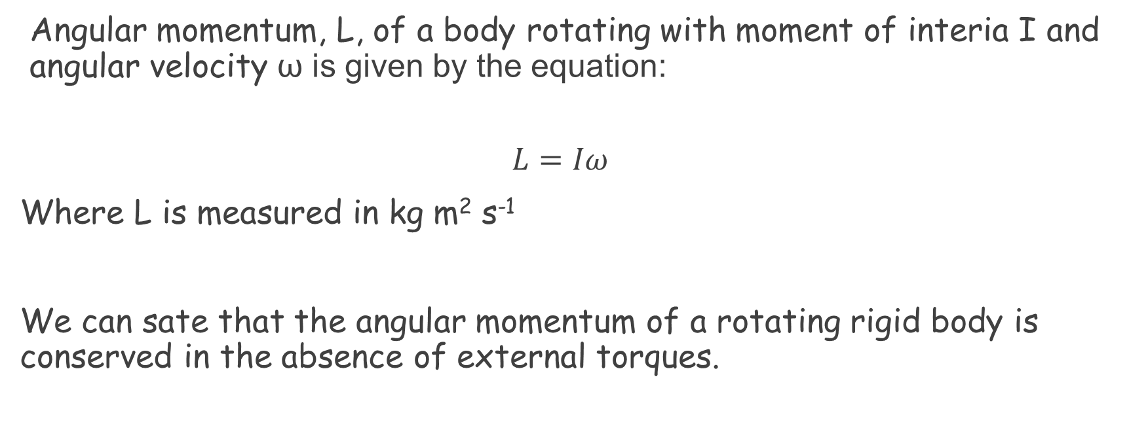
Angular Momentum
Copy into notes jotter:
Angular momentum, L, of a body rotating with moment of interia I and angular velocity ω is given by the equation:
$$L=Iω$$
Where L is measured in kg m² s⁻¹
We can sate that the angular momentum of a rotating rigid body is conserved in the absence of external torques.

Slide 4
Angular Momentum
Copy into notes jotter:
To calculate the angular momentum of an object at a point, we can substitute $I=mr^{2}$ and $ω=\frac{v}{r}$ into the angular momentum equation to get:
$L=mr^{2}ω$ and $L=mvr$

Slide 5
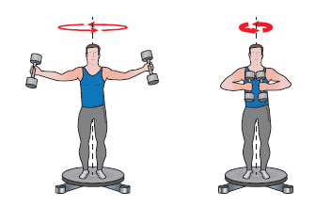
Conservation of angular momentum
Copy into notes jotter:
Since angular momentum depends on the moment of inertia of an object, then it depends of the distribution of mass about the axis.
If moment of inertia increases, angular velocity must decrease to keep the angular momentum constant and vice versa.

Slide 6
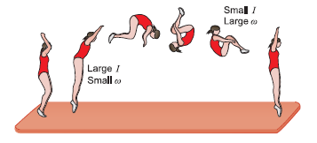
Angular momentum in sports
Gymnasts, snowboarders, divers and acrobats all use this concept of conservation of momentum.
Standing position = large moment of inertia, so small angular velocity.
Tucked position = small moment of inertia, so large angular velocity.

Slide 7
Example
Copy into notes jotter:

Slide 8
Answer
Copy into notes jotter:
Angular momentum is always conserved, so angular momentum before must equal angular momentum after.
$$L_{i}=L_{f}$$
$$I_{i}ω_{i}=I_{f}ω_{f}$$
$$4.7 x 7=1.8 ω_{f}$$
$$ω_{f}=\frac{4.7 x 7}{1.8}$$
$$ω_{f}=18 rad s^{−1}$$

Slide 9
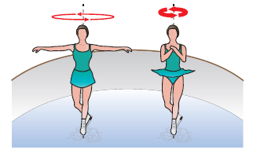
Everyday examples
Ice skaters also use this concept when spinning:

Slide 10
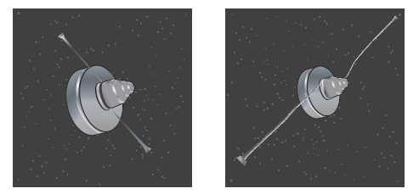
Everyday examples
The mars exploration rover’s angular velocity was reduce by having extended arms with masses attached to them, which, when extended, increases the moment of inertia, so decreases the angular velocity.

Slide 11
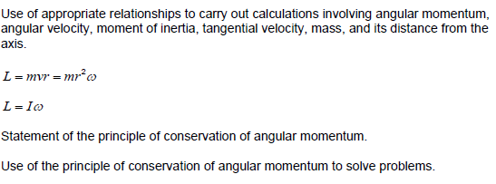
Mandatory content

Slide 12
Quiz

Slide 13
Quiz cont…

Slide 14
Rotational Kinetic Energy
Copy into notes jotter:
There are also expressions for calculating work done and kinetic energy in rotational motion, that are again analogous to expressions used to describe linear motion. These are:
$$W=Tθ for work done$$
$$and$$
$$E_{k}=\frac{1}{2}Iω^{2} for rotational kinetic energy.$$

Slide 15
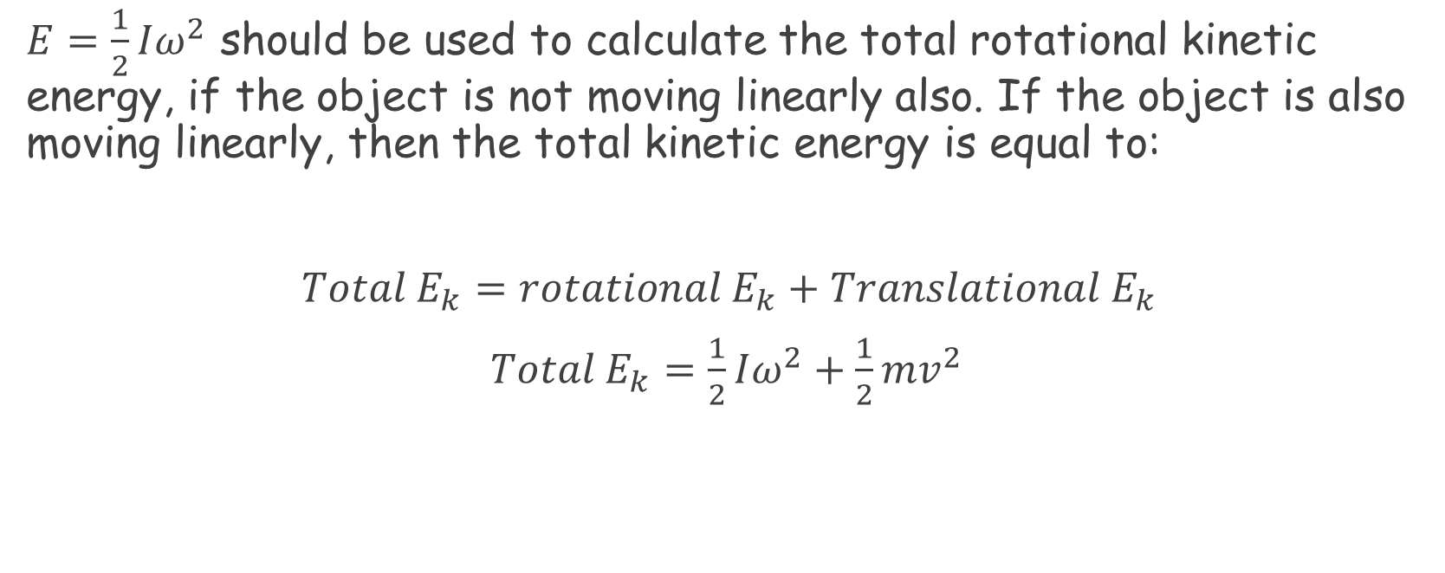
Total kinetic Energy
Copy into notes jotter:
$E=\frac{1}{2}Iω^{2}$ should be used to calculate the total rotational kinetic energy, if the object is not moving linearly also. If the object is also moving linearly, then the total kinetic energy is equal to:
$Total E_{k}=rotational E_{k}+Translational E_{k}$
$Total E_{k}=\frac{1}{2}Iω^{2}+\frac{1}{2}mv^{2}$

Slide 16
Example 1
Copy into notes jotter:
A solid sphere of radius and mass has moment of inertia about any axis though its centre.
Calculate the translational and rotational kinetic energies of a sphere of mass 0.40 kg and radius 20 cm rolling (without slipping) along a horizontal surface with translational speed 5.0ms⁻¹

Slide 17
Answer
Copy into notes jotter:
The translational Ek is:
$${Translational E}_{k}=\frac{1}{2}{mv}^{2}$$
$$=\frac{1}{2}x 0.4 x {0.5}^{2}$$
$$=5.0J$$

Slide 18
Answer
Copy into notes jotter:
To find the rotational Ek, we need to find the angular speed of the object first:
$$ω=\frac{v}{r}$$
$$=\frac{5.0}{0.20}$$
$$=25 rad s^{−1}$$
$$E_{k}=\frac{1}{2}Iω^{2}$$
$$=\frac{1}{2}x\frac{2}{5}mr^{2}x {25}^{2}$$
$$=\frac{1}{5}x 0.40x{0.20}^{2}x {25}^{2}=2J$$

Slide 19
Mandatory Content

