Slide 1
The Standard Model
Lesson 3:
The Standard Model

Slide 2
What are we learning today?
The 12 fundamental matter particles of the Standard Model.
What Hadrons, Baryons and Mesons are and how they are made up.

Slide 3
The Atom – A recap
In the 1920’s scientists had concluded that all matter was made up of atoms.
These atoms were made up of a positive nucleus, containing protons and neutrons, with electrons orbiting in distinct energy levels.
These three particles were thought to be fundamental, that is, they weren’t made up of anything smaller.

Slide 4
Using particle accelerators, scientists were able to accelerate particles like protons and electrons at nearly the speed of light.
They found that when these particles were collided with a stationary target, or another particle, large amounts of energy were produced.
There were also other particles.
So protons, neutrons and electrons are not fundamental.
They are made up of even smaller particles.

Slide 5
Physicists currently believe that there are 12 fundamental matter particles.
These are known as fermions.
Fermions can be split into two distinct groups
  Quarks
  Leptons
There are also 4 force mediating particles called bosons.

Slide 6

Quarks
Quarks are Fermions as they are one type of matter giving particle.
They are fundamental in that they can’t be broken down any further.
There are 6 types (or flavour) of quark:
Quarks
6 types: - up down
charm strange
top bottom
each has ±1/3 or ±2/3 charge

Slide 7
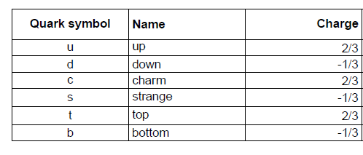
Quark Data
the charge is a fraction of the charge on an electron

Slide 8
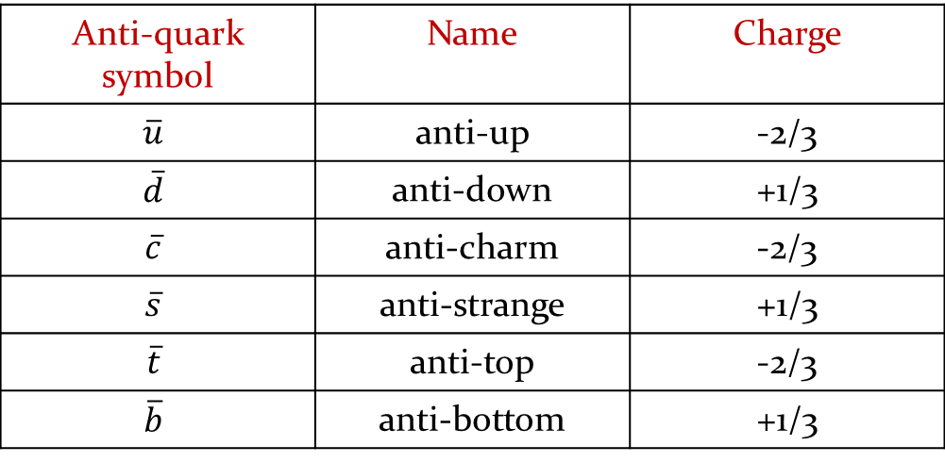
Anti-Quarks
Evidence from particle accelerators show that all particles have an antimatter equivalent.
Therefore each quark has its own equivalent anti-quark.
They are also fundamental in that they can’t be broken down any further.
There are also 6 types (or flavour) of anti-quark:
Anti-quark symbol | Name | Charge
$$\overline{u}$$ | anti-up | -2/3
$$\overline{d}$$ | anti-down | +1/3
$$\overline{c}$$ | anti-charm | -2/3
$$\overline{s}$$ | anti-strange | +1/3
$$\overline{t}$$ | anti-top | -2/3
$$\overline{b}$$ | anti-bottom | +1/3
Note that the charge of an anti-quark is the same magnitude but opposite polarity of its quark equivalent

Slide 9
Hadrons (made from quarks)
Hadros is Greek for ‘massive’.
These are particles that are made up of quarks.
There are two types of hadron.
  Baryons – these are made up of three quarks.
  Mesons – these are made up of a quark and anti-quark pair.

Slide 10

Baryons – the heavyweights
Baryons are made up of 3 quarks.
Examples include a neutron, proton and antiproton (yes there are anti-baryons too!)
These all have a Baryon number of 1
Examples:
Proton – made of 2 up quarks and a down quark.
- analysing charge we see:
proton (p) = u + u + d
= 2/3 + 2/3 – 1/3
= +1

Slide 11
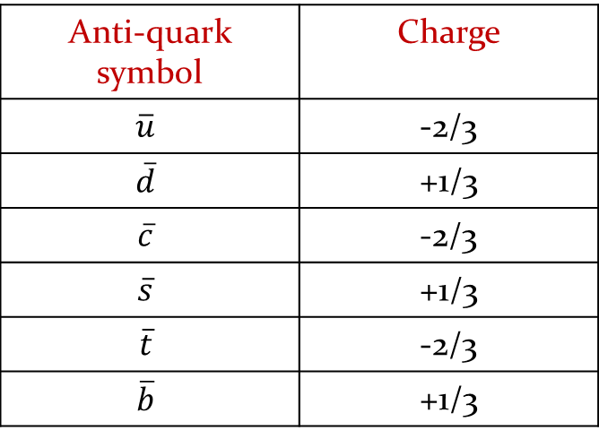
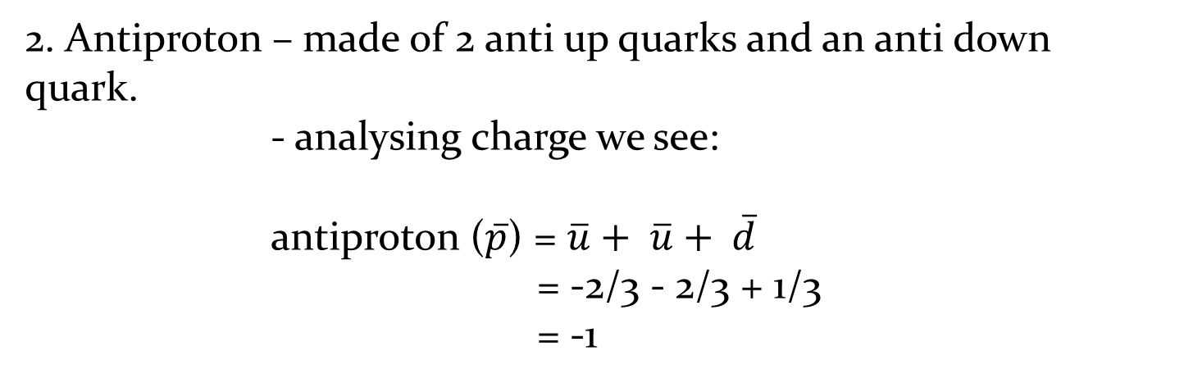
2. Antiproton – made of 2 anti up quarks and an anti down quark.
- analysing charge we see:
antiproton ($\overline{p}$) = $\overline{u}+ \overline{u}+ \overline{d}$
= -2/3 - 2/3 + 1/3
= -1
Anti-quark symbol | Charge
$$\overline{u}$$ | -2/3
$$\overline{d}$$ | +1/3
$$\overline{c}$$ | -2/3
$$\overline{s}$$ | +1/3
$$\overline{t}$$ | -2/3
$$\overline{b}$$ | +1/3

Slide 12
3. Neutron – what do you think?
- what is the overall charge on a neutron?
- how can 3 quarks combine to give a charge of 0? (hint nucleons are made from up and down quarks)

Slide 13
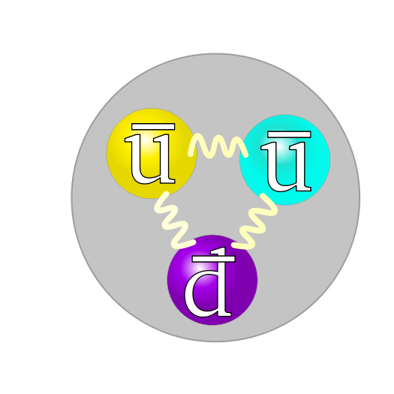
There are six groups of baryons depending on the type of quark that makes them
nucleon (N),
Delta (Δ),
Lambda (Λ),
Sigma (Σ),
Xi (Ξ),
and Omega (Ω).
We tend to focus on the nucleons (made from up and down quarks)

Slide 14
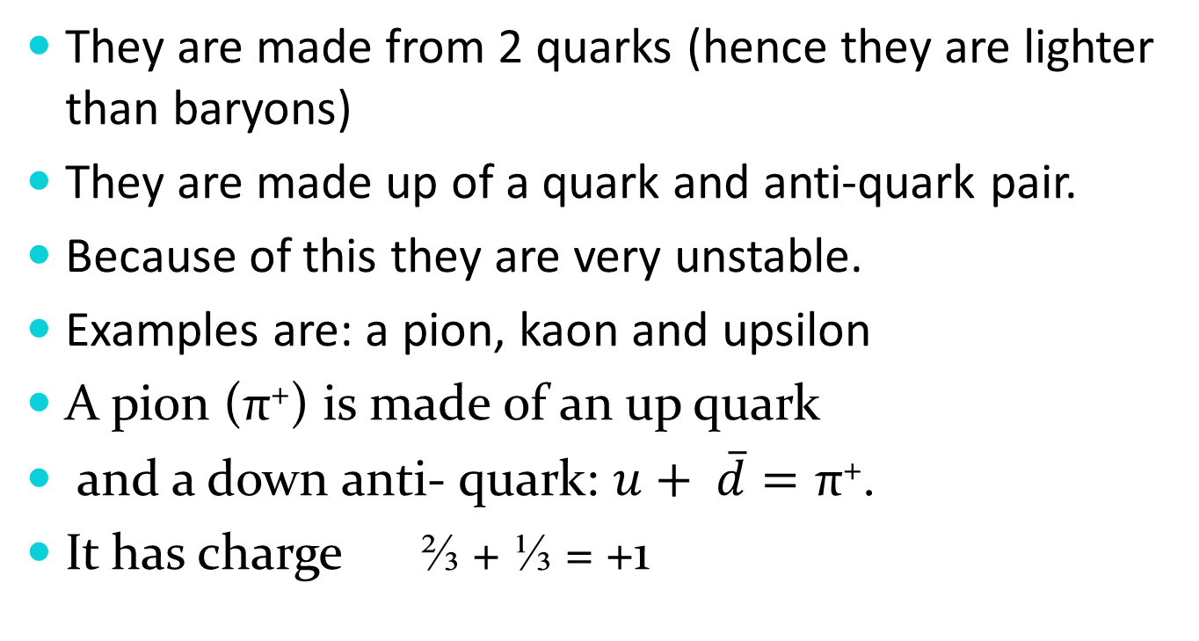
Mesons (the middle weights)
They are made from 2 quarks (hence they are lighter than baryons)
They are made up of a quark and anti-quark pair.
Because of this they are very unstable.
Examples are: a pion, kaon and upsilon
A pion (π⁺) is made of an up quark
and a down anti- quark: $u+ \overline{d}=\text{π}\text{+}$.
It has charge ⅔ + ⅓ = +1

Slide 15
Lesson Starter
Name the 6 different types of quark.
What are the two types of hadrons?
Which one is made up of 3 types of quark?

Slide 16
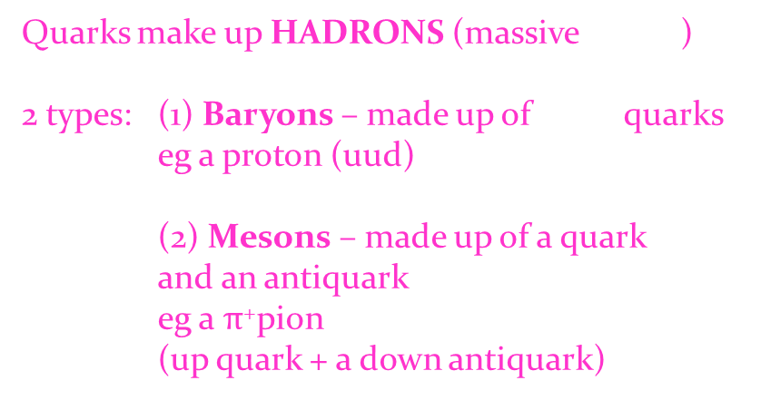
Quarks – in summary
Quarks – a type of fermion
6 types: - up down
charm strange
top bottom
each has ±1/3 or ±2/3 charge
Quarks make up HADRONS (massive )
2 types: (1) Baryons – made up of quarks
eg a proton (uud)
(2) Mesons – made up of a quark and an antiquark
eg a $π$⁺pion (up quark + a down antiquark)
3
very unstable

Slide 17

Leptons
From Greek meaning ‘light ones’.
These are fundamental particles, i.e. they can’t be split into anything smaller.
The three negatively charged leptons are - electron (e) - muon (µ) - tau (τ)
The muon and tau leptons are heavier than the electron
There is some debate over the existence of anti- leptons

Slide 18
Neutrinos
These have no charge.
Because of this they never interact with any other particles.
Neutrinos are produced in a variety of interactions, especially in particle decays.
They were initially discovered in radioactive beta decay experiments.
There are 3 of them: electron neutrino, muon neutrino and tau neutrino (v_{e} , v_{µ} , v_{τ} )
And yes there are anti-neutrinos too!

Slide 19
Beta Decay
In beta decay, a neutron decays into a proton and an electron.
In order for momentum to be conserved another particle must be emitted.
This is the neutrino.
e
n
p

Slide 20



Leptons
– in summary
Leptons -light ones
6 types: e, electron
µ, muon
τ, tau (not TOWIE!)
and 3 neutrinos: v_{e}, v_{µ}, v_{τ}
all
vely
charged
-
no charge
never interact
produced in particle decays
β decay: n p + e + neutrino
the neutrino conserves momentum

Slide 21
Putting it all together looks something like this…..

Slide 22
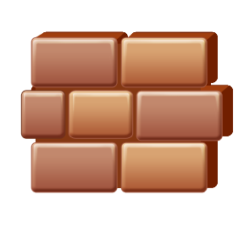
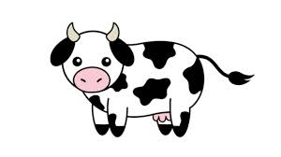
Fermions
(the 12 fundamental matter particles)
Quarks
Leptons -light ones
6 types: e, electron
µ, muon
τ, tau (not TOWIE!)
and 3 neutrinos: v_{e}, v_{µ}, v_{τ}
6 types: - up down
charm strange
top bottom
-
all
vely
charged
each has 1/3 or 2/3 charge
-
Quarks make up HADRONS (massive )
2 types: (1) Baryons – made up of quarks
eg a proton (uud)
(2) Mesons – made up of a quark and an antiquark
eg a $π$⁺pion (up quark + a down antiquark)
no charge
never interact
produced in particle decays
3
β decay: n p + e + neutrino
very unstable
the neutrino conserves momentum

Slide 23
Fermions
There are 12 fundamental particles. Fundamental means they can’t be broken down any further.
One type of fermion is the quark.
There are 6 types of quark:
  Up and down
  Top and bottom
  Charm and strange
All of these have a charge of either ±1/3 or 2/3.
Quarks make up HADRONS.
There are two types of hadrons:
  Baryons and mesons.

Slide 24
Fermions
Baryon’s are made up of 3 quarks e.g. up + up + down. A proton is a type of baryon.
Mesons are made up of 2 quarks - a quark and anti-quark pair. They are very unstable. E.g. a pion (up + anti-down)

Slide 25
Fermions
Leptons are a type of fermion.
There are 6 types of leptons:
  Electron and electron neutrino
  Tau and tau neutrino
  muon and muon neutrino
The electron, tau and muon are all negatively charged.
All neutrinos have no charge.
Neutrinos never interact and are produced in particle decays:
β decay: n p + e + neutrino
the neutrino conserves momentum

Slide 26
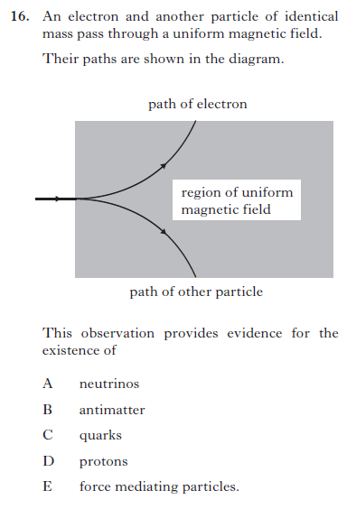
2012

Slide 27
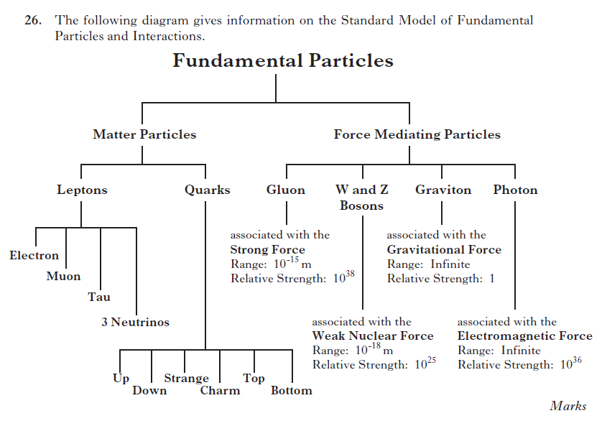
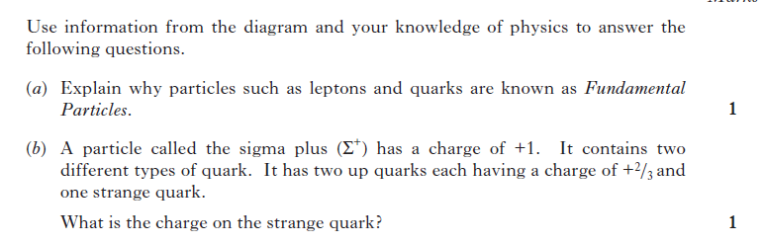
2012

