Slide 1
Rotational Dynamics
CfE Advanced Higher Physics

Slide 2
Torque and Moment
We are going to look at the turning effect of a force being used to make an object rotate about an axis.
This will lead to the concept of the moment of inertia.

Slide 3
Torque and Moment
Consider opening a door with a force F. What would happen if you were to use a larger force to push the door in the same place?
Since F=ma, the door will open quicker than before. The turning effect increases as the force increases.

Slide 4
Torque and Moment
What do you think would happen if you were to push the door with the same force, but at a different point on its axis? i.e. close to the hinge and far away from the hinge?
The force has a greater turning effect when it is applied near the edge of the door – it is harder to push the door close to its hinge.
The turning effect also depends on the axis of rotation the force is being applied to.

Slide 5
Torque and Moment
Copy into notes jotter:
The torque or moment of a force is related by the equation:
$$T=Fr$$
T – Torque (Nm)
F – Force (N)
r – Radius (m)
This equation is only valid when a force is applied at right angles to the radius.

Slide 6
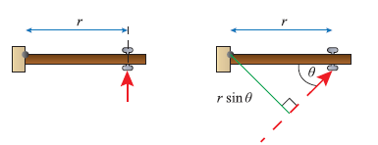
Torque and Moment
The diagram compares forces being applied perpendicular to the door and at an angle to the door:
The important distance is not where the force is applied, but the perpendicular distance from the line of action to the axis of rotation.

Slide 7
Torque and Moment
Copy into notes jotter:
If F makes an angle, θ, to the radius, r, then the following equation applies:
$$T=Frsinθ$$

Slide 8
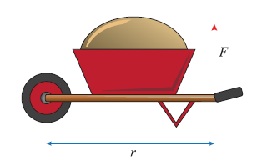
Example
Copy into notes jotter:
A gardener picks up her wheelbarrow to wheel it along by applying a perpendicular force of 50N to the handles. If the handle grips are 1.2m from the axis of the wheel, what is the torque she applies?

Slide 9
Answer
A perpendicular force, so we can apply the first equation:

Slide 10
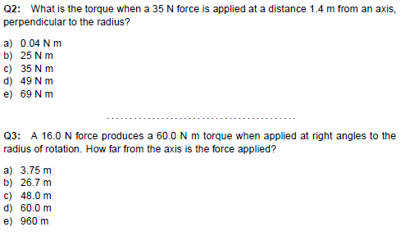
Quiz - torques

Slide 11
Quiz - Torques

Slide 12
Newton’s Laws applied to rotational dynamics – Torques in equilibrium
To consider the equilibrium situation, we will consider the wheelbarrow again.
Assume the wheelbarrow stays horizontal and we remove the support so the gardener has to apply a perpendicular force to keep the barrow horizontal.

Slide 13
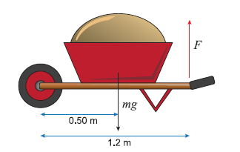
Torques in Equilibrium
Copy into notes jotter:
The barrow is filled with 20kg of rubble and the centre of mass of the rubble is 50cm from the wheel axis. If we can neglect the mass of the barrow, what force is required to keep the barrow horizontal?

Slide 14
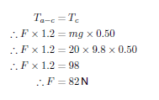
Torques in Equilibrium
Copy into notes jotter:
Because the barrow is in equilibrium, we can assume the clockwise torque and the anticlockwise torque are equal, so:

Slide 15
Tips to these types of questions
Copy into notes jotter:
Always draw a free body diagram.
Draw where the forces are acting on the diagram.
The weight acts through the centre of mass, and the distance to this centre of mass must be known to calculate the torque.

Slide 16
Example
A serving table of mass 2.5kg and length 80cm is hinged to a wall, and is supported by a chain which makes and angle of 50⁰ with the horizontal table top.
The chain is attached to the edge of the table furthest from the wall (r_{c}= 80cm). The table is uniform, so it’s centre of mass is r_{t}= 40cm from the wall.
A full serving dish of mass 1kg is placed on the table r_{d}= 60cm from the wall. Calculate the tension in the chain.

Slide 17
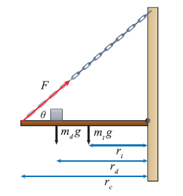
Answer
Draw a free body diagram and mark the radii and forces.

Slide 18
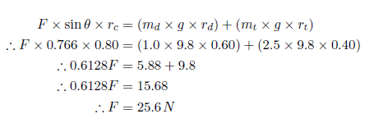
Answer
Anti-clockwise torques must balance clockwise torques, so:

Slide 19
Notes on example
If you changed where the dish is placed, the tension in the chain will also change. If it is placed 80cm from the wall, tension in the chain would be 28.8N, if placed 20cm from the wall, tension in the chain would be 19.2N.
The mass distributed on the axis will vary the tension in the chain.
The smaller the radius, the smaller the tension.

Slide 20
Mandatory Key Areas

Slide 21
Lesson Starter
An old humpback bridge has a radius of curvature of 20 m. What is the maximum speed at which a car can pass over this bridge if the car is not to leave the road surface?
An object of mass 0.20 kg is connected by a string to an object of half its mass. The smaller mass is rotating at a radius of 0.15 m on a table which has a frictionless surface. The larger mass is suspended through a hole in the middle of the table.
Calculate the number of revolutions per minute the smaller mass must make so that the larger mass is stationary.

Slide 22
Angular acceleration and inertia
The moment of inertia is a body's tendency to resist angular acceleration.
We are going to derive an expression for the moment of inertia.
Moment of inertia includes torque and its angular acceleration.

Slide 23
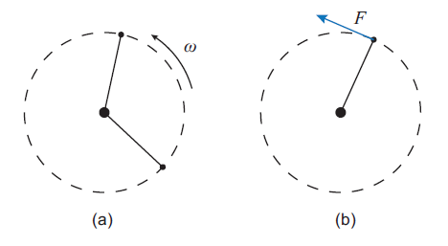
Angular acceleration and inertia
We will consider Newton’s second law and look at an object moving in a horizontal circle with a fixed radius, r, at an angular velocity, ω:

Slide 24
Angular acceleration and inertia
Copy into notes jotter:
The moment of inertia is a body's tendency to resist angular acceleration.
Newton’s second law states that
$$F=ma$$
We know that $a=rα$, so:
$$F=mrα$$
The rotational torque of the object is $T=Fr$, so we can sub in for the force: $\frac{T}{r}=mrα,$ so,
$T=mr^{2}α$

Slide 25
Angular acceleration and moment of inertia
Copy into notes jotter:
Substituting in $I$ for $mr^{2}$ we get:
$$T=Iα$$
Where $I$is the moment of inertia for the object and has units of kg m²
The moment of inertia take into consideration the mass of the object and also where it is on its axis of rotation (the radius).
$I=mr^{2}$ is for point masses only, but for a sum of masses:
$$I_{total}=m_{1}r_{1}^{2}+m_{2}r_{2}^{2}+…=\sum_{i}{m_{i}r_{i}^{2}}$$

Slide 26
Moment of Inertia for Different shapes:
Copy into notes jotter:
All can be found on page 3 of the relationships sheet.

Slide 27
Mandatory Content

Slide 28
Mandatory Content

Slide 29
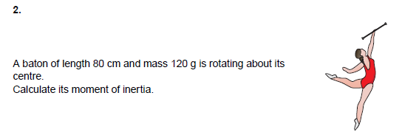
Examples

Slide 30
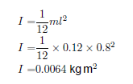
Answers
1.
2.

Slide 31
Examples

Slide 32
Answers
3.
4.

Slide 33
Example
Answer:

Slide 34
Combinations of rotating bodies example:
Copy into notes jotter:

Slide 35
Answer
Copy into notes jotter:

Slide 36
Answer
Copy into notes jotter:

Slide 37
Answer
Copy into notes jotter:

Slide 38
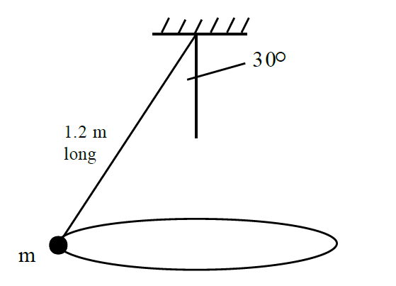
Lesson Starter
A small object of mass m revolves in a horizontal circle at constant speed at the end of a string of length 1.2 m. As the object revolves, the string sweeps out the surface of a right circular cone.
The cone has semi-angle 30°.
Calculate:
(a) the period of the motion;
(b) the speed of the object.

