Slide 1
Lesson Starter
Derive the expression: $s=ut+\frac{1}{2}at^{2}$
What is the acceleration of a particle, whose velocity is described by the expression: $v=20t^{2}−5t^{3}$
Is the acceleration a constant? Explain.

Slide 2
Rotational motion
Advanced Higher Physics

Slide 3
Angular displacement and radians
Firstly we will look at angular displacement, which replaces the linear displacement we are used to dealing with. Imagine a disc spinning about a central axis.
We can draw a reference line along the radius of the disc.
The angular displacement is the angle through which this line (the radius) has swept in time.

Slide 4
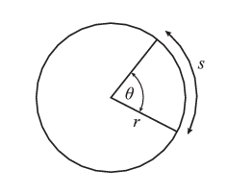
Angular displacement and radians
In the above diagram, the angle θ, measured in radians, is equal to $\frac{s}{r}$.
To compare radians with degrees, consider an angular displacement of one complete circle, equivalent to a rotation of 360°. In this case, the distance is equal to the circumference of the circle. Hence $θ=\frac{s}{r}=\frac{2πr}{r}=2π rad$

Slide 5
Angular displacement and radians
360° is equivalent to 2π rad, and this relationship can be used to convert from radians to degrees, and vice versa.
It is useful to remember that π rad is equivalent to 180° and π/2 rad is equivalent to 90°.
For the sake of neatness and clarity, it is common to leave an angle as a multiple of π rather than as a decimal, so the equivalent of 30° is usually expressed as π/6 rad rather than 0.524 rad.

Slide 6
Changing Degrees to Radians
Copy into notes jotter:
To convert degrees to radians:
$$radians=degrees x\frac{π}{180}$$
To convert radians to degrees:
$$degrees=radians x\frac{180}{π}$$
Not on
formula sheet

Slide 7
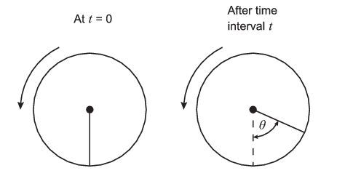
Angular displacement and Radians
Copy into notes jotter
The angular displacement is given the symbol θ, and is measured in radians (rad).
The angular displacement is the angle through which the radius has swept in time.

Slide 8
Angular velocity and acceleration
Copy into notes jotter:
The angular velocity ω is equal to the rate of change of angular displacement in time.
Just as the linear velocity is the rate of change of linear displacement in time:
$$ω=\frac{dθ}{dt} v=\frac{ds}{dt}$$
ω is measured in radians per second (rad/s or rad s⁻¹).

Slide 9
Example
Copy into notes jotter:
It takes the Moon 27.3 days to complete one orbit of the Earth. Assuming the Moon travels in a circular orbit at constant angular velocity, what is the angular velocity of the Moon?

Slide 10
Answer
27.3 days is equal to (27.3 × 24) = 655.2 hours
which is equal to (655.2 × 60) = 39312 minutes
which is equal to (39312 × 60) = 2358720 s
So the angular velocity ω is given by
$$ω=\frac{dθ}{dt}$$
$$ω=\frac{2π}{2348720}$$
$$=2.66x{10}^{−6}{rad s}^{−1}$$

Slide 11
Orbits of the planets
Fill in the gaps for the following planets:

Slide 12
Revolutions per minute to Radians per second
Copy into notes jotter:
Some problems may have revolutions per minute and may ask you to convert to radians per second.
To convert revolutions per minute to radians per second:
$$radians per second=revolutions x\frac{2π}{60}$$
To convert radians per second into revolutions per minute:
$$Revolutions=rad s^{−1}x\frac{60}{2π}$$
Remember! Radians per second = angular velocity!
Not given in
formula sheet

Slide 13
Tutorial 2.0
Questions 1-4

Slide 14
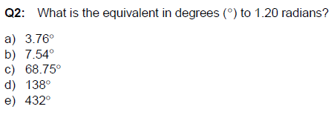
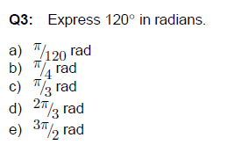
Radian Quiz

Slide 15
Radians quiz

Slide 16
Periodic time and angular velocity
The period T is the time taken for one complete rotation.
The angular velocity of an object moving in a circle can be found using the equation:
$$ω=\frac{θ}{t}$$
2π
0
3π/2
π/2
π

Slide 17
Angular velocity, period and frequency
Copy into notes jotter:
Where $θ$ is the angular displacement covered in the circle and t is the time taken to do cover the angular displacement.
For one rotation, the displacement will be 2π.
The time for one rotation is the period of the rotation.
So the angular velocity can be found using:
$$ω=\frac{2π}{T}$$
Where:
ω = angular velocity (rad s⁻¹)
T = period of rotation (s)

Slide 18
Angular velocity, period and frequency
Copy into notes jotter:
The angular velocity can be found using:
$$ω=\frac{2π}{T}$$
The period is also related to the expression:
$$T=\frac{1}{f}$$
So another expression for the angular velocity is:
$$ω=2πf$$
Where:
ω = angular velocity (rad s⁻¹)
f = frequency of rotation (Hz)

Slide 19
Mandatory Course Content Covered

Slide 20
Angular Acceleration
Having defined angular displacement θ and angular velocity ω, it should be clear that if ω is changing then we have an angular acceleration the rate of change of angular velocity, measured in rad s ⁻².
The instantaneous angular acceleration α is the rate of change of angular velocity, measured in rad s⁻².
$$α=\frac{dω}{dt}$$

Slide 21
Angular Acceleration
Copy into notes jotter:
The instantaneous angular acceleration α is the rate of change of angular velocity per time, measured in rad s⁻².
$$α=\frac{dω}{dt}$$
Where:
ω = angular velocity (rad s⁻¹)
α= angular acceleration (rad s⁻²)
t = time (s)

Slide 22
Kinematic relationships for angular motion
With the definition of instantaneous angular acceleration $α=\frac{dω}{dt} ,$we can begin to derive an expression for the angular velocity:
$$\int_{ω_{0}}^{ω}{dω= \int_{t=0}^{t}{αdt }= α\int_{t=0}^{t}{dt}}$$
$${\left[ω\right]}_{ω_{0}}^{ω}=α{\left[t\right]}_{t=0}^{t}$$
$$∴ω−ω_{0}=αt$$
$$∴ω=ω_{0}+αt$$

Slide 23
Kinematic relationships for angular motion
We can now substitute for this equation: $\frac{dθ}{dt}=ω_{0}+αt$
And integrate over a time of t and t=0:
$$\int_{θ=0}^{θ}{dθ}= \int_{t=0}^{t}{\left(ω_{0}+αt\right)}$$
$$∴θ={\left[ω_{0}t+\frac{1}{2}αt^{2}\right]}_{0}^{t}$$
$$∴θ=ω_{0}t+\frac{1}{2}αt^{2}$$

Slide 24
Kinematic relationships for angular motion
If we rearrange this equation to $t=\frac{ω−ω_{0}}{α}$ we can then find our final rotational equation of motion:
$$θ=ω_{0}\left(\frac{ω−ω_{0}}{α}\right)+\frac{1}{2}α{\left(\frac{ω−ω_{0}}{α}\right)}^{2}$$
$$2αθ={2ω}_{0}ω −{2ω}_{0}^{2}+ω^{2}−2ω_{0}ω+ω_{0}^{2}$$
$$2αθ= ω^{2} −ω_{0}^{2}$$
$$∴ω^{2}= ω_{0}^{2 }+2αθ$$

Slide 25
Linear vs Rotational
Copy into notes jotter:
Where:
ω = final angular velocity (rad s⁻¹)
ω₀ = initial angular velocity (rad s⁻¹)
Θ = angular displacement (rad)
$α$ = angular acceleration (rad s ⁻²)
t = time (s)

Slide 26
Angular velocity Quiz

Slide 27
Quiz

Slide 28
Example 1
An electric fan has blades that rotate with angular velocity 80 rad s⁻¹. When the fan is switched off, the blades come to rest after 12 s. What is the angular deceleration of the fan blades?

Slide 29
Example 1 Answer
We follow the same procedure as we used to solve problems in linear motion - list the data and select the appropriate kinematic relationship.
Here we are told ω ₀ = 80 rad s⁻¹ ω= 0 rad s⁻¹ t = 12 s α= ?
$$ω=ω_{0}+αt$$
$$α=\frac{ω −ω_{0}}{t}$$
$$α=\frac{0−80}{12}$$
$$α=−6.7 rad s^{−2}$$

Slide 30
Example 2
Copy into notes jotter:
A wheel is rotating at 35 rad s⁻¹. It undergoes a constant angular deceleration. After 9.5 seconds, the wheel has turned though an angle of 280 radians.
What is the angular deceleration?

Slide 31
Example 2 Answer
Copy into notes jotter:
$$θ=ω_{0}t+\frac{1}{2}αt^{2}$$
$$280=\left(35x9.5\right)+\frac{1}{2}α\left({9.5}^{2}\right)$$
$$α=−1.2 {rad s}^{−2}$$

Slide 32
Example 3
An ice skater spins with an angular velocity of 15 rad s⁻¹. She decelerates to rest over a short period of time. Her angular displacement during this time is 14.1 rad.
Determine the time during which the ice skater decelerates.

Slide 33
Example 3 Answer
$$ω^{2}= ω_{0}^{2 }+2αθ$$
$$0^{2}={15}^{2}+2α x 14.1$$
$$α=−7.98 {rad s}^{−2}$$
$$ω=ω_{0}+αt$$
$$0=15+ \left(−7.98\right)t$$
$$t=1.9s$$

Slide 34
Lesson Starter
A disk start from rest and accelerates for 2.5s. After 2.5s the disk is rotating at 300 rpm. Calculate its angular acceleration.
Calculate the angular displacement of the disk.

Slide 35
Mandatory Content Covered

Slide 36
Lesson Starter 22/06/17

Slide 37
Tangential speed and angular velocity
Suppose an object is moving in a circle of radius with angular velocity ω. What is the relationship between ω and, the velocity of the object measured in m s⁻¹?
$$θ=\frac{s}{r}$$
Differentiate with respect to t:
$$\frac{dθ}{dt}=\frac{d}{dt}\left(\frac{s}{r}\right)$$
r is a constant so can be re-arranged:
$$\frac{dθ}{dt}=\left(\frac{1}{r}\right)\frac{ds}{dt}$$
$$∴ ω=\frac{1}{r}v$$
$$∴ω=\frac{v}{r}$$
$$v=rω$$

Slide 38
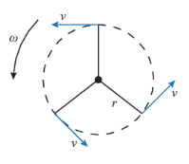
Tangential speed and angular velocity
The tangential speed is the speed at any point and is always perpendicular to the radius of the circle at that point.
If it was on a string and the string broke, the mass would continue to travel in a straight line in the direction of the linear speed arrow – it would follow the tangent.
$$v=rω$$

Slide 39
Tangential Speed and angular velocity
There is an important difference between v and ω - that two objects with the same angular velocity can be moving with different tangential speeds.

Slide 40
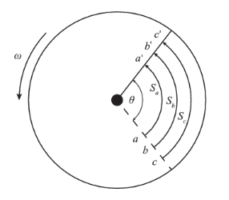
Tangential Speed and angular velocity
This difference in tangential speeds is emphasised in the diagram below:

Slide 41
Tangential Speed and angular velocity
The bigger the radius, the bigger the tangential speed, because $v=rω$.
The bigger radius also travels a greater angular displacement ($v=\frac{s}{t}$).

Slide 42
Tangential speed and angular velocity
Copy into notes jotter:
The tangential speed is the speed at any point and is always perpendicular to the radius of the circle at that point.
This is the relationship between the speed of the object (m s⁻¹), its angular velocity (rad s⁻¹) and its radius (m).
$$ω=\frac{v}{r}$$
$$v=rω$$

Slide 43
Example 1
Copy into notes jotter:
A turntable of radius 0.30 m is rotating at constant angular velocity 1.5 rad s⁻¹. Compare the tangential speeds of a point on the circumference of the turntable and a point midway between the centre and the circumference.

Slide 44
Example 1 Answer
Copy into notes jotter:
The point on the circumference has r= 0.30 m, so:
$$v_{1}=r_{1}ω$$
$${ v}_{1}=0.3 x 1.5$$
$${ v}_{1}=0.45ms^{−1}$$
The point midway between the centre and the circumference is moving with the same angular velocity, but the radius of the motion is only 0.15 m.
$$v_{2}=r_{2}ω$$
$${ v}_{2}=0.15 x 1.5$$
$${ v}_{2}=0.225ms^{−1}$$
The point on the circumference is moving at twice the speed (in m s⁻¹) of the point with the smaller radius.

Slide 45
Tangential Acceleration
The tangential acceleration is the rate at which the speed of an object is changing. We can derive an expression starting with: $v=rω$
Differentiate this equation with respect to time:
$$\frac{dv}{dt}=\frac{d}{dt}\left(rω\right)$$
$$\frac{dv}{dt}=r \left(\frac{dω}{dt}\right)$$
$$a_{t}=rα$$
The tangential acceleration depends on the radius of the motion as well as the rate of change of angular velocity.
This acceleration is always perpendicular to the radius of the circle.

Slide 46
Tangential Acceleration
Copy into notes jotter:
The tangential acceleration is the rate at which the speed of an object is changing.
$$a_{t}=rα$$
The tangential acceleration depends on the radius of the motion as well as the rate of change of angular velocity.
This acceleration is always perpendicular to the radius of the circle.

Slide 47
Mandatory content covered

Slide 48
Experiment
Find the following for your own objects in circular motion:
Radius of string
Time taken for 10 rotations
Angular displacement
Tangential velocity
Angular velocity
Try with different radii

Slide 49
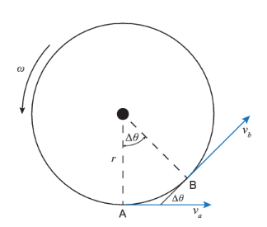
Centripetal Acceleration
Consider an object moving in a circle of radius r with constant angular velocity ω. We know that at any point on the circle, the object will have tangential velocity v=rω. The object moves through an angle Δθ in time Δt.

Slide 50
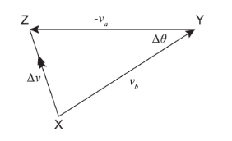
Centripetal Acceleration
The change in velocity Δv is equal to v_{b}-v_{a}. We can use a 'nose-to-tail' vector diagram to determine Δv , as shown below. Both and have magnitude v, so the vector XY represents v_{b} and vector YZ represents -v_{a}.

Slide 51
Centripetal Acceleration
In the limit where Δt is small, Δθ tends to zero. In this case the angle ZXY tends to 90°, and the vector Δv is perpendicular to the velocity, so Δv points towards the centre of the circle.
The velocity change, and hence the acceleration, is directed towards the centre of the circle.
Centripetal acceleration has the symbol a_{r} since it acts towards the centre of the circle.

Slide 52
Centripetal Acceleration
To calculate the magnitude of a_{r}, we use the equation:
$$a_{r}=\frac{∆v}{∆t}$$
Since Δθ is small, Δv= v Δθ, so long as Δθ is measured in radians. The acceleration is therefore:
$$a_{r}=\frac{v∆θ}{∆t}$$
$$∴a_{r}=vω$$
Finally we can substitute for v= rω to get:
$$a_{r}=\frac{v^{2}}{r}$$
$$a_{r}=rω^{2}$$

Slide 53
Centripetal Acceleration
The centripetal acceleration is always directed towards the centre of the circle, and it must not be confused with the tangential acceleration, which occurs when an orbiting object changes its tangential speed.
The centripetal acceleration occurs whenever an object is moving in a circular path, even if its tangential speed is constant. (can also be referred to as “radial acceleration”)

Slide 54
Centripetal Acceleration
Copy into notes jotter:
The centripetal acceleration is always directed towards the centre of the circle, and it must not be confused with the tangential acceleration, which occurs when an orbiting object changes its tangential speed.
$$a_{r}=\frac{v^{2}}{r}$$
$$a_{r}=rω^{2}$$
The centripetal acceleration occurs whenever an object is moving in a circular path, even if its tangential speed is constant. (can also be referred to as “radial acceleration” or “perpendicular acceleration”)

Slide 55
Example 1
Find the centripetal acceleration of an object moving in a circular path of radius 1.20 m with constant tangential speed of 4.00 m s⁻¹.

Slide 56
Answer
The centripetal acceleration is calculated using the formula:
$$a_{r}=\frac{v^{2}}{r}$$
$$a_{r}=\frac{{4.00}^{2}}{1.20}$$
$$a_{r}=13.3 ms^{−2}$$

Slide 57
Example 2
Copy into notes jotter:
A model aeroplane on a rope 10 m long is circling with angular velocity 1.2 rad s⁻¹. If this speed is increased to 2.0 rad s⁻¹ over a 5.0 s period, calculate
the angular acceleration;
the tangential acceleration;
the centripetal acceleration at these two velocities.

Slide 58
Answer
Copy into notes jotter:
$ω=ω_{0}+αt$
$$α=\frac{ω−ω_{0}}{t}$$
$$α=\frac{2.0−1.2}{5}$$
$$α=0.16 rad s^{−2}$$

Slide 59
Answer
Copy into notes jotter:
2. To calculate the tangential acceleration:
$$a_{t}=rα$$
$$a_{t}=10x0.16$$
$$a_{t}=1.6 m s^{−2}$$

Slide 60
Answer
Copy into notes jotter:
We use the formula $a_{r}=rω^{2}$to calculate the centripetal acceleration. When ω= 1.2 rad s⁻¹
$$a_{r}=rω^{2}$$
$$a_{r}=10 x {1.2}^{2}$$
$$a_{r}=14.4 m s^{−2}$$
When ω= 2.0 rad s⁻¹ :
$$a_{r}=rω^{2}$$
$$a_{r}=10 x 2^{2}$$
$$a_{r}=40 m s^{−2}$$

Slide 61
Mandatory Content Covered

Slide 62
Centripetal Force
Newton's second law of motion tells us that if an object is undergoing acceleration, then a net force must be acting on the object in the direction of the acceleration. Since we have a centripetal acceleration acting towards the centre of the circle, there must be a centripetal force acting in that direction.
Newton's law can be summed up by the equation:
$$F=ma$$

Slide 63
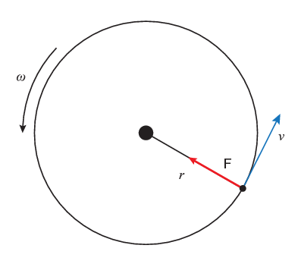
Centripetal Force
If the centripetal acceleration is given by $a_{r}=\frac{v^{2}}{r}=rω^{2}$, then the centripetal force acting on a body of mass moving in a circle of radius is:
$$F=\frac{mv^{2}}{r}=mrω^{2}$$
The centripetal force acts in the
same direction as the
centripetal acceleration.
(In towards the radius)

Slide 64
Centripetal Force
Copy into notes jotter:
This is the force which must act on a body to make it move in a circular path. This results in centripetal (radial or central) acceleration of the object.
$$F=\frac{mv^{2}}{r}$$
$$F=mrω^{2}$$
If this force is suddenly removed, the body will move in a straight line at a tangent to the circle with speed v, since there will be no force acting to change the velocity of the body.

Slide 65
Example 1
Copy into notes jotter:
Compare the centripetal forces required for a 2.0 kg mass moving in a circle of radius 40 cm if the velocity is:
3.0 m s⁻¹;
6.0 m s⁻¹.

Slide 66
Answer
Copy into notes jotter:
1. Using
$$F=\frac{mv^{2}}{r}$$
$$F=\frac{{2.0 x 3.0}^{2}}{0.40}$$
$$F=45 N$$
2. Using
$$F=\frac{mv^{2}}{r}$$
$$F=\frac{{2.0 x 6.0}^{2}}{0.40}$$
$$F=180 N$$
So doubling the velocity means that the centripetal force required increases by a factor of four, since F∝v².

Slide 67
Mandatory Content Covered

Slide 68
Do you remember?
Derive v=u +at
Write down the angular equations of motion.
What is the acceleration of a particle whose velocity is described by the expression: $v=20t^{2}−5t^{3}$
A disk start from rest and accelerates for 2.5s. After 2.5s the disk is rotating at 300 rpm. Calculate its angular acceleration.
What is the equation for centripetal force?
What is the equation used to find the tension of a string moving in a horizontal circle?

Slide 69
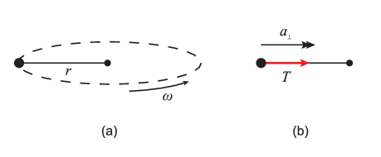
Object moving in a horizontal circle
Consider the case shown below of an object moving at constant angular velocity ω in a horizontal circle, such as a mass being whirled overhead on a string.
In the horizontal direction, there is an acceleration acting towards the centre of the circle. The only force acting in the horizontal direction is the tension in the string, so this tension must provide the centripetal force $mrω^{2}$. So in this case: $T=mrω^{2}$

Slide 70
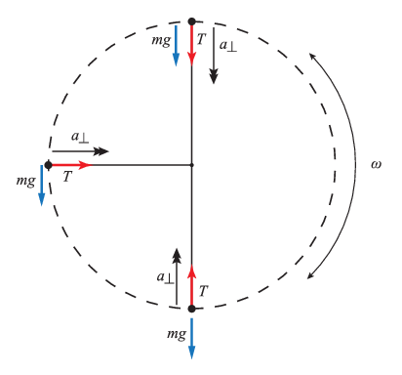
Vertical Motion
Let us now consider the same object being whirled in a vertical circle. The diagram below shows the object at three points on the circle, with the forces acting at each point.

Slide 71
Vertical Motion
If we consider the forces acting when the object is at the top of the circle, we find that both the weight and the tension in the string are acting downwards. Thus the resultant force acting towards the centre of the circle is:
$T_{top}+mg=mrω^{2}$
This resultant force must provide the
centripetal force to keep the object
moving in its circular path. Hence:
$T_{top}=mrω^{2} −mg$

Slide 72
Vertical Motion
On the other hand, when the object reaches the lowest point on the circle, the tension and the weight are acting in opposite directions, so the resultant force acting towards the centre of the circle is:
$$T_{bottom}−mg=mrω^{2}$$
Again, this force supplies the
centripetal force so in this case:
$$T_{bottom}=mrω^{2}+mg$$
Minimum speed at top of circle: $v_{top}=\sqrt{gr}$

Slide 73
Vertical Motion
These equations give us the minimum and maximum values for the tension in the string.
When the string is horizontal, there is no component of the weight acting towards the centre of the circle, so the tension in the string provides all the centripetal force:
$$T_{Horiz }=mrω^{2}$$

Slide 74
Example
A man has tied a 1.2 kg mass to a piece of rope 0.80 m long, which he is twirling round in a vertical circle, so that the rope remains taut. He then starts to slow down the speed of the mass.
At what point of the circle is the rope likely to go slack?
What is the speed (in m s⁻¹) at which the rope goes slack?

Slide 75
Answer
The rope is most likely to go slack when the mass is at the top of the circle. Compare to understand why.
At the top of the circle, tells us
${ T}_{top}=mrω^{2}−mg$
Expressing this in terms of the tangential speed ,
$$T_{top}=\frac{mv^{2}}{r}−mg$$
When the rope goes slack, the tension in it must have dropped to zero, so:
$$0=\frac{mv^{2}}{r} −mg$$
$$∴\frac{mv^{2}}{r}=mg$$
$$v^{2}=gr$$
$$v=2.8 m s^{−1}$$

Slide 76
Quiz

Slide 77
Quiz

Slide 78
Applications
When a person rides on a rollercoaster that follows a loop the loop track, they often feel very "light" at the top of the loop. Their weight does not change, it is the normal reaction force applied to them by the seat which alters. It is this which causes the strange sensation.
Assume the rollercoaster is moving at a constant speed, then the centripetal force required to keep them moving in a circle will also be constant. However, when they are at the top of the loop, the centripetal force is provided by both their weight and the normal reaction force. So the normal reaction force is very small and the person feels "light".

Slide 79
Rollercoaster

Slide 80
Rollercoaster

Slide 81
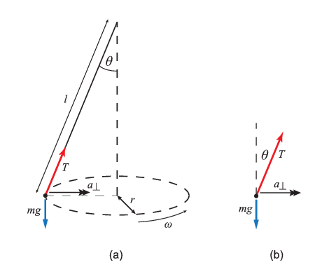
Conical Pendulum
The next situation we will study is the conical pendulum - a pendulum of length whose bob moves in a circle of radius at a constant height. The diagram shows such a pendulum, with a free-body diagram of all the forces acting on the bob.

Slide 82
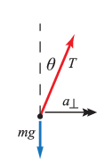
Conical Pendulum
The string of the pendulum makes an angle θ with the vertical, such that $\sin{θ}=\frac{r}{l}$. To calculate this angle, we use the free-body diagram shown and resolve vertically and horizontally.
Vertically, the system is in equilibrium, so:
$$\operatorname{Tcos}{θ}=mg$$

Slide 83
Conical Pendulum
Horizontally, we have an acceleration towards the centre of the circle, so there must be a centripetal force which is provided by the horizontal component of the tension, Tsinθ, so:
$$T\sin{θ}=mrω^{2}$$
$$∴T\sin{θ}=ml\sin{θ}ω^{2}$$
$$∴T=mlω^{2}$$

Slide 84
Conical Pendulum
We can substitute $T=mlω^{2}$for in the first equation, which gives us:
$$mlω^{2}\cos{θ}=mg$$
$$∴lω^{2}cosθ=g$$
$$∴cosθ=\frac{g}{lω^{2}}$$

Slide 85
Example
Consider a conical pendulum of length 1.0 m. Compare the angle the string makes with the vertical when the pendulum completes exactly 1 revolution and 2 revolutions per second (ω = 2π rad s⁻¹ and ω =4π rads⁻¹).

Slide 86
Answer

Slide 87
Answer

Slide 88
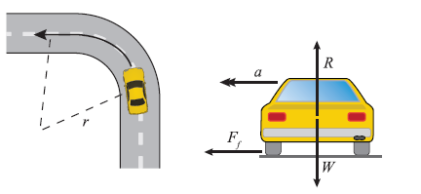
Cars cornering
When a car takes a corner it is the frictional force between the car tyres and the road that provides the centripetal force.
If there is insufficient friction, the car will skid.

Slide 89
Cars Cornering
The frictional force provides the centripetal force acting on the car.
If $F_{f max}$ is the maximum value of the frictional force, then the max speed the car can take the corner is given by:
$$F_{f max}=\frac{mv_{max}^{2}}{r}$$

Slide 90
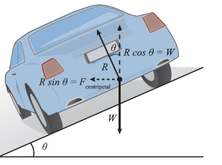
Banked tracks
When a car is on a banked track, it can still successfully take a corner when there is no frictional force present.
Banked tracks are set at an angle, so the horizontal component of the normal reaction force provide the required centripetal force. The vertical component of the normal reaction force balances the weight.

Slide 91
Banked Tracks
For a sloped track at angle θ to the horizontal:
$$Rsinθ=\frac{mv^{2}}{r}$$
$$Rcosθ=mg$$
Dividing these we get:
$$tanθ=\frac{v^{2}}{gr}$$
$so$,
$$v=\sqrt{grtanθ}$$
The steeper the bank, the faster you can take the corner.

Slide 92
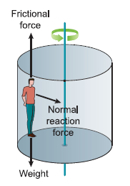
Funfair rides
One funfair ride which spins on its axis and then the floor drops gives people the sensation they are “stuck” to the wall.
What happens is the drum wall is exerting a normal reaction force, which provides the centripetal force to keep them moving in a circular path.
They do not fall because the friction acting
upwards balances their weight.

Slide 93
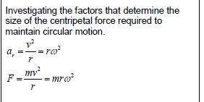
Mandatory Content covered
Mandatory Key Area
Examples of key area

Slide 94
Quiz

Slide 95
Quiz

