Slide 1
The Standard Model
Lesson 2:
Historical Background

Slide 2
What are we learning today?
The history behind our current understanding of the atom.

Slide 3
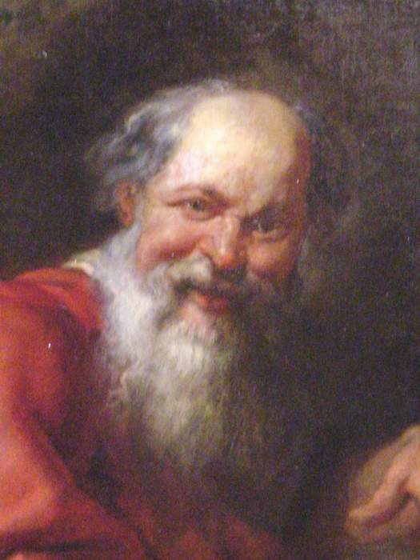
The History of the Atom
Democritus
He believed
atoms are indivisible particles separated by empty space.
different types of atoms had different shapes and sizes.

Slide 4
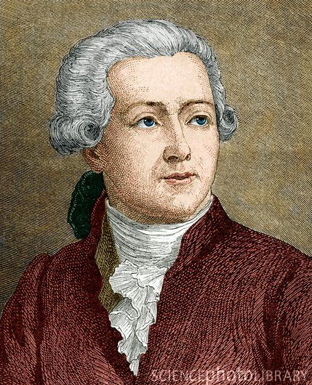
Lavoisier
Discovered
the total mass in a chemical reaction stays the same.
defined elements as materials that could not be broken down further.

Slide 5
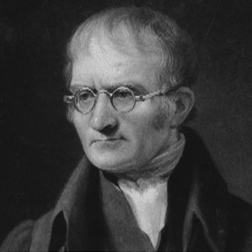
Dalton
Concluded
different elements differ in mass.
atoms cannot be subdivided, created or destroyed.
different atoms combine to form chemical compounds.

Slide 6
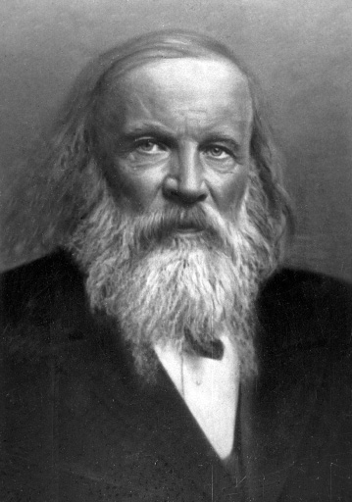
Mendeleev
Noticed
that certain chemical processes repeated themselves periodically.
He produced the first periodic table.
Notes:
http://www.youtube.com/watch?v=bw5TE5o7JtE 2:03 minutes

Slide 7
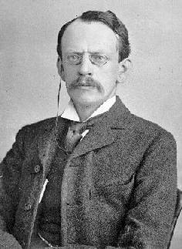
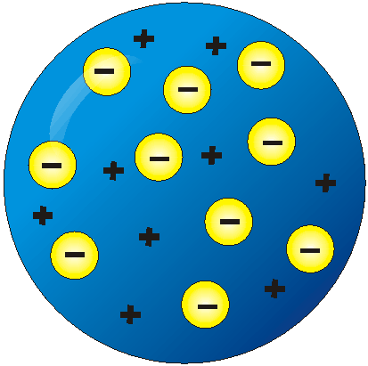
JJ Thomson
Discovered the electron.
Described the atom as a solid sphere of positive charge with electrons stuck in it like plums in a pudding.
This became known as the plum pudding model.
Notes:
http://www.youtube.com/watch?v=IdTxGJjA4Jw 2.54 minutes

Slide 8
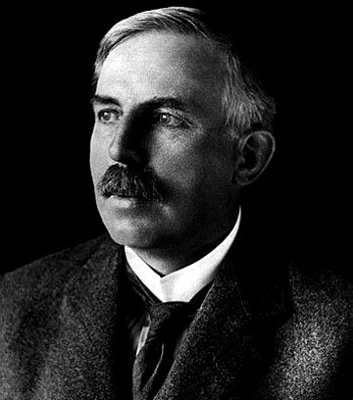
Ernest Rutherford
Carried out the first scattering experiment.
Found that the atom consisted of mostly empty space with a positively charged centre.
Notes:
http://www.youtube.com/watch?v=wzALbzTdnc8 3:28 minutes
If available use Atom – Clash of the titans to show Rutherfords experiment.

Slide 9
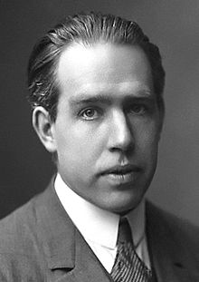
Neils Bohr
Concluded the planetary model of the atom.
Positive nucleus in the centre with electrons orbiting around it.
Discovered that these orbits have an associated energy.
Notes:
If available use Atom – Clash of the titans

Slide 10
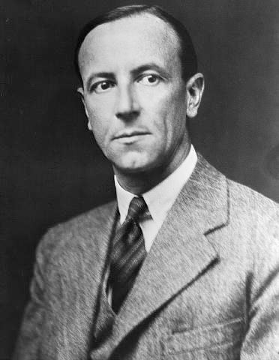
James Chadwick
Discovered the neutron.
This explained why different isotopes of the same element exist.
Notes:
Use Atom – Clash of the titans if available.

Slide 11
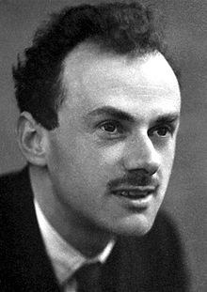
Paul Dirac
First prediction of antimatter.
Postulated the positron.
This was proven later by Carl Anderson while analysing the tracks from a cloud chamber.
Every particle has a corresponding antiparticle.
Notes:
http://www.youtube.com/watch?v=en2S1tBl1_s 4:25 minutes

Slide 12
Annihilation
In an annihilation a matter and antimatter particle completely annihilate into energy.
Other particles are created from this energy.
For example, when an electron and positron annihilate photons are produced.

Slide 13
The advent of particle accelerators led to the discovery of nearly 200 different particles.
A new theory was needed to simplify what was going on.
This theory is called the Standard Model.

