Slide 1
Lesson Starter
Remember: If one of your values is 3x larger than the other you use this value, otherwise you must use the combination equation!
AB is measured using a metre stick.
A trolley is timed between AB.
The following results were obtained.
AB = (60.0 + 0.1) cm
t/s 1.21, 1.21, 1.23, 1.21, 1.24 and 1.24.
Find:
The mean time.
The random uncertainty in the time.
The percentage uncertainty in the time and length.
Express the average speed in the form (value ± absolute uncertainty).

Slide 2
Linear motion
Advanced Higher Physics

Slide 3
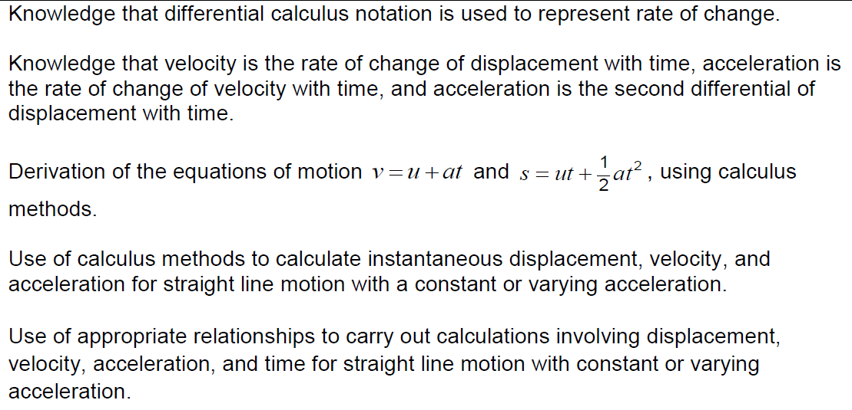
Mandatory Course content

Slide 4
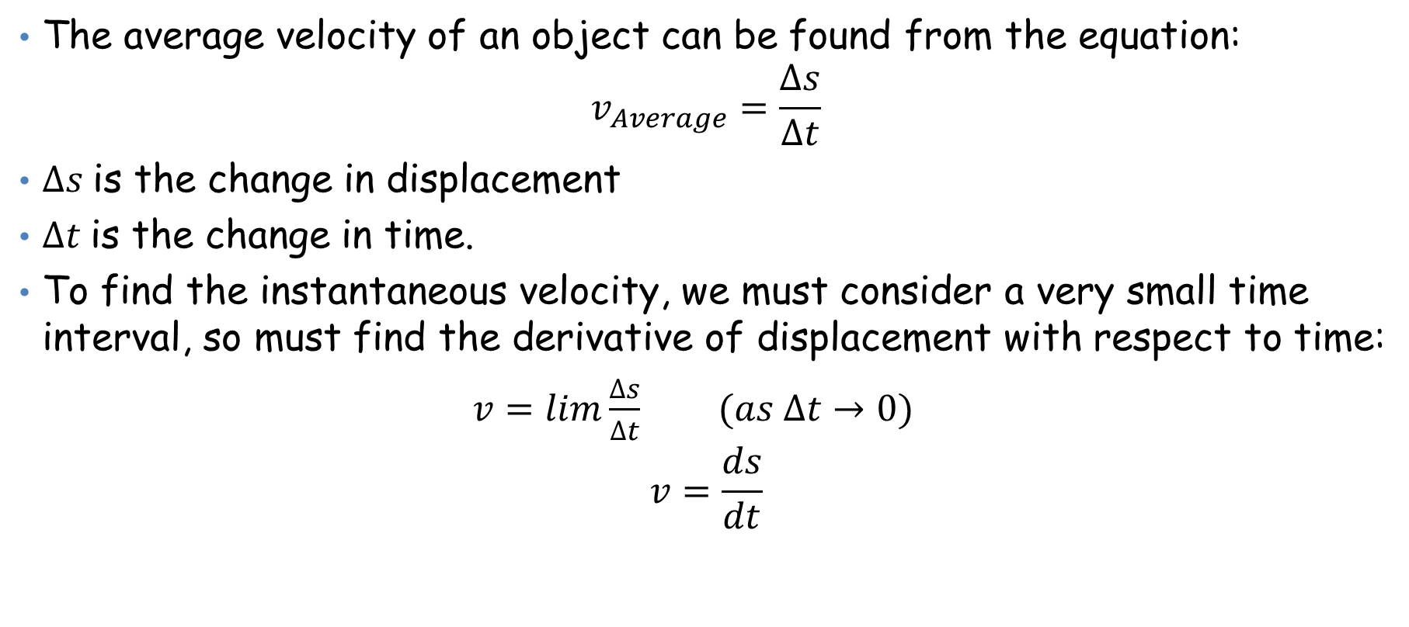
Calculus Methods
Copy into notes jotter:
The average velocity of an object can be found from the equation:
$$v_{Average}=\frac{∆s}{∆t}$$
$∆s$is the change in displacement
$∆t$is the change in time.
To find the instantaneous velocity, we must consider a very small time interval, so must find the derivative of displacement with respect to time:
$v=lim\frac{∆s}{∆t}$ $(as ∆t→0)$
$$v=\frac{ds}{dt}$$

Slide 5
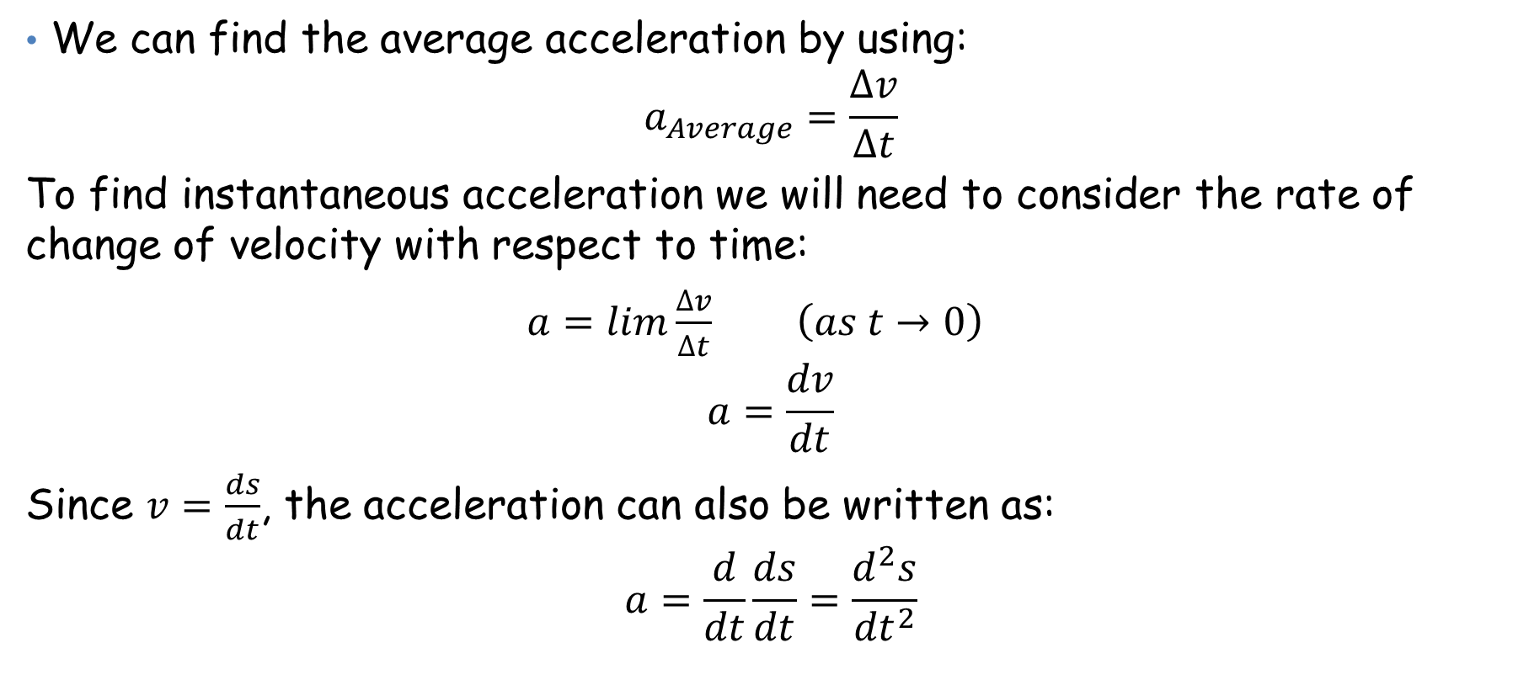
Calculus Methods
Copy into notes jotter:
We can find the average acceleration by using:
$$a_{Average}=\frac{∆v}{∆t}$$
To find instantaneous acceleration we will need to consider the rate of change of velocity with respect to time:
$a=lim\frac{∆v}{∆t}$ $\left(as t→0\right)$
$$a=\frac{dv}{dt}$$
Since $v=\frac{ds}{dt}$, the acceleration can also be written as:
$$a=\frac{d}{dt}\frac{ds}{dt}=\frac{d^{2}s}{{dt}^{2}}$$
Remember:
Velocity and Acceleration
Are VECTORS!!

Slide 6
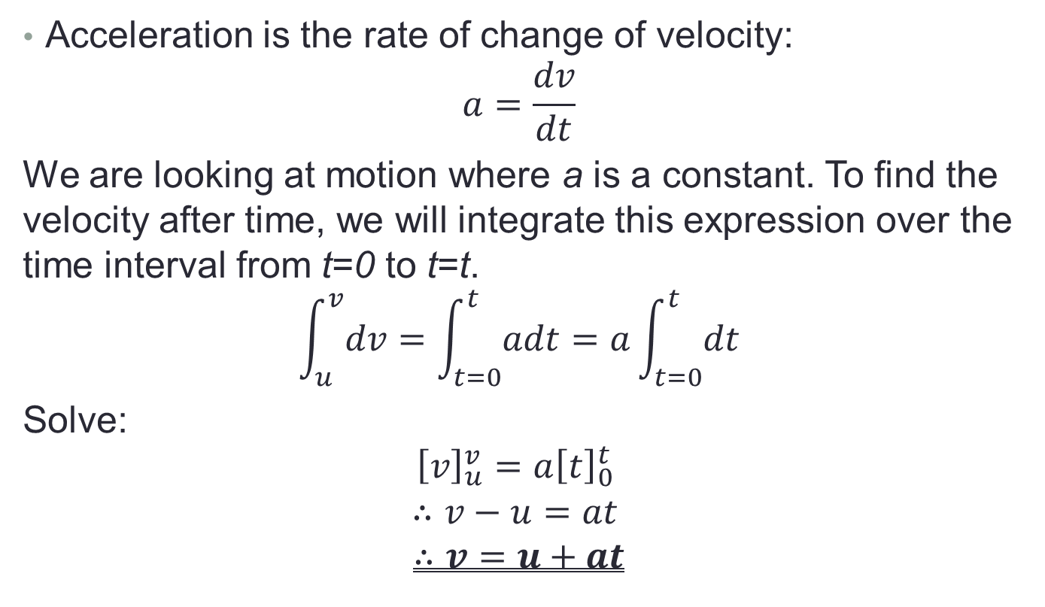
Deriving the equations for uniform acceleration
Copy into notes jotter:
Acceleration is the rate of change of velocity:
$$a=\frac{dv}{dt}$$
We are looking at motion where a is a constant. To find the velocity after time, we will integrate this expression over the time interval from t=0 to t=t.
$$\int_{u}^{v}{dv}=\int_{t=0}^{t}{adt}=a\int_{t=0}^{t}{dt}$$
Solve:
$${\left[v\right]}_{u}^{v}={a\left[t\right]}_{0}^{t}$$
$$∴v−u=at$$
$$∴v=u+at$$

Slide 7

Deriving the equations for uniform acceleration
Copy into notes jotter:
Integrating over the time interval from 0 to t gives:
$$\int_{s=0}^{s}{ds}=\int_{t=0}^{t}{\left(u+at\right)dt}$$
$$∴{\left[s\right]}_{o}^{s} = \left[ut+\frac{1}{2}at^{2}\right]$$
$$∴s=ut+\frac{1}{2}at^{2}$$

Slide 8
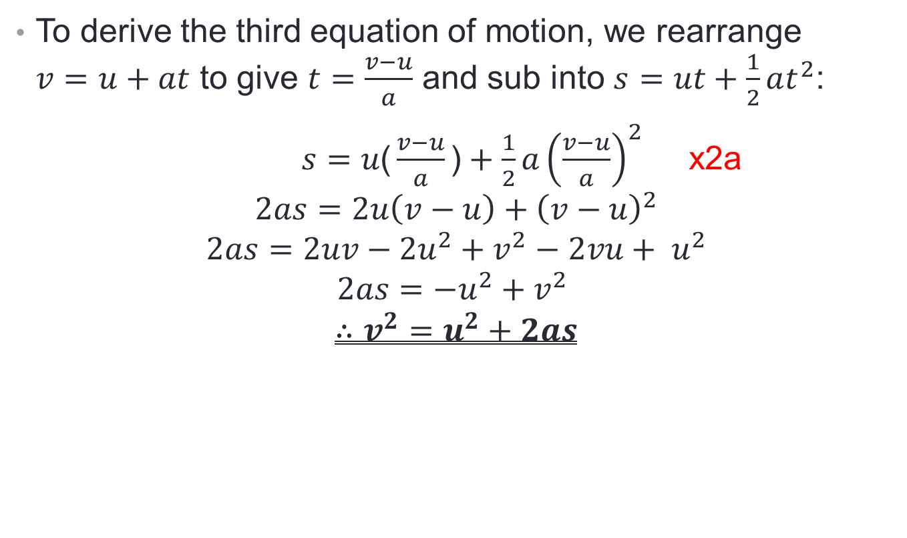
Deriving the equations for uniform acceleration
To derive the third equation of motion, we rearrange $v=u+at$ to give $t=\frac{v−u}{a}$ and sub into $s=ut+\frac{1}{2}at^{2}$:
$s=u\text{(}\frac{v−u}{a}\text{)}+\frac{1}{2}a{\left(\frac{v−u}{a}\right)}^{2}$ x2a
$$2as=2u\left(v−u\right)+{\left(v−u\right)}^{2}$$
$$2as=2uv−2u^{2}+v^{2}−2vu+ u^{2}$$
$$2as=−u^{2}+v^{2}$$
$$∴v^{2}=u^{2}+2as$$

Slide 9
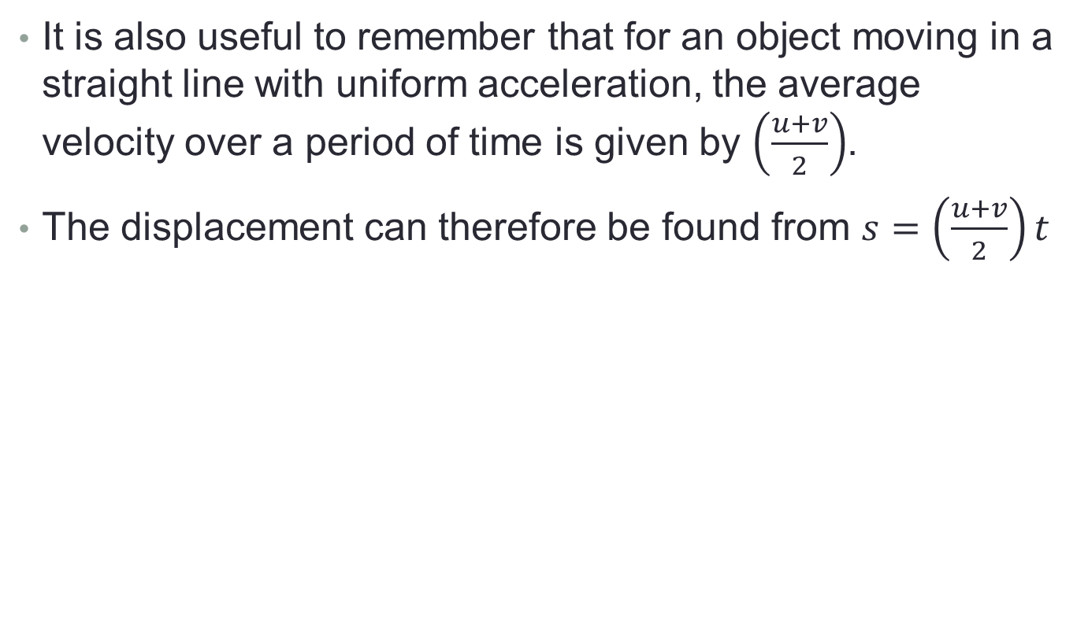
Deriving the equations for uniform acceleration
It is also useful to remember that for an object moving in a straight line with uniform acceleration, the average velocity over a period of time is given by $\left(\frac{u+v}{2}\right)$.
The displacement can therefore be found from $s=\left(\frac{u+v}{2}\right)t$

Slide 10
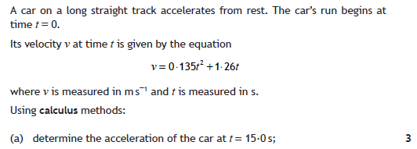

Example 1

Slide 11
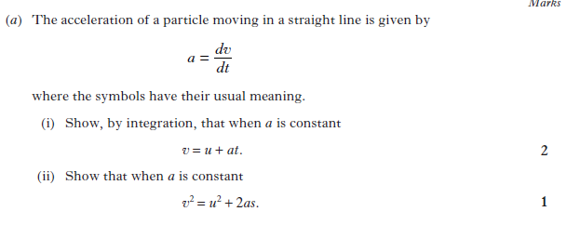
Example 2

Slide 12
Horizontal Motion
The kinematic relationships can be used to solve problems of motion in one dimension with constant acceleration. In all cases we will be ignoring the effects of air resistance.

Slide 13
Example
A car accelerates from rest at a rate of 4.0 m s⁻².
What is its velocity after 10 s?
How long does it take to travel 72 m?
How far has it travelled after 8.0 s?

Slide 14
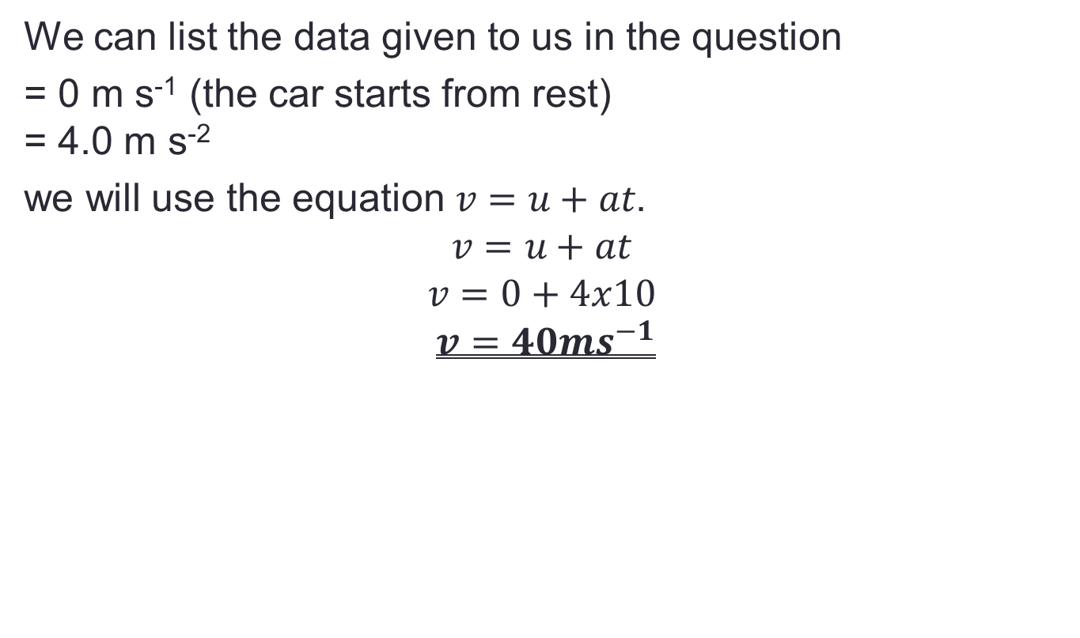
Example Answer
We can list the data given to us in the question
= 0 m s⁻¹ (the car starts from rest)
= 4.0 m s⁻²
we will use the equation $v=u+at$.
$$v=u+at$$
$$v=0+4x10$$
$$v=40ms^{−1}$$

Slide 15
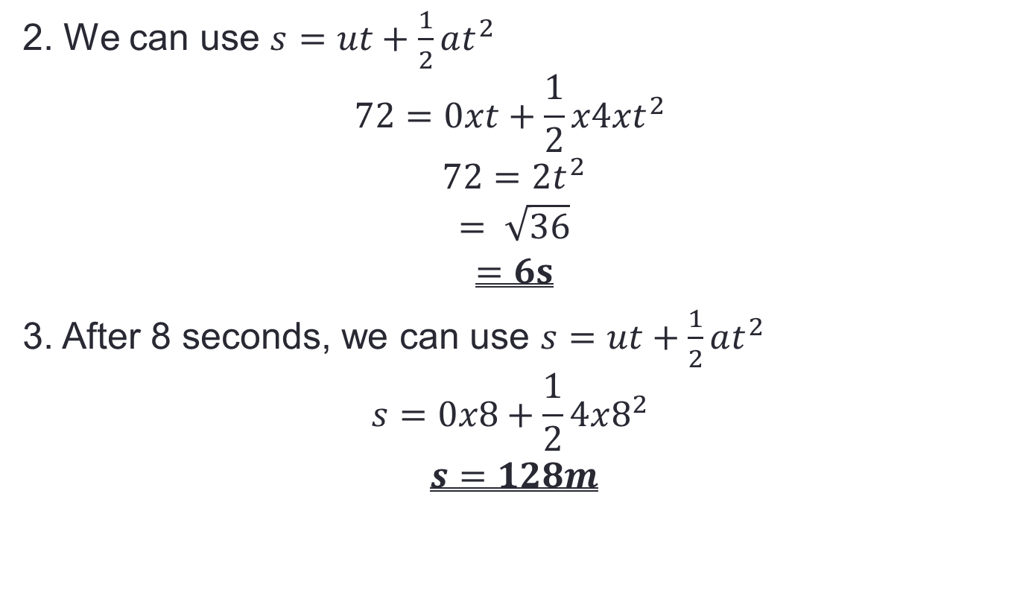
Example
2. We can use $s=ut+\frac{1}{2}at^{2}$
$$72=0xt+\frac{1}{2}x4xt^{2}$$
$$72=2t^{2}$$
$$= \sqrt{36}$$
$$=6s$$
3. After 8 seconds, we can use $s=ut+\frac{1}{2}at^{2}$
$$s=0x8+\frac{1}{2}4x8^{2}$$
$$s=128m$$

Slide 16
Tips
Copy into notes jotter:
The same strategy should be used in solving all of the problems for constant acceleration.
list the data given to you in the question.
It is often useful to make a sketch diagram with arrows, to ensure that any vector quantities are being measured in the correct direction.

Slide 17
Vertical Motion
Copy into notes jotter:
When dealing with freely-falling bodies on Earth, the acceleration of the body is the acceleration due to gravity, = -9.8 m s⁻².
If any force other than gravity is acting in the vertical plane, the body is no longer in free-fall, and the acceleration will take a different value.
Problems should be solved using exactly the same method we used to solve horizontal motion problems.

Slide 18
Vertical Motion Example
Copy into notes jotter:
A student drops a stone from a second floor window, 15 m above the ground.
How long does it take for the stone to reach the ground?
With what velocity does it hit the ground?

Slide 19
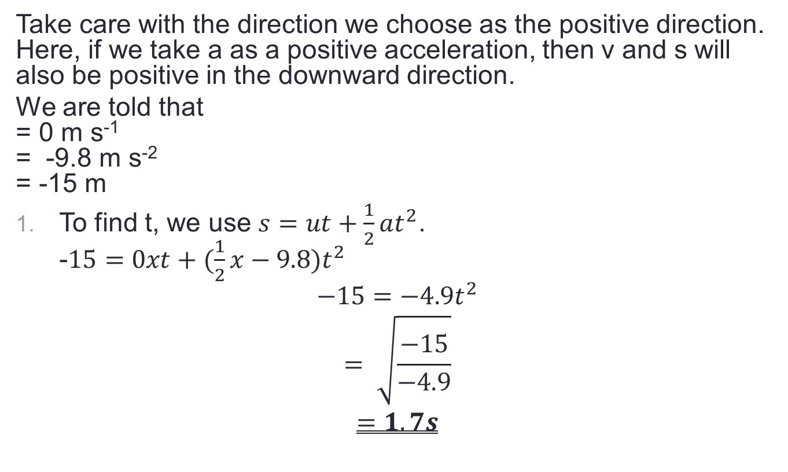
Example answers
Copy into notes jotter:
Take care with the direction we choose as the positive direction. Here, if we take a as a positive acceleration, then v and s will also be positive in the downward direction.
We are told that
= 0 m s⁻¹
= -9.8 m s⁻²
= -15 m
To find t, we use $s=ut+\frac{1}{2}at^{2}$.
-$15=0xt+(\frac{1}{2}x−9.8)t^{2}$
$$−15=−4.9t^{2}$$
$$= \sqrt{\frac{−15}{−4.9}}$$
$$=1.7s$$

Slide 20
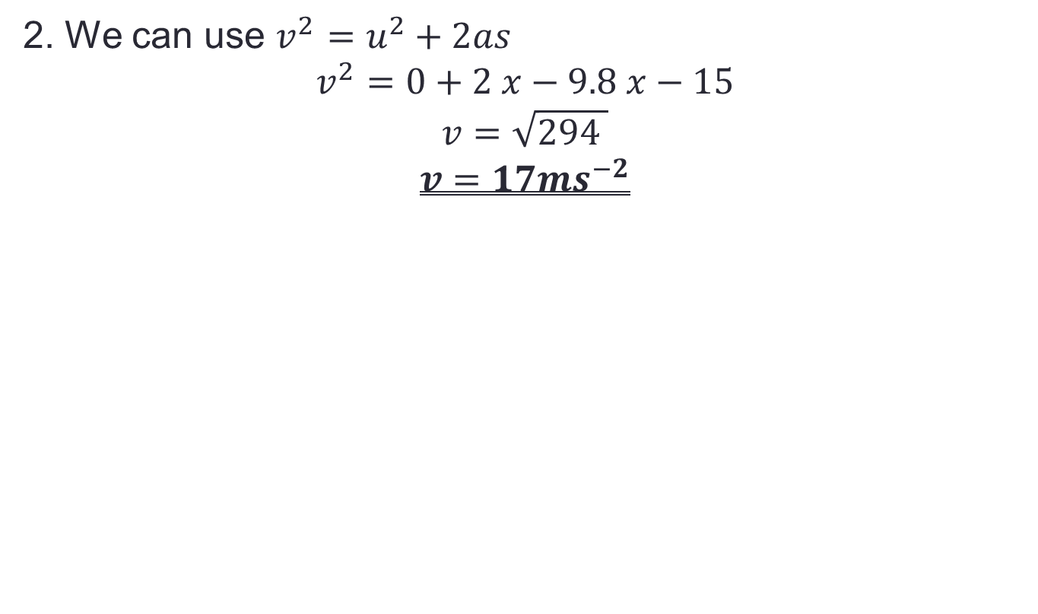
Example answers
Copy into notes jotter:
2. We can use $v^{2}=u^{2}+2as$
$$v^{2}=0+2 x−9.8 x−15$$
$$v=\sqrt{294 }$$
$$v=17{ms}^{−2}$$

Slide 21
Tips
Difficulties sometimes occur when the initial velocity is directed upwards, for example if an object is being thrown upwards from the ground.
To solve such a problem, it is usual to take the vertical displacement as being positive in the upwards direction.
The velocity vector is then positive when the object is travelling upwards, and negative when it is returning to the ground.
In this situation the acceleration is always negative, as it is always directed towards the ground.

Slide 22
Mandatory Course content Covered

Slide 23
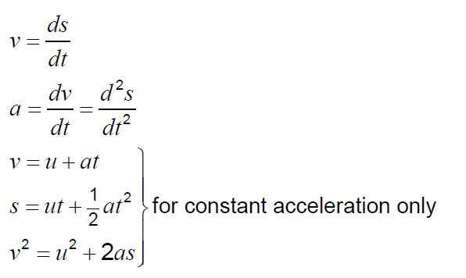
Mandatory Course content Covered

Slide 24
Lesson Starter
Write down the equation for instantaneous velocity.
Write down the equation for instantaneous acceleration.
Derive the expression: v=u +at

Slide 25
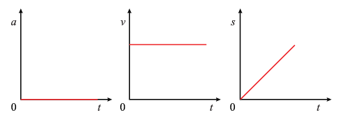
Graphs for motion with constant velocity
Copy into notes jotter:
The graphs below all represent motion with a constant velocity:
You will also recall from Higher that the area under a velocity time graph is equal to the displacement.
Similarly, it is worth noting that the area under an acceleration time graph is equal to the change in velocity.

Slide 26
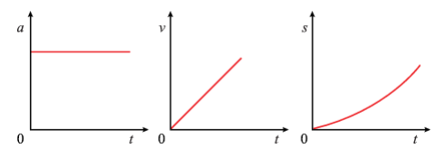
Graphs for motion with constant positive acceleration
Copy into notes jotter:
The graphs below all represent motion with a constant positive acceleration:
Note that since acceleration and velocity are the same sign, the object is speeding up.

Slide 27
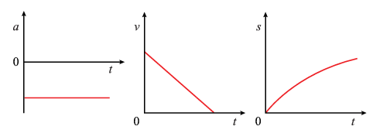
Graphs for motion with constant negative acceleration
Copy into notes jotter:
The graphs below all represent motion with a constant negative acceleration:
Note that since the acceleration and the velocity are the opposite sign, the object is slowing down.

Slide 28
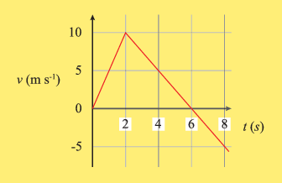
Example 1
For the velocity - time graph shown, calculate:
The acceleration from 2.0 s to 8.0 s.
The displacement after 8.0 s.

Slide 29
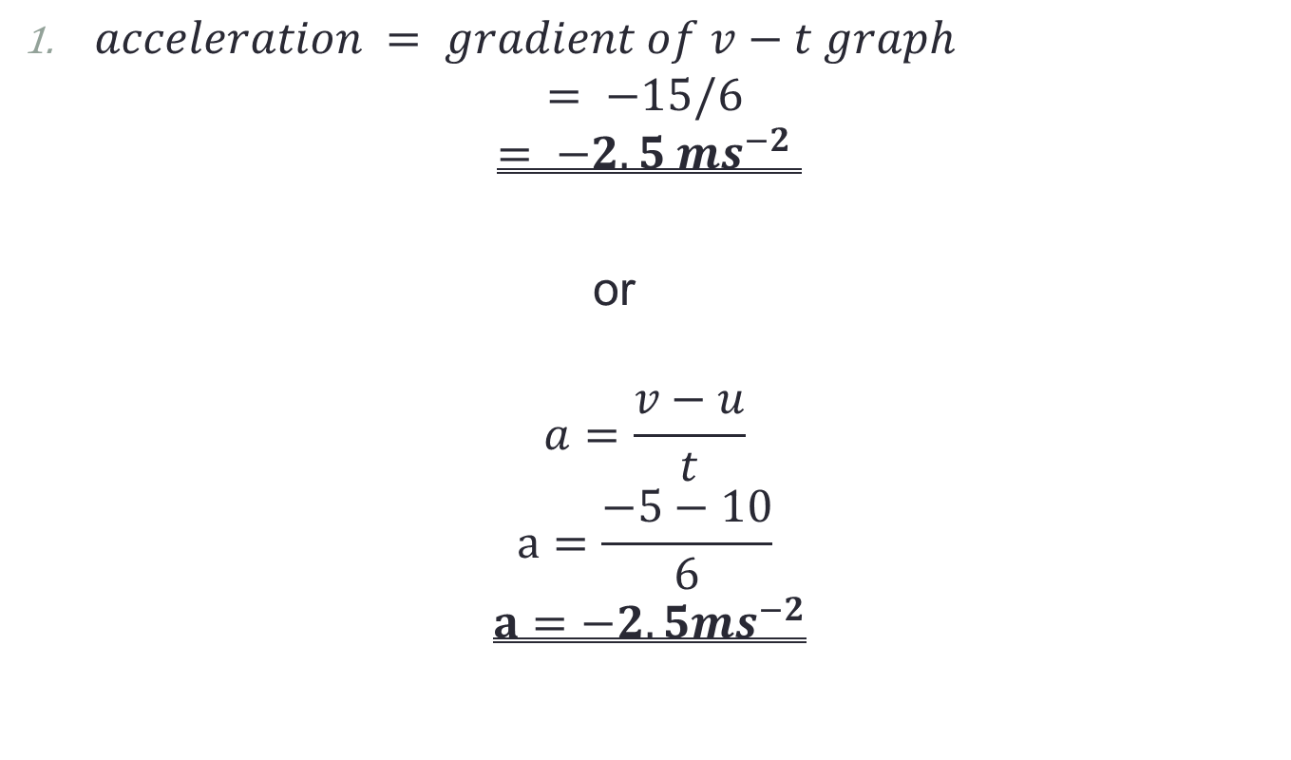
Example answers
$acceleration = gradient of v−t graph$
$$= −15/6$$
$$= −2.5 {ms}^{−2}$$
or
$$a=\frac{v−u}{t}$$
$$a=\frac{−5−10}{6}$$
$$a=−2.5{ms}^{−2}$$

Slide 30
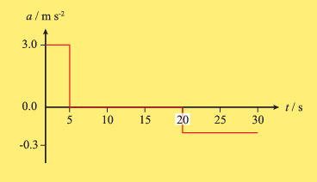
Example 2
Copy into notes jotter:
Find the change in velocity in:
The first 5 seconds.
Between 0 and 30 seconds.

Slide 31

Example 2 answers
Copy into notes jotter:
1. $Change in velocity = area under acceleration time graph$
$$=3x5$$
$$=15ms^{−1}$$
2. $change in velocity=area under acceleration time graph$
$$=15−3 (10x−0.3)$$
$$=12ms^{−1}$$

Slide 32
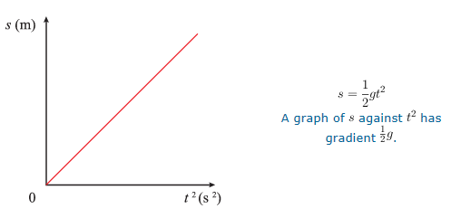
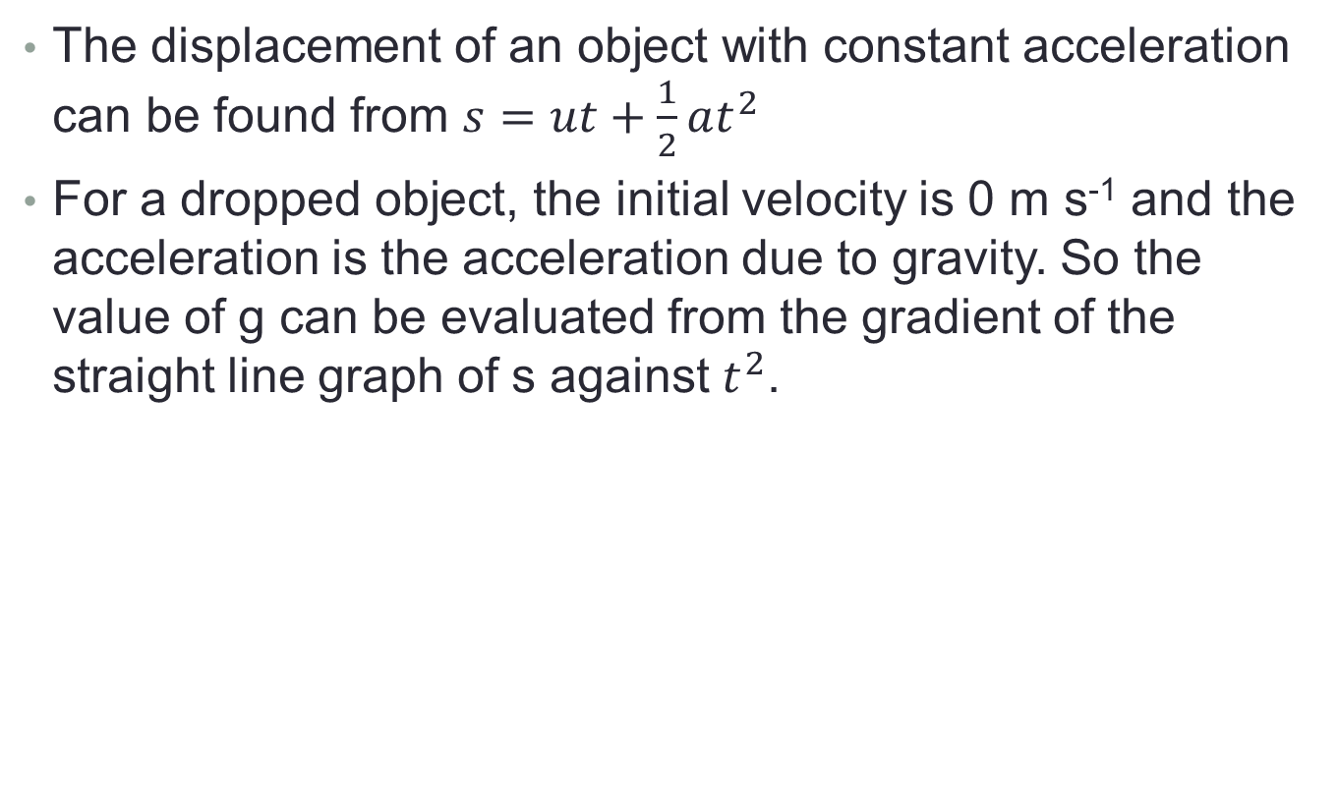
Objects in Free fall
The displacement of an object with constant acceleration can be found from $s=ut+\frac{1}{2}at^{2}$
For a dropped object, the initial velocity is 0 m s⁻¹ and the acceleration is the acceleration due to gravity. So the value of g can be evaluated from the gradient of the straight line graph of s against $t^{2}$.

Slide 33
Finding g Experiment
Measure several heights using a meter stick.
Drop an object from these heights and time how long it takes to fall (complete 5 times).
Get the mean time.
Draw a graph of displacement vs time squared.
Find g.

Slide 34
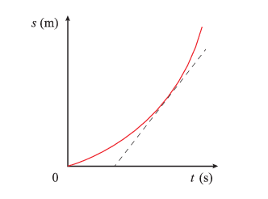
Objects in Free fall
Copy into notes jotter:
The acceleration due to gravity can also be found by considering the displacement-time graph.
The gradient of the graph is increasing since the instantaneous velocity increases.

Slide 35
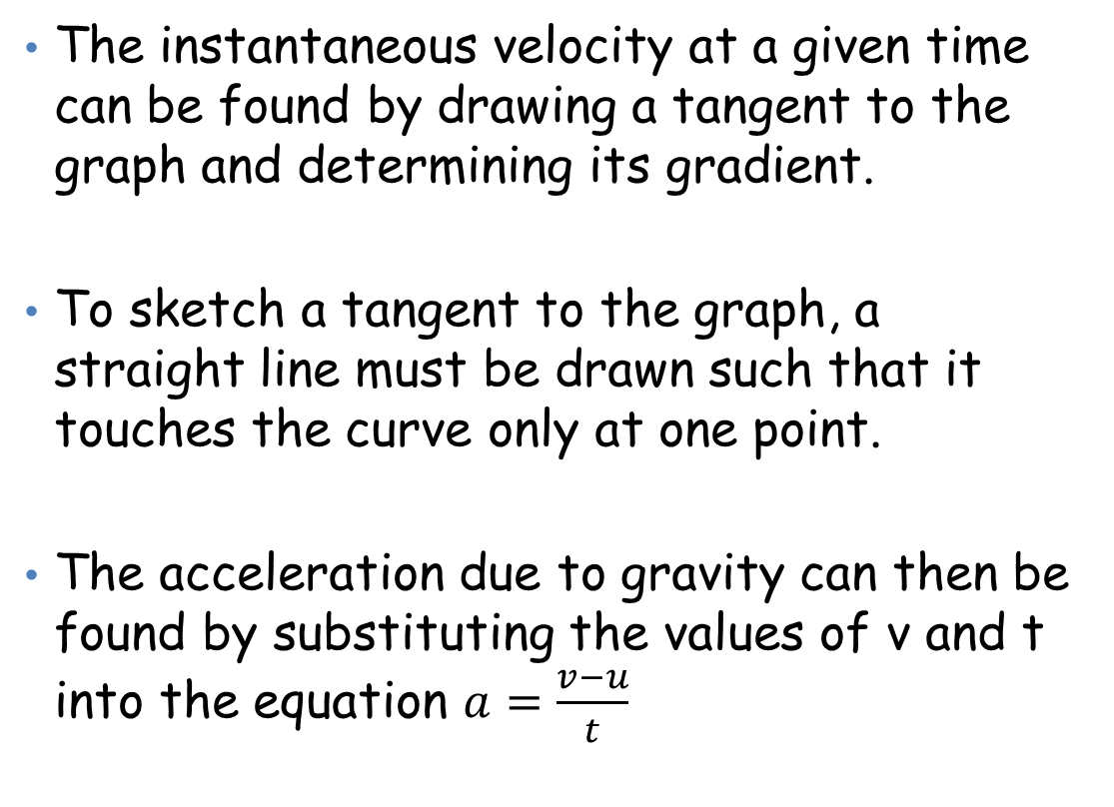
Objects in free fall
Copy into notes jotter:
The instantaneous velocity at a given time can be found by drawing a tangent to the graph and determining its gradient.
To sketch a tangent to the graph, a straight line must be drawn such that it touches the curve only at one point.
The acceleration due to gravity can then be found by substituting the values of v and t into the equation $a=\frac{v−u}{t}$

Slide 36
Graphical methods for non-uniform acceleration
For non-uniform acceleration, the change of velocity with time is not constant throughout the motion. So the slope of the velocity-time graph will be changing and it may have curved sections.
Therefore, to find the acceleration at a given point in time, you need to draw a tangent to the curve at that point and then calculate its gradient.

Slide 37
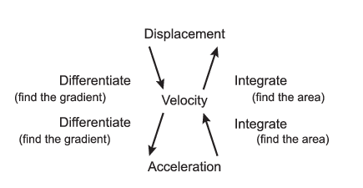
Summary
Copy into notes jotter:

Slide 38

Example 1 - Varying Acceleration
Copy into notes jotter:
The velocity in m s⁻¹ of a moving particle is given by the equation $v=4t^{3}−5t^{2}+6t$
Where t = time in seconds.
Find the acceleration when t = 0.5s.

Slide 39
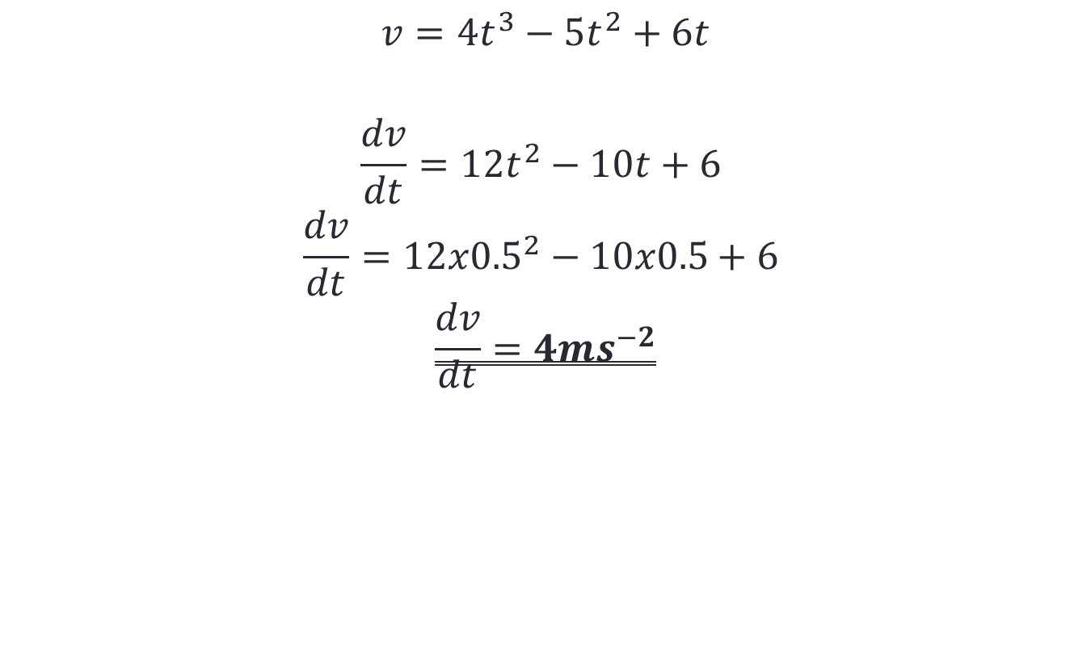
Answer 1
Copy into notes jotter:
$$v=4t^{3}−5t^{2}+6t$$
$$\frac{dv}{dt}=12t^{2}−10t+6$$
$$\frac{dv}{dt}=12x{0.5}^{2}−10x0.5+6$$
$$\frac{dv}{dt}=4ms^{−2}$$

Slide 40
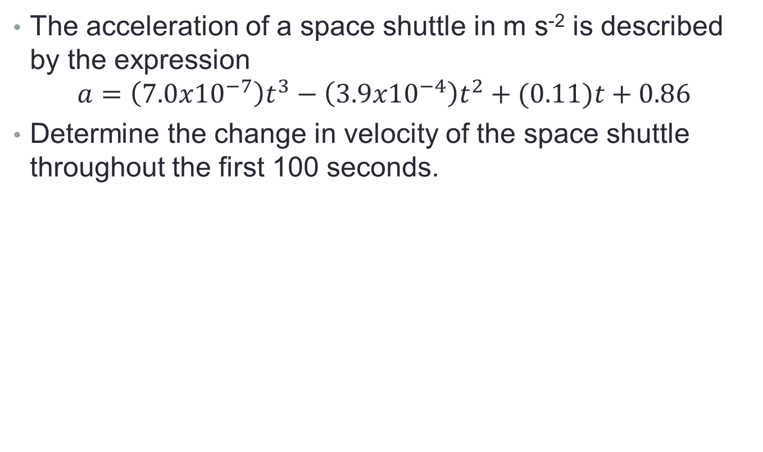
Example 2
Copy into notes jotter:
The acceleration of a space shuttle in m s⁻² is described by the expression
$$a=\left(7.0x{10}^{−7}\right)t^{3}−\left(3.9x{10}^{−4}\right)t^{2}+(0.11)t+0.86$$
Determine the change in velocity of the space shuttle throughout the first 100 seconds.

Slide 41
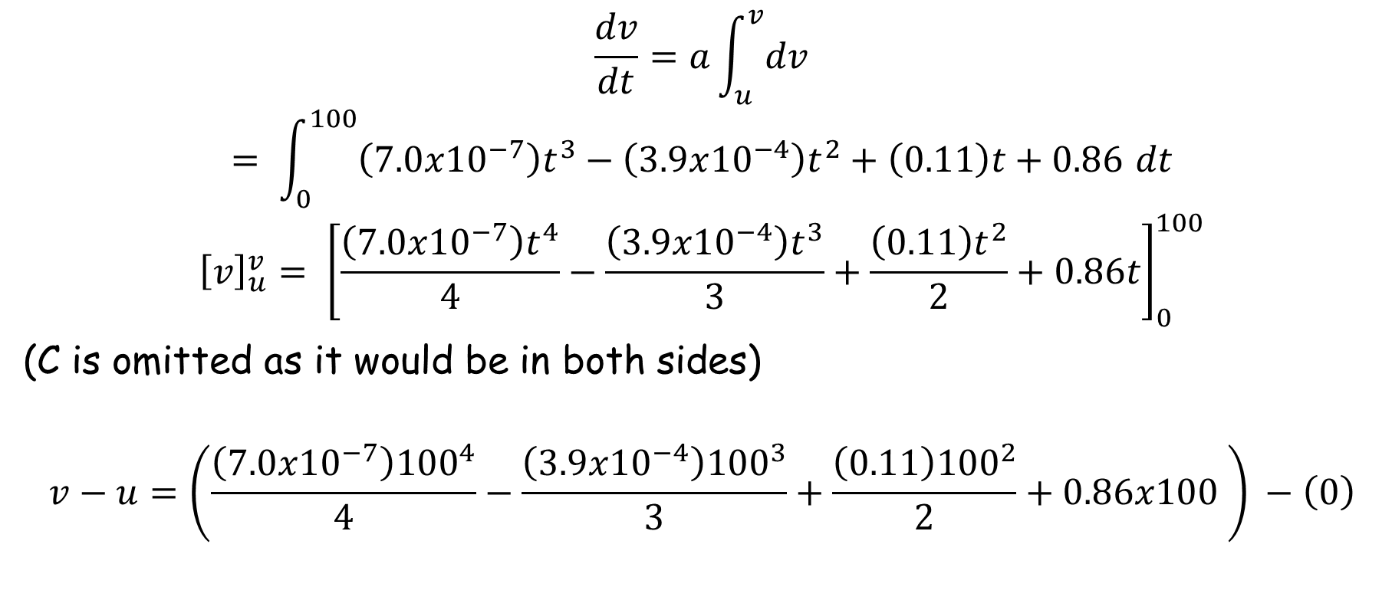
Example answer
Copy into notes jotter:
$$\frac{dv}{dt}=a\int_{u}^{v}{dv}$$
$$= \int_{0}^{100}{\left(7.0x{10}^{−7}\right)t^{3}−\left(3.9x{10}^{−4}\right)t^{2}+\left(0.11\right)t+0.86 dt}$$
$${\left[v\right]}_{u}^{v}= {\left[\frac{\left(7.0x{10}^{−7}\right)t^{4}}{4}−\frac{\left(3.9x{10}^{−4}\right)t^{3}}{3}+\frac{\left(0.11\right)t^{2}}{2}+0.86t\right]}_{0}^{100}$$
(C is omitted as it would be in both sides)
$$v−u=\left(\frac{\left(7.0x{10}^{−7}\right){100}^{4}}{4}−\frac{\left(3.9x{10}^{−4}\right){100}^{3}}{3}+\frac{\left(0.11\right){100}^{2}}{2}+0.86x100 \right) −\left(0\right)$$

Slide 42
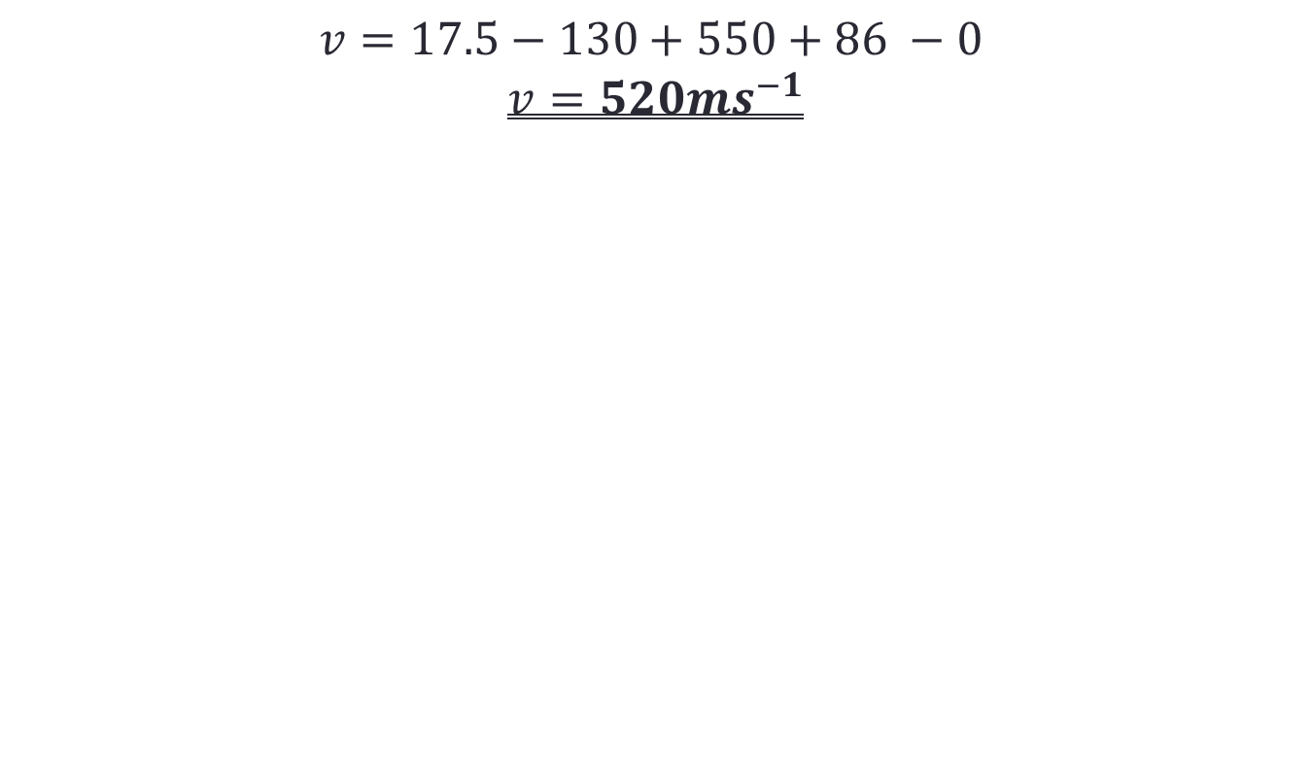
Answer cont…
Copy into notes jotter:
$$v=17.5−130+550+86 −0$$
$$v=520ms^{−1}$$

Slide 43
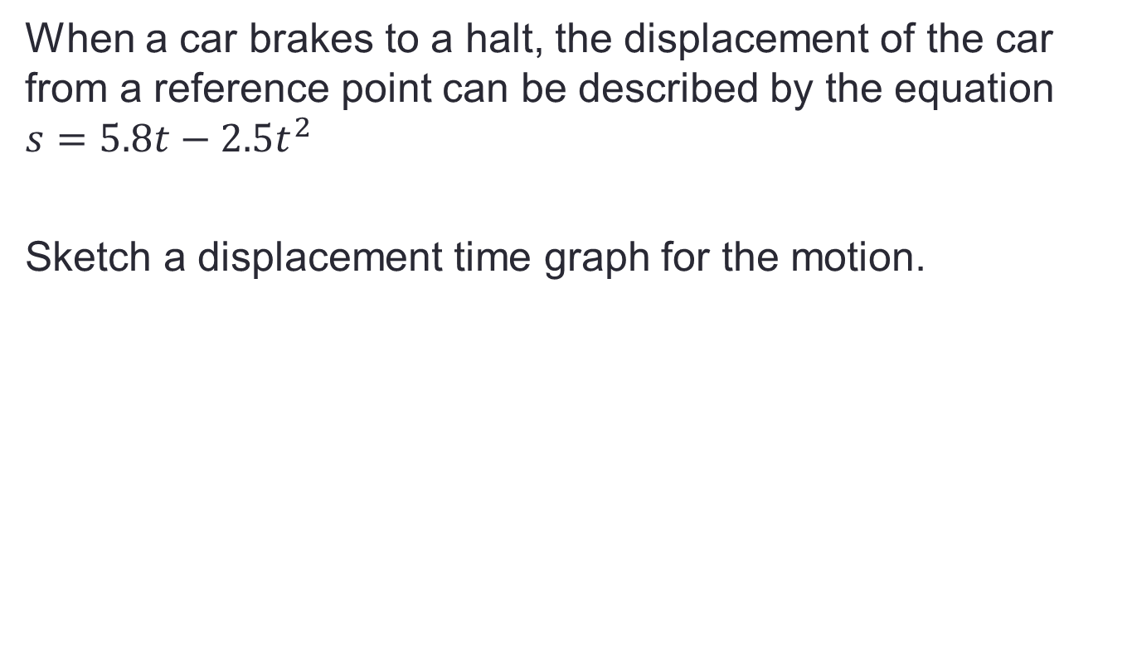
Example 3
Copy into notes jotter:
When a car brakes to a halt, the displacement of the car from a reference point can be described by the equation $s=5.8t−2.5t^{2}$
Sketch a displacement time graph for the motion.

Slide 44
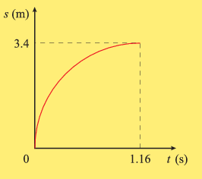

Answer
Copy into notes jotter:
$$v=\frac{ds}{dt}=\frac{d}{dt}\left(5.8t−2.5t^{2}\right)$$
$$v=5.8 −5t$$
$$when v=0ms^{−1}, t=\frac{5.8}{5}=1.16s$$
$$s=5.8x1.16 −\left(2.5x{1.16}^{2}\right)$$
$$s=3.4m$$

Slide 45
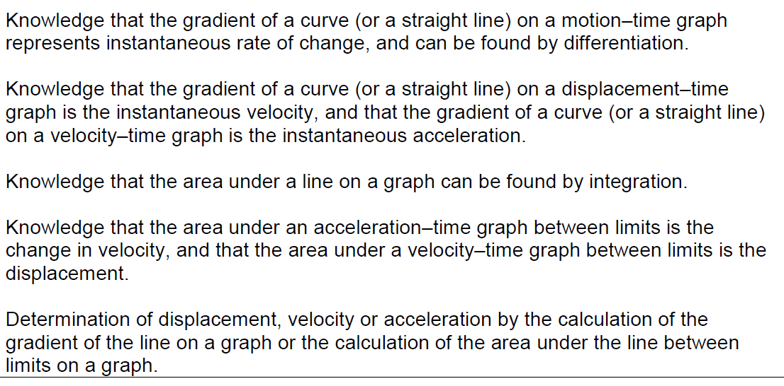
Mandatory Course Content Covered…

Slide 46
Tutorial Questions
You can now complete all of tutorial 1

Slide 47
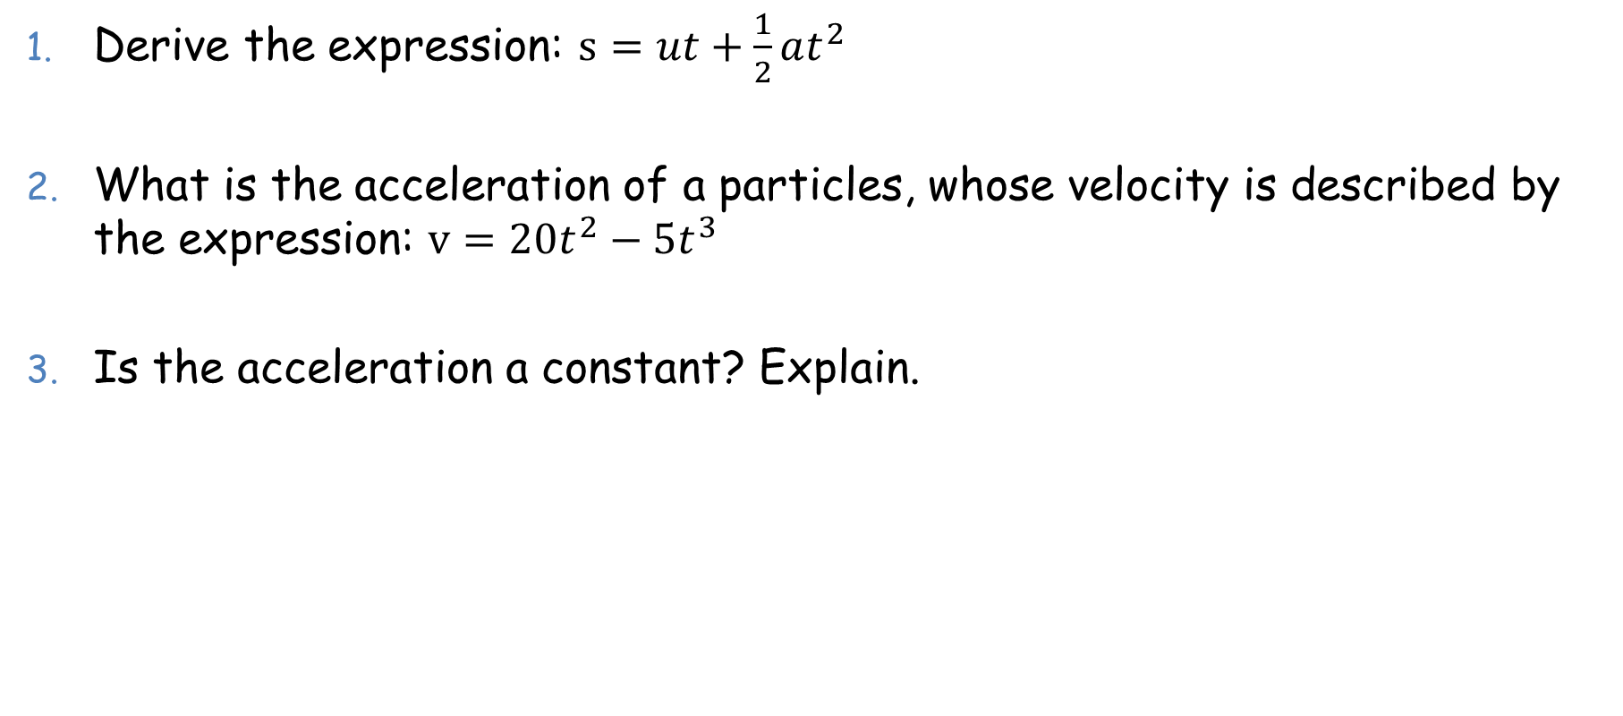
Lesson Starter
Derive the expression: $s=ut+\frac{1}{2}at^{2}$
What is the acceleration of a particles, whose velocity is described by the expression: $v=20t^{2}−5t^{3}$
Is the acceleration a constant? Explain.

