Slide 1
Lesson Starter.
What is a variable?
Name two variables.

Slide 2
Variables
A variable is something that can be changed in an experiment.
For example:
Temperature
Time
Concentration
Volume
Particle Size

Slide 3
Success Criteria
WHAT CAN I DO? | Red | Amber | Green
State what the terms solute, solvent and solution mean.
Successfully carry out an experiment into the solubility of substances.
Write a valid conclusion.
You should be able to do these by the end of the lesson!

Slide 4
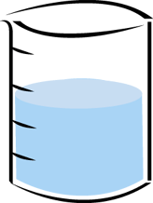
Solutions
If a material dissolves it is soluble.
If a material doesn’t dissolve, it is insoluble.
soluble
insoluble

Slide 5
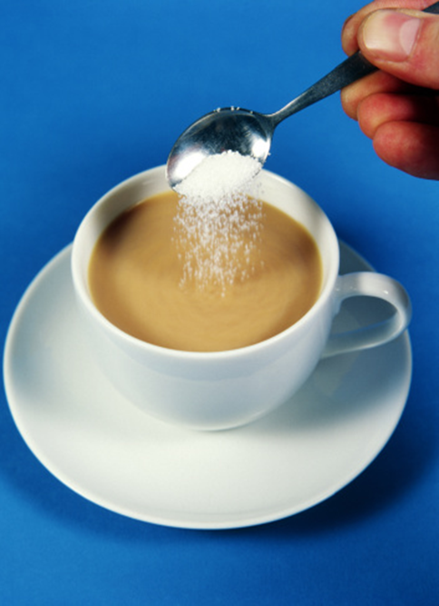
Solutions
Sugar dissolves, therefore sugar is soluble!

Slide 6
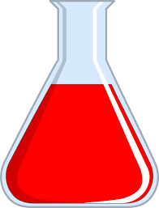
Solutions
The solid that dissolves is called the solute
The liquid that the solid dissolves in is called the solvent
The mixture of the solute and solvent is called a solution
solution
solvent
solute

Slide 7
Solutions
Solute + Solvent = Solution
(solid) (liquid) (solid + liquid)

Slide 8
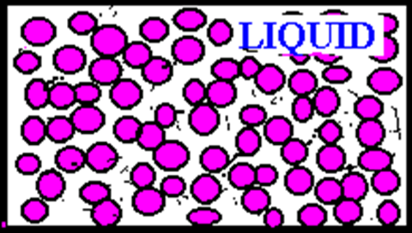
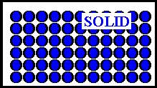
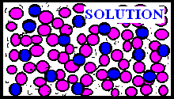
What happens when a solid dissolves?

Slide 9
Definitions! - Solubility
Solute - A solid that is dissolved in a liquid.
Solvent - A liquid in which a solid is dissolved.
Solution - A mixture of a solute and solvent.
Soluble - A substance that will dissolve.
Insoluble - A substance that will not dissolve.

Slide 10
Solubility
http://www.twigonglow.com/films/solutions-1475/

Slide 11
Experiment
Aim: To find out the solubility of certain compounds in water.
Method:
Collect 4 test tubes.
Half fill each test tube with water
Add a spatula of the first solid to the first test tube.
Decide if it is soluble or insoluble.
Record in the table.
Repeat for the other solids.

Slide 12
Experiment
Results:
Compound name | Cloudy/ Clear | Soluble/ Insoluble
Salt
Sugar
Cetyl alcohol
Salicylic acid

Slide 13
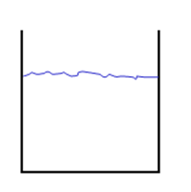
Saturation:
Saturation is the point at which a solute is no longer soluble in a solvent (It will appear as a precipitate (solid) in the solution).
Saturated

Slide 14
Success Criteria
WHAT CAN I DO? | Red | Amber | Green
State what the terms solute, solvent and solution mean.
Successfully carry out an experiment into the solubility of substances.
Write a valid conclusion.
You should be able to do these by the end of the lesson!

