Slide 1
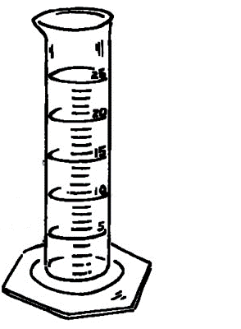
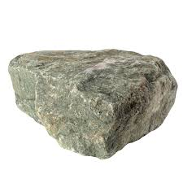
Lesson Starter.
You are given a stone and need to find its volume. How would you find this out using a measuring cylinder and water?

Slide 2
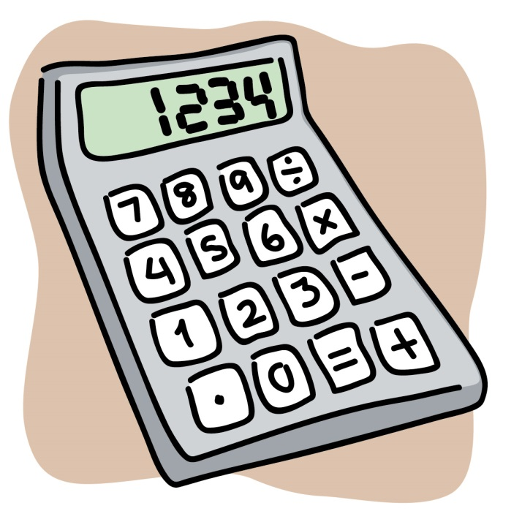
Calculations in science.
Aims:
To measure small quantities using calculations.
To calculate averages.

Slide 3
Success Criteria
WHAT CAN I DO? | Red | Amber | Green
I can measure small quantities, by measuring a large quantity and dividing.
I can calculate an average from a selection of results.
You should be able to do these by the end of the lesson!

Slide 4
Small Quantities
To measure a small quantity, measure a large quantity and divide by the number of the large quantity.
For example:
Measure the mass of 1 paper clip.
- weigh 10 paper clips and divide by 10.

Slide 5
Small Quantities
If you know that the mass of 20 paper clips is 5g, calculate the mass of one paper clip.
A: 20 paper clips = 5g
1 paper clip = $\frac{5}{20}$ = 0.25g

Slide 6
Small Quantities
If you know that the mass of 10 paper clips is 5g, calculate the mass of one paper clip.
A: 10 paper clips = 5g
1 paper clip = $\frac{5}{10}$ = 0.5g

Slide 7
Small Quantities
If you know that the width of 500 pieces of paper is 20 cm, calculate the width of one piece of paper.
A: 500 pieces of paper = 20cm
1 piece of paper = $\frac{20}{500}$ = 0.04cm

Slide 8
Small Quantities
If you know that the volume of 25 stones is 30 ml, calculate the volume of one stone.
A: Volume of 25 stones = 30 ml
Volume of 1 stone = $\frac{30}{25}$ = 1.2 ml

Slide 9
Lesson Starter
Why is observation important when carrying out experiments?
What is meant by the terms:
- method
- results

Slide 10
Learning Intention
Carry out measurements accurately.
Success Criteria
Pupils should be able to:
Choose the correct apparatus
Carry out the experiments safely and accurately
Use the correct units

Slide 11
Units and Apparatus

Slide 12
Lesson Starter
What apparatus is used for measuring time?
What is the unit of measurement for mass?
What apparatus is used to measure volume?

Slide 13
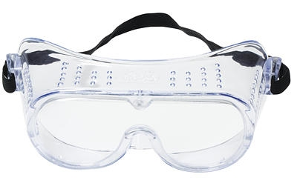
Hard Measurements
Work through each station writing down:
1. Experiment number (e.g. Experiment 1.)
2. What you had to do (e.g. measure the volume of a stone.)
3. What the measurement was (e.g. The mass was 2g)

Slide 14
Learning Intention
Carry out measurements accurately.
Success Criteria
Pupils should be able to:
Choose the correct apparatus
Carry out the experiments safely and accurately
Use the correct units

Slide 15
Lesson Starter.
What is the volume of one stone, if the volume of 10 is 5ml?
What is the mass of one bottle, if the mass of 15 is 200g?

Slide 16
Averages
To calculate an average from a selection of results or measurements, use the formula:
Average = $\frac{Sum of measurements}{Number of readings or measurements}$

Slide 17
Averages
So, add up all the results, then divide by the total number of results.
Average = $\frac{Sum of measurements}{Number of readings or measurements}$

Slide 18
Averages
Average = $\frac{Sum of measurements}{Number of readings or measurements}$
Find the average of 2, 4 and 6.
Average = $\frac{2+4+6}{3}$ = $\frac{12}{3}$ = 4

Slide 19
Averages
Average = $\frac{Sum of measurements}{Number of readings or measurements}$
Find the average of 5, 12 and 7.

Slide 20
Average = $\frac{Sum of measurements}{Number of readings or measurements}$
Four groups measured the volume of a large test tube. Their results were: 24ml, 25ml, 26ml, 25ml.
Calculate the average volume of the test tube.

Slide 21
Average = $\frac{Sum of measurements}{Number of readings or measurements}$
Five groups measured the mass of 10 ml of water. Their results were: 20g, 22g, 23g, 20g, 25g.
Calculate the average mass of 10 ml of water.

Slide 22
Average = $\frac{Sum of measurements}{Number of readings or measurements}$
Four groups measured the volume of a stone. Their results were: 30ml, 34ml, 29ml, 31ml.
Calculate the average volume of the stone.

Slide 23
Success Criteria
WHAT CAN I DO? | Red | Amber | Green
I can measure small quantities, by measuring a large quantity and dividing.
I can calculate an average from a selection of results.
You should be able to do these by the end of the lesson!

Slide 24
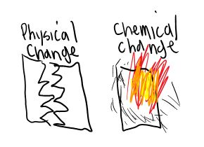
Next Day:
Chemical and Physical Changes.

