Slide 1
UCAS Application Process
St Ninian’s High School
October 2022

Slide 2
Application Timeline
DATE | ACTION POINTS
Friday 30th September 2022 | All applicants should have registered on UCAS
Friday 28th October 2022 | All Personal Details, Education, Exam Results & Employment entered
Friday 11th November 2022 | First draft of applicants personal statement submitted to Pastoral teacher, with parental signature
Friday 18th November 2022 | All choices for University Courses entered
Friday 8th December 2022 | Final draft of applicants personal statement submitted to Pastoral teacher with parental signature and entered online on the electronic application
Friday 16th December 2022 | Students must submit their application to the school by this date. Applications will be checked, processed and sent to UCAS by the school. Individual applications will be checked and sent upon completion.

Slide 3
Application Timeline
All applications will be checked, processed and sent to UCAS by Friday 23rd December 2022.

Slide 4
Today we are
Thursday 6th October 2022
Creating an account with UCAS online if you have not already
Beginning/Continuing to complete the Personal Details, Contact & Residency, Nationality, English Language Skills, Supporting Information, Employment, and Education sections of your application form
Researching courses, universities and entry requirements
PLEASE REMEMBER TO ACCESS THE UCAS TEAMS PAGE FOR ADDITIONAL INFORMATION AND MATERIALS TO HELP YOU COMPLETE YOUR APPLICATION.

Slide 5
Creating a UCAS account online
(also available on UCAS Teams page)

Slide 6
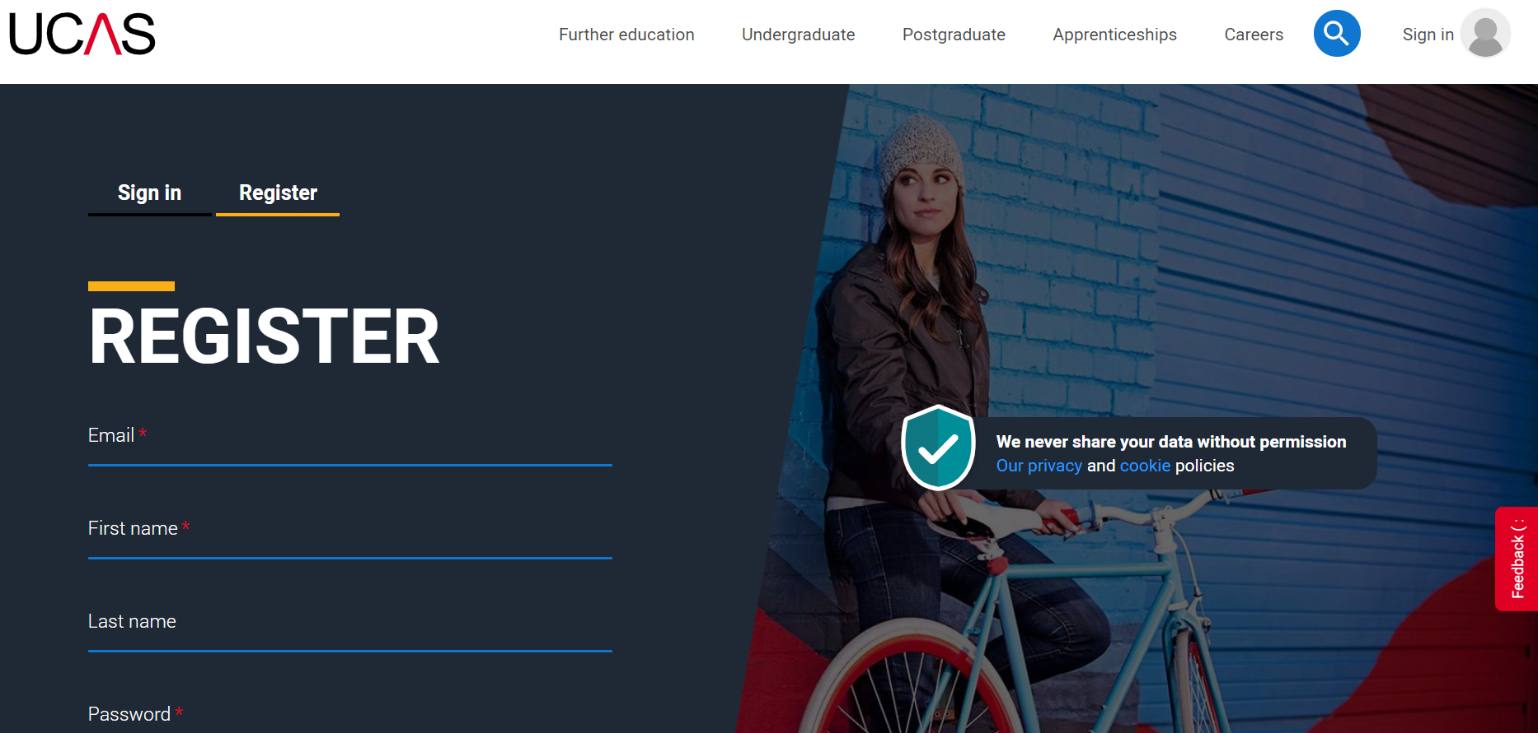
Google “register for UCAS” and select the link titled “UCAS Hub – sign up today”

Slide 7
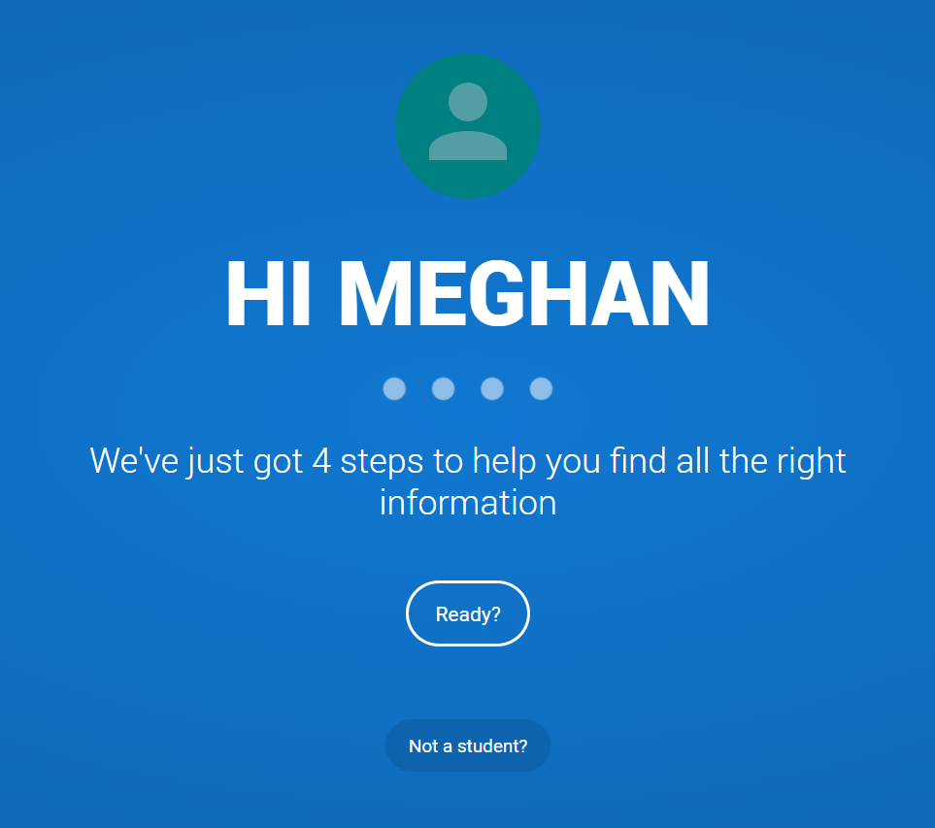

Slide 8
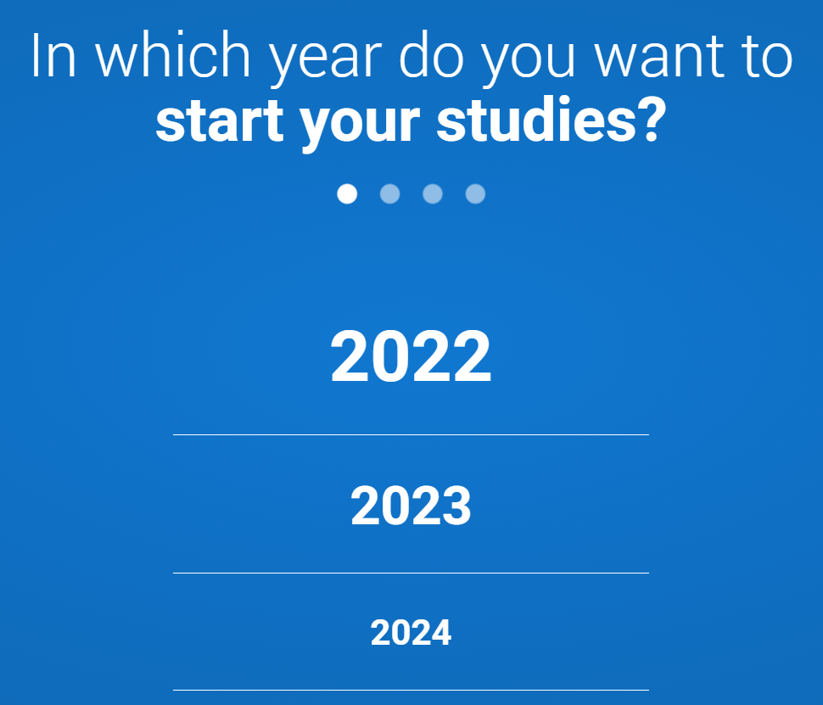

Slide 9
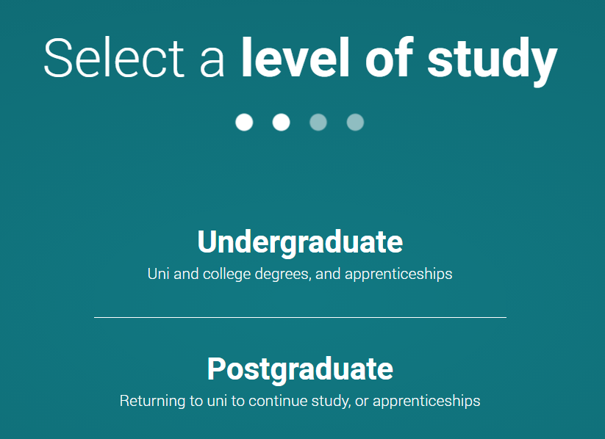

Slide 10
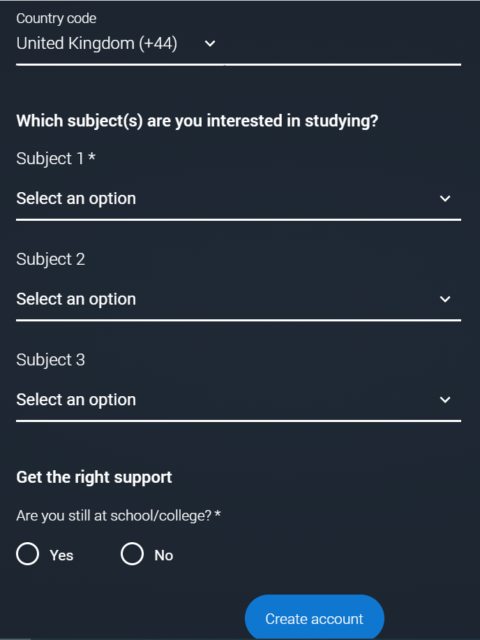

Slide 11
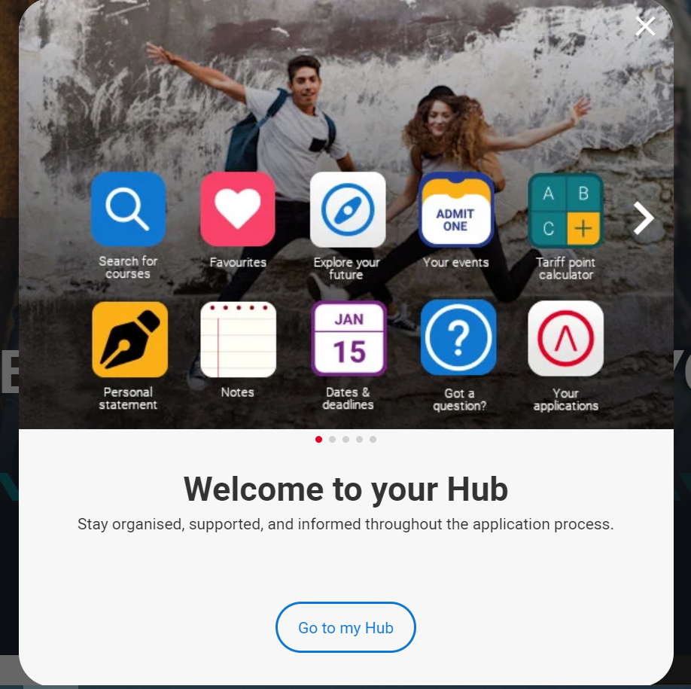

Slide 12
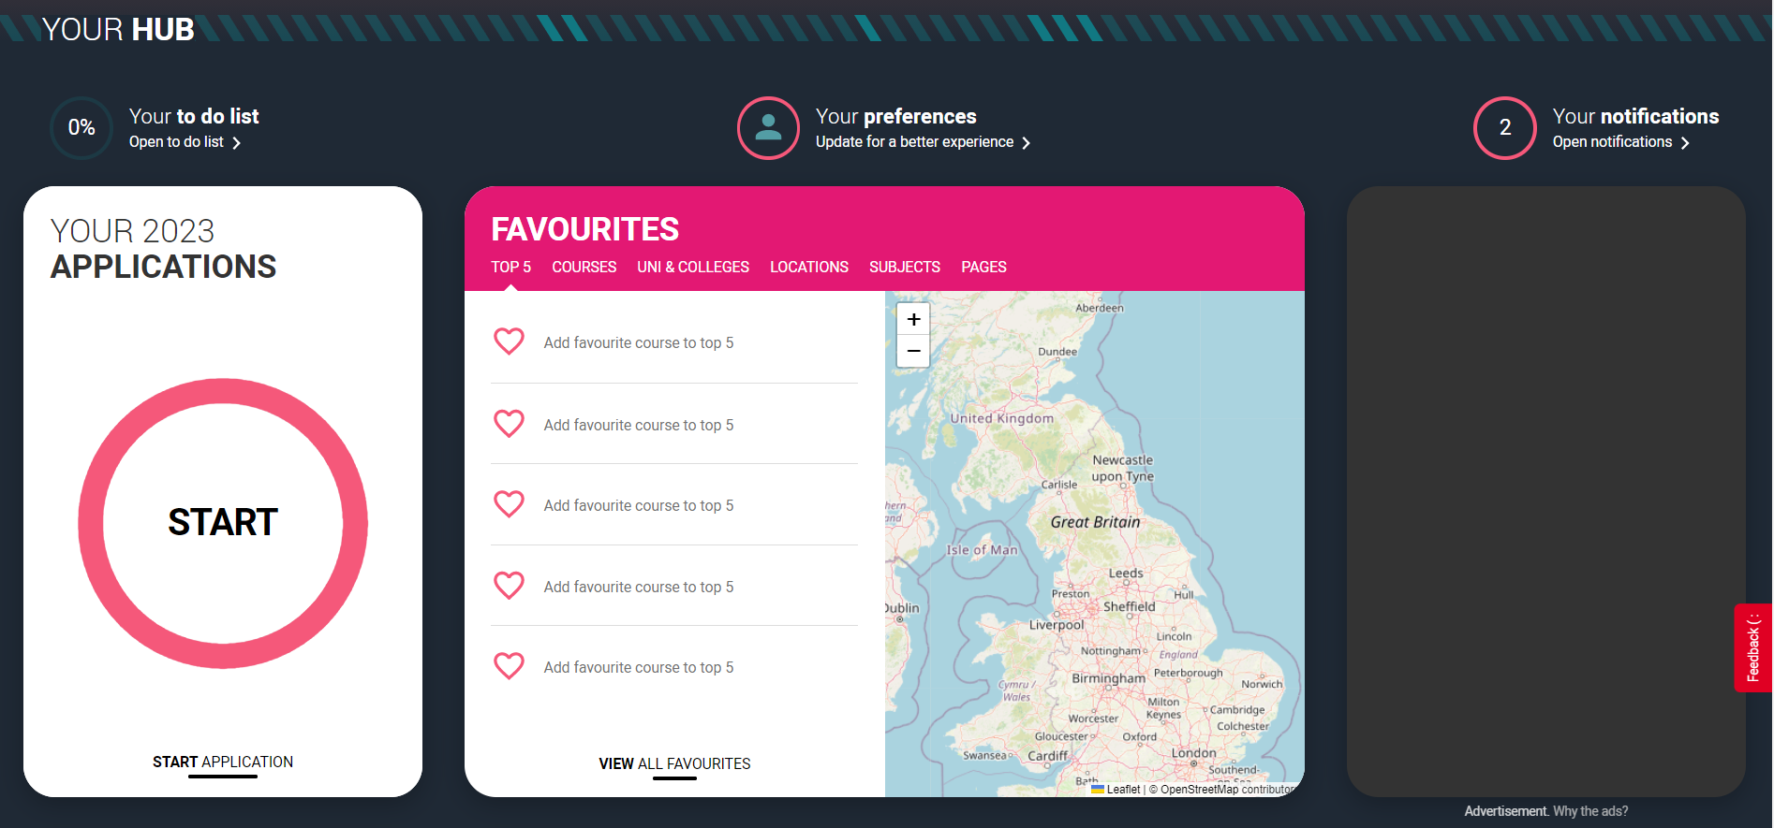

Slide 13
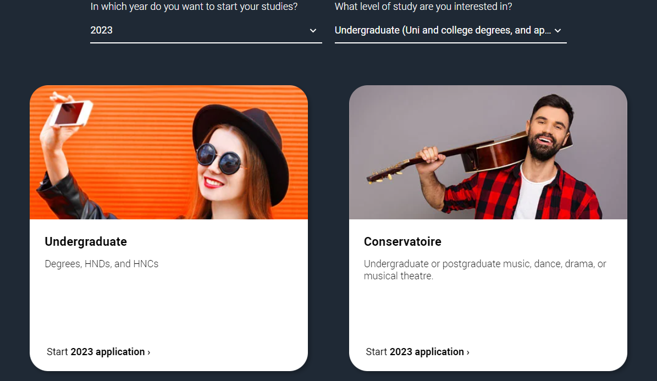

Slide 14
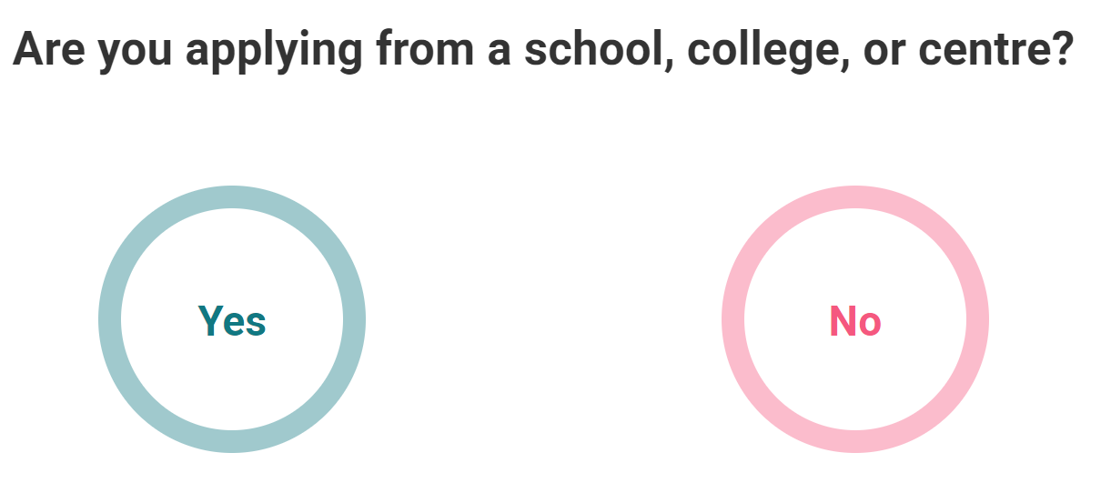

Slide 16
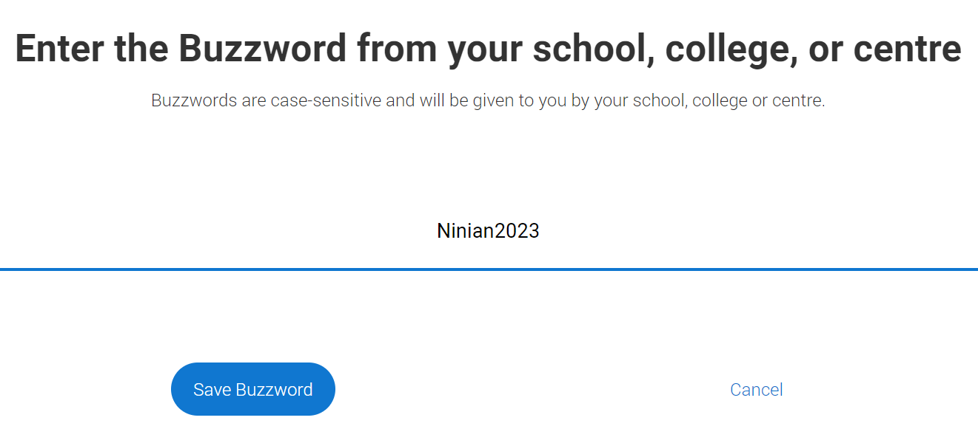
Ninian2023

Slide 17
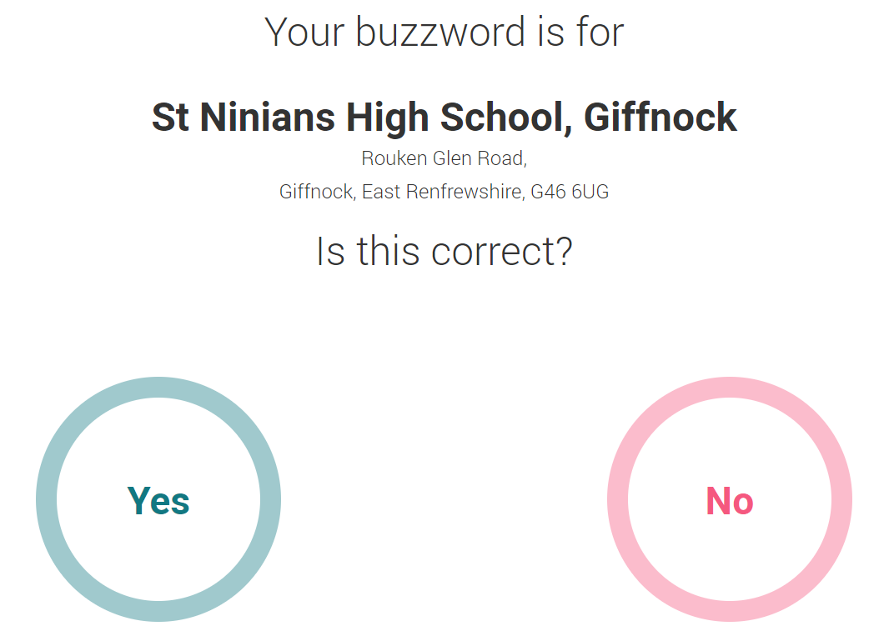

Slide 18
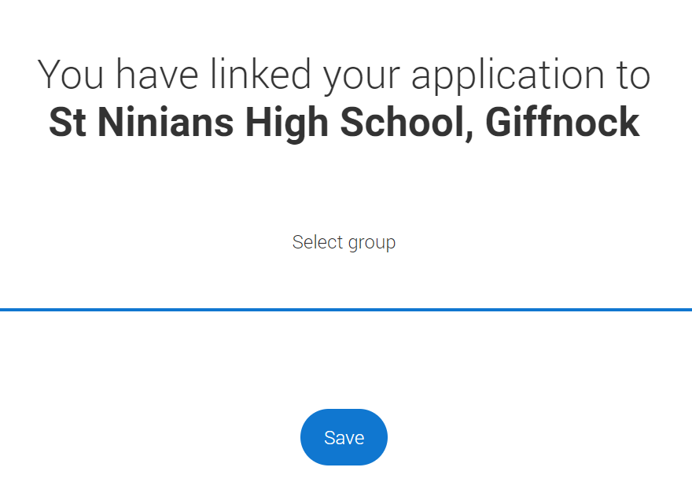

Slide 19
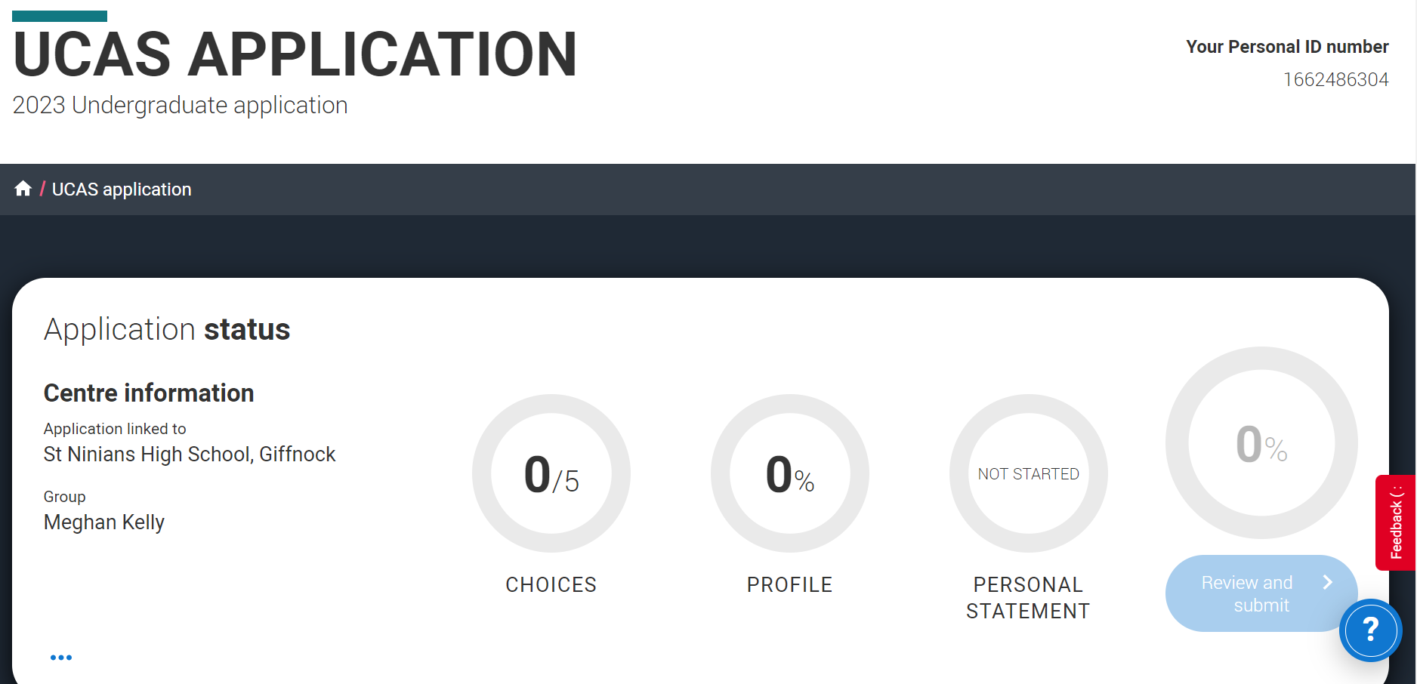

Slide 20
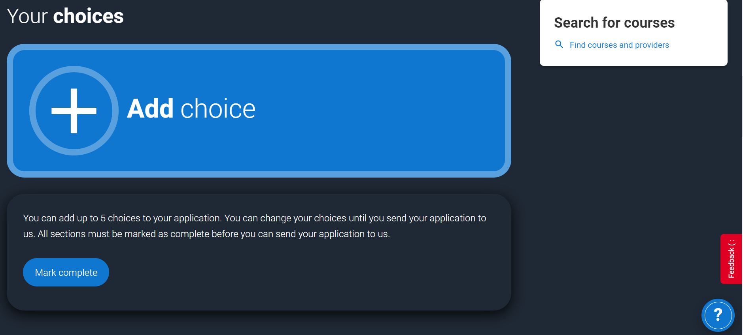

Slide 21
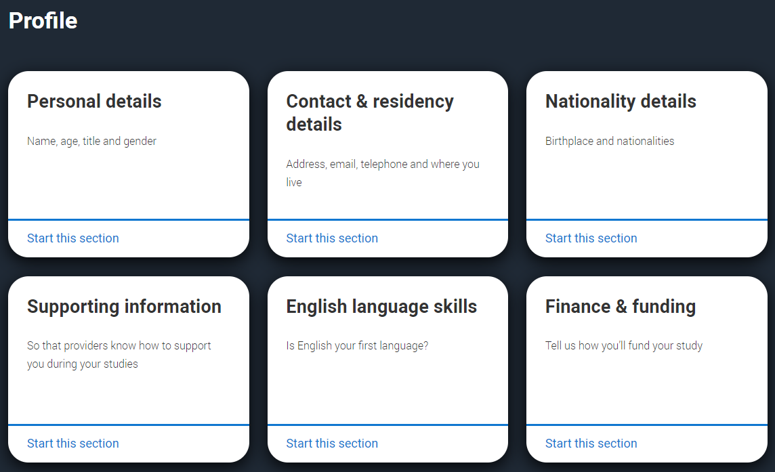
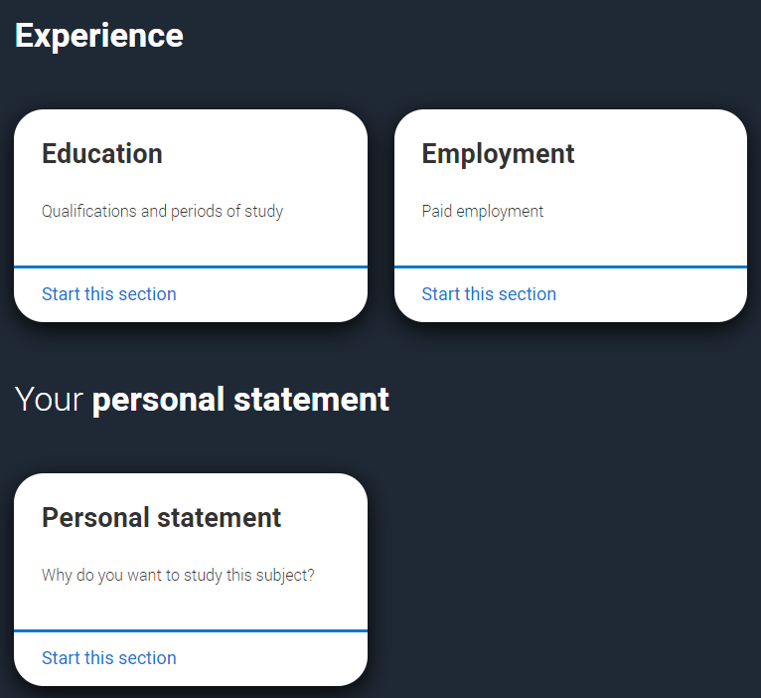

Slide 22
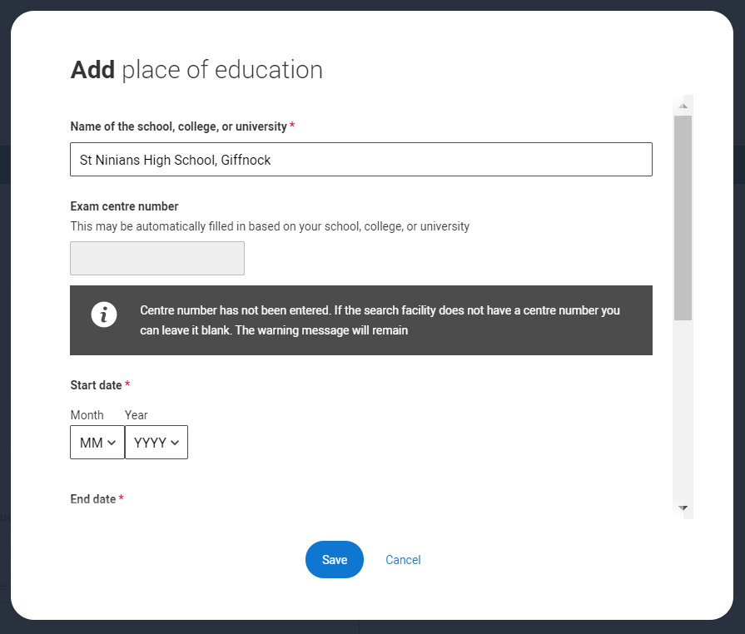

Slide 23
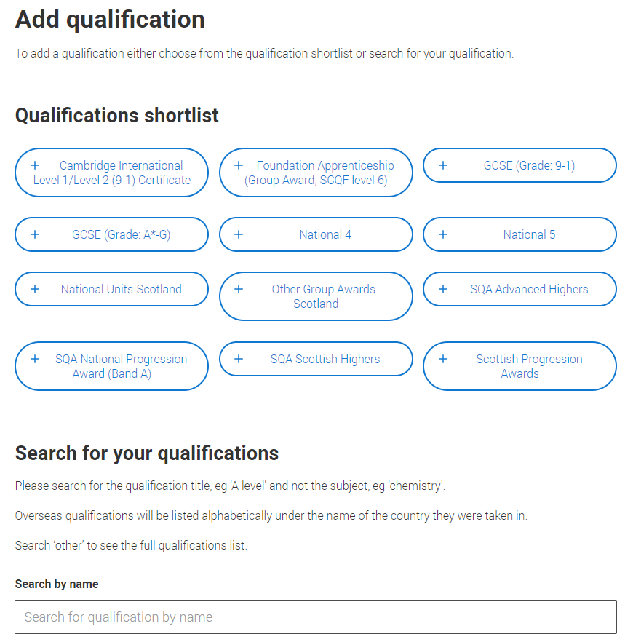

Slide 24
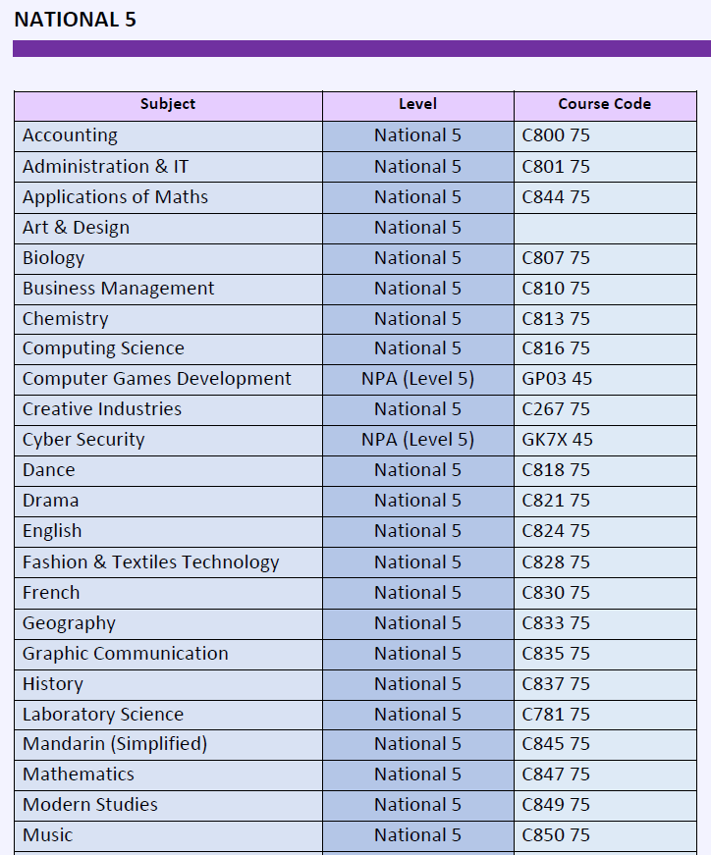
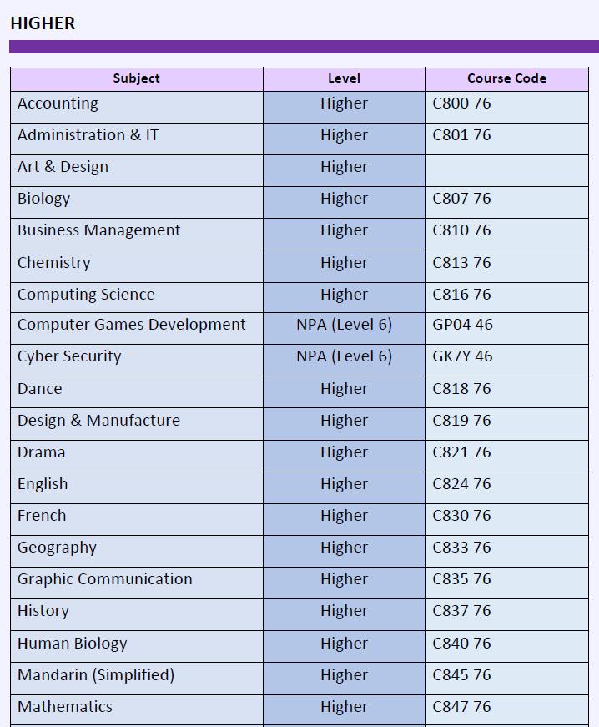
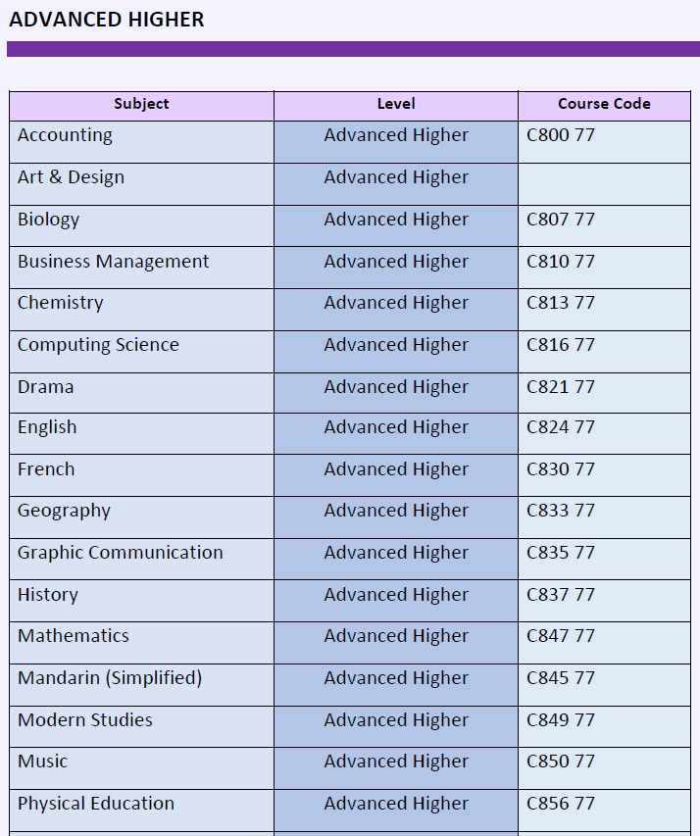
Course Codes
Accessible on UCAS Teams page

Slide 25
Writing Your Personal Statement
(also available on UCAS Teams page)

Slide 26
What is the purpose of the Personal Statement?
The personal statement gives you the opportunity to tell the university why they should pick you above all the other candidates
You must give the best account of yourself!

Slide 27
Getting started
Do your research!
Check entry requirements
Check what skills are required
Everything in your personal statement should aim to show that you have the skills and qualities they are looking for

Slide 28
Structure
Paragraph 1 – Why you have chosen this subject/course
Paragraph 2 – Academic Skills
Paragraph 3 – Personal Skills: Work experience, Volunteering
Paragraph 4 – Personal Skills: Extracurricular/ Interests
Paragraph 5 - Conclusion

Slide 29
Opening Paragraph
Why you want to study the course
It should give convincing reasons for your choice of course and show that serious research has been undertaken into the subject
Show enthusiasm, interest, excitement
Avoid dramatic openings/clichés

Slide 30
What makes you suitable to study the subject?
Paragraph 2
Academic skills
Don’t list your subjects and grades
You must identify the skills you have developed and provide evidence of these

Slide 31
Subject Course Specifications

Slide 32
Evidencing Skills
Example: Medicine
Through studying Biology and Chemistry to Advanced Higher level, I have acquired and honed a suite of skills essential for a successful career in Medicine. By participating in investigative experimental work, I have developed an understanding of the importance of problem solving as an essential life skill that enables me to apply my learning to complex real world situations to arrive at the best possible solution.

Slide 33
Example: English Literature
Through studying English to Advanced Higher level, I have developed a robust and refined skillset that will stand me in excellent stead for pursuing an undergraduate degree in English Literature. I am an avid reader and I am well-versed in multiple genres, possessing a broad vocabulary and utilising critical terminology appropriately. I have refined my skills in critical analysis and can effectively carry out detailed, balanced and meticulous examination of texts to present well-articulated ideas on what I have read.

Slide 34
Example: Business
The Advanced Higher Business course presents me with the opportunity to improve my proficiency by working independently on a project. Through the research and project work that I have undertaken, I have developed my knowledge and understanding of effective project management and can apply relevant skills and knowledge to achieve specific project objectives. I have also had the opportunity to develop strong critical thinking and analytical skills, carrying out effective data analysis to evaluate the outcome and success of a given project and devise the most suitable next steps for taking the work forward.

Slide 35
How will you contribute to the course and the university community and what makes you an interesting and unique individual?
Paragraph 3 - Personal Skills
Work Experience
Volunteering/S6 Service
Paragraph 4 – Extracurricular (both in and outwith school)/Interests/Part time work
Your interests outside of school, particularly those that show you are a responsible and reliable person able to work well as part of a team as well as independently.
What makes you stand out?

Slide 36
Conclusion
Commitment to course not profession
What research you have undertaken (open days, prospectuses, discussions etc) that has helped inform your choice and application.
Demonstrate that you will be hardworking
Understand the demands of life at university
Closing statement –summarise your suitability and interest for the course
E.g. “If successful in my application, I will strive to be fully committed to the course, and intend to live up to the high standards which I have set myself. I look forward to the challenges that university will bring.”

Slide 37
What to Avoid
Mentioning a particular University
Exaggerating
Arrogance
Waffling or flowery language
Poor spelling and grammar
Clichés
Plagiarism – UCAS uses software that will identify sections of text that have been copied

Slide 38
Limit
4000 characters including spaces or 47 lines
Whichever one comes first
You need to be concise

Slide 39
Summary
Show that you know your strengths and can outline your ideas clearly
Use words you know will be understood by the person reading your statement
Be enthusiastic – if you show your interest in the course, it may help you get a place
Expect to produce several drafts of your personal statement before being totally happy with it
Ask people you trust for their feedback.

Slide 40
What pupils need to do
Conduct thorough research on courses and universities/colleges
Prepare well – organise your time to dedicate sufficient effort to personal statement
Keep up-to-date with announcements on S6 UCAS Teams page
Stick to the timeline!!!
Liaise closely with your Pastoral Support Teacher
Take responsibility – this is your application and your future

