Slide 1
Work Experience 2018 NHS Information Meeting

Slide 2
A variety of placements are available within the NHS.
www.nhscareers.nhs.uk
may help you in identifying career choices.

Slide 3
List of Departments In Hospital
Allergy services in hospital
Cardiology
Cardiothoracic surgery
Children's & Adolescent Services
Dentistry and Orthodontics
Dermatology
Diabetic Medicine
Ear, Nose & Throat
Endocrinology and Metabolic Medicine

Slide 4
Gastrointestinal and Liver services
General Surgery
Genito-Urinary Medicine
Geriatric Medicine
Gynaecology
Haematology
Infectious Diseases
Interventional Radiology
Mental Health - Adults of all ages
Mental Health - Child and Adolescent

Slide 5
Neurology
Neurosurgery
Obstetrics
Ophthalmology
Orthopaedics
Orthotics and Prosthetics
Palliative Medicine
Physiotherapy
Respiratory Medicine
Rheumatology
Vascular surgery

Slide 6
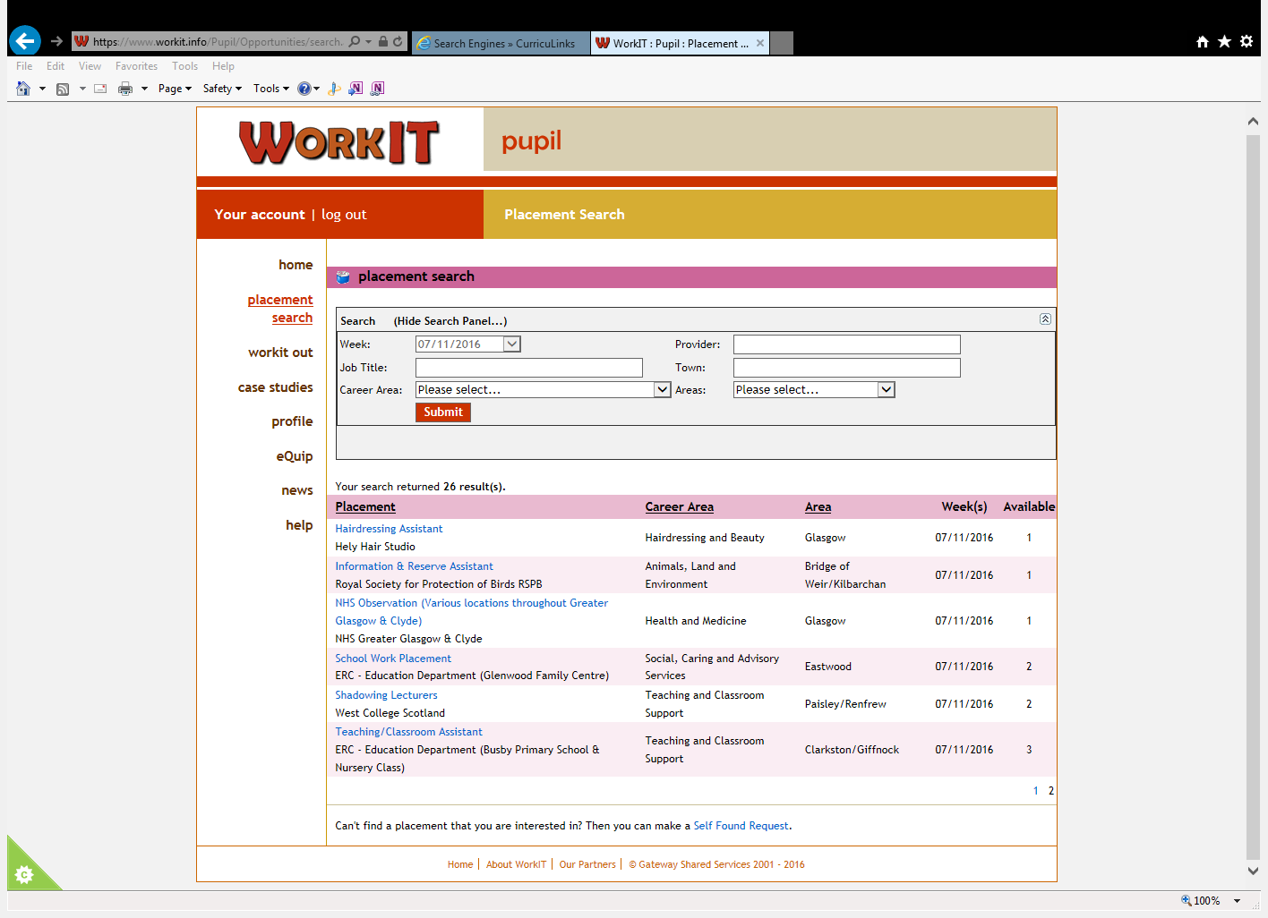
All Greater Glasgow NHS work experience placements (self-found and requested) must be applied for on the Workit website
Click on the placement search and select NHS observation:-

Slide 7
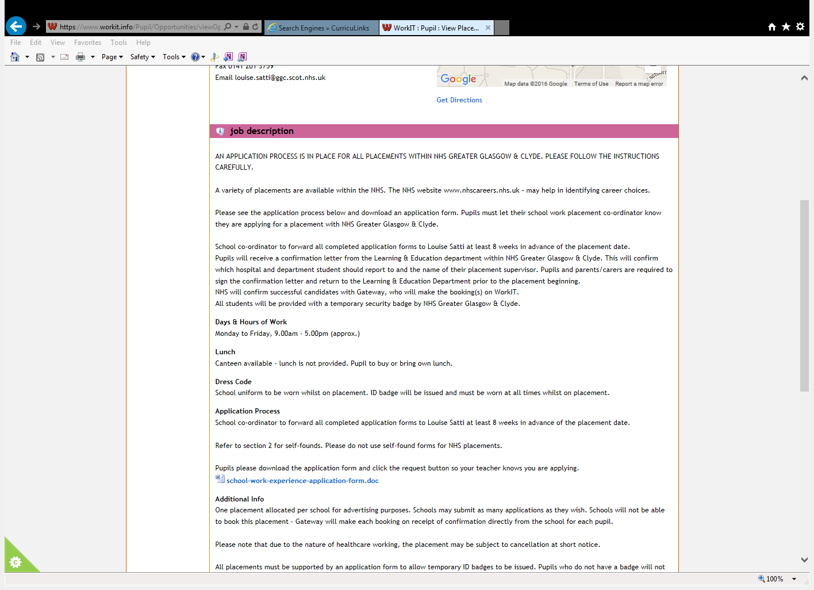
Read the job description carefully and then click the Word document:- NHS Greater Glasgow application form July16.docx to download the application form

Slide 8
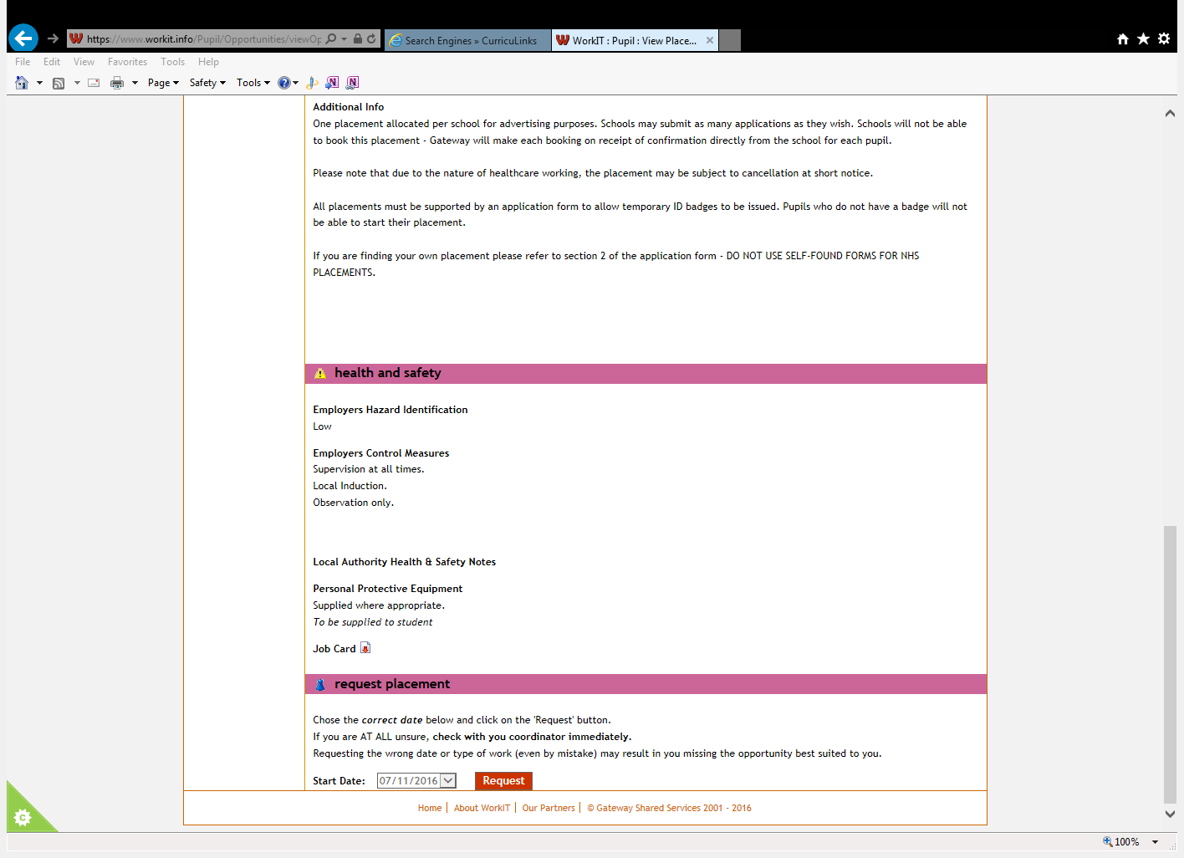
You must click the request button at the bottom of the page so that the school knows you have applied.

Slide 9
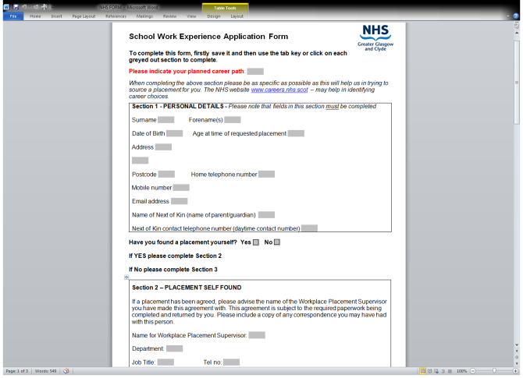
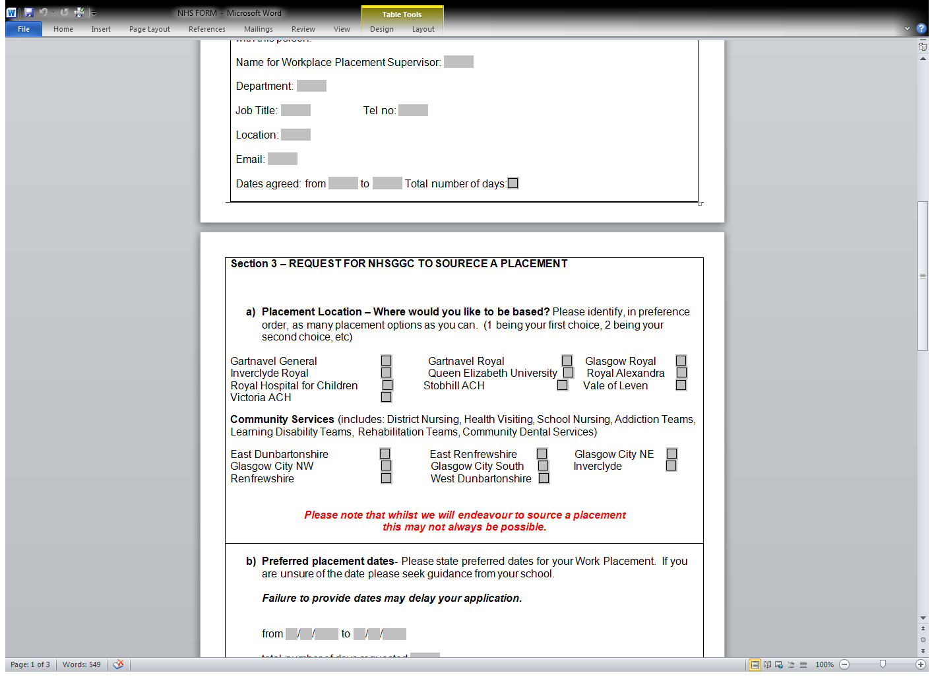
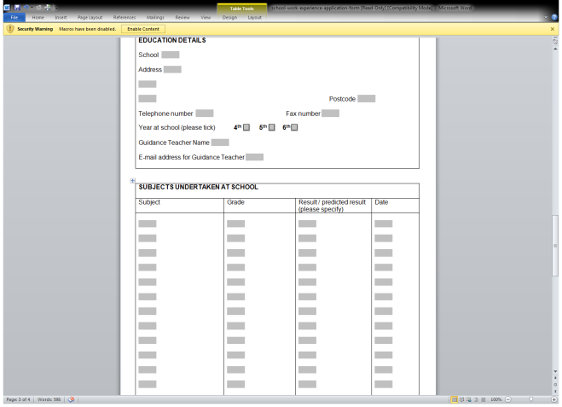
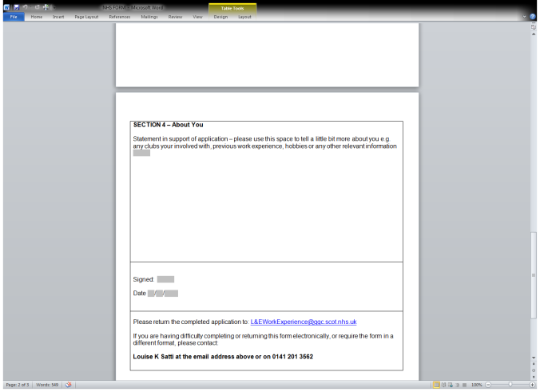
Fill in the form, it always helps to have someone else read over your completed form.

Slide 10
Completed application forms must be submitted by e-mail to :-
workexperience@ggc.scot.nhs.uk
You must cc St Ninian’s at time of submission
SchoolMail@st-ninians.e-renfrew.sch.uk
If for any reason you cannot e-mail the form, fill it out by hand and pass it to the school office where Mrs McLuskie will submit it for you.

Slide 11
If you are making a Placement Request please remember to have some back-up options as unfortunately it is common for requests to be declined.
Self-Found placements are often only for part of the week as a consultant/department will only be able to offer you a few hours. You will need to find another placement for the days when you are not with the NHS.
REMEMBER – GP’s, Dental Practices, Physiotherapist practices etc… are not NHS placements for the purpose of Work Experience.

Slide 12
Enjoy your placement!

