Slide 1


St Ninian’s High School
Faculty of Performing Arts
S2 Pupil Experience in Music
September 2021

Slide 2
Music Department Vision
The St Ninian’s High School Music Department aims to: -
include everyone in a vibrant musical culture
enable all students to realise their own artistic ambitions and aspirations regardless of whether or not they have previously played an instrument.

Slide 3
Music Department Vision
Curriculum is performance orientated and puts music making at the centre of all our lessons.
Students will set their own goals and targets as well as having a say in how their curriculum works through personalisation and choice of instruments and repertoire.
S2 and beyond, students will develop instrumental skills on Xylophone, Keyboard, Guitar, Bass Guitar and Drum Kit.
Option to further develop their skills in class if they play a traditional instrument, orchestral instrument or piano.
They will start to explore how to compose creatively, develop their skill of improvisation and how to work as a group, ultimately developing team work skills and confidence.

Slide 4
CfE Expressive Arts – Music
Performing (the absolute core of all activities)
  Solo
  Group
Composing
  Improvising
  Composition
Understanding Music
  Musical Literacy
  Identifying a range of features and concepts in solo and group performances
  Cultural influences on music

Slide 5
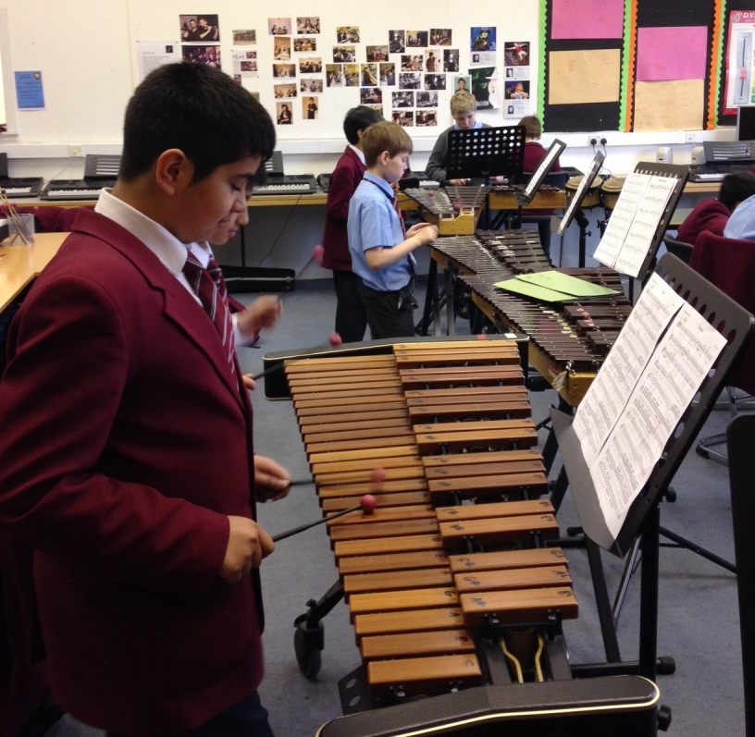
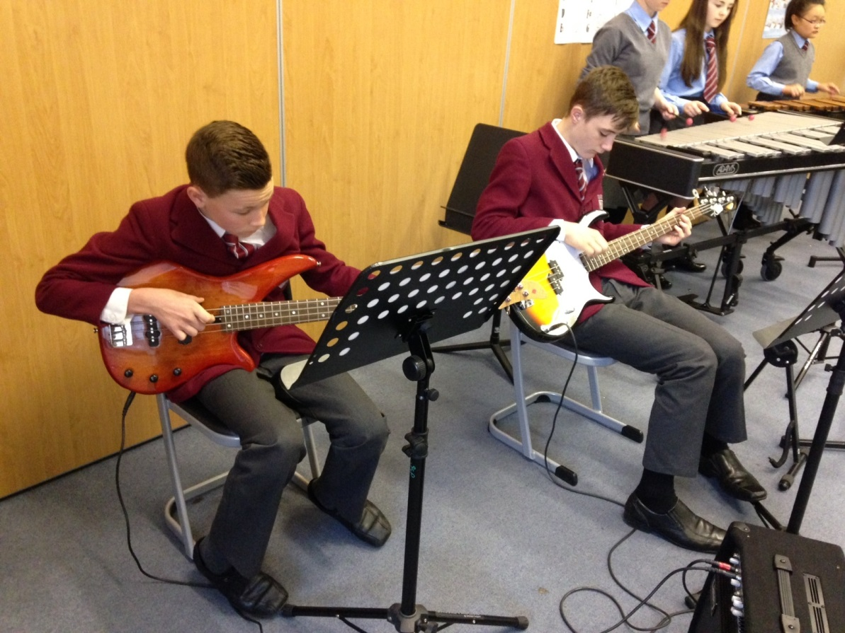
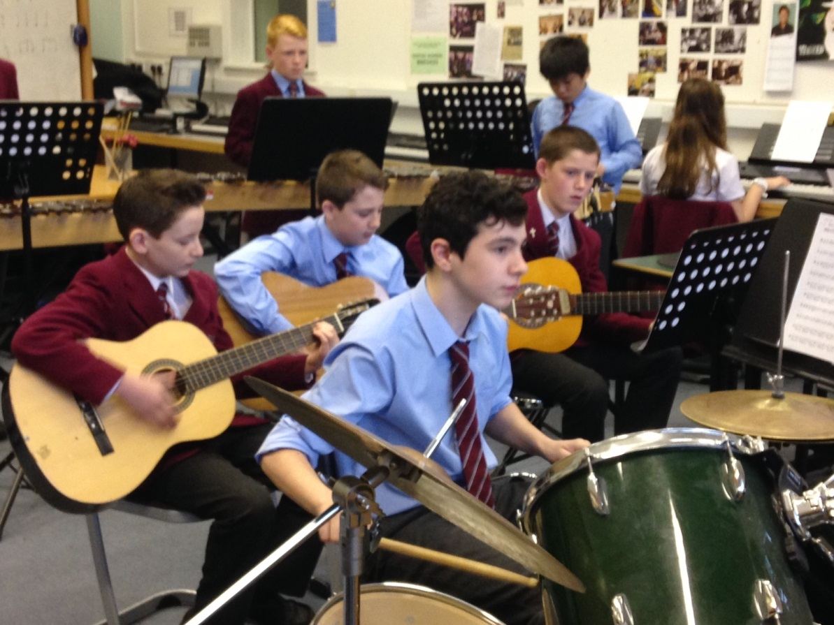
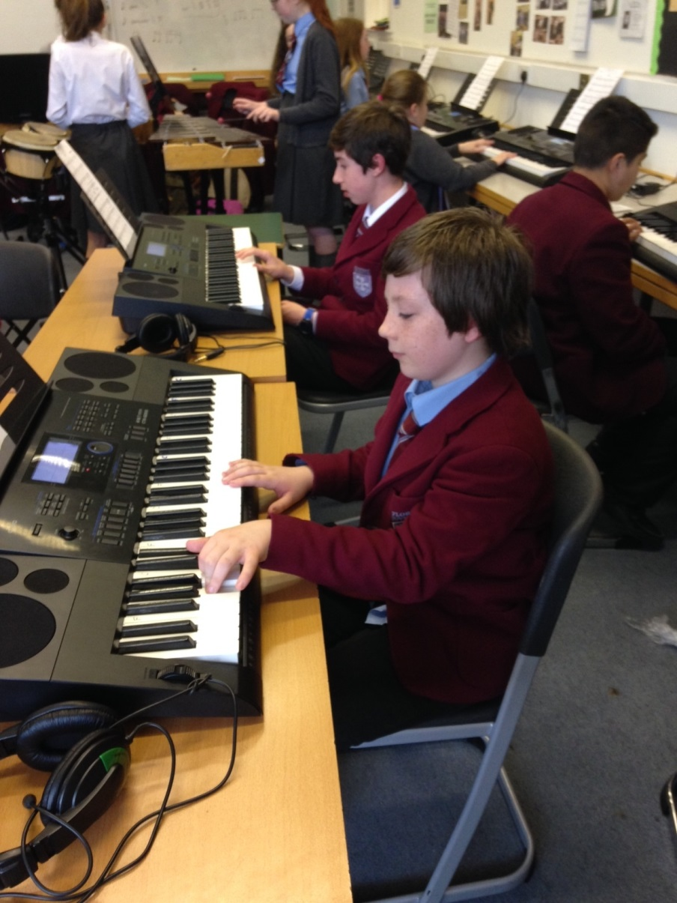

Slide 6
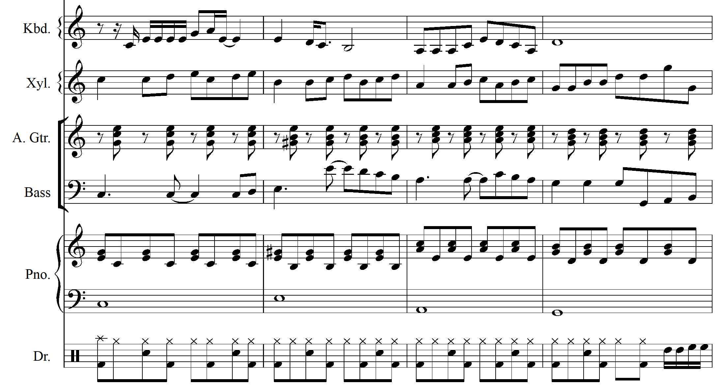
Billionaire
Key – C major
Sequence
Broken Chord
Scotch snap
Rests
Off beat chords
Drum fill

Slide 7
Homework
THERE IS HOMEWORK IN MUSIC.
Regular practice of instruments out of class
  Facilities in the department to do this
  After school
Follow up Listening Concepts explored in class
  Music concepts
Learn Musical Literacy taught in class

Slide 8
Assessment
Continuous
Regular Performance classes
Recordings – video and audio

Slide 9
Co-curricular
(Not just for instrumentalists)
Wind Band
Ceilidh Band
Keyboard Club
Symphony Orchestra
Sing
String Orchestra
Percussion Ensemble
Brass Ensemble
Guitar Ensemble

Slide 10
Follow us on Twitter
@snhsmusicdrama

