Slide 1
Nat 5 Practical Cookery Study skills

Slide 2
Table of contents
1
2
3
Assignment
Each component of assessment will consist of an explanation and some tips on how to study for each of them.
Practical
Question Paper
4
Revision Techniques
Notes:
These slides will cover the following topics of the practical cookery course assessments, the assignment, the practical activity and the question paper

Slide 3
Components of the Course Assessment
1
3
2
Assignment
Practical
Question Paper
18 marks
Scaled mark 13
82 marks
Scaled mark 62
1 hour duration
30 marks
Scaled mark 25
Notes:
The course assessment has three components with a total mark of 130 marks. To give a percentage of overall mark each component has to be scaled to a percentage of the course. The assignment is worth 18 marks, scaled to 13, the largest part of the assessment is the practical which is worth 82 marks and accounts for 62% of the marks, and finally the question paper which is out of 30 and scaled mark of 25.

Slide 4
1
Assignment
The Assignment consists of:
Time Plan - 10 Marks
Equipment List - 4 Marks
Service details - 4 Marks
This is carried out under exam conditions where you are given 1 hour 45 mins to complete the three components of the assignment.
The assignment is then sent to SQA for marking.
Notes:
The purpose of this is to assess candidates’ ability to plan, prepare and present a three course meal to a given specification within a given timescale. A brief specifies the three dishes to be produced. The assignment and practical assessment are inter-related. The assignment is the planning stage and with the making of the dishes the implementation stage. This is carried out under exam conditions where you are given 1 hour 45minutes to complete the three components of the assignment.
The assignment is then sent to SQA for marking. The time plan shows how and when you will carry out making each dish, the equipment requistion is where you list all the equipment necessary to successfully make the dishes and in the service details you will illustrate or describe how you will serve the dishes according the specification provided.

Slide 5
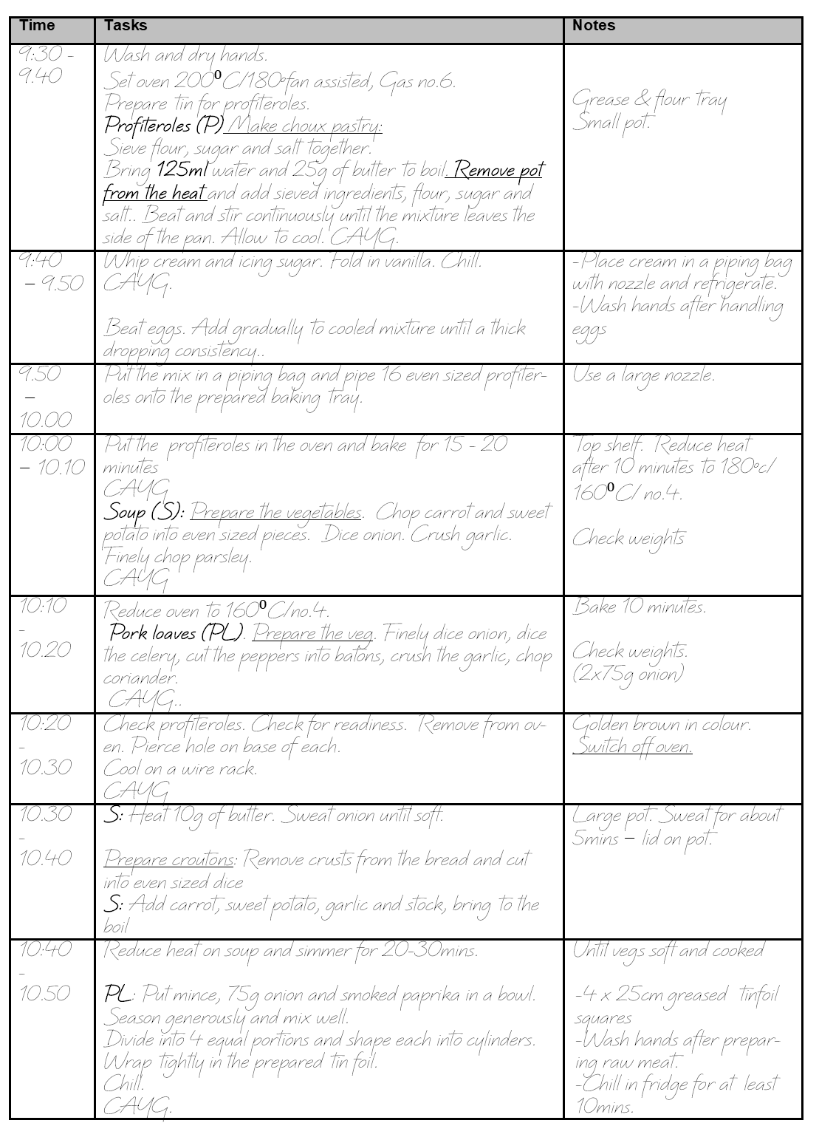
Time Plan
Purpose
Demonstrate your organisational skills and time management for producing a three course meal.
Logical sequence
Temperature control
Hygiene
Tasting for seasoning
Service
= 10 Marks
Notes:
In the time plan you show how you will organise your time to make the three dishes. Your plan should show a a logical sequence
Highlight temperature control
Take account of Hygiene procedures
Show where you are tasting for seasoning
When and how you will serve the dishes.
This part is worth 10 marks.
= 10 Marks

Slide 6
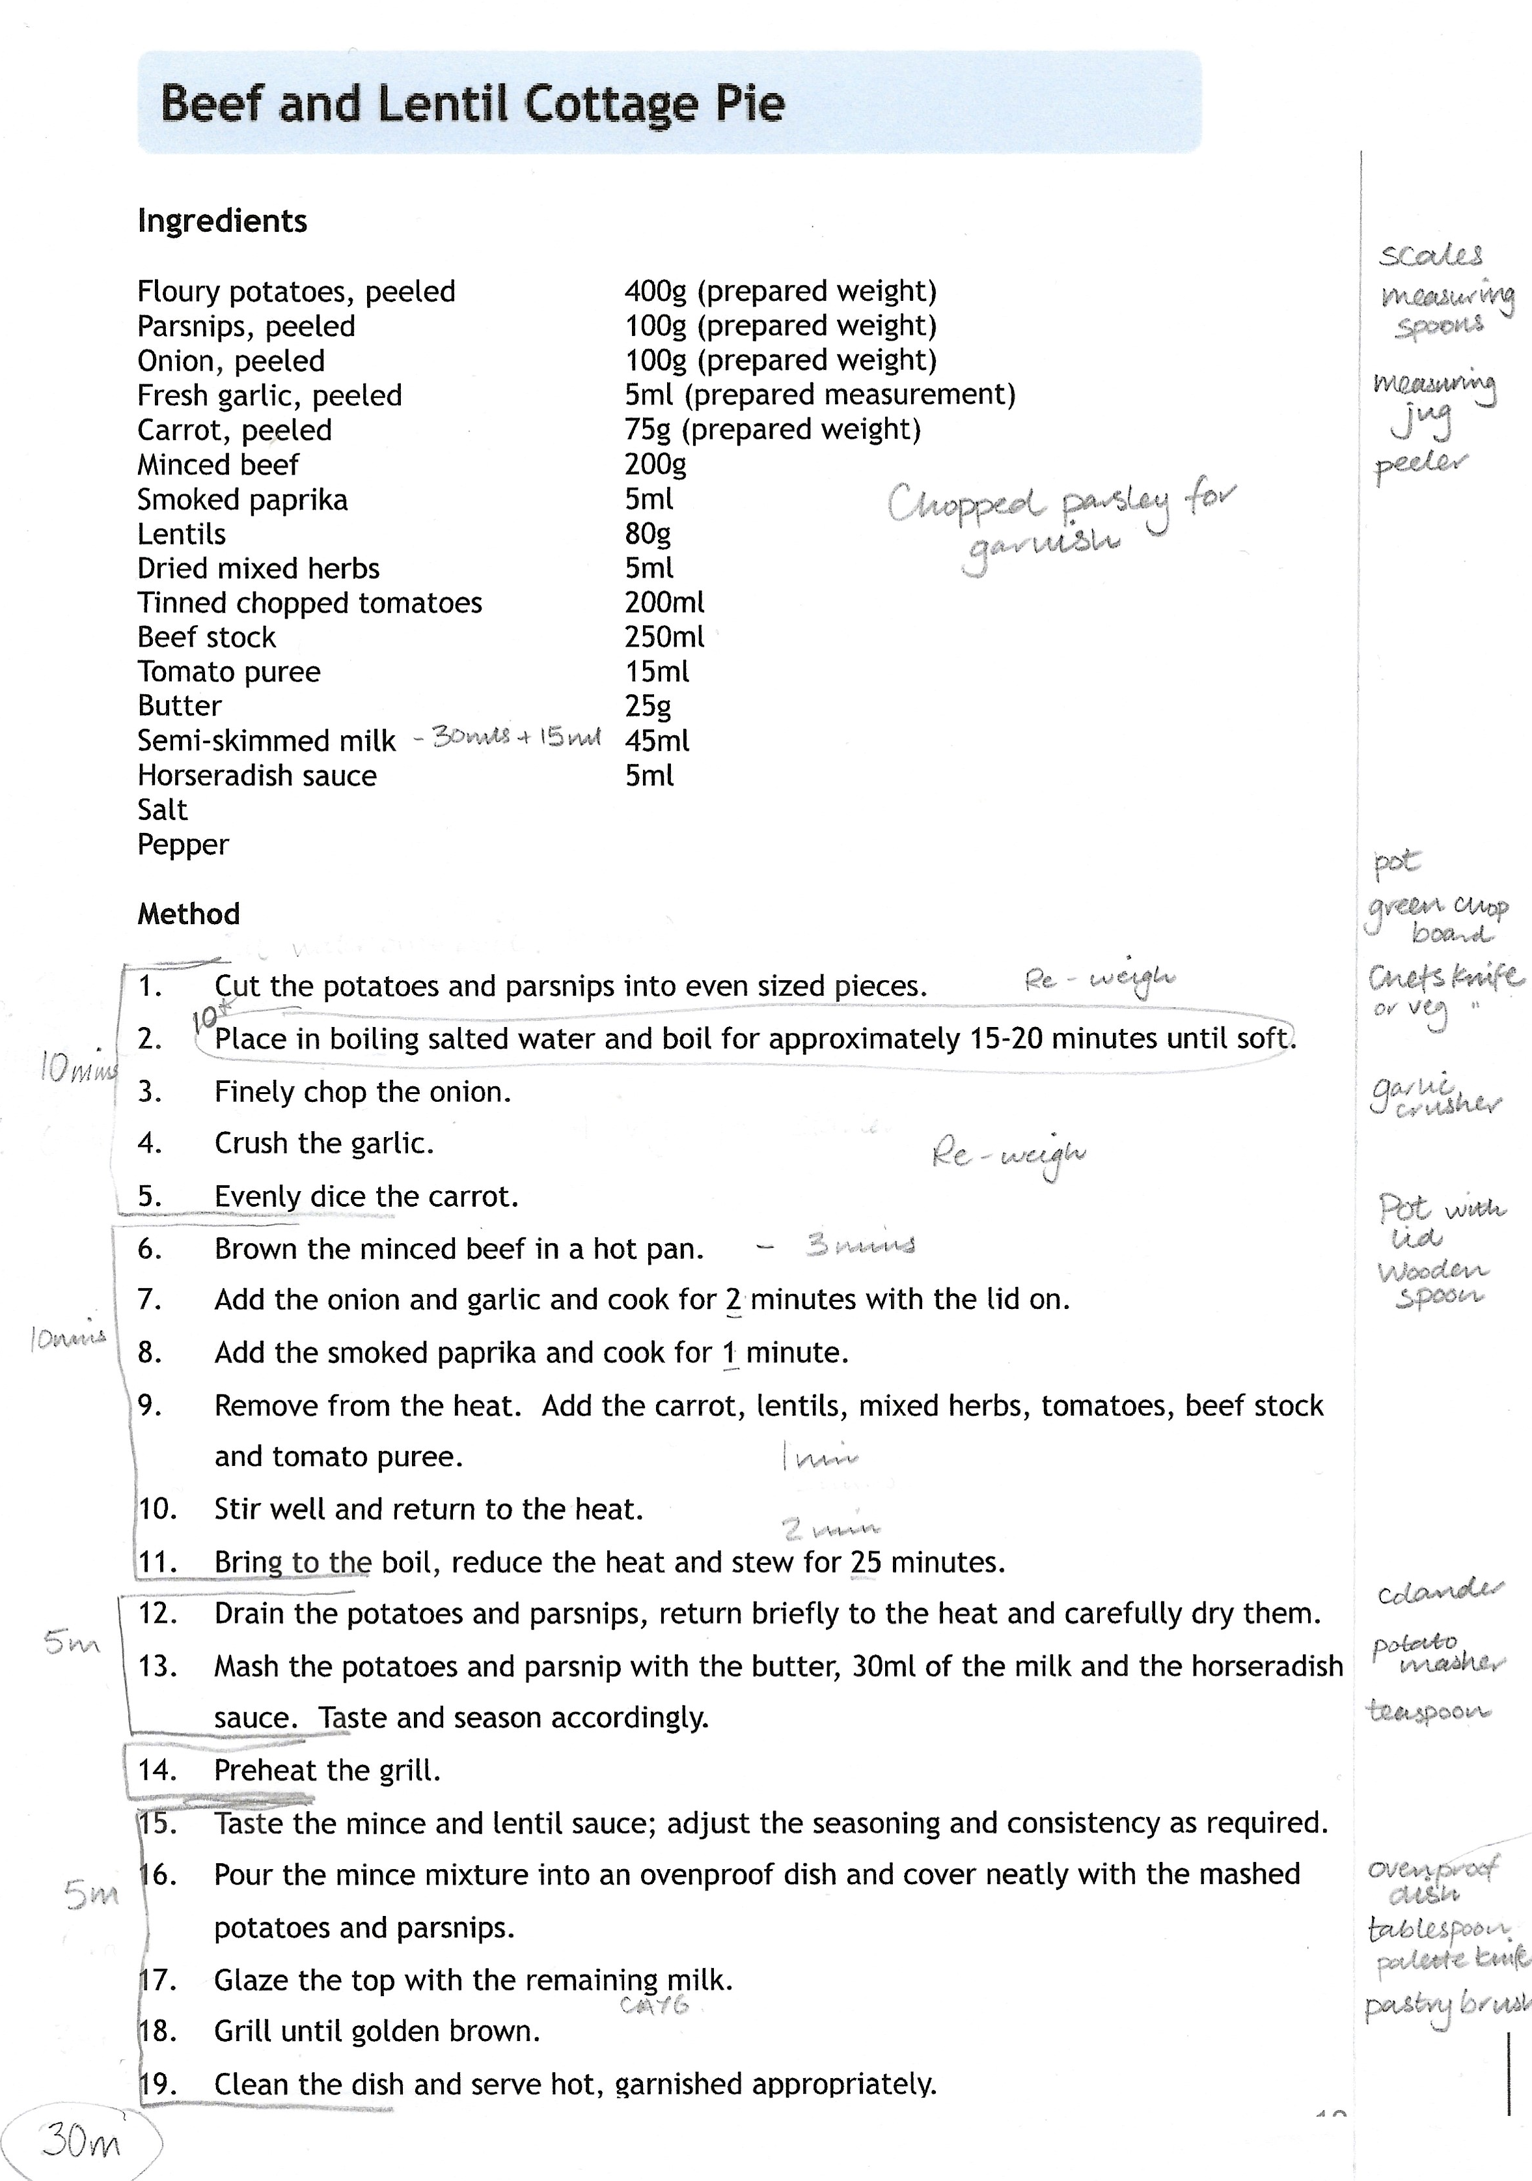
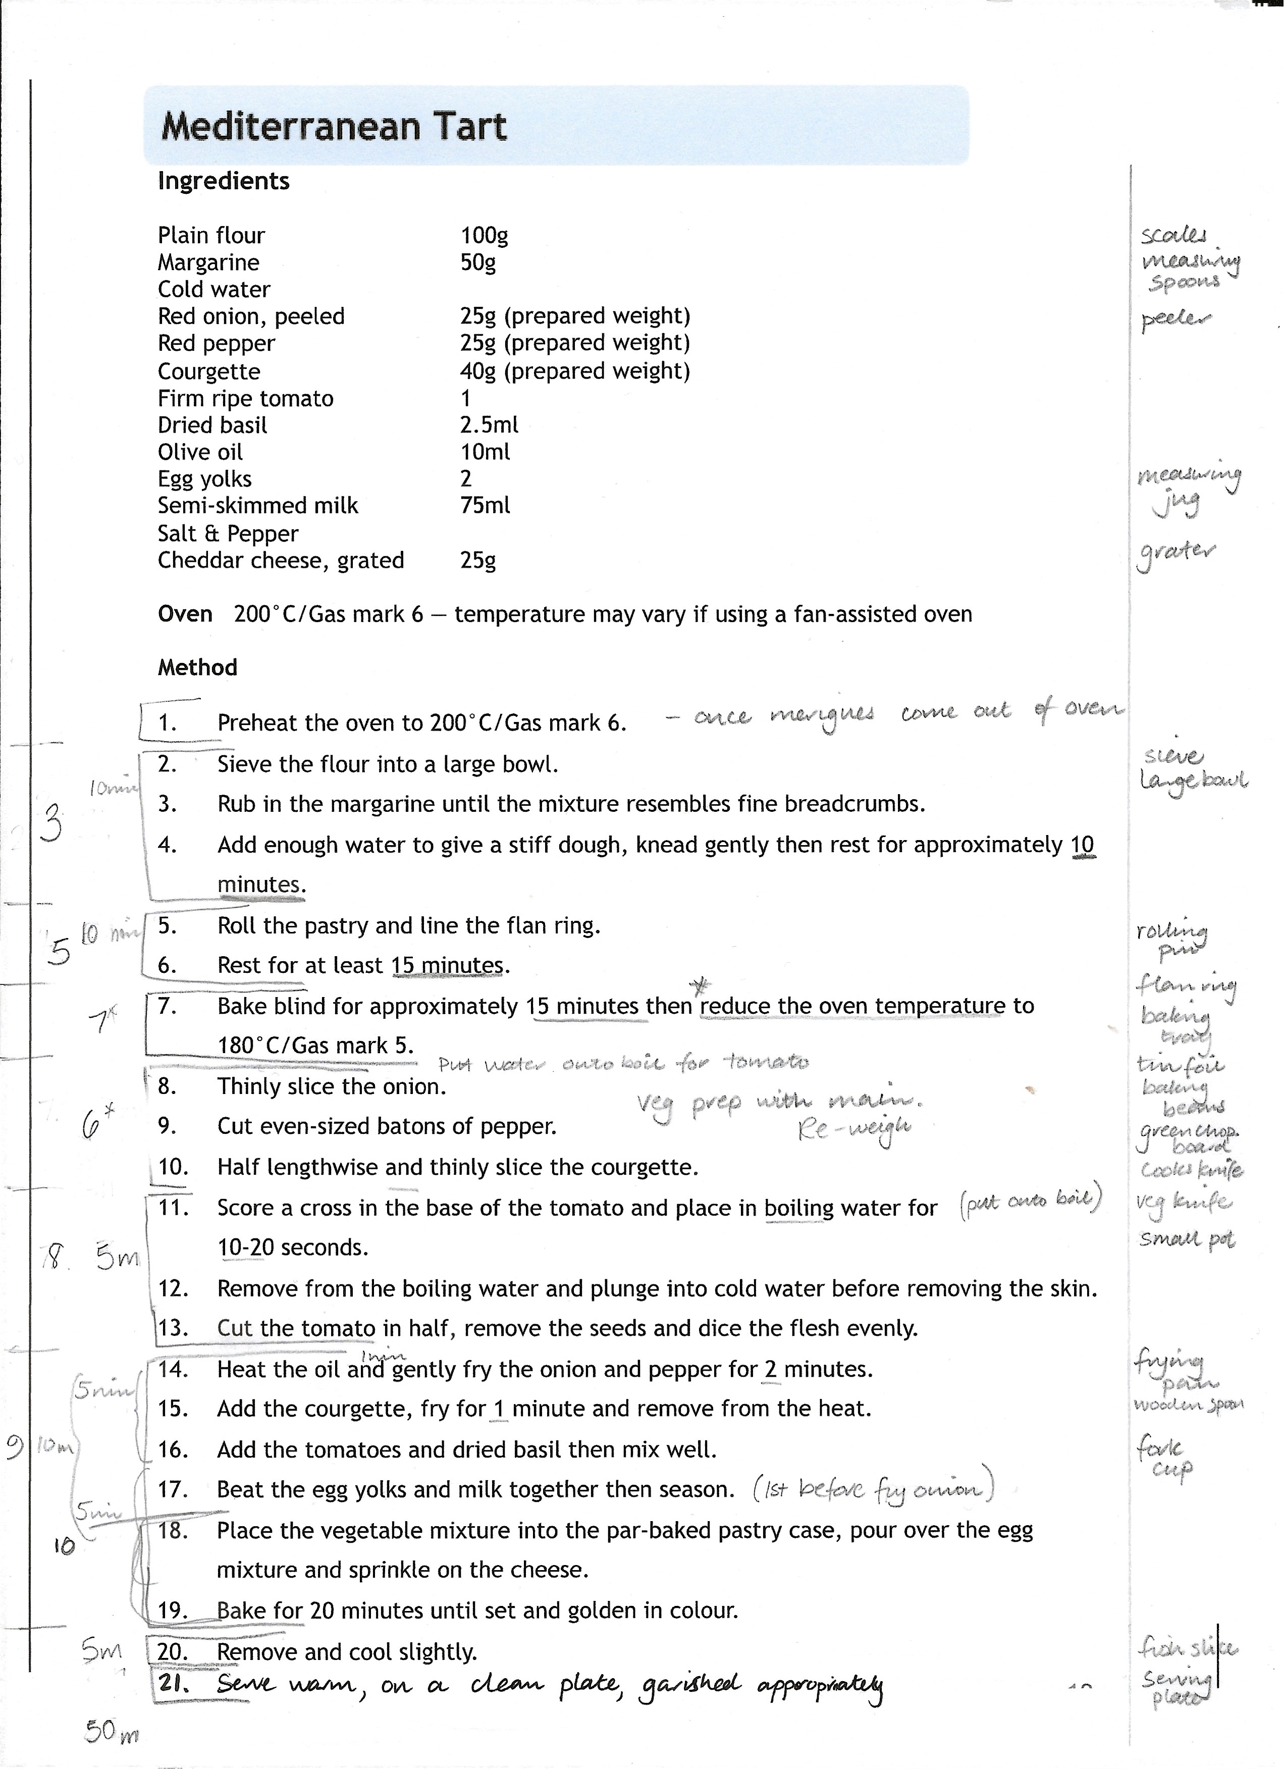
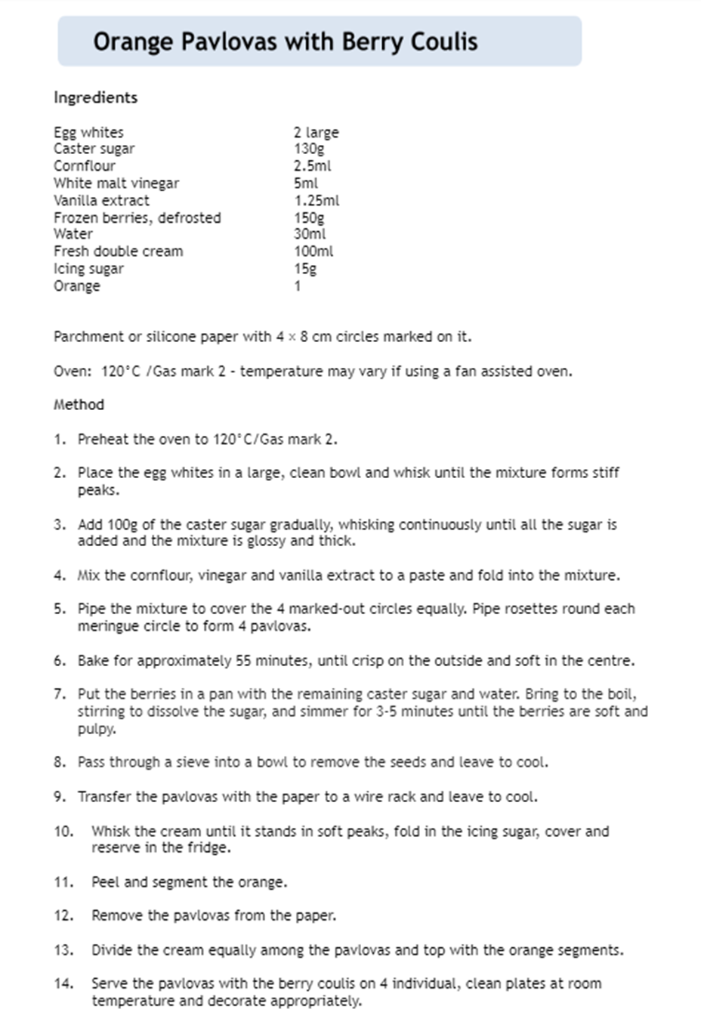
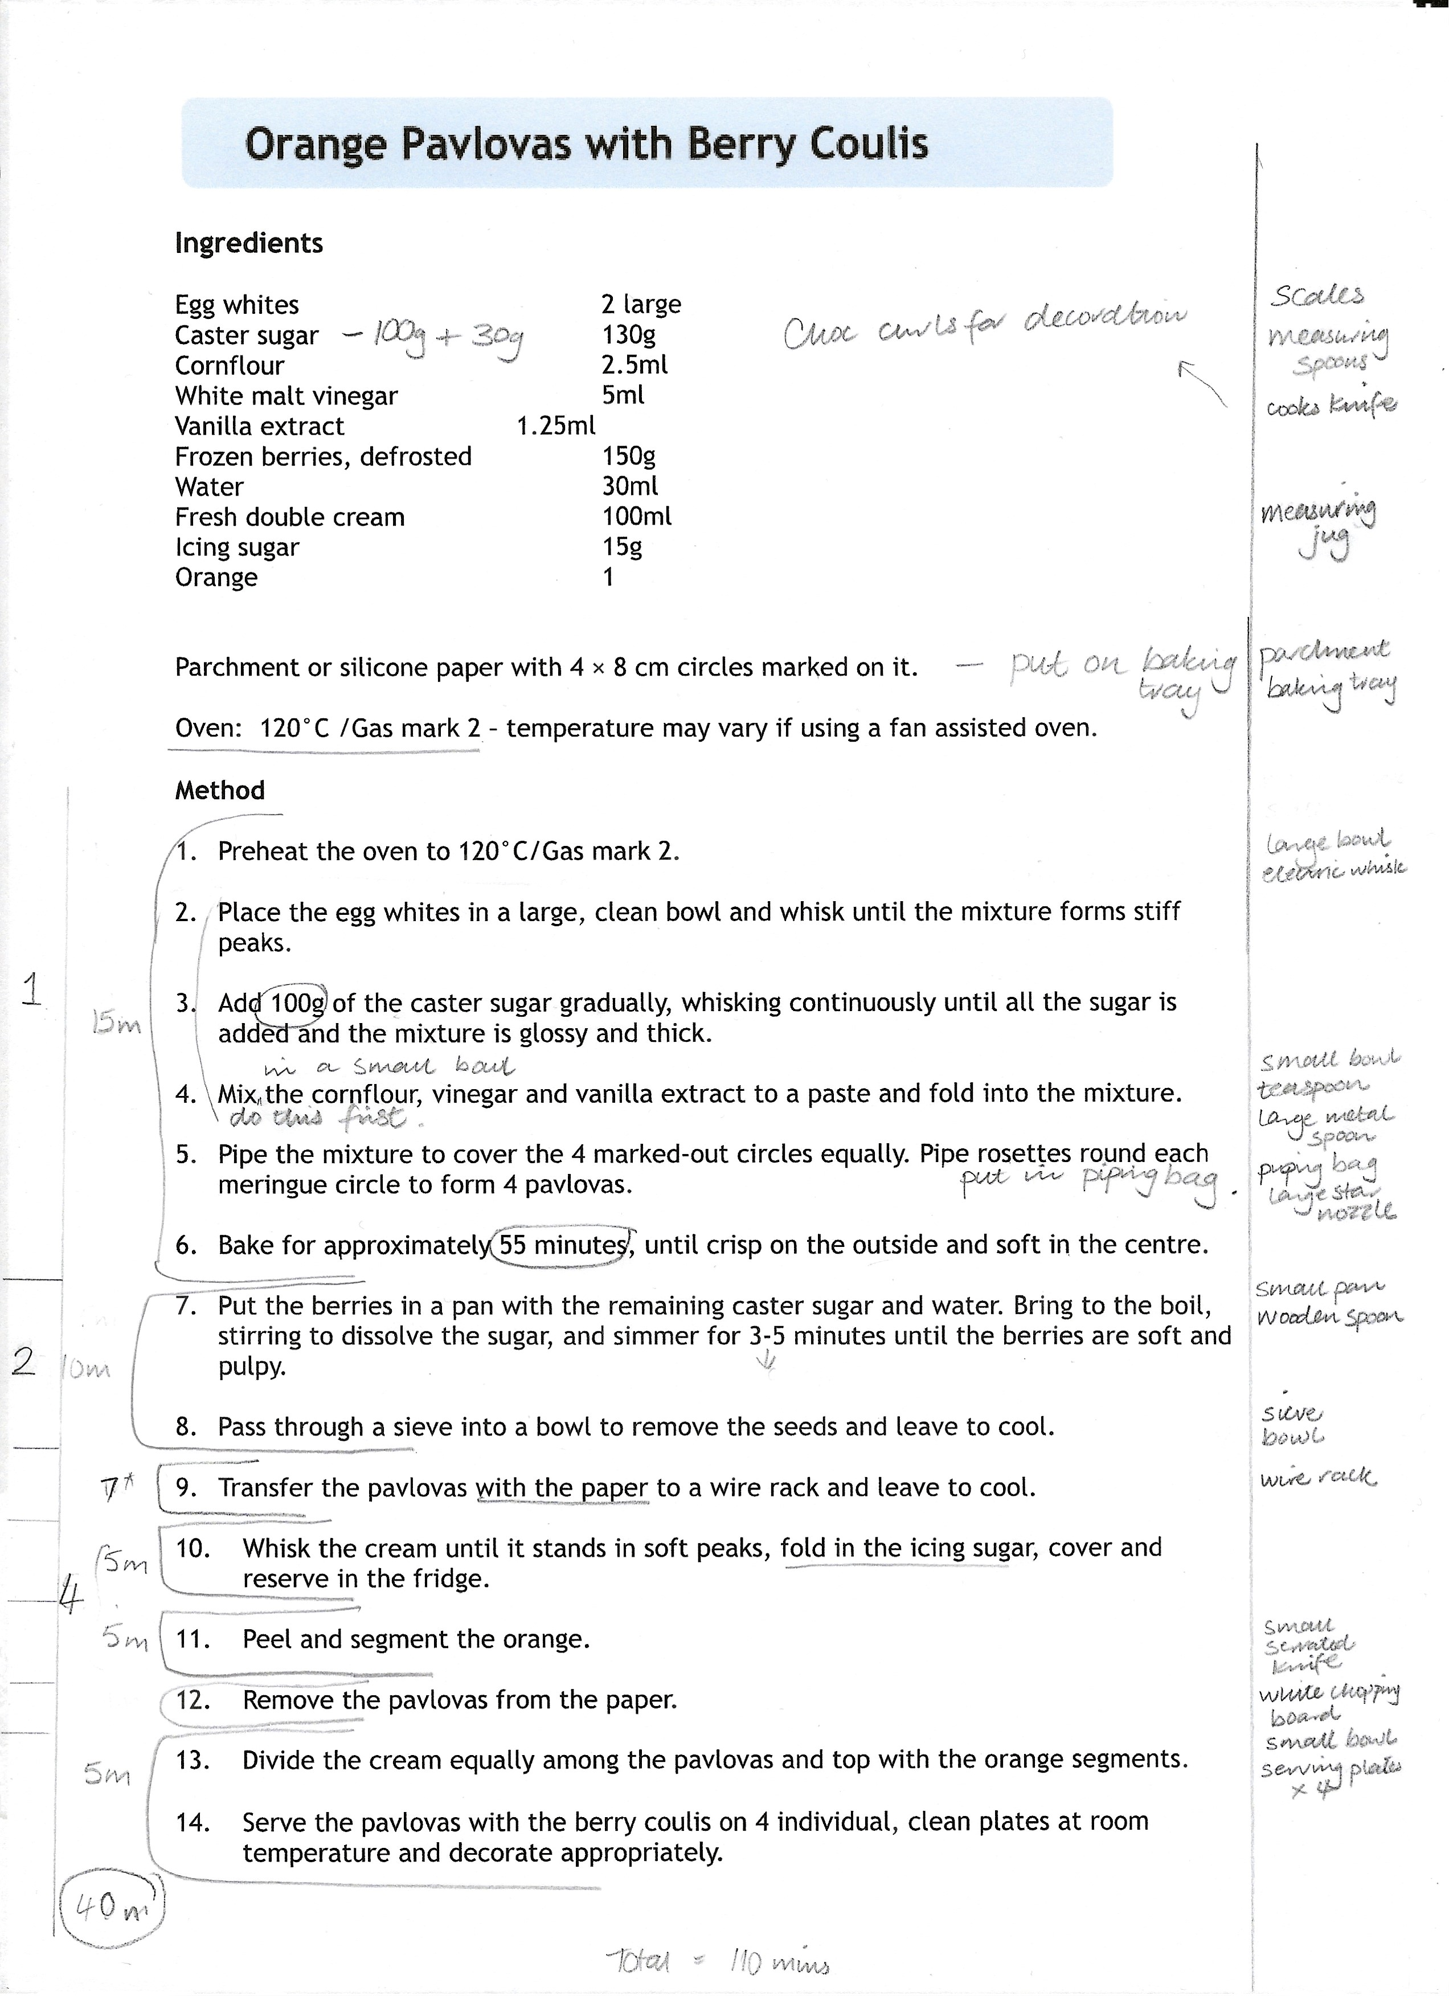
Working out your time plan
Calculate time required for each step
Work out order of steps
Equipment needed
Add up the total time for each recipe & total overall
Notes:
You will have three recipes to put into a logical order of work. You will see these recipes only once to practice making the dishes.
Draw a column at side of recipes and go through each stage and write down all equipment, re-check.
Write garnish on each recipe.
Lay out menus and divide steps into what can be done in one step.
Calculate times for each step.
Write notes for what to remember e.g. re-weigh, put pot onto boil.
Check if something can be done in a better order.
Write order number on recipes

Slide 7
Time Plan - common mistakes
Know your times - Start time is 9.30
Service times are:
Starter 11.30 : Main 11.45 : Dessert 11.55
- Be sure of what you are doing in the preparation stage, e.g. garnishes are prepared beforehand, can vegetables be peeled?
CAYG
Check for readiness
Seasoning
Change oven temperatures
Re-weigh vegetables
Ingredients that need to be divided e.g 45mls milk in recipe is divided into 30mls for potatoes and 15mls for glaze
State technique e.g. bake in oven for…
Wash hands after touching eggs and raw meat
Check time slots, ensure time matches up – when you put something in the fridge or oven for X Minutes, ensure you check at the correct time for taking out.
Heat up serving dishes
Switch off applicances e.g.oven, grill
Notes:
Know your times –
Dishes should be served as follows:
Starter: 2 hours after the start of the assessment
Main course: 2 hours and 15 minutes after the start of the assessment
Dessert: 2 hours and 25 minutes after the start of the assessment
Your practical assignment will begin at 9.30.
Service times are:
Starter 11.30 : Main 11.45 : Dessert 11.55
- Be sure of what you are doing in the preparation stage, e.g. garnishes are prepared beforehand, can vegetables be peeled?
CAYG – include Clean as you go at the proper time throughout your time plan.
Check for readiness and and seasoning, adding if required
Change oven temperatures if required, it is normally better to increase oven temperature, so make the dish with the lower temperature first if feasible.
Re-weigh vegetables – you will have weighed out the vegetables before preparing them and if it states on the recipe ‘re-weigh’ vegetables then you need to include this in the time plan.
Check for ingredients that need to be divided e.g 45mls milk in recipe is divided into 30mls for potatoes and 15mls for glaze
State technique e.g. son’t just say put in the oven, it is better to say bake in oven for…
Always wash hands after breaking eggs and touching raw meat – you will be marked on hygiene and safety.
Check time slots, ensure time matches up – when you put something in the fridge or oven for e.g. 10 Minutes, ensure you check at the correct time for taking out and that it matches the time you have given. It is better to put in time from and to rather than just one time. Remember this box is for a 10 minute slot so the start of the step will be a different time from the end of the slot.
Remember to Heat up serving dishes and heat up the grill to do this.
And always Switch off applicances when you are finished with them. e.g.oven, grill

Slide 8
Equipment Requisition
You are required to list all the minimum equipment required to make the three dishes.
Use the template and the Mnemonic tool (Mary Prepared Her Own Mixer Perfectly Placed Sideways) to recall equipment for each preparation stage
Practice with different recipes
Marks awarded:
4 Marks • All minimum equipment listed for three dishes
3 Marks • Almost all minimum equipment listed for three dishes
2 Marks • Most minimum equipment listed for three dishes
1 Mark • Some minimum equipment listed for three dishes
0 Mark • No equipment identified

Slide 9
Service details
Name of the dish
Garnish or decoration
Serving Plate
State preparation technique and the position of the garnish
State what type of plate of dish you are going to serve it on
Temperature
Portions
State the temperature of the food and temperature of the serving dish
State if it is for one or four portions and if there is one or four serving plates

Slide 10
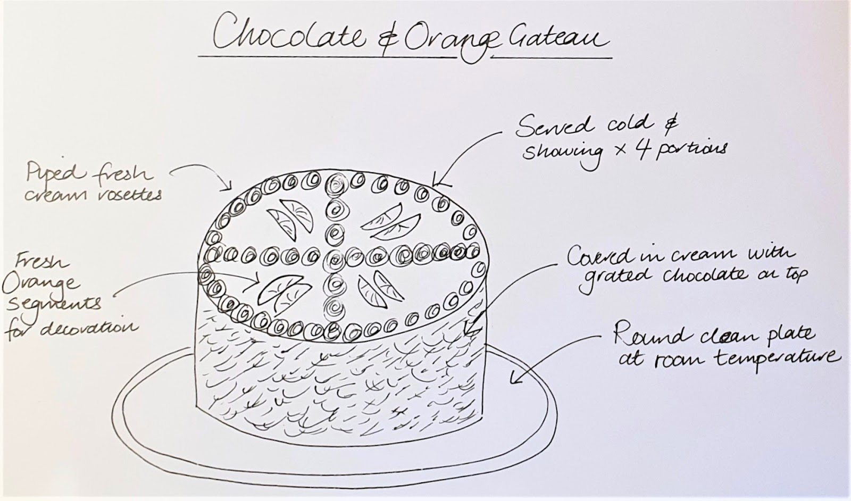
Example Chocolate Orange Gateau
Cold food
Plate at room temperature
Piped cream rosettes and decorated with orange segments on top (preparation technique + position)
Grated chocolate around the sides
Clearly show 4 portions
Tips
Read the recipe carefully for how to serve the dish. The recipe will state; at what temperature it is to be served, and if you are to add a garnish or decoration.
Practice with other dishes you make
Have a check list in your mind: STOP
Serving plate, Temperatures: food, plate Ornate: Garnish/decoration & techniques, Portions

Slide 11
Practical Assessment
2
You implement your time plan to prepare, cook and serve the three dishes within the allocated time of 2 hours and 30 minutes.
You will carry this out on your own
You can ask the teacher only about accessing further ingredients or equipment
Dishes should be served as follows:
Starter: 2 hours after the start of the assessment
Main course: 2 hours and 15 minutes after the start of the assessment
Dessert: 2 hours and 25 minutes after the start of the assessment
Notes:
You should then implement your plan to prepare, cook and serve the three dishes within 2 ½ hours. You must complete this stage independently. You will not have a partner and you will not be allowed to talk to other candidates. The teacher or lecturer can answer questions from about accessing further ingredients and/or equipment, but not about how to make any of the dishes. The teacher may also if there are any safety issues. The teacher will give time prompts at regular intervals, and 5 minutes before each service time. Dishes should be served as follows: Starter: 2 hours after the start of the assessment, 11.30 Main course: 2 hours and 15 minutes, 11.45 after the start of the assessment Dessert: 2 hours and 25 minutes, 11.55 after the start of the assessment Dishes may be presented 5 minutes before or after the service time. If a candidate serves a dish more than 5 minutes early they can still be awarded marks allocated to ‘service’ but marking must take place at the correct service time, so you would risk you dish being at the wrong temperature. If a candidate serves a dish more than 5 minutes late, or after the end of the practical activity, no marks can be awarded for ‘service’. The candidate would retain any marks already awarded for the preparation and cooking of the dish.

Slide 12
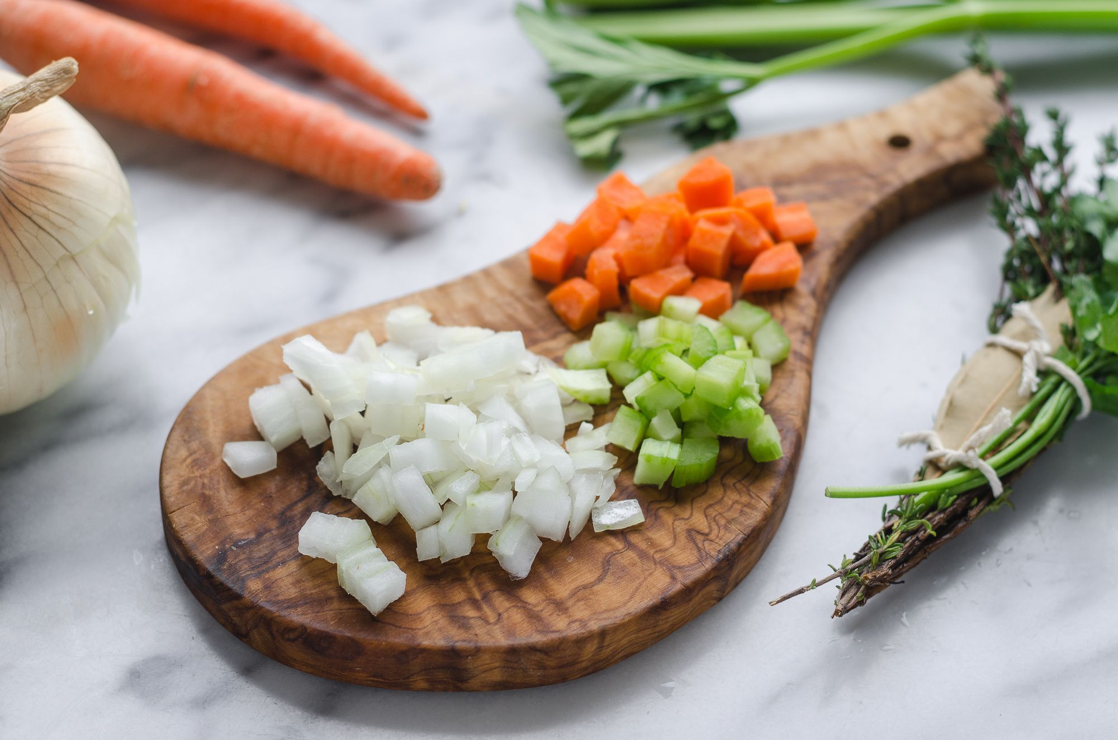
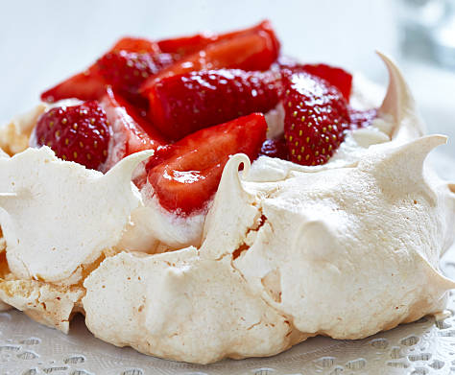
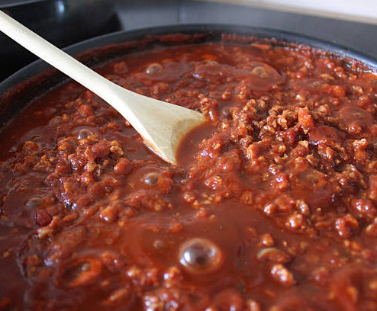
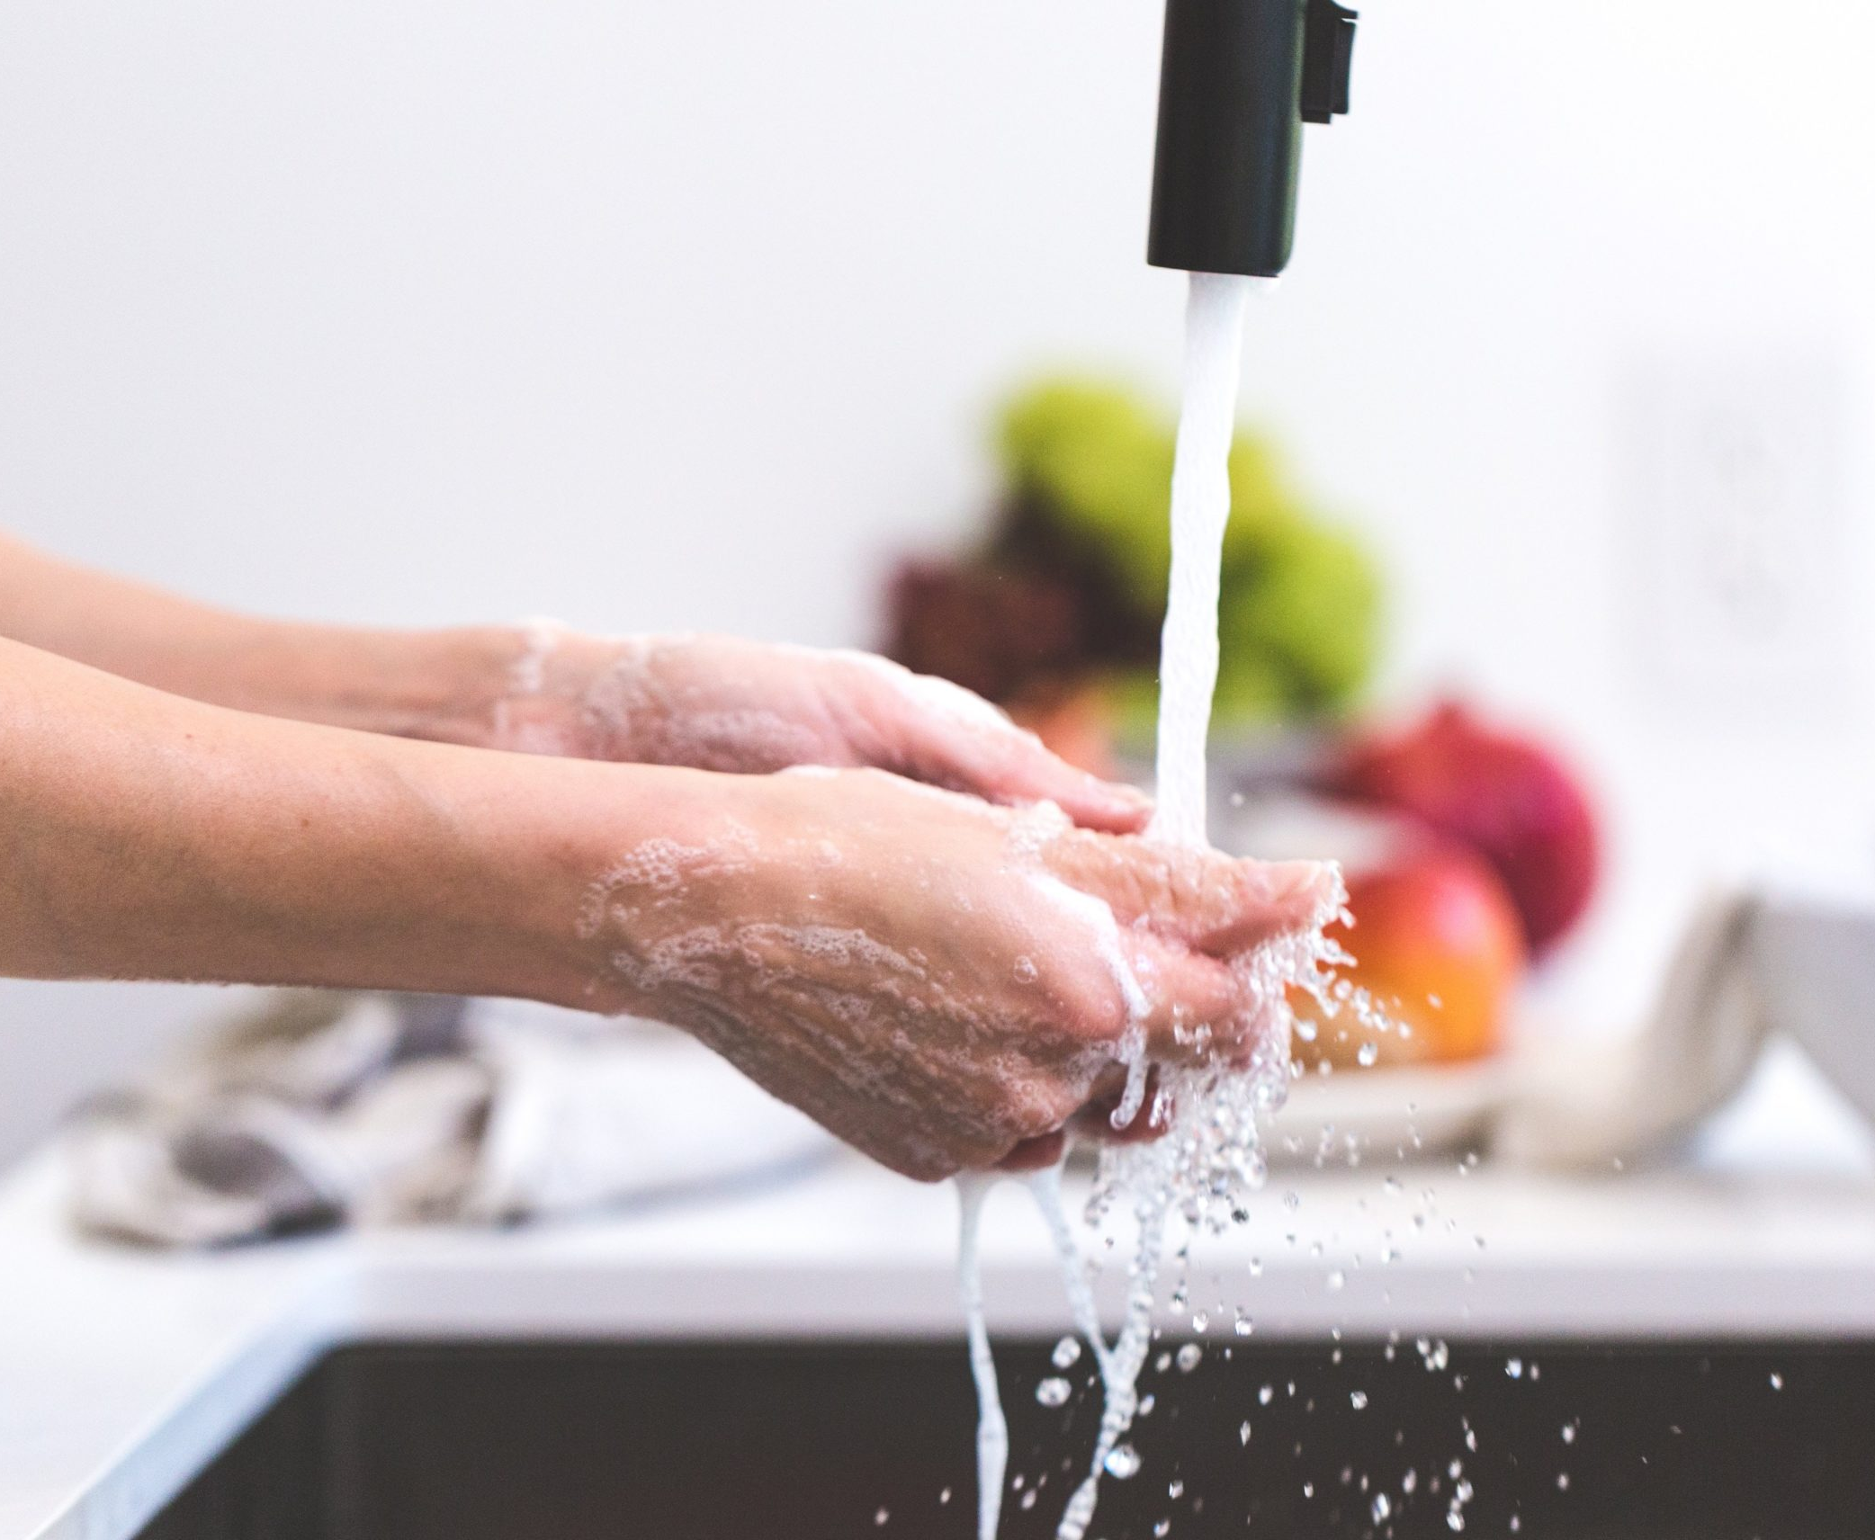
What you will be assessed on
Skills and techniques
Service
Service includes: Appropriate serving plate and food temperature Appearance
Flavour
Texture
Garnish
Includes correct techniques for chopping, slicing, dicing, shaping, rubbing in, rolling, whisking, portioning, working in an organised manner
Cookery processes
Professional practice
E.g. boiling, simmering, grilling, stewing, baking.
Weighing and measuring
Hygiene
Safety

Slide 13
How to Prepare
You will have a chance to practice making all three dishes on one separate occasion in class – but only once per dish
Take notes during demonstrations
You will really need to practice on your own at home making a three course meal in 2hrs 30mins.
You should practice making 3 similar meals
Try timing yourself during practical sessions at school
Get into the habit of being more organised in practical session in class, e.g. ensure you have all equipment and ingredients before starting to make a dish in class;
- Ask about dish to made beforehand and write out all the equipment you will need;
- Aim to increase speed– try to be finished with 5 then 10 minutes to spare.
Links to cookery videos
SQA videos – click this link to SQA website for skills demonstration videos
Food a fact of life cookery videos
Gary McLean SQA - Gary MacLean, Senior Lecturer at City of Glasgow College and Scotland’s national chef shares some cookery skills.
Notes:
You will have a chance to practice making all three dishes on one separate occasion in class – but only once per dish – the teacher will demonstrate each dish and then you will make it. Take notes during demonstrations. You will really need to practice on your own at home making a three course meal in 2hrs 30mins, you should make 3 similar meals which you will do in class, however there will not be the opportunity to practice making all 3 in 2 ½ hours.
Try timing yourself during practical sessions at school, so you know how long it will take to carry out tasks.
Get into the habit of being more organised in practical session in class, e.g. ensure you have all equipment and ingredients before starting to make a dish in class;
- Ask about dish to made beforehand and write out all the equipment you will need so you can get this organised as soon as you get to class;
- Aim to increase speed– try to be finished with 5 then 10 minutes to spare. This means be all cleaned up as well. You will need to complete your 3 meals plus be completely cleared up in the allocated time.
There are a wealth of cookery skills videos online, some here are SQA skills demonstration videos, Food a fact of life and Gary McLean, Seniour lecturer at City of Glasgow College and first national Scottish chef

Slide 14
Question Paper
3
The question paper is to assess your knowledge and understanding of the areas covered in the course including:
Hygiene & safety Food preparation techniques Cookery Processes Current dietary advice Categories of ingredients Garnishes Costing Functions of ingredients Evaluation of dishes Weighing and measuring Sustainable ingredients
Notes:
Questions for the question paper can be from any of the topics covered in the course and will asses your knowledge and understanding. There will be 3 questions broken down into sections related to the topic and will comprise of a sample from the following:
Understanding the principles of hygiene and safety, including safe use of equipment, preparing and storing food safely and hygienically and prevent cross-contamination and reduce hazards.
Food preparation techniques – you will need to know how to carry out techniques in preparing dishes and following recipes
Understanding and application of cookery processs including baking, boiling, grilling, poaching, shallow/stir frying, steaming and stewing and can relate these to current dietary advice. Know the use of different categories of ingredients including herbs, spices, dry ingredients, fruit and vegetables, meat and poultry, dairy, fish, eggs. Understand their use in cooking, e.g. the origin of an ingredient, it use in cooking, appearance and taste. How they relate to current dietary advice and the importance of sourcing and using sustainable ingredients.

Slide 15
Command words
State : Name
Give : Identify
Describe
Explain
Evaluate
List one or a number of items or facts linked to the question​
More depth in answer, than state question. Give a description about a fact or facts linked to the question. ​
Provide a fact or number of facts linked to the question, explaining the outcome of the points made.​
A judgement question where you are stating a fact, giving an opinion and a consequence linked to the question
Calculate
Use the information provided in the question to calculate the cost of the identified ingredients. You will asked to calculate the total cost of the dish and usually for a number of portions.
Notes:
For questions that ask you to state, give, name or identify you should list one or a number of relevant items or facts linked to the question. They do not need to be in any particular order.
In describe questions more depth is required in your answer, you are defining or giving an account of points linked to the question. That is you are giving a description about a fact or facts related to the question.
IN explain questions you are aiming to make the relationship between points clear, showing connections. That is you should provide a fact or facts linked to the question and explain the outcome of the points you have made.
Evaluate – you should make a number of evaluative comments, making a judgement based on the information provided in the question. You are stating a fact, giving your opinion on this and a consequence of the fact stated.
I will no further explain how to answer each of these types of questions.

Slide 16
State / Name Give / Identify
This will be the easiest type question you will be asked.
Example Question: Identify three correct pieces of equipment required to blind bake a pastry case. (3)
Answer: Flan ring, tin foil and baking beans.
Example Question: Name a garnish, including the preparation technique, that would be suitable for a macaroni cheese. (1)
Possible Answer: Chopped parsley, chopped chives, tomato wedges.
Notes:
This will be the easiest type question you will be asked and you will likely only be given one of these in the question paper.
…any other possible answer.

Slide 17
Describe question
How to structure your answer
More depth required in this question.
Always answer in a sentence
2 parts to your answer: 1. link to the question 2. make points and give a description of them.
You are not stating WHY something is done, but describing HOW it is done.
When answering describe questions, it helps to imagine you are writing for someone who knows absolutely nothing about the subject.
Example Question: Describe where fresh cream should be stored to ensure food safety. (1)
Answer: To ensure food safety, fresh cream should be stored in a clean, covered/airtight container and put in the fridge.
link to the question | Describe points
To ensure food safety fresh cream should be stored | in a clean, covered, airtight container and put in the fridge. 1 mark for correct description of storage (how it is stored)
Notes:
More depth is required in this question and the other types of questions than in the previous type of question. You should therefore always answer in a sentence and not provide a list of points. It is easier to think of this question in two parts, firstly link your answer to the question and then make and define your points, that is make a point and describe it.
You are answering why something is done and not how it is done. It may be helpful to imagine you are giving information to someone who knows nothing about your topic.
Example question: …. You are describing a couple of points on how fresh cream should be stored but not why it should be stored in the fridge, this would be expected in an explain question.

Slide 18
Explain question
How to structure your answer
Always answer in a sentence
4 parts to your answer: 1. link to the question 2. give a fact 3. use a connecting word 4. explain the outcome.
Connecting word: So, Therefore, As, Because STAB
You are explaining the HOW and the WHY something is done.
When answering explain questions, it helps to imagine you are writing for someone who knows absolutely nothing about the subject.
Example Question: Explain why poaching is a suitable method for cooking fish (1)
Answer: Poaching is a gentle method of cooking fish therefore it will help the fish to retain its shape and not break during the cooking process.
Link to question | Fact | Connecting word STAB | Outcome
Poaching fish | is a gentle method of cooking fish | therefore | it will help the fish to retain its shape and not break up.
Notes:
Again always answer in a sentence. It is useful here to break down your answer into 4 parts. Firstly link to the question, this sets the context for your answer, provide a fact, use a connecting word such as so, therefore, as, because, think STAB, and then explain the outcome of what you have stated. This time you are telling the how and why something is done.

Slide 19
Explain question example
Explain an advantage of stir-frying as a method of cooking. (1)
Link to question | Fact | Connecting word STAB | Outcome
Stir frying | is a quick method of cooking, using a little oil and no water | so | this will help vegetables retain their nutrients
Stir frying | will help vegetables to retain their nutrients | because | it is quick cooking method where no water is added, and only a little oil.

Slide 20
Explain question example
Question: Explain how fresh cream should be stored to ensure food safety. (1)
Answer: To ensure food safety, fresh cream should be stored in a clean, covered/airtight container and put in the fridge so as to prevent any bacterial growth .
Link to question | FACT | STAB | Outcome
To ensure food safety fresh cream should be stored | In a clean, covered, airtight container and put in the fridge | so | as to prevent any bacterial growth.

Slide 21
Evaluate Questions
F
FACT
You must give a true fact on the information provided
Make a judgement based on the information provided, LINKED to the question, and develop the comment.
You will be asked to evaluate the effect of taste, texture, appearance or colour on a food product.
OPINION
O
You give your opinion on whether you think the fact you have stated has a positive or negative effect on the food product
C
CONSEQUENCE
The consequence is the outcome related to the fact.

Slide 22
Evaluate Questions
TASTE, TEXTURE, APPEARANCE or COLOUR OF FOOD
It’s important to be PRECISE and THOROUGH when choosing words to describe food flavour.
Avoid using words such as ‘nice’ or ‘horrible’
You need to be aware of different tastes, textures and colours when adding ingredients to foods
Use a different effect in each evaluation.
Do not state more than one effect in a single evaluation. E.g. if you are referring to the texture in your evaluation do not explain the consequence as an effect on colour.
You need to state the three points: fact, opinion, consequence to gain 1 mark.
Example Question: Evaluate the effect on the taste, texture or appearance of adding the following ingredients to a ‘Tart Provencale’ (1)
Chopped garlic
Cheddar cheese
Tomatoes.

Slide 23
Possible answers
CHOPPED GARLIC possible answers
Chopped garlic can be gritty in texture (F) which may not be good (O) as it would spoil the smooth texture (O) of the Tart Provencale.
MATURE CHEDDAR CHEESE
Mature cheddar cheese has a strong taste (F) which is good (O) as the Tart Provencale would taste bland without it (C).
TOMATOES
Adding tomatoes to a Tart Provencale would have the effect of adding a red colour (F) to the tart, which is good (O), as this will contrast well with the light colour of the filling (C).
*Do not state more than one effect in a single evaluation*
E.g. Tomatoes have a sweet taste (F) which is good (O) as this would add a red colour to the tart (C)
Correct answer:
Tomatoes have a sweet taste (F) which is good (O) as this would enhance the flavour (C) of the Tart Provencale.

Slide 24
Costing Question
How do you work out the cost?
Cost to buy the ingredient
Quantity of
Ingredient in
the packet
x
Quantity required in the recipe
=
Cost of the ingredient
Example: 100g of castor sugar is needed in a recipe
The castor sugar costs £1.60 for 1kg - change £ to pence and kg to gms
1600p ÷ 1000g x 100g = £0.16 16p is the total cost
*Figures should be rounded up from 0.5p and down <0.5p to the nearest whole number
Costing exercise – link to a youtube video on costing
Notes:
For this you will be required to make a calculation based on the formula given to work out the individual cost of items in a recipe. You will be allowed to use a calculator for this, but not your phone.

Slide 25
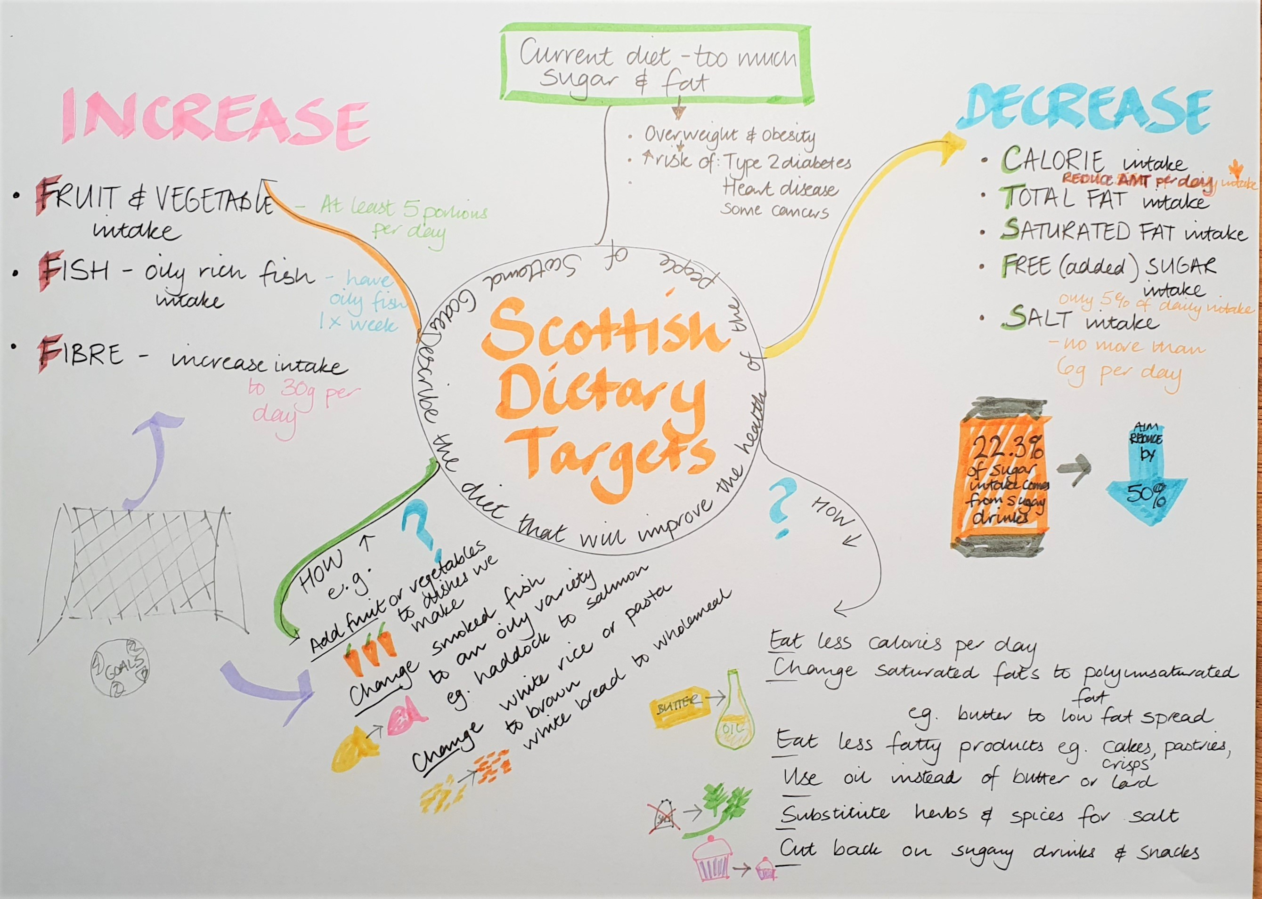
Revision Techniques
4
Mind maps
Select a topic and place in the centre of the page, and place words, pictures and symbols around the topic that are associated with it

Slide 26
Revision Techniques
Food Processes
SDG
Stir-Frying
Aim to Increase
Dry, healthy method of cooking as it is:
Fast method
Cut into small pieces turn evenly in pan
Uses little or no fat, so fat content is low
Minimal nutrient loss, vitamins retained
Fruit and Vegetable intake
Oily Fish intake
Fibre
Flashcards
Local food
You could use colour coded ones for each topic e.g. Yellow is food processes and techniques, orange for Scottish dietary goals, green for sustainability, blue for storage…..
Sustainability
Food Storage
Dry foods

Slide 27
Revison techniques
5 a day
Total Fat
Flour storage
Baking
Select 5 words per day and place each on a post it notes
- stick around the house or your bedroom, or in the kitchen on the piece of equipment it relates to– they could be colour coded the same as your revison cards – so in an exam you could think ‘ah baking, that was the one stuck on the oven..’
Bake blind
Organic

Slide 28
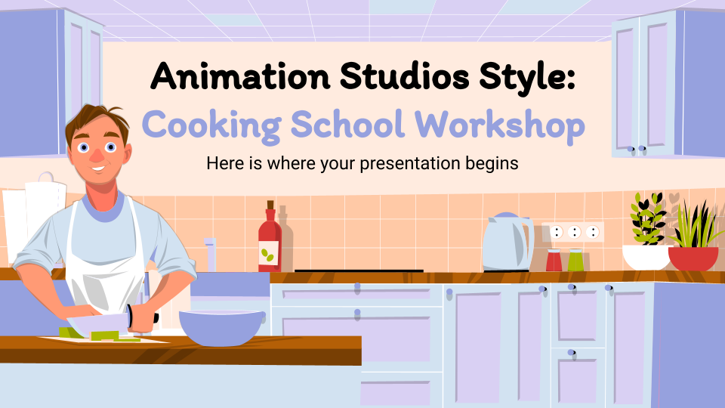
SQA website Past papers
Past papers link https://www.sqa.org.uk/sqa/47439.html
Do lots of practice papers and questions!
Once you have tried the questions and answers you could make a spreadsheet and copy and paste questions and anwers under topics and types of questions, and you can also add the pupils answers and commentary.
Other websites:
Food a fact of life – lots of resources on SQA topics plus quizzes and games
M&S Marks in time – includes some resources on Food and nutrition
British Nutrition Association - evidence-based information, education and expertise sustainable diets
Healthy eating.org – nutrition resources for online learning

Slide 29
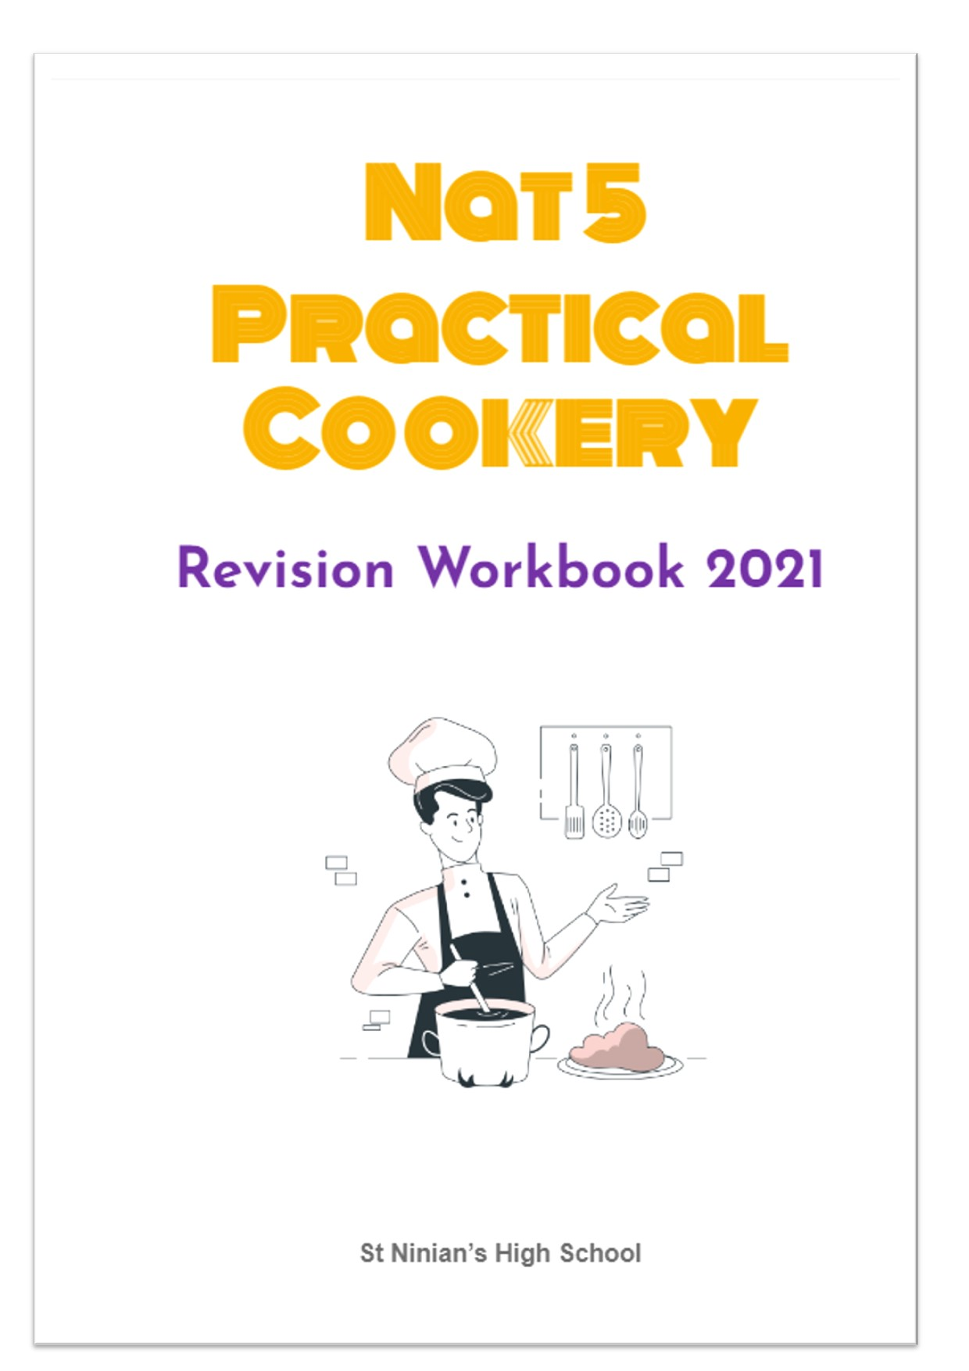
HE Department Support
Slides and resources on Google classroom
Revision booklet with questions for each topic, and answer sheet when completed.
After school on Tuesday
Lunch time Friday
Ask your teacher anytime for extra support

