Slide 1
S4 TRIP TO LIVERPOOL

Slide 2
WELCOME
FIRST S4 EXCURSION
LINKS TO ATLANTIC SLAVE TRADE TOPIC
OVERNIGHT VISIT
73 PUPILS, 7 MEMBERS OF STAFF

Slide 3
STAFF
MRS HAYES
MR MARTIN
MRS HOWSON
MR RIMICANS
MS KELLY
MS BAIRD
MR DOCHARTY

Slide 4
ITINERARY
DEPART 6AM FROM ST NINIAN’S HIGH SCHOOL
ARRIVE IN LIVERPOOL (mid morning)
TOUR OF ANFIELD IN TWO GROUPS
LUNCH
INTERNATIONAL MUSEUM OF SLAVERY
BOWLING
HOTLE CHECK-IN
OUT FOR DINNER

Slide 5
FRIDAY
BREAKFAST AT HOTEL
LIVERPOOL CITY SITES AND BEATLES BUS TOUR
TRAVEL TO MANCHESTER
SHOPPING AND LUNCH AT THE TRAFFORD CENTRE
AFTERNOON DEPARTURE

Slide 6
SPENDING MONEY
BREAKFAST AT SERVICE STATION (THURSDAY)
LUNCH AT THE TRAFFORD CENTRE (FRIDAY)
SPENDING MONEY FOR THE TRAFFORD CENTRE
RECOMMENDATION OF £20

Slide 7
WHAT TO PACK?
TRAVEL OUTFIT THAT IS ALSO APPROPRIATE FOR A DAY OF ACTIVITIES
JEANS AND A JUMPER
CHANGE OF CLOTHES FOR DINNER AT NIGHT
PYJAMAS
CHANGE OF CLOTHES FOR FRIDAY
TOILETRIES
DAY BAG (PURSE, PHONE ETC.)

Slide 8
PICK UP
PUPILS WILL BE TOLD WHEN WE’RE NEARING ST NINIAN’S SO AS TO ALERT PARENTS FOR PICK UP.

Slide 9
Safety
CONSENT FORMS DUE
MEDICAL ISSUES FLAGGED
STAFF ON HAND TO BE CONTACTED 24/7
RISK ASSESSMENTS CARRIED OUT

Slide 10
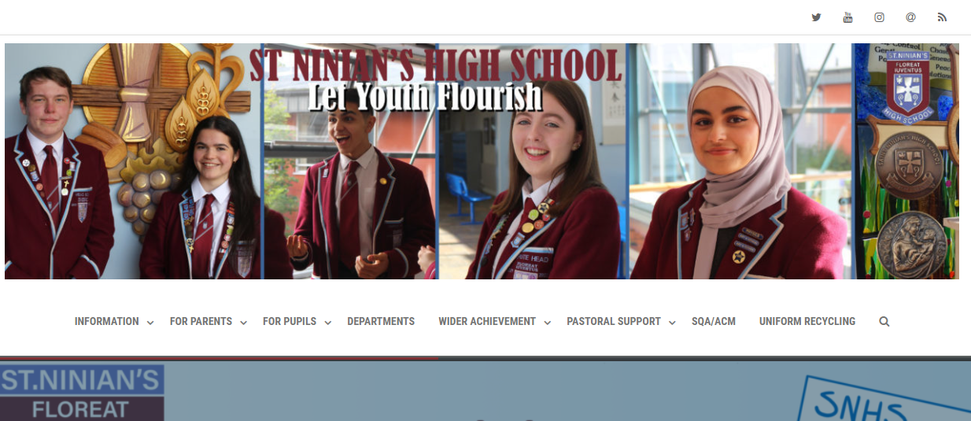

Slide 11
