Slide 1
S4 revision
31st March 2021

Slide 2
Timed questions
Describe the importance of the Catholic church to Irish immigrants (4)
Explain the reasons why so many Scots were successful in the countries to which they emigrated (6)
To what extent was fear of revolution the main reason why many Americans’ attitude towards immigration changed after 1918? (9)

Slide 3
Marking scheme
Describe:
Priests helped them to write letters home and apply for jobs
Allowed them to practice their faith
Receiving sacraments: Holy communion, baptism, weddings, funerals etc.
A home away from home: sense of family and community
Religious freedom
Charity help – St Vincent de Paul etc.
Football clubs (Celtic, hibs etc…)

Slide 4
Marking scheme

Slide 6
French Revolution
What happened
The French Revolution was a period of time in France when the people overthrew the monarchy and took control of the government.
The French Revolution lasted 10 years from 1789 to 1799.
The French Revolution completely changed the social and political structure of France. It brought new ideas to Europe including liberty and freedom for the commoner as well as the abolishment of slavery and the rights of women.
When did it happen
Outcomes in France

Slide 7
Effects on Europe
Through the Napoleonic wars the new ideas of Liberty, Freedom and Equality spread quickly all across Europe.
These ideas attracted the attention of many ordinary people who started to make demands of change in their own countries.
These demands for change often frightened the wealthy as if threatened their position in society.

Slide 8
Copy this mind map into your jotter leaving space to add on information about each!
New Ideas
Growing of the Navy
Effects of the French Revolution on the Abolition of the Atlantic Slave Trade
War between Britain and France
Poor overthrowing the wealthy
War & Revolution in Haiti

Slide 9
Adding Information
Cut out neatly round the boxes of the information sheet you have been given.
Read the information in the squares and match to the correct impact on your mind map.
Once you are certain glue it onto the mind map and colour around the outside of the box the same colour you have underlined the impact.

Slide 10
French revolutionary ideas of liberty and freedom became linked with the arguments of the abolitionists
This alarmed the British government who made it difficult for the abolitionists to hold meetings.
In 1793 Britain became involved in the French Revolutionary Wars. They needed money to pay for the war.
Britain needed ships and sailors to protect itself and the Empire at times of war.
New Ideas
Growing of the Navy
War between Britain and France
Effects of the French Revolution on the Abolition of the Atlantic Slave Trade
To oppose the slave trade during a major war seemed unpatriotic (disloyal to your country) to many and the abolitionists lost support.
The slave trade was seen as the ‘nursery of seamen’ - it provided training for sailors joining the Royal Navy.
Poor overthrowing the wealthy
War & Revolution in Haiti
The poor overthrowing their King and getting rid of the Monarchy made many wealthy and powerful people in Britain afraid of what might happen
France created a new class system, government and State where the People had more rights. British government were worried the British people would want this also.
Led by Toussant L’ouverture the freed slaves set up an independent nation called Haiti.
A slave revolt on the French colony of Saint Domingue frightened the British government who thoughts steps towards abolition would encourage more slave rebellions.

Slide 11
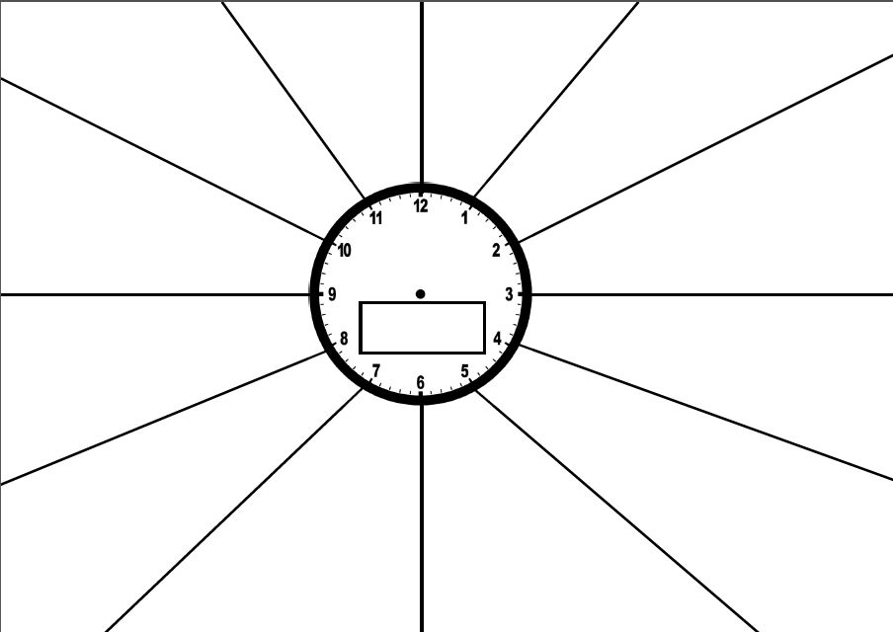
Impact of the empire on Scotland
Montgomery Bus Boycott
Abolition movement
Little-Rock
Sit-Ins
Resistance on plantations
The Middle Passage
Black power
Scots contribution to the empire
Reasons for immigration to Scotland
Changing attitudes to immigrants in the USA
Experience of immigrants in Scotland

Slide 12
