Slide 1
Revision
Prelim = Friday

Slide 2
Starter
Put these events in order and give one fact about each:
Little Rock
Montgomery Bus Boycott
March on Selma
March on Washington
Sit-Ins

Slide 3
Free at Last
Little Rock | Selma
Washington | KKK

Slide 4
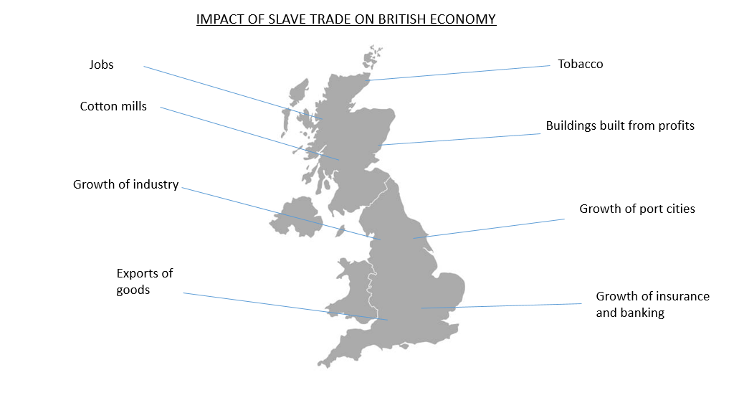

Slide 5
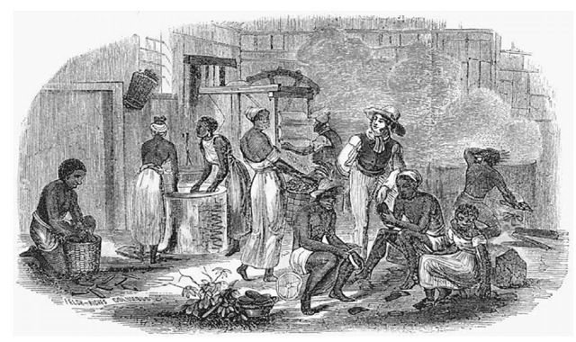
See, Think, Wonder…What does this picture tell you about life on plantations?

Slide 6
Describe
Describe life on plantations for slaves (4)
7 minutes

Slide 7
Reasons for Scottish migration
The Highland Clearances
The industrial revolution
Transport
Poverty
Overcrowding
Emigration agencies
Opportunities abroad

Slide 8
