Slide 1
Retrieval Practice
What is it?
Why is it useful?
How do I use it?
Examples
Timers
Miss Russell Annan Academy

Slide 2
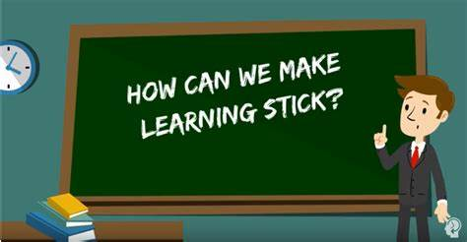
What is retrieval practice?
Return to title slide
Retrieval practice is any strategy that involves retrieving material that has been previously learned.
It is a learning strategy, not an assessment tool which means it is used to cement learning, strengthen memory and improve long-term retention, not to assess learning.
Retrieval practice can be used by teachers in lessons or can be used by learners themselves or with study partners

Slide 3
Why is retrieval practice useful?
Return to title slide
Retrieval practice strengthens memory, therefore forgetting is less likely to occur in the long-term.
Retrieval practice identifies gaps in learning as it forces an examination of what has been learned and where to focus more learning.
Retrieval practice prevents overconfidence of learning, improves metacognition* and can be used to guide independent study.
Retrieval practice improves understanding of material.
Retrieval practice reduces test/assessment anxiety as learners feel more confident in their knowledge and also because it reduces the need for ‘cramming’.
* Awareness and understanding of one’s own thought processes.

Slide 4
How do I use retrieval practice?
Return to title slide
Retrieval practice should be completed without access to textbooks or notes.
Retrieval practice should be used regularly over the year/course. Each topic should be retrieved multiple times.
Retrieval practice should be low stakes –results should not be monitored/recorded – this reduces the pressure to perform
Feedback has to be given to improve memory of the ‘correct’ answers.
Learners should self-mark their own retrieval practice as this ensures that they are aware of what they do know and do not know, so they can then work on filling in the gaps.
Teachers must teach the use of retrieval practice, including an explanation of why it is effective to learners so that they are able to use it in independent study.
Use a mix of tasks. This prevents boredom and strengthens memory.

Slide 5
EXAMPLES Return to title slide
Power Tickets
Fix the errors grid
Key word retrieval
Brain dump
Retrieval grid
List it
Retrieval clocks
Summary sheets
Throwback Thursday/Flashback Friday
‘Five a day’ sheets
‘Give me five’
‘Because, but, so’
Mind maps
‘On the other hand...’
Essay retrieval
Improve the answer
Odd one out
Cops and Robbers

Slide 6
Power tickets
Return to EXAMPLES
Write down three facts that you have learnt last lesson, last week, last month and last term.
Last lesson:
Last week:
Last month:
Last term:

Slide 7
‘Fix the Errors’ grids
Return to EXAMPLES
Create a grid and include correct and incorrect statements. Correct the incorrect statements in the grid.
Topic: __________________________________

Slide 8
Key word retrieval
Return to EXAMPLES
Select a list of key words (use your Cornell notes key words margins to help) and write down definitions for the key words without using your notes/books.
Key word/phrase | Definition
Retrieval practice
Meta-cognition
Cornell notes
Long-term memory
Short-term memory
Self-regulated learner

Slide 9
Brain dump
Return to EXAMPLES
Simply write down as much as you can
remember about a topic.
Once completed check your notes or your
course outline details to see what areas you
remembered and what areas you forgot.
Focus on the parts you forgot for future study.

Slide 10
Retrieval grid
Return to EXAMPLES
Answer as many questions as you can about the topic from memory. The questions can be colour coded in terms of difficulty/how recently they were first studied.
Question | Answer

Slide 11
List it
Return to EXAMPLES
List as many points as you can under key headings
These headings could be factors in an essay, or categories, or dates in a time-line etc
Factor 1:
-
-
-
-
-
-
-
-
-
Factor 2:
Factor 3:
Factor 4:
Factor 5:
Factor 6:

Slide 12
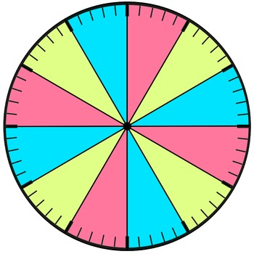
Retrieval clocks
Return to EXAMPLES
Add headings to each segment of a clock face.
Spend 5 minutes retrieving your knowledge on each topic.

Slide 13
Summary sheets
Return to EXAMPLES
Divide a whole page or sheet of A4 into sections – 4, 6, 8 etc.
Identify the main aspects of a topic and use as headings in each box. Retrieve your knowledge on each aspect in the relevant box.

Slide 14
Throwback Thursday or Flashback Friday
Return to EXAMPLES
At the end of a lesson or week of lessons create a series of ten questions based on the lesson content. You should include the answers too.
Go back to these questions a week later, or longer and test yourself.
Best way to do it: write questions on the left side of an A4 sheet with answers on the right. Then fold the paper in two to have one side for the question and one side for the answers, Then you can assess yourself.

Slide 15
‘Five a day’ sheets
Return to EXAMPLES
Think of five questions for a neighbour to answer.
This could include a range of question types/tasks including questions, keywords to define, words to use in a paragraph to summarise a topic, images to describe, events to put into chronological order, etc.
Question | Answer

Slide 16
‘Give me five’
Return to EXAMPLES
Identify aspects of a topic and give five possible answers to each of them.
1 | 2 | 3 | 4 | 5

Slide 17
‘Because, but, so’
Return to EXAMPLES
Provide three sentence starters –one ending in ‘because’, one ending in ‘but’ and one ending in ‘so’. Then complete the sentences.
Retrieval practice is useful because …
Retrieval practice should be used by teachers but …
Retrieval practice is best completed spaced out on a regular basis so …

Slide 18
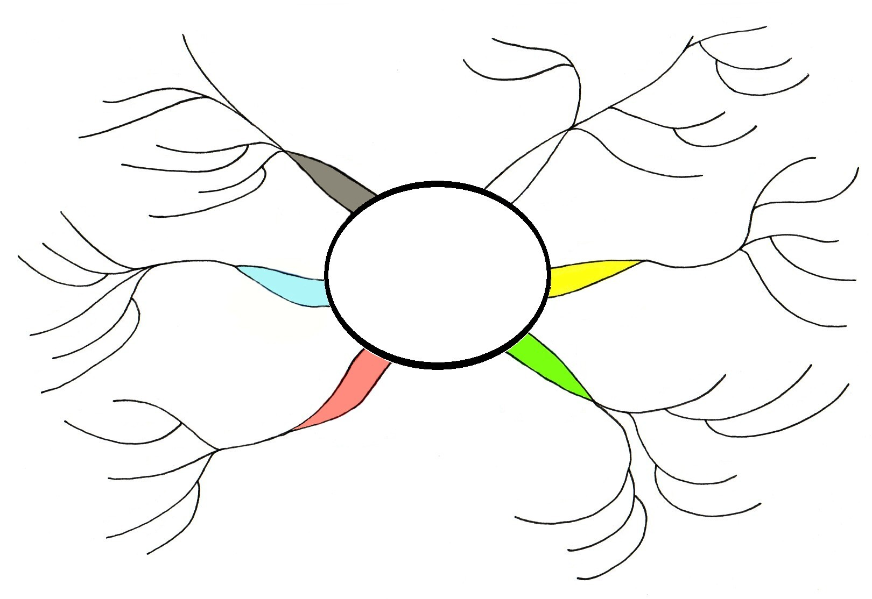
Mind maps
Return to EXAMPLES
Provide the outline of a mind map for a topic for yourself or someone else to complete.

Slide 19
‘On the other hand...’
Return to EXAMPLES
Present a topic area/argument and explain both sides of the argument or present it to someone else to complete.
Topic Area / Argument

Slide 20
Essay retrieval
Return to EXAMPLES
Introduction
- Context 1
Factor 2 =
Factor 3 =
- Knowledge 1
Factor 4 =
Summary of arguments
Relative judgement
- Context 2
- Line of argument
Factor 1 =
- Knowledge 1
- Knowledge 2
- Analysis
- Analysis +
- Evaluation
- Knowledge 1
- Knowledge 2
- Analysis
- Analysis +
- Evaluation
- Factors
- Knowledge 2
- Analysis
- Analysis +
- Evaluation
Conclusion
-Knowledge 1
- Knowledge 2
- Analysis
- Analysis +
- Evaluation
Supporting reasons
Look up essay questions in past papers. Write down the key elements and factors (with details) to include in an essay.
SQA Past Papers online service

Slide 21
Improve the answer
Return to EXAMPLES
Answer a question from a past paper then give it someone else to improve on. This helps you to create a response to a question whilst knowing the wrong steps to do and helps others identify the wrong steps in a response to be able to correct them. Knowing the mistakes to make allows you to become better at understanding the correct steps.
SQA Past Papers online service
Answer 1
Corrections
Feedback

Slide 22
Odd one out
Return to EXAMPLES
Each row contains something that is the odd one out. Pupils identify the odd one out and explain why it is odd.
Category
Category
Category

Slide 23
Cops and Robbers
Return to EXAMPLES
The cops column is for you to write as much as you can from memory about a specific topic in a set amount of time. Once the first column is completed swap with other learners to see if you can get more information to put in the second column. It is not a competition, it’s a focus on recall and working with others.
Your own knowledge and recall | Information you have stolen from your peers
Notes:
The « cops » column is for pupils to write as much as they can from memory about a specific topic or previously-covered material in a set amount of time (sort of brain dump). Once they have completed the first column (4-5 minutes), they need to get out of their seats and go around the class and see if they can get more information from other pupils. They should write these details in the second column. It is not a competition, it’s a focus on recall and working with others.

Slide 24
Timers – click on the timers in presentation mode to activate them
Return to EXAMPLES
End
1
2
3
4
5
6
7
8
9
10
11
12
13
14
15
16
17
18
19
20
21
22
23
24
25
26
27
28
29
30
31
32
33
34
35
36
37
38
39
40
41
42
43
44
45
46
47
48
49
50
51
52
53
54
55
56
57
58
59
60
End
1
2
3
4
5
6
7
8
9
10
11
12
13
14
15
16
17
18
19
20
21
22
23
24
25
26
27
28
29
30
31
32
33
34
35
36
37
38
39
40
41
42
43
44
45
End
1
2
3
4
5
6
7
8
9
10
11
12
13
14
15
16
17
18
19
20
21
22
23
24
25
26
27
28
29
30
Button timers in seconds
End
1
2
3
4
5
6
7
8
9
10
11
12
13
14
15
16
17
18
19
20
End
1
2
3
4
5
6
7
8
9
10
11
12
13
14
15
End
1
2
3
4
5
6
7
8
9
10

Slide 25
1 minute
2 minutes
3 minutes
4 minutes
5 minutes
Return to EXAMPLES
10 minutes
15 minutes
20 minutes

Slide 26
2:00
1:59
1:58
1:57
1:56
1:55
1:54
1:53
1:52
1:51
1:50
1:49
1:48
1:47
1:46
1:45
1:44
1:43
1:42
1:41
1:40
1:39
1:38
1:37
1:36
1:35
1:34
1:33
1:32
1:31
1:30
1:29
1:28
1:27
1:26
1:25
1:24
1:23
1:22
1:21
1:20
1:19
1:18
1:17
1:16
1:15
1:14
1:13
1:12
1:11
1:10
1:09
1:08
1:07
1:06
1:05
1:04
1:03
1:02
1:01
1:00
0:59
0:58
0:57
0:56
0:55
0:54
0:53
0:52
0:51
0:50
0:49
0:48
0:47
0:46
0:45
0:44
0:43
0:42
0:41
0:40
0:39
0:38
0:37
0:36
0:35
0:34
0:33
0:32
0:31
0:30
0:29
0:28
0:27
0:26
0:25
0:24
0:23
0:22
0:21
0:20
0:19
0:18
0:17
0:16
0:15
0:14
0:13
0:12
0:11
0:10
0:09
0:08
0:07
0:06
0:05
0:04
0:03
0:02
0:01
End
2:00
1:30
1:29
1:28
1:27
1:26
1:25
1:24
1:23
1:22
1:21
1:20
1:19
1:18
1:17
1:16
1:15
1:14
1:13
1:12
1:11
1:10
1:09
1:08
1:07
1:06
1:05
1:04
1:03
1:02
1:01
1:00
0:59
0:58
0:57
0:56
0:55
0:54
0:53
0:52
0:51
0:50
0:49
0:48
0:47
0:46
0:45
0:44
0:43
0:42
0:41
0:40
0:39
0:38
0:37
0:36
0:35
0:34
0:33
0:32
0:31
0:30
0:29
0:28
0:27
0:26
0:25
0:24
0:23
0:22
0:21
0:20
0:19
0:18
0:17
0:16
0:15
0:14
0:13
0:12
0:11
0:10
0:09
0:08
0:07
0:06
0:05
0:04
0:03
0:02
0:01
End
1:30
1:00
0:59
0:58
0:57
0:56
0:55
0:54
0:53
0:52
0:51
0:50
0:49
0:48
0:47
0:46
0:45
0:44
0:43
0:42
0:41
0:40
0:39
0:38
0:37
0:36
0:35
0:34
0:33
0:32
0:31
0:30
0:29
0:28
0:27
0:26
0:25
0:24
0:23
0:22
0:21
0:20
0:19
0:18
0:17
0:16
0:15
0:14
0:13
0:12
0:11
0:10
0:09
0:08
0:07
0:06
0:05
0:04
0:03
0:02
0:01
End
1:00
Return to EXAMPLES

