Slide 1
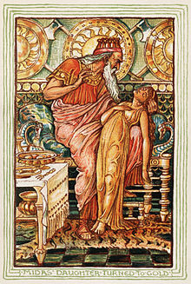
Mrs Midas
CAROL ANN DUFFY
TO BE COMPLETED BY PUPILS WHO HAVE NOT YET STUDIED THIS POEM.
WEEK BEGINNING 11TH JANUARY
DEADLINE: FRIDAY 15TH JANUARY

Slide 2
‘Mrs Midas’ – Planning your work.
Tasks 1-4 introduce the poem and ensure your understanding. These will form your notes on the poem. This should take you 1-2 periods.
Task 5 is to annotate the poem.
If possible, print off a copy of the poem so that you can annotate it tomorrow.
Otherwise, you should write out each stanza (take at least half a page) and add your annotations around it. This is likely to take the equivalent of 3 periods.
All tasks and annotations must be completed by Friday 15th January as next week you will be answering textual analysis questions on the poem.

Slide 3
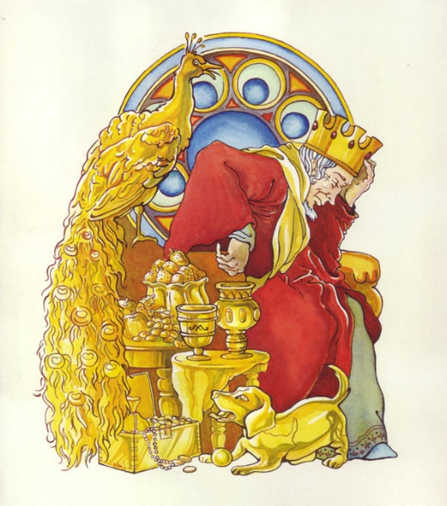
Starter
Research ‘King Midas from Greek Mythology’.
What did Midas wish for?
What were the consequences?
What might be the message of the myth of King Midas?

Slide 4
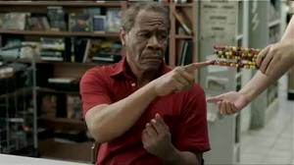
Watch the following advert. Note down any day to day issues King Midas might experience as a result of his wish.
Task 2
http://www.averagejoesblog.com/skittles-midas-touch-advert/

Slide 5
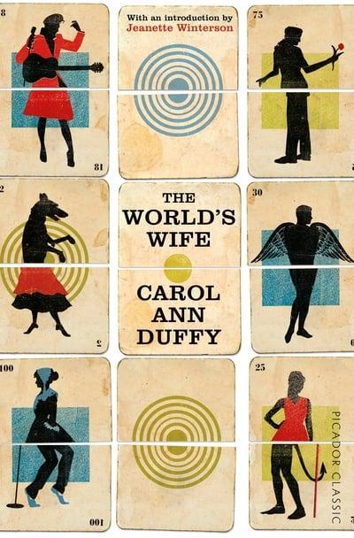
Task 3 – Introduction to the poem
This is the third poem by Carol Ann Duffy you will study.
This poem is from a collection called ‘The World’s Wives’. Each poem from this book imagines the life of the wife of a famous man from history, mythology or literature.
‘Mrs Midas’ is an imaginary narrative poem that tells the story of the devastating consequences of King (or Mr) Midas’ wish on his wife.
‘Mrs Midas’ is set roughly in the present day.
TASK: Watch this short clip which will give you an overview of the poem and the mythological tale it was inspired by:https://online.clickview.co.uk/libraries/videos/36703005/higher-english-mrs-midas-context-lesson
You will need to sign into click view with your glow login details.

Slide 6
Task 4 - Understanding
Once you have attempted these questions I will post answers. You can then self correct your work.
Read the poem once through and complete the following tasks:
1. Write a brief summary of the poem: a short paragraph will do.
2. Explain how the relationship between Mrs Midas and her husband changes over the course of the poem.
3. (a) Read stanza one. What do you think the mood/atmosphere is at this point in the poem?
(b) Read stanza three. How has the mood/atmosphere changed by this point in the poem?
4. (a) Read through the poem and circle or underline every word that has connotations of or links to the idea of gold.
(b) Why do you think Duffy has repeated this idea throughout the poem?
5. Re-read your notes and annotations of ‘Originally’ and ‘In Mrs Tilscher’s Class’. List the key themes of each poem. Can you identify any of these key themes in ‘Mrs Midas’?

Slide 7
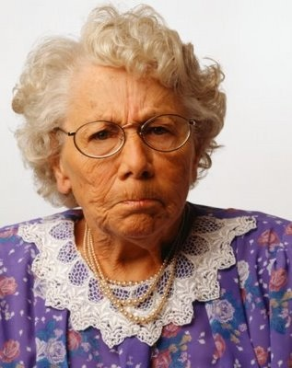
Vocab and References in the Poem
The Field of the Cloth of Gold (French: Champ du Drap d'Or) is the name given to a place in Balinghem, between Guînes and Ardres, in France, near the then English royal fortress of Calais, which was the site of a meeting that took place from 7 June to 24 June 1520, between King Henry VIII of England and King Francis I of France.
Miss Macready – Mrs Midas’ history teacher, perhaps?
(Stanza 3)

Slide 8
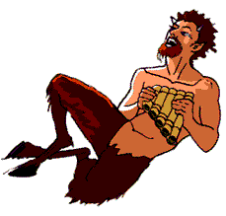
Tutankhamun - An Egyptian pharaoh famous for his golden burial mask and tomb. (stanza 7)
Pan - Greek God of nature (stanza 10)
Ore is a type of rock that contains sufficient minerals with important elements including metals that can be economically extracted from the rock. (stanza 8_

Slide 9
Task 5 – Annotate the Poem
Read the poem carefully, stanza by stanza.
Step One: As we did with ‘In Mrs Tilscher’s Class’ and ‘Originally’ you should identify the techniques used by Duffy in key quotations.
I have used the following colour coding in the annotations:
Word choice – yellow
Imagery – green
Structure – blue
Sound techniques (alliteration, onomatopoeia, sibilance etc.) – orange
Other techniques: contrast,
Instructions for step two – the most important part – on the next slide.

Slide 10
Task 5 – Annotate the Poem
Word choice – which connotations are suggested about what does it help you to understand about the main ideas of the poem or the characters?
Imagery – explain the literal and metaphorical meaning. What extra information do you gain about the key ideas, characters or themes from this description?
Sentence structure – what is the effect of the punctuation or feature of structure? Which important idea does it emphasise?
Sound techniques – describe the sound and its effect. Which important idea does it emphasise?
Step Two
Remember: you get no marks for simply identifying a technique; it’s all about the analysis!!
Comment on the effect of each key quotation. Try to link your comments to the important ideas and key themes. Use the guide to the right to help you.
Aim high and try to analyse the poem independently, using these resources to help you:
https://www.bbc.co.uk/bitesize/guides/zyk887h/revision/1
https://online.clickview.co.uk/libraries/videos/36703084/higher-english-mrs-midas-analysis-stanza-1-4
As a last resort, have a look at the annotations provided on the next 11 slides.

Slide 11
A typical domestic scene is presented in the first stanza.
‘September’ – a time we would associate with the golden colours of autumn. But also, new beginning and things coming to an end.
1
The language used to describe the scene reflects the Mrs Midas’ relaxed mood as she ‘unwinds’
Description of kitchen – a home full of life. Warm, appealing atmosphere..
It was late September. I’d just poured a glass of wine, begun
to unwind, while the vegetables cooked. The kitchen
filled with the smell of itself, relaxed, its steamy breath
gently blanching the windows. So I opened one,
then with my fingers wiped the other’s glass like a brow.
He was standing under the pear tree snapping a twig.
Simile introduces importance of sense of touch to Mrs M – she is later unable to touch Midas.
Atmosphere is shattered by the final line: ‘snapping a twig.’ – connotes something violent. Harsh consonant sounds in final phrase contrast with softer consonant and vowel sounds earlier in the stanza.

Slide 12
2
Personification: ‘dark of the ground seems to drink the light of the sky’ – sounds ominous and dark. Reflects the idea of life being drained from something.
Suggests lack of clarity, haziness, fog.
Builds tension
Now the garden was long and the visibility poor, the way the dark of the ground seems to drink the light of the sky, but that twig in his hand was gold. And then he plucked a pear from a branch - we grew Fondante d'Automne - and it sat in his palm like a light bulb. On. I thought to myself, Is he putting fairy lights in the tree?
Parenthesis – emphasizes their comfortable lifestyle and their closeness as a couple.
Contrast between lack of light in first two lines and brightness of ‘gold’ twig and pear ‘like a lightbulb.’ Highlights the stark change in the couple’s life.
Minor sentence dramatises her moment of realization.
Question in last line again highlights Mrs M’s confusion and disbelief.

Slide 13
Mrs M is reminded of a history lesson where she learned the English King met the French and remembers her teacher – shows the mind wandering
3
She never mentions his name – perhaps out of anger/disgust.
Series of short sentences illustrates Mrs M’s gradual, shocking realization as to what is going on.
He came into the house. The doorknobs gleamed. He drew the blinds. You know the mind; I thought of the Field of the Cloth of Gold and of Miss Macready. He sat in that chair like a king on a burnished throne. The look on his face was strange, wild, vain. I said, What in the name of God is going on? He started to laugh.
Simile emphasizes his new found wealth. ‘Burnished’ – polished metal. This further highlights his greed.
Contrasts his wife’s confusion and fear; he is carefree and pleased with his new ability.
List conveys climactic realization of what has happened to her husband but also of his true character.
Question again reflects Mrs’ M’s disbelief and creates an exasperated tone.

Slide 14
Appropriate choice of food – visually fitting. Horror of what is happening becomes apparent – Midas can’t even eat. This illustrates the dire consequences of his greed.
4
Comic effect – Mrs M tries to normalize everything and continue to go about her daily life.
Foreshadows that he will waste away due to his power and greed.
I served up the meal. For starters, corn on the cob. Within seconds he was spitting out the teeth of the rich. He toyed with his spoon, then mine, then with the knives, the forks. He asked where was the wine. I poured with shaking hand, a fragrant, bone-dry white from Italy, then watched as he picked up the glass, goblet, golden chalice, drank.
Suggests a child like delight and fascination with his new power
List conveys Mrs M’s growing horror and Midas’ excitement through the endless listing of items he has destroyed.
Connotations of royalty and excess to highlight his greed.
Alliteration/Harsh consonant sounds shows the quick, unexpected transition from normality to this sheer horror.
‘shaking’ further emphasises Mrs M’s fear.
Mood/atmosphere: tense

Slide 15
5
Dramatic opening to stanza as both accept full reality of what has happened. Mrs M has finally snapped and cannot keep her composure.
Contrast between ‘scream’ and ‘calm’ creates an element of humour due to the ridiculousness and absurdity of the situation.
It was then that I started to scream. He sank to his knees. After we had both calmed down, I finished the wine on my own, hearing him out. I made him sit on the other side of the room and keep his hands to himself. I locked the cat in the cellar. I moved the phone. The toilet I didn't mind. I couldn't believe my ears:
Makes reference to their once intimate relationship
Enjambment builds tension
Simple, repetitive statements creates a matter of fact tone. This suggests Mrs M is trying to be methodical and logical in response to the situation.
Further comedy and black humour

Slide 16
Enjambment – the fragmented line reflects Mrs M’s disbelief as she hears the confession from Midas.
6
Tone: tense, confused, bitter.
Pun and variation of repetitive structure highlights the difference between us and Midas, highlighting his grotesque greed
how he'd had a wish. Look, we all have wishes; granted. But who has wishes granted? Him. Do you know about gold? It feeds no one; aurum, soft, untarnishable; slakes no thirst. He tried to light a cigarette; I gazed, entranced, as the blue flame played on its luteous stem. At least, I said, you'll be able to give up smoking for good.
One word sentence – Mrs M’s disgust as she
Mrs M answers her own question explicitly highlighting the selfishness of his wish as it has no benefit to anyone but himself.
Further question emphasises that Mrs M thinks wish was outrageous.
Personally challenges the reader to consider their own greed.
Harsh ‘t’ sound creates a cutting remark. Black humour used to show that Mrs M is attempting to make light of a dire situation – conveys a sense of her personality.
One fatal addiction swapped for another. Suggests his lack of control over his own selfish desires.
Suggests Midas is utterly transfixed by his new power

Slide 17
This creates a contrast with the comfortable, relaxed atmosphere from the beginning.
Abrupt short sentence highlights the irresolvable distance between husband and wife. Highlights the destructive consequences of his greed.
7
Imagery
Grotesque display of wealth and associations with death suggest the catastrophic consequences of greed and foreshadows Midas’ eventual demise.
connotations of calm and peacefulness. Suggests fond memories contrast with the current grim reality of her life.
Separate beds. In fact, I put a chair against my door, near petrified. He was below, turning the spare room into the tomb of Tutankhamun. You see, we were passionate then, in those halcyon days; unwrapping each other, rapidly, like presents, fast food. But now I feared his honeyed embrace, the kiss that would turn my lips to a work of art.
Emphasises his obsession with gold. Sticky texture highlights his greed is a trap in itself.
Demonstrates the loss of intimacy as they can no longer be affectionate. Refers to the gold statue of Midas’ daughter (in the myth). Theme of loss/change
Simile: ‘fast food’ – suggests that their relationship was enticing and enjoyable, but short lived.

Slide 18
Atmosphere: sad, sombre.
8
Cliched expression and questions creates a scathing tone. Imagery – usually suggests warmth, but here, gold is associated with coldness, greed and selfishness.
Contrast and imagery creates a nightmarish description of a baby.
Amber – warm, orange, flames.
Flies – repulsive.
And who, when it comes to the crunch, can live with a heart of gold? That night, I dreamt I bore his child, its perfect ore limbs, its little tongue like a precious latch, its amber eyes holding their pupils like flies. My dream-milk burned in my breasts. I woke to the streaming sun.
Connotations of bright yellow, gold. Sibilance is a reminder that her every day is dominated by gold.
Imagery - The speaker's longing for a child is encapsulated here. This image of thwarted maternal love illustrates the pain Midas has caused his life.
Repetition of ‘dream’/dreamt’ emphasises that this longed for child can only ever be a fantasy.

Slide 19
In Stanza 9, the consequences of the myth and the effect on their lives continues to destroy their relationship.
9
Short statement creates a matter of fact tone, suggesting Mrs M had reached the end of her tether.
So he had to move out. We'd a caravan in the wilds, in a glade of its own. I drove him up under cover of dark. He sat in the back. And then I came home, the women who married the fool who wished for gold. At first I visited, odd times, parking the car a good way off, then walking.
Separated and removed from society. Suggests shame, danger, outcast. Highlights Mrs M’s embarassment
Third person narrative - clearly blaming her husband for stupidly wishing for gold while reflecting on the derision and mockery of gossipmongers.
The fact she parks the car 'a good way off‘ suggests hesitancy and fear.
The long sentence with parenthesis emphasises the slow breakdown of the relationship.

Slide 20
Stanza 10 describes Midas’ distanced, detached separate lifestyle.
10
Lemon: yellow, bitter taste. Emphasises Mrs M’s feelings towards her husband.
Oxymoron of beautiful and mistake
These trophies are the legacy he leaves behind him rather than the perfect child she longed for.
Contrast between ‘glistening’ and ‘thin’ – highlights the devastating consequences of being able to create such beauty.
You knew you were getting close. Golden trout on the grass. One day, a hare hung from a larch, a beautiful lemon mistake. And then his footprints, glistening next to the river's path. He was thin, delirious; hearing, he said, the music of Pan from the woods. Listen. That was the last straw.
Parenthesis highlights he is the only one who can hear this music.
Emphasises his madness and the delirium that has set in.
Word choice depicts Midas as an empty shell of the man he was, highlighting the pitfalls of greed. Links back to ‘slakes no thirst’
Blunt, short sentences highlight that this proves to be the breaking point for Mrs Midas; she can no longer cope with the distress Midas has burdened her with.

Slide 21
There is a bitter, wistful tone as the final stanza stresses Mrs Midas’ anger and reflection at her husband’s ‘pure selfishness’
11
Blunt, summative statement emphasises her lingering feelings of anger and bitterness.
Series of words with connotations of gold reveals that memories of her husband are ubiquitous.
What gets me now is not the idiocy or greed but lack of thought for me. Pure selfishness. I sold the contents of the house and came down here. I think of him in certain lights, dawn, late afternoon, and once a bowl of apples stopped me dead. I miss most, even now, his hands, his warm hands on my skin, his touch.
Reminiscent of the tomb, statue etc. A morbid, ironic reminder of the devastating effects of her husband’s powers
The repetition of the words “hands” emphasises how important intimacy was to their relationship. This highlights her longing and sorrow for her lost relationship, as well as her current feelings of loneliness and isolation.

