Slide 1
Nat 5 Graphic Communication Prelim Study

Slide 2
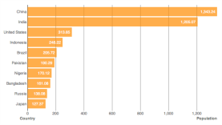
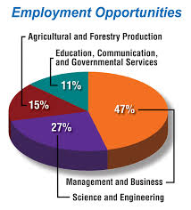
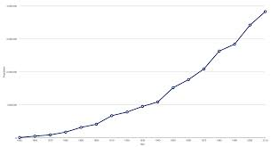
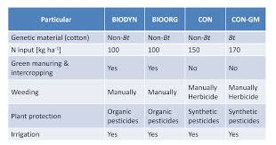
Charts and Graphs L&L 150
Bar Charts – A row of bars (data) showing different values.
Pie Chart – The whole (100%) in segments for amounts.
Line Graph- Population against time showing gradual change against time.
Table - A list of items numbers or words in rows (usually descriptions of items).

Slide 3
3D CAD L&L p90-92
Animations is Graphical movements of a model for visual impact.
Simulation is used to train people or test products

Slide 4
CAD uses
CAD library, saving objects (drawings of trees etc.) which can be reused saves time and aids standardisation.
Symbols are used to identify object with no need to write their name in text each time. e.g. save time, space and less confusion.

Slide 5
Orthographic Projection

