Slide 1
DTP Features
National 5
Graphic Communication

Slide 2
Shape – Solid Fill
Shape – Gradient Fill
Shape – Pattern Fill
Shape – Transparent Fill

Slide 3
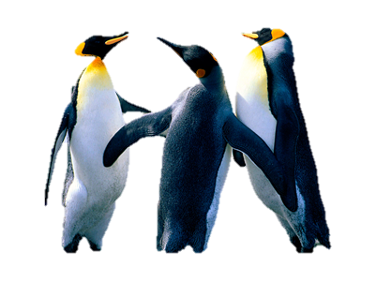
Image
Image - resized
Image - rotated
Image - cropped
Image – Filter effect added
Image – fully cropped
Handles

Slide 4
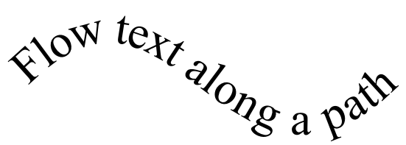
Title
Resize – point size
Changing font
Reverse text
Text frame
Drop shadow text

Slide 5
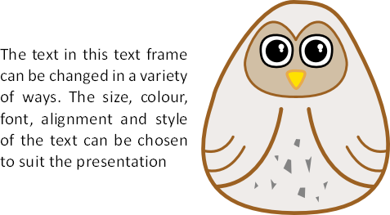
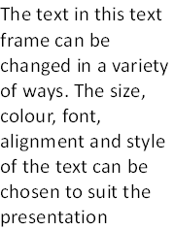
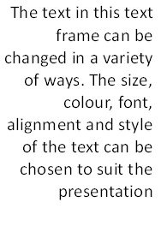
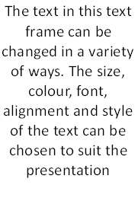
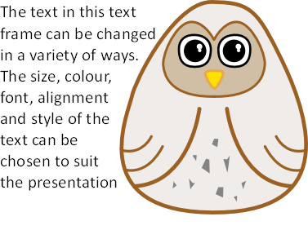
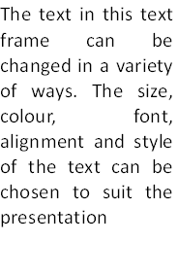
Text-aligned left
Text-aligned right
Text and Image
Text- centre aligned (justified)
Text wrap to Image
Text- fully justified

Slide 6
Single Page Format
Portrait
Alternative Format
Landscape

Slide 7
Header
Inserted in header space
Bleed
Extended Text
Drop Shadow
White Space
Footer
Caption
Inserted in footer space

Slide 8
Grid Structure
Guidelines
Columns
Gutters
Snap to Grid
Margins

Slide 9
Benefits of DTP to the Graphic Designer
Layouts can be created on a grid using the snap-to-grid and guidelines functions for speed and accuracy
Images can be edited and manipulated easily: colour, size, cropping and shaping can all be edited creatively.
Visuals can be sent electronically to the client saving time.
The client’s and editors modifications can be made quickly and easily.
Graphic designers can work from home, saving travel costs and reducing their carbon footprint.
Communication between the graphic designer, client and print company is easily done via email.

