Slide 1
Higher Chemistry – Unit 2: Nature’s chemistry
Lesson 2 – oxidation of alcohols
By the end of this lesson you should know:
What is meant by the terms “oxidation” and “reduction” in carbon chemistry
The names of two oxidising agents for alcohols
That when some alcohols oxidise, they can produce aldehydes, ketones and carboxylic acids. Some alcohols do not oxidise.
How to draw and name carbonyl compounds, aldehydes and ketones.

Slide 2
Oxidation of Alcohols
In carbon compounds, oxidation means either adding oxygen or removing hydrogen.
i.e. increasing the oxygen to hydrogen ratio
eg
C₂H₅OH →
C₂H₄O →
C₂H₄O₂ (CH₃COOH)
O : H
O : H
O : H
1 : 6
1 : 4
2 : 4 (= 1 : 2)
The opposite of oxidation is
Reduction.
In organic chemistry, reduction is a decrease in the oxygen to hydrogen ratio, by either the addition of hydrogen or the removal of oxygen.

Slide 3
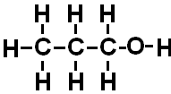
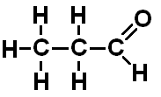
1. Oxidation of Primary Alcohols
Primary alcohol
ALDEHYDE
C₃H₇OH
C₃H₆O
Propan-1-ol
Propanal
Can further oxidise to carboxylic acid

Slide 4
Aldehydes (Alkanals)
Contain the carbonyl functional group at the end of a chain
General formula C_{n}H_{2n}O
eg. propanal :
Molecular formula:
C₃H₆O
Structural formula:
Shortened structural formula:
CH₃CH₂CHO
O at the end

Slide 5
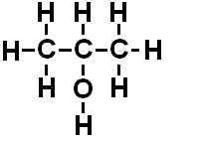

2. Oxidation of Secondary Alcohols
Secondary alcohol
KETONE
C₃H₆O
C₃H₇OH
Propanone
Propan-2-ol
Cannot further oxidise

Slide 6
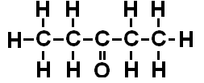
Ketones (Alkanones)
Contain the carbonyl functional group in the middle of a chain
General formula C_{n}H_{2n}O (isomers of aldehydes)
eg. Pentan-3-one :
Molecular formula:
C₅H₁₀O
Structural formula:
Shortened structural formula:
CH₃CH₂COCH₂CH₃
O somewhere in the middle – no bracket

Slide 7
3. Oxidation of Tertiary Alcohols
Tertiary Alcohols
cannot be oxidised!

Slide 8
Oxidising Agents (for Alcohols)
Oxidising agent
Colour change
hot copper(II) oxide
Black to copper red
acidified dichromate solution
Orange to blue-green

Slide 9
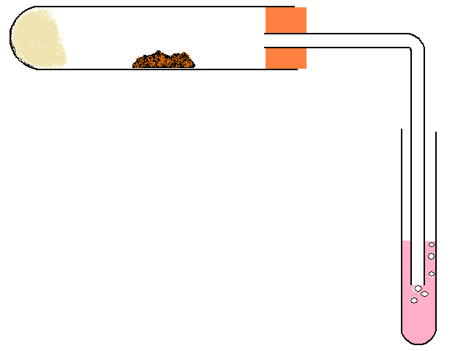
1. Oxidation of ethanol (primary alcohol) using hot copper oxide
HEAT
copper(II) oxide
colour change from black to red/brown
ceramic wool soaked in ethanol
universal indicator shows an acid is produced
This reaction produces ethanal and ethanoic acid.

Slide 10
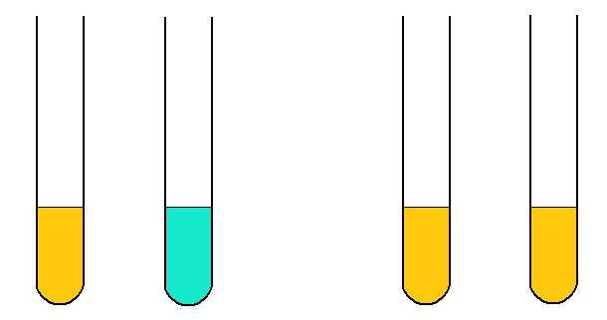
2. Oxidation of propan-2-ol (secondary alcohol) and 2-methylpropan-2-ol (tertiary alcohol) using acidified potassium dichromate.
HEAT
HEAT
propan-2-ol
in acidified dichromate solution
colour change from orange to green
2-methylpropan-2-ol
in acidified dichromate solution
no oxidation occurs
In this reaction, the secondary alcohol will oxidise to form propanone.
The tertiary alcohol will not oxidise.

Slide 11
Oxidation Summary
Primary alcohol
aldehyde
carboxylic acid
ketone
No further oxidation
Secondary alcohol
Tertiary alcohol
No oxidation

Slide 12

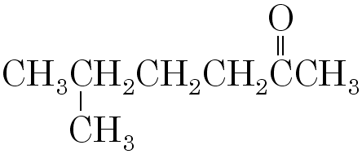
Naming Aldehydes and Ketones
Aldehyde
4-methyl pentanal
CH₃
CH₃CH(CH₃)CH₂CH₂CHO
Ketone
5-methyl hexan-2-one
CH₃CH(CH₃)CH₂CH₂COCH₃

Slide 13
You should now know:
Oxidation increases the oxygen to hydrogen ratio
Oxidising agents for alcohols include:
  hot copper(II) oxide – changes from black to red/brown
  acidified dichromate solution – changes from orange to green
Primary alcohols can be oxidised to aldehydes and then to carboxylic acids
Secondary alcohols can be oxidised to ketones
Tertiary alcohols cannot be oxidised.
Aldehydes and Ketones are two homologous series, both with the general formula C_{n}H_{2n}O.
Aldehydes and Ketones both contain the carbonyl functional group, –C=O.

