Slide 1
Welcome
P4 Parents’ Evening
Preparing for the Sacrament of Penance &
First Holy Communion

Slide 2
Sign of the Cross
Opening Prayer –
Lord, be the beginning and the end of all we say and do, prompt our actions by your Spirit, and complete them with your all powerful help.
Scripture Reading – John 4
If anyone acknowledges that Jesus is the Son of God, God lives in him, and he in God. We ourselves have known and put our faith in God’s love towards ourselves. God is love and anyone who lives in love, lives in God and God lives in him.

Slide 3
Prayers of Intercession
Our Father …
Closing Prayer –
Lord God, renew your Church with the Spirit of Wisdom and love, which you gave so fully to the Saints. Lead us by that same Spirit to seek you, the only foundation of true wisdom and the source of everlasting love. Through our Lord Jesus Christ, your Son, who lives and reigns with you in the unity of the Holy Spirit, one God for ever and ever. Amen

Slide 4
Scripture – Matthew 28: 18-20
Jesus came up and spoke to his disciples. He said, “All authority in heaven and on earth has been given to me. Go therefore, make disciples of all nations; baptise them in the name of the Father and of the Son and of the Holy Spirit, and teaching them to observe all the commands I gave you. And know that I am with you always; yes to end of time.”

Slide 5
Pope Emeritus Benedict XVI
On Christian Family
“Everyone knows that the Christian family is a special sign of the presence and love of Christ and that it is called to give a specific and irreplaceable contribution to evangelisation... the Christian family has always been the first way of transforming the faith...”
(Apostolic Pilgrimage to Croatia)

Slide 6
Blessed Pope Paul VI
On Evangelisation
“It would be useful if every Christian and every evangeliser were to pray about the following thought: Through God’s mercy, people can gain salvation in other ways besides our preaching the Gospel to them: but as for us, can we gain salvation, if through negligence, fear, shame – what St. Paul calls “shrinking from the Gospel” – or as a result of false ideas, we fail to preach it.”
(Apostolic Exhortation, Evangelii Nuntiandi)

Slide 7
Scripture – John 1
On the following day as John stood there again with two of his disciples, Jesus passed, and John stared hard at him and said, “Look, there is the lamb of God”. Hearing this, the two disciples followed Jesus, Jesus turned round, saw them following and said, “What do you want?’ They answered “Rabbi – which means Teacher – “Where do you live?” “Come and see”, he replied; so they went and saw where he lived and stayed with him the rest of that day.

Slide 8
Scripture John 1
One of those two who became a follower of Jesus after hearing what John had said was Andrew, the brother of Simon Peter. Early next morning, Andrew met his brother and said to him, “We have found the Messiah” – which means Christ – and he took Simon to Jesus.

Slide 9
Scripture - John 1
The next day, after Jesus had decided to leave for Galilee, he met Philip and said, “Follow me”. Philip came for the same town, Bethsaida, as Andrew and Peter. Philip found Nathanael and said to him, “We have found the one Moses wrote about in the Law, the one about whom the prophets wrote: he is Jesus, son of Joseph, from Nazareth.”

Slide 10
Lineamenta on the New Evangelism
Transmitting the faith in Christ means to create the conditions for a faith which is thought-out, celebrated, lived and prayed: in short, this means participating in the life of the Church. The gospel can only be transmitted on the basis of “being” with Jesus and living with Jesus the experience of the Father, in the Spirit: and, in a corresponding way of “feeling” compelled to proclaim and live what is lived as a good and something positive and beautiful

Slide 11
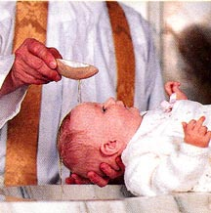
Baptism
The First of the Sacraments of Christian Initiation

Slide 12
Rite of Baptism
Reception of the Child
You have asked to have your child baptised. In doing so you are accepting the responsibility of training him (her) in the practice of the faith. It will be your duty to bring him (her) up to keep God’s commandments as Christ taught us.

Slide 13
Rite of Baptism
Renunciation of Sin & Profession of Faith
On your part you must make it your constant care to bring him (her) up in the practice of the faith. See that the divine life which God gives him (her) is kept safe from the poison of sin, to grow always stronger in his (her) heart.

Slide 14
Rite of Baptism
Renunciation of Sin & Profession of Faith
If your faith makes you ready to accept this responsibility, renew now the vows of your own baptism. Reject sin: profess your faith in Christ Jesus. This is the faith of the Church. This is the faith in which this child is about to be baptised.

Slide 15
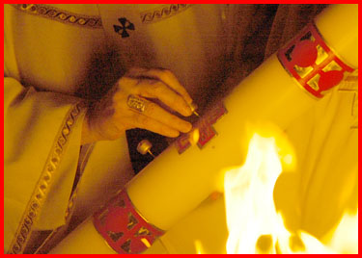
Rite of Baptism
The Lighted Candle

Slide 16
The Lighted Candle
Parents and Godparents, this light is entrusted to you to be kept burning brightly. This child of yours has been enlightened by Christ. He (she) is to walk always as a child of the light. May he (she) keep the flame of faith alive in his (her) heart. When the Lord comes, may he (she) go out to meet him with all the saints in the heavenly kingdom.

Slide 17
The Lord’s Prayer
This child has been reborn in baptism. He (she) is called the child of God, for so indeed he (she) will receive the fullness of God’s Spirit. In holy communion he (she) will share the banquet of Christ’s sacrifice, calling his (her) father in the midst of the Church.

Slide 18
Parents take the responsibility of training their child in the practice of faith
...of bringing them up in the practice of faith
...of keeping them safe from the poison of sin
...of nurturing the light of Christ within them
...of bringing them to the banquet of Christ's sacrifice

Slide 19
The Responsibility of Parents
Catechism of the Catholic Church

Slide 20
Catechism no. 2223
Parents have the first responsibility for the education of their children. They bear witness to this responsibility first by creating a home where tenderness, forgiveness, respect, fidelity and disinterested service are the rule.

Slide 21
Catechism no. 2223
The home is well suited for education in the virtues. This requires and apprenticeship in self-denial, sound judgements and self-mastery – the preconditions of all true freedom.

Slide 22
Catechism no. 2223
Parents have a grave responsibility to give good example to their children. By knowing how to acknowledge their own failings to their children, parents will be better able to guide and correct them.

Slide 23
Catechism no. 2225
Through the grace of the sacrament of marriage, parents receive the responsibility and privilege of evangelising their children.

Slide 24
Catechism no. 2225
Parents should initiate their children at an early age into the mysteries of the faith of which they are the “first heralds” for their children.
(Ordination of deacons: receive the Gospel of Christ, whose herald you now are: believe what you read, teach what you believe and practice what you teach.)

Slide 25
Catechism no. 2225
They should associate them from their tenderest years with the life of the Church

Slide 26
Catechism no. 2226
Education in faith by parents should begin in the child’s earliest years. This already happens when family members help one another to grow in faith by witness of a Christian life in keeping with the Gospel.
Family catechesis precedes, accompanies and enriches other forms of instruction in the faith. Parents have the mission of teaching their children to pray and to discover their vocation as children of God.

Slide 27
Catechism tells us of...
First responsibility of parents to educate
Home – tenderness, forgiveness, respect, fidelity and service
Grave responsibility of parents to give good example
Responsibility and privilege of evangelising
Witness of Christian life
Family catechesis that precedes other instruction

Slide 28
Through this “Children contribute to the growth in holiness of their parents”
ccc 2227

Slide 29
Home-School-Parish
A working relationship

Slide 30
Much of what has been said you instinctively do as Christian/Catholic parents
Reminds us all of the privilege of bringing children up in faith
Reminds us that this is central to the vocation to marriage, from which parents receive the grace to fulfil their vocations as parents

Slide 31
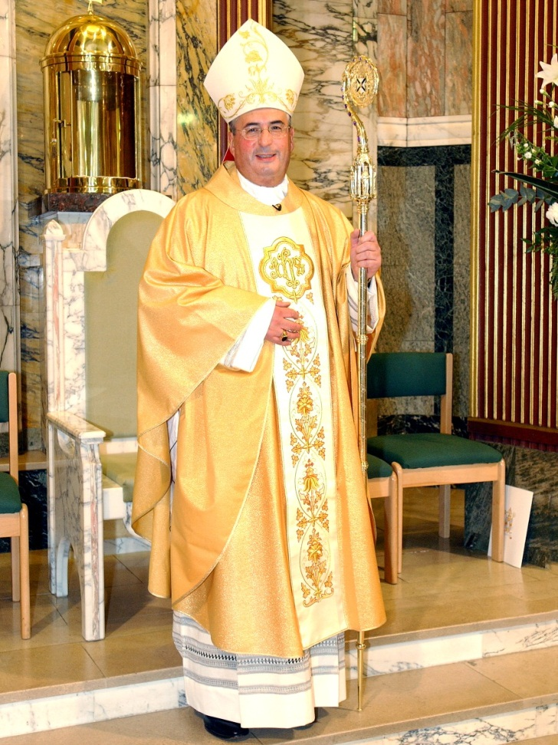
Change in timing of the Sacraments
Bishop Philip decided in the summer of 2008 that the Sacrament of Confirmation would no longer be celebrated with First Holy Communion.
Confirmation will be celebrated by the Bishop, normally in P7

Slide 32
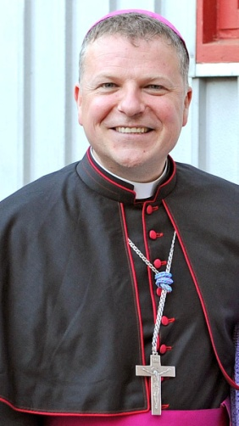
I would like to stress that in preparing the children for these sacraments, the most important thing is the witness of faith and practice by all those who are involved in their preparation. For parents, this means their faithful catholic practice. For teachers this means witness to the children that Jesus Christ is the centre of their lives and that going to Mass and Confession are essential dimensions of their lives of faith. All the clever catechetics and creative teaching or liturgy in the world will not compensate for the absence of that core witness.

Slide 33
“it is especially to be borne in mind that the centre of the Sacraments of initiation is the Eucharist. One of the arks and obligations of the fully-initiated Catholic is the full, active and conscious participation at Sunday Mass. Young Catholics must fulfil the serious obligation to participate at Sunday Mass so that the Eucharist will be at the centre of a full Christian life”
(Principles, Confirmation, 15.)

Slide 34
With regard to the sacramental initiation of children, our practice needs to be guided above all by the Eucharist, the source and summit of Christian life. What we are doing in the sacramental initiation of children is helping them to be young Catholics and then adult Catholics who have the Lord at the centre of their lives and who go to Mass on a Sunday.

Slide 35
Sacraments for Baptised Children
Doctrinal, Pastoral, Practical Principles
Document by Bishop Philip

Slide 36
Principles
Baptism, the first Sacrament, is birth in to the new life of Christ, incorporation in to the Church, and the gateway to the other Sacraments.

Slide 37
Principles
First Confession and Reconciliation, the Second Sacrament for baptised children, is for the forgiveness of sins committed after baptism, and is a preparation for First Eucharist

Slide 38
Principles
First Eucharist (First Holy Communion) is the centre of the sacramental initiation of baptised children and the Sacrament of full communion with the church all the sacraments are ordered to the Eucharistic Sacrifice (the Mass) as the source and summit of Christian life.

Slide 39
Principles
Confirmation completes baptism, deepens further the bond of communion with the Church, and confers the special strength of the Holy Spirit for the witness of Christian life.

Slide 40
Principles
All these Sacraments are sacraments of faith. Each one, both in preparation and celebration, is an occasion for the evangelisation of he children themselves, their families and of the Catholic community as a whole. Each one is to be received with faith and led to growth in faith.

Slide 41
Principles
Parents are chiefly responsible for the faith and sacramental initiation of their children. Parents will petition the parish for their children to be admitted to each of these Sacraments. Parents must accompany and support the children with their own faith and religious practice before and after the children are admitted to these Sacraments.

Slide 42
Dress Code
The dress code for the First Communion Mass should be characterised by a religious simplicity, with an emphasis on the white garments (albs, white shirts, first communion dresses) to recall the baptismal robe. Ostentation is to be avoided, as are the accessories which have no place in liturgy.

Slide 43
Reflections on Faith & Sacraments
Mass during Advent & Lent
In the Primary Schools of St. Joseph’s & Our Lady of the Missions weekly Services
St. Ninian’s H/School@ 8:25am daily
In the Parish @ 9:30am.

Slide 44
Dates
Rite of Commitment for St. Joseph’s P3
Sunday, 27th Nov. 2022 @ at 10.00am
Rite of Commitment for OLM’s P3
Sunday, 27th Nov. 2021 @ at 12.00am
Rite of Enrolment for St. Joseph’s P4
Sunday, 19th February 2023 @ at 10.00am
Rite of Enrolment for St. OLM’s P4
Sunday, 19th February 2023 @ at 12.00 Noon

Slide 45
First Confessions
Our Lady of the Mission’s School Service
- Monday, 20th February 2023 @9:10am
St Joseph’s School Service
- Tuesday, 21st February 2023 @ 11:00am

Slide 46
First Communion
St. Joseph’s Church
St Joseph’s – Saturday, 22nd April 2023
@ 10:00am & 11:30am
OLM’s – Saturday, 6th May 2023
@10:00am & 11:30am

Slide 47
Mass of Thanksgiving
St Joseph’s Church
St Joseph’s – Sunday, 23rd April 2023
@ 10:00 am Mass
OLM – Sunday, 7th May 2023
@10:00 am Mass

Slide 48
Pope Emeritus Benedict XVI
On prayer in the home
Commit yourselves always to teach your children to pray, and pray with them; draw them close to the Sacraments, especially to the Eucharist... In the intimacy of the home so not be afraid to read the Sacred Scriptures, illuminating family life with the light of faith and praising God as Father. Be like a little Upper Room, like that of Mary and the Disciples, in which to live unity, community and prayer.
(Apostolic Pilgrimage to Croatia)

Slide 49
Pope Emeritus Benedict XVI
The purpose of our lives is to reveal God to men. And only when God if seen does life truly begin. Only when we meet the living God in Christ do we know what life is. We are not some causal and meaningless product of evolution. Each of us is a result of a thought of God. Each of us is willed, each of us is loved, each of us in necessary.
(Inaugural homily)

Slide 50
Pope Emeritus Benedict XVI
There is nothing more beautiful than to be surprised by the Gospel, by the encounter with Christ. There is nothing more beautiful than to know Him and speak to others of our friendship with Him.
(Inaugural homily)

