Slide 1
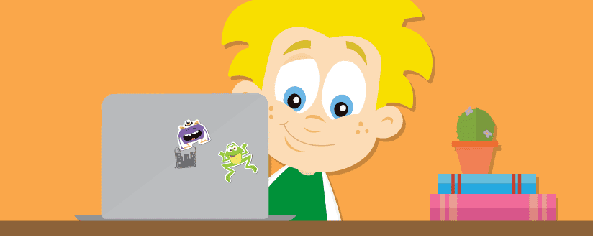
Making the Most of Your Access to Education City

Slide 2
Getting started.
Whether this is your first day using Education City or you’ve had access for a few days/weeks, we want to help you and your child/children to make the most of your access to Education City.
We understand when trying out a new online resource, that it can be a little daunting until you get to grips with how to use it to best suit you and your child.
Once you’re all set and logged in, it’s time to get started!
If you don’t have a log in for your child please email the school and request a copy.

Slide 3
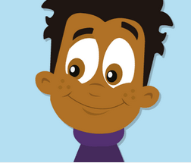
How to access your child’s allocated work.
The teacher will allocate your child work via their MY CITY.
To access MY CITY firstly, your child must log in.
Once logged in you will come to the home page. Down the left hand side of the page you will see a section called class work.
When you click on CLASS WORK it will take to a series of work that has been personally allocated work for your child.
This work will be marked into specific curricular areas. The games within these folders have been chosen to directly match with your child’s current and or past learning.

Slide 4
Once logged in click classwork.

Slide 5
Once you have clicked on classwork. Your child’s personalised task will come up in subject specific folder.

Slide 6
As your child completes task their score will be displayed at the bottom.

Slide 7
Free use of Education city.
If you child does not have any allocated work to complete within their My City they have the freedom to access a variety of different tasks. It is important to note that some of these tasks may be too hard for children if they haven’t covered that particular topic in class.
Firstly, after logging in you will be taken to the home page.
On the home page on the left hand side you will see a section called subjects.
Once you have clicked on subjects you will be taken to a page that gives you a choice of subjects.
When you have chosen your subject you will asked to choose a level. The level for children within P2,3& (partly) 4 is the FIRST LEVEL.
You will notice that the FIRST LEVEL options are starred with either 1, 2 or 3 stars (*,**,***) This shows the level of difficulty of tasks within that section. 1 being easier and 3 being challenging.
Once you click on your level of challenge you will be taken to options.
Select ACTIVITY.

Slide 8
Home Page. Click subjects.

Slide 9
Select your chosen subject.

Slide 10
Select FIRST LEVEL.- Choose level of challenge.

Slide 11
Select Activity.

Slide 12
Here you can choose Literacy activities. These can be sectioned into; 1- Talking and Listening. 2- Reading 3- Writing.

